Slide 1

Azure COSMOS DB

Slide 2
AGENDA
Introduction : Slide 3 to 34
Throughput and Cost : Slide 35 to 46
Horizontal Partitioning : Slide 47

Slide 3
What is noSQL?
A buzz word to solve the problem of Big Data. Often described by three V’s (Volume, Velocity and Variety)
Relational databases are not really designed to handle really big data. These databases were designed back then for
Systems that would scale up for faster CPU’s, larger RAM and bigger disks on steady basis.
At some point, you just can’t build a bigger machine and then the only solution is to scale out.So putting workload not just
on one machine but 2 machines, 5 machines, 10, 100 or 1000 machines. And this is crux of NO SQL is all about.
Volume : We are talking about database sizes that are in the terabytes or even petabytes, too much for a single machine.
Velocity : It is all about throughput and keeping pace with requests that are coming in fast and furious. Workload is distributed across multiple machines.
Variety : This has to do with schema and the problems you have in relational world coping with schema changes. As schemas evolve more and more frequently, it is difficult to apply those schema changes to mission critical databases that
Require continuous uptime around the clock and the pain is even greater for distributed databases when schema changes
need to be deployed to multiple regions.

Slide 4
What is a nosql database?
Distributed : From ground up. Multiple copies of your data are distributed to separate replicas, and more copies you have
of the same data, the more available it is to more users and the more resilient your database is to failure if and when the
replicas should go down.
Scale out : Not just in terms of storage but throughput. This is achieved by horizontal portioning which balances the
Workload uniformly across cluster of machines.
Schema free: There is no enforced schema and no defined shape.

Slide 5
What is cosmos db?
Cosmos DB is a massively scalable No SQL Database that is available to your application as a fully managed Platform as
a Service that runs on Azure. There are comprehensive SLA’s on throughput, latency, consistency and availability.
Four Nines (99.99%)
Max 52.56 minutes downtime per year
Five Nines (99.999%)
Max 5.26 minutes downtime per year.
Automatic Horizontal Partioning : Elastic scale for both storage and throughput.
Global Distribution: Point and click geo-replication. Multiple write regions.
Multi-model / Multi API : Supports document, table, graph and columnar.

Slide 6
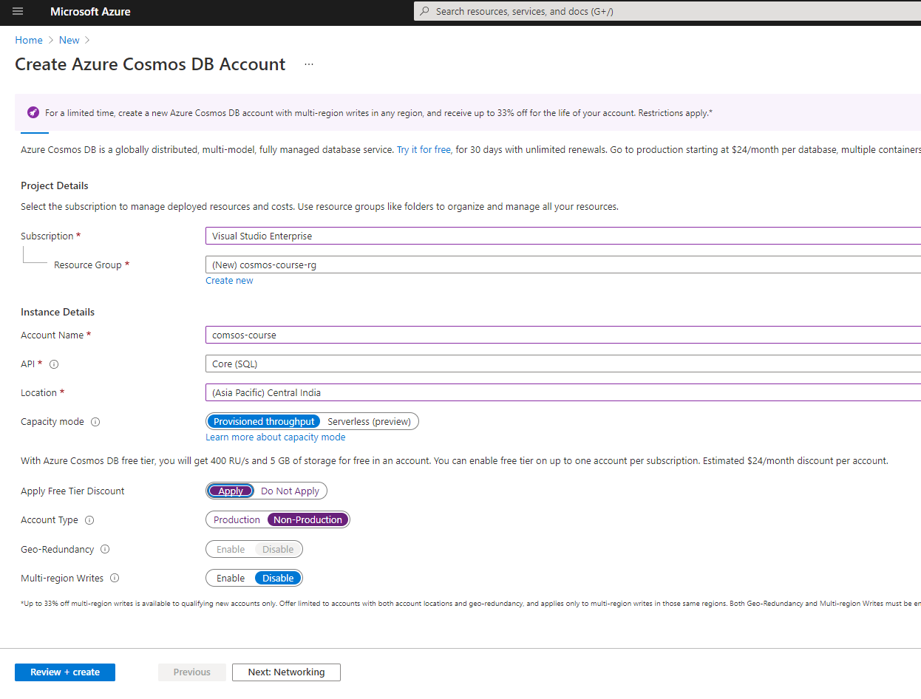
AZURE COSMOS DB ACCOUNT – 1

Slide 7
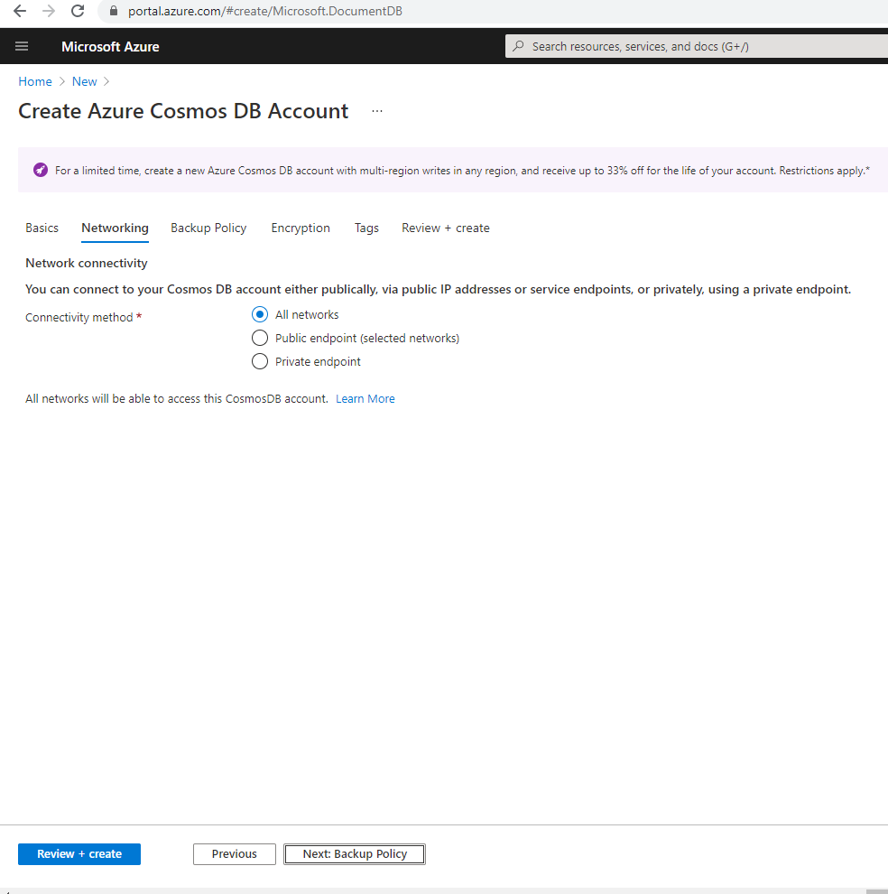
AZURE COSMOS DB ACCOUNT – 2

Slide 8
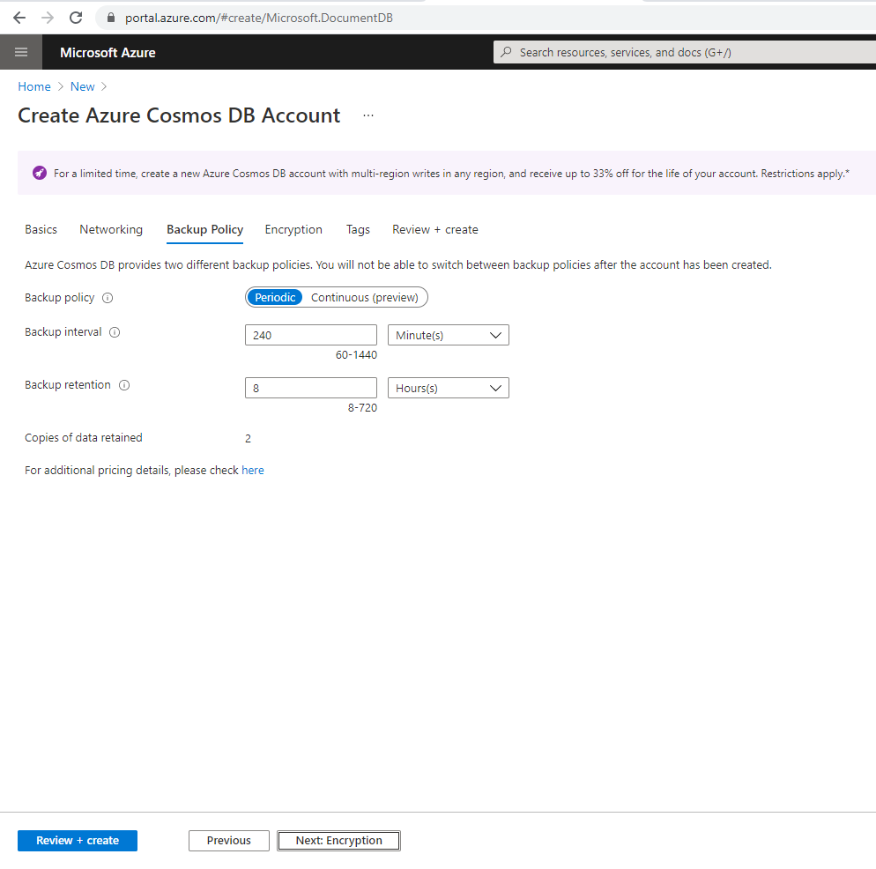
AZURE COSMOS DB ACCOUNT – 3

Slide 9
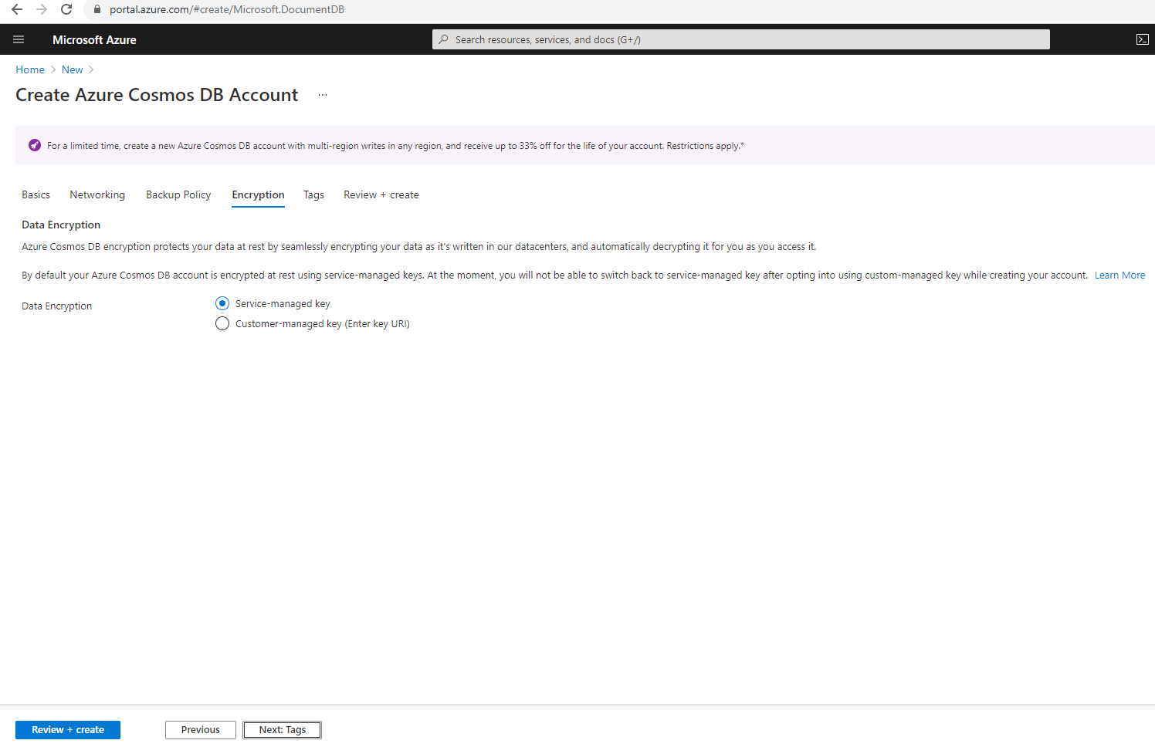
AZURE COSMOS DB ACCOUNT – 4

Slide 10
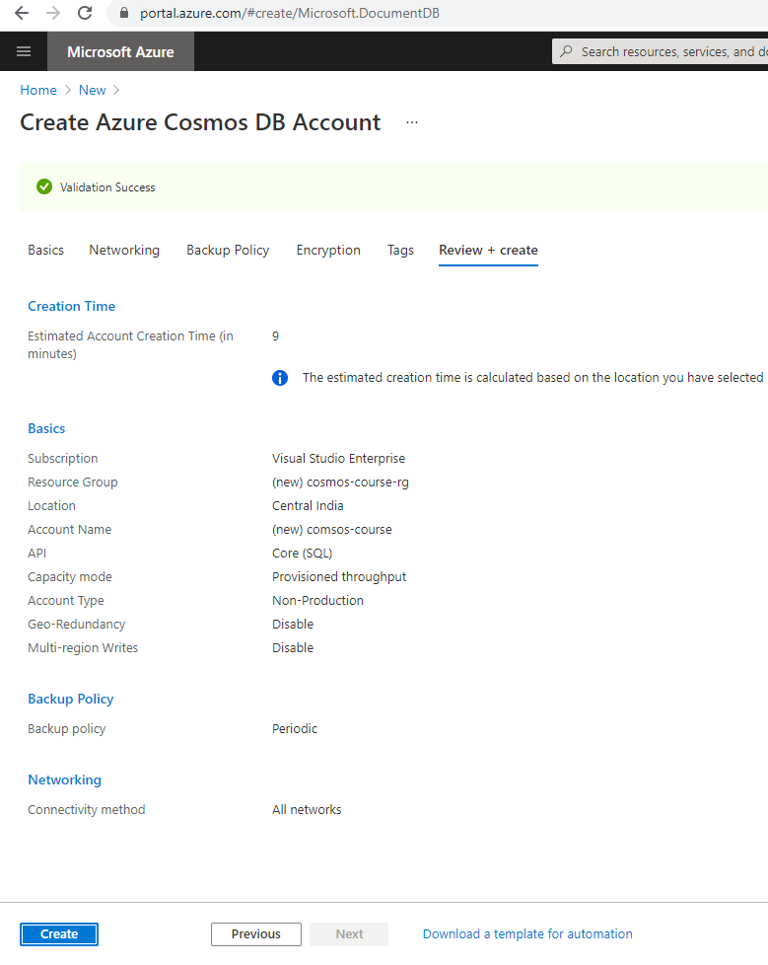
AZURE COSMOS DB ACCOUNT – 5

Slide 11
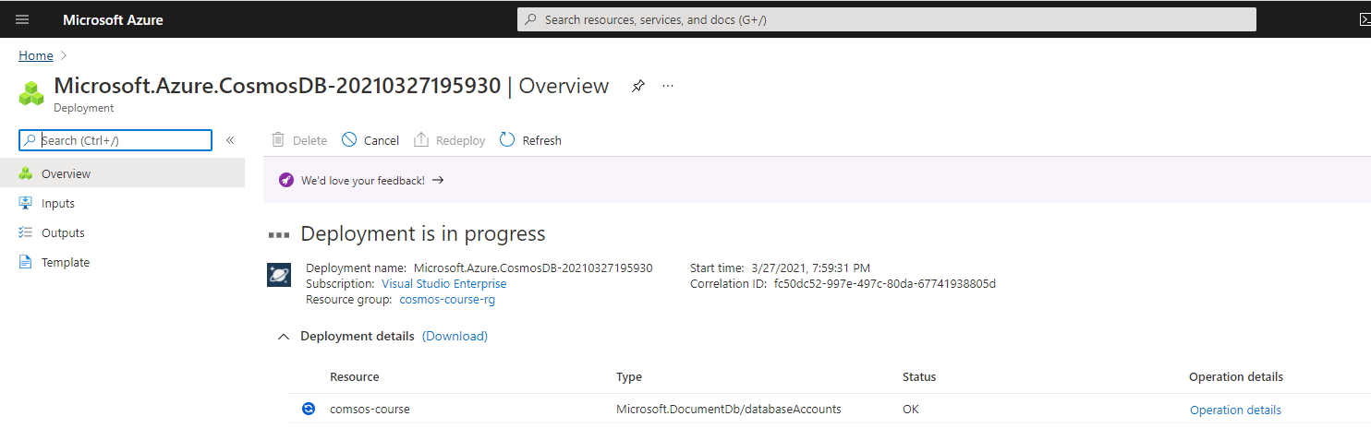
AZURE COSMOS DB ACCOUNT – 6

Slide 12
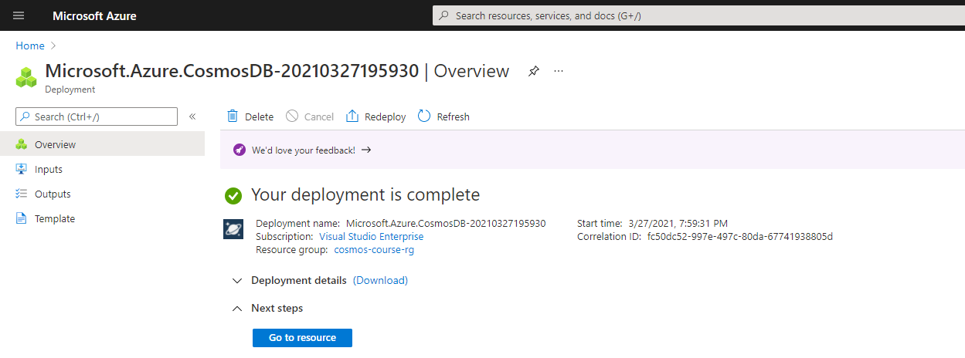
AZURE COSMOS DB ACCOUNT – 7

Slide 13
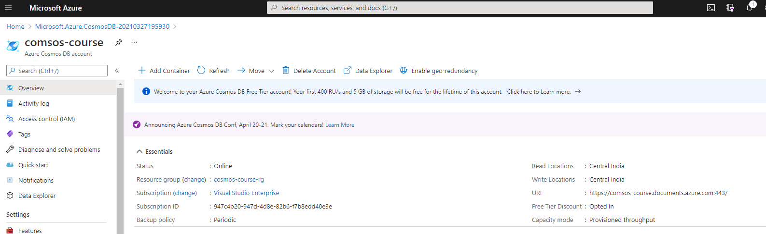
AZURE COSMOS DB ACCOUNT – 8

Slide 14
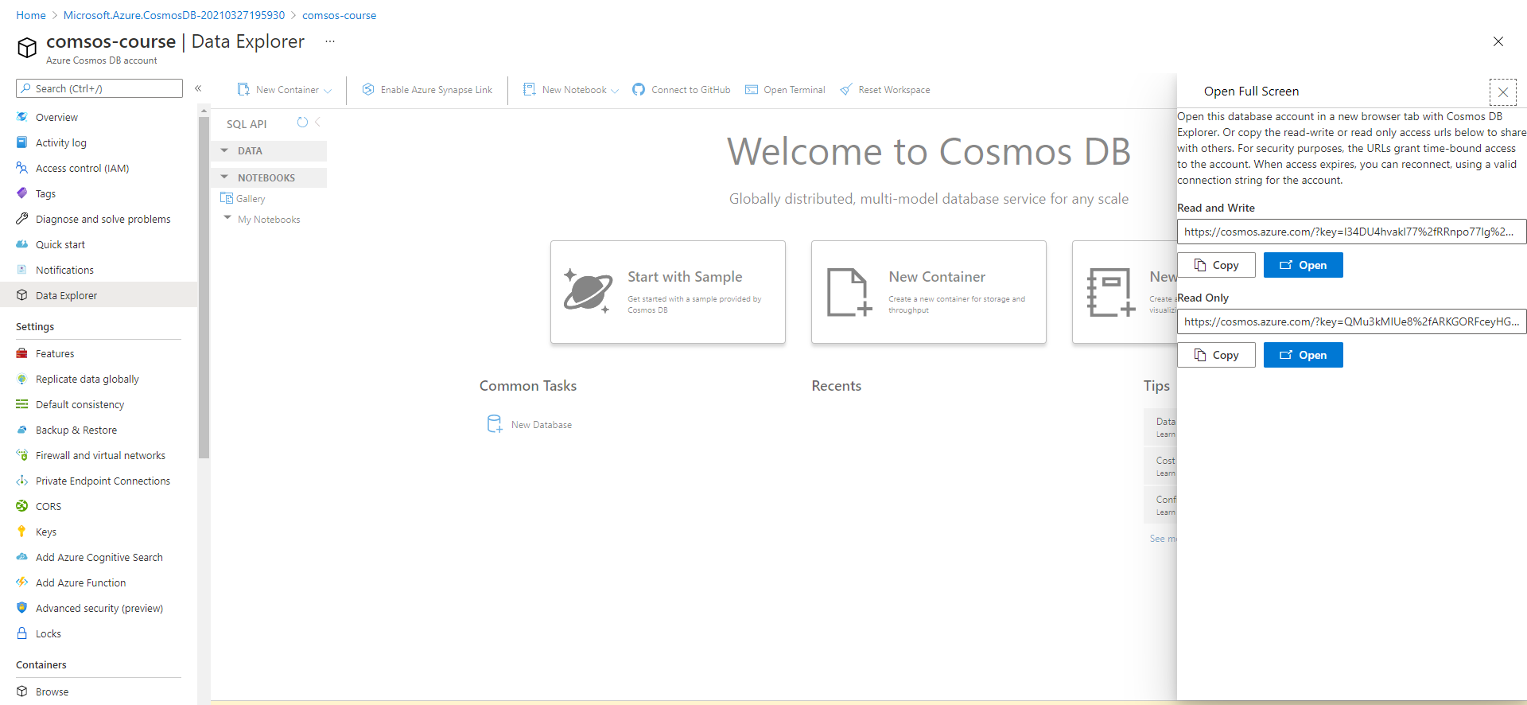
AZURE COSMOS Data explorer

Slide 15
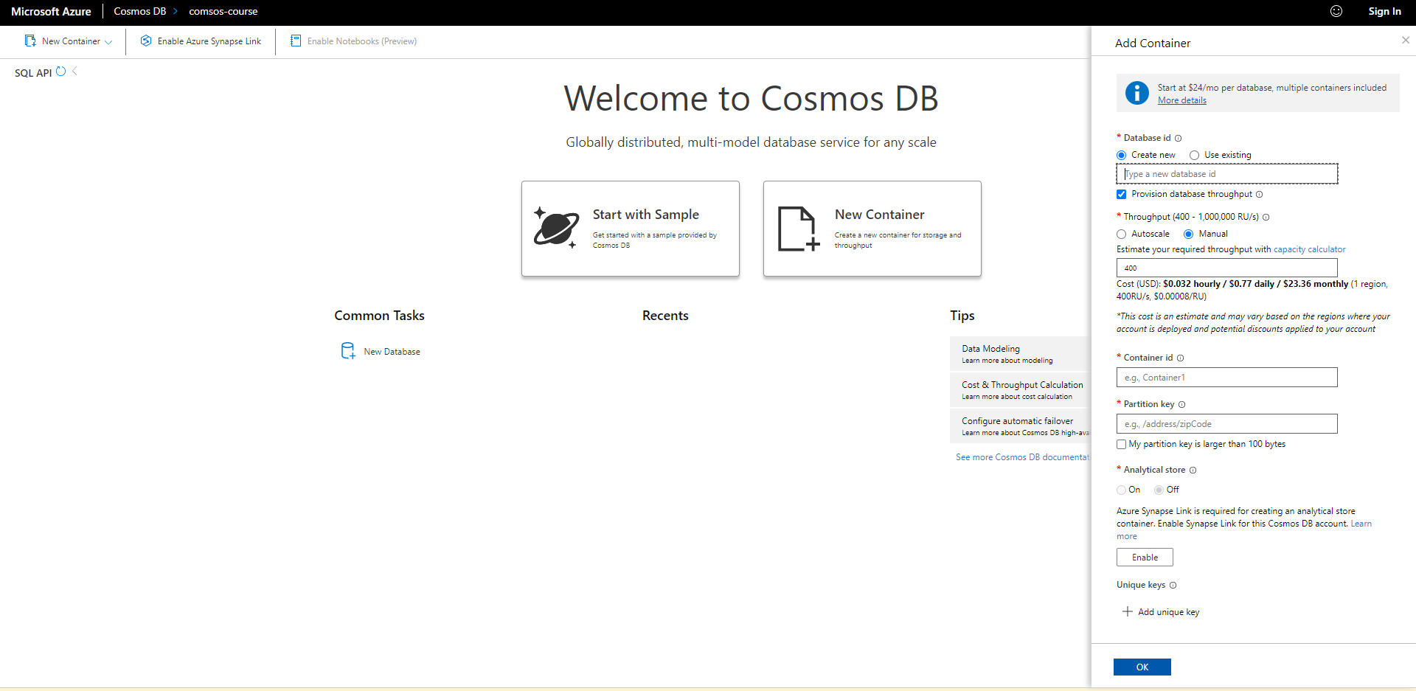
Create a database and container
Name of the database and name of the container to be created within that database. In some cases, you may have only one
container in a database. All items in a container can be of different types and have different schemas.

Slide 16
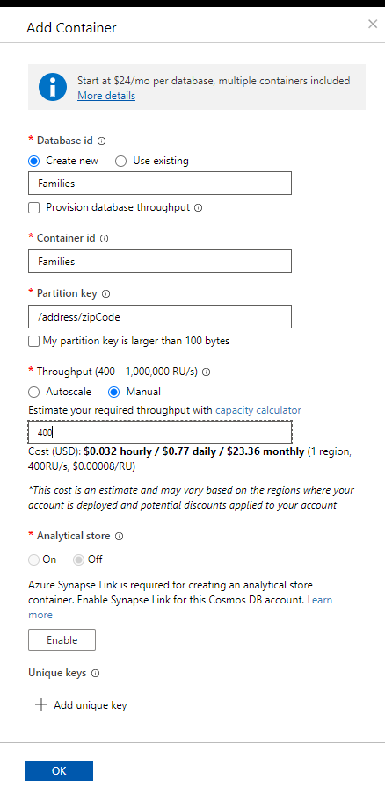
Create a database and container

Slide 17
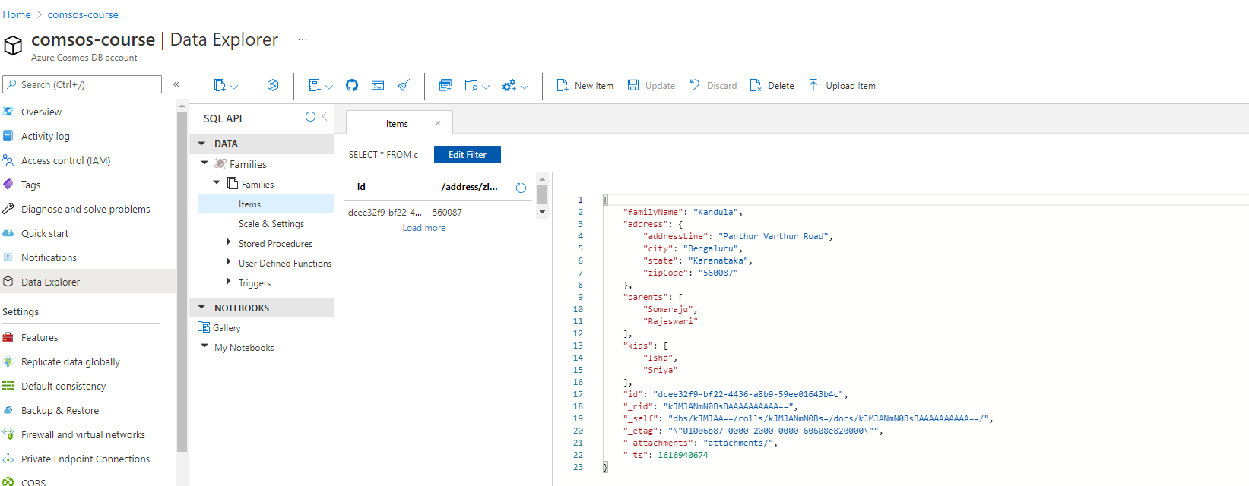
Create document - 1
Check notes.
Notes:
{
"familyName": "Kandula",
"address": {
"addressLine": "Panthur Varthur Road",
"city": "Bengaluru",
"state": "Karanataka",
"zipCode": "560087"
},
"parents": [
"Somaraju",
"Rajeswari"
],
"kids" :[
"Isha",
"Sriya"
]
}

Slide 18
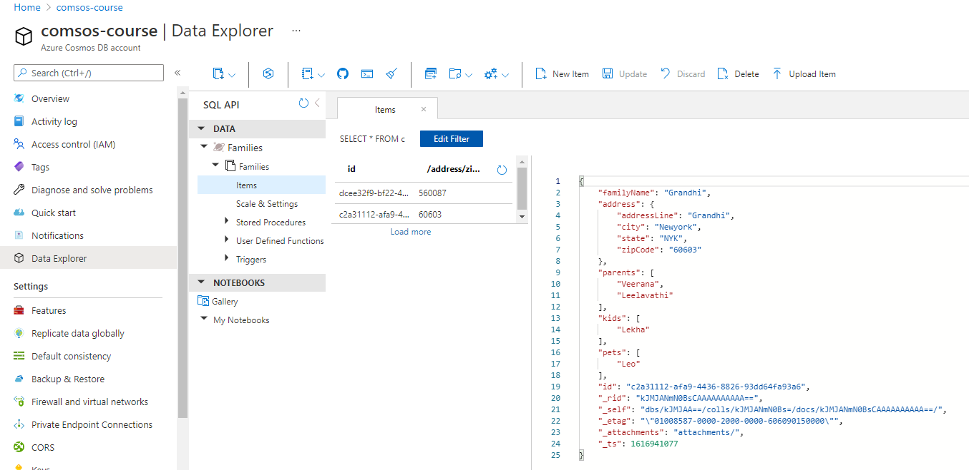
Create document - 2
Check notes.
Notes:
{
"familyName": "Grandhi",
"address": {
"addressLine": "Grandhi",
"city": "Newyork",
"state": "NYK",
"zipCode": "60603"
},
"parents": [
"Veerana",
"Leelavathi"
],
"kids": [
"Lekha"
],
"pets": [
"Leo"
]
}

Slide 19
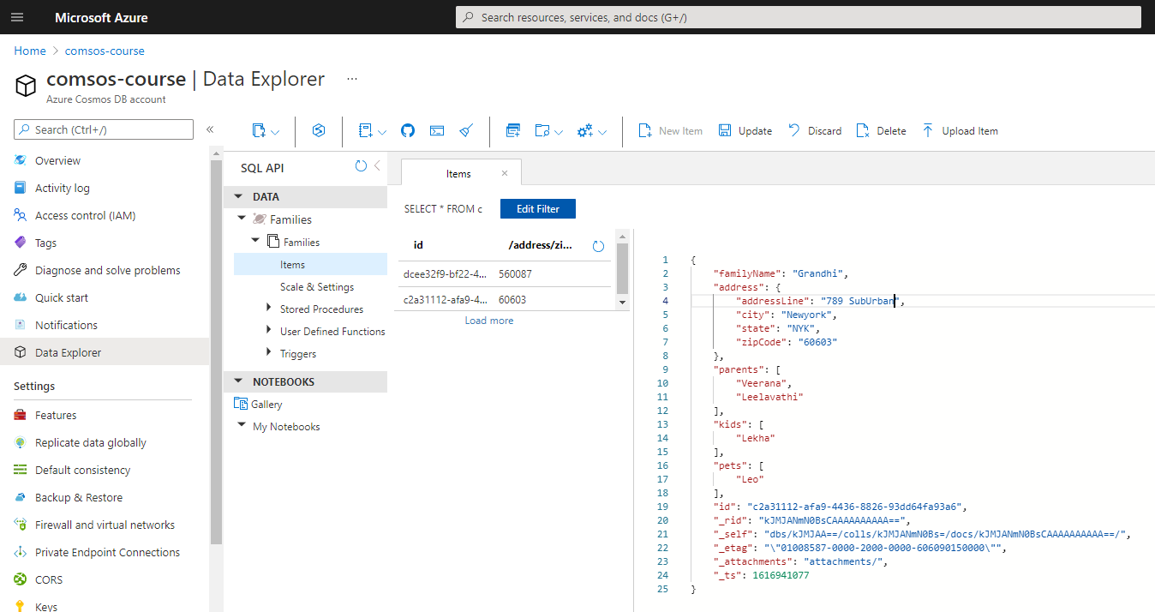
UPDATE DOCUMENT
Notes:
{
"familyName": "Grandhi",
"address": {
"addressLine": "789 SubUrban",
"city": "Newyork",
"state": "NYK",
"zipCode": "60603"
},
"parents": [
"Veerana",
"Leelavathi"
],
"kids": [
"Lekha"
],
"pets": [
"Leo"
],
"id": "c2a31112-afa9-4436-8826-93dd64fa93a6",
"_rid": "kJMJANmN0BsCAAAAAAAAAA==",
"_self": "dbs/kJMJAA==/colls/kJMJANmN0Bs=/docs/kJMJANmN0BsCAAAAAAAAAA==/",
"_etag": "\"01008587-0000-2000-0000-606090150000\"",
"_attachments": "attachments/",
"_ts": 1616941077
}

Slide 20
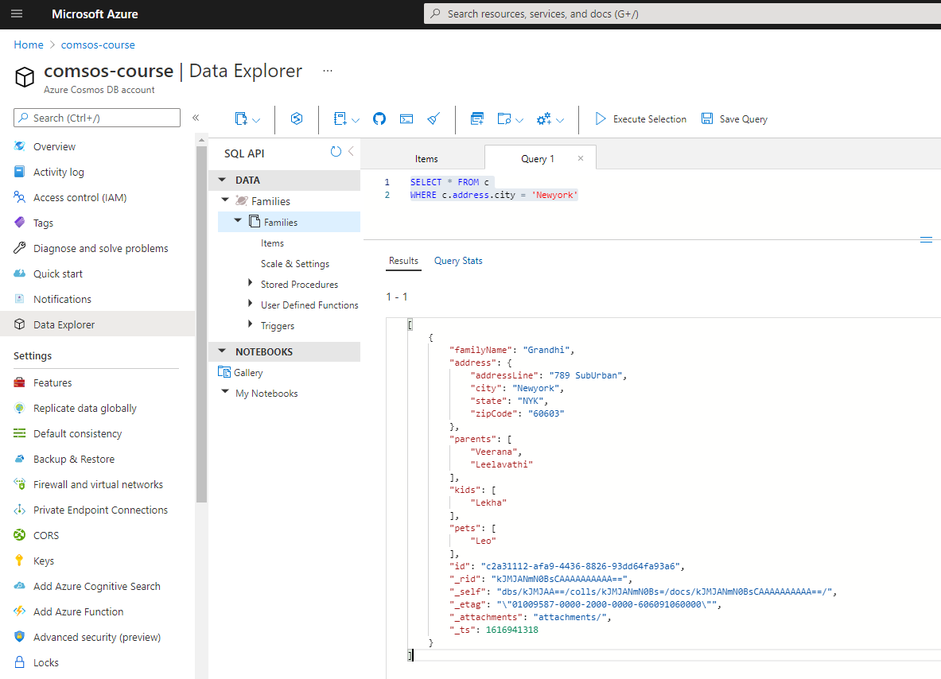
Query document - 1
Notes:
SELECT * FROM c
WHERE c.address.city = 'Newyork'

Slide 21
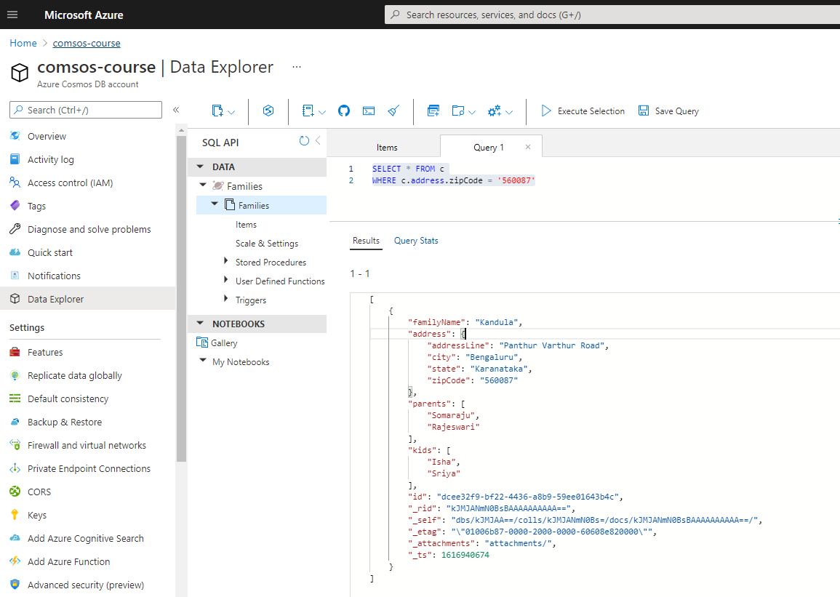
Query document - 2
Notes:
SELECT * FROM c
WHERE c.address.zipCode = '560087'

Slide 22
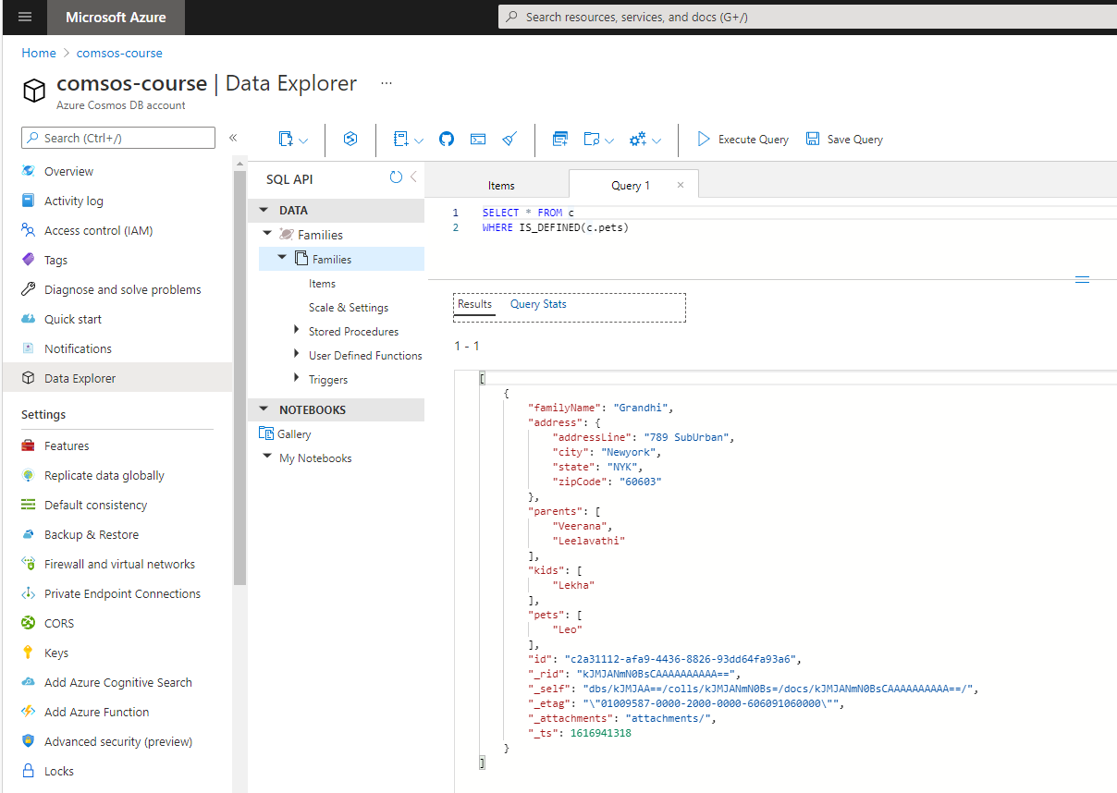
Query document - 3
Notes:
SELECT * FROM c
WHERE IS_DEFINED(c.pets)

Slide 23
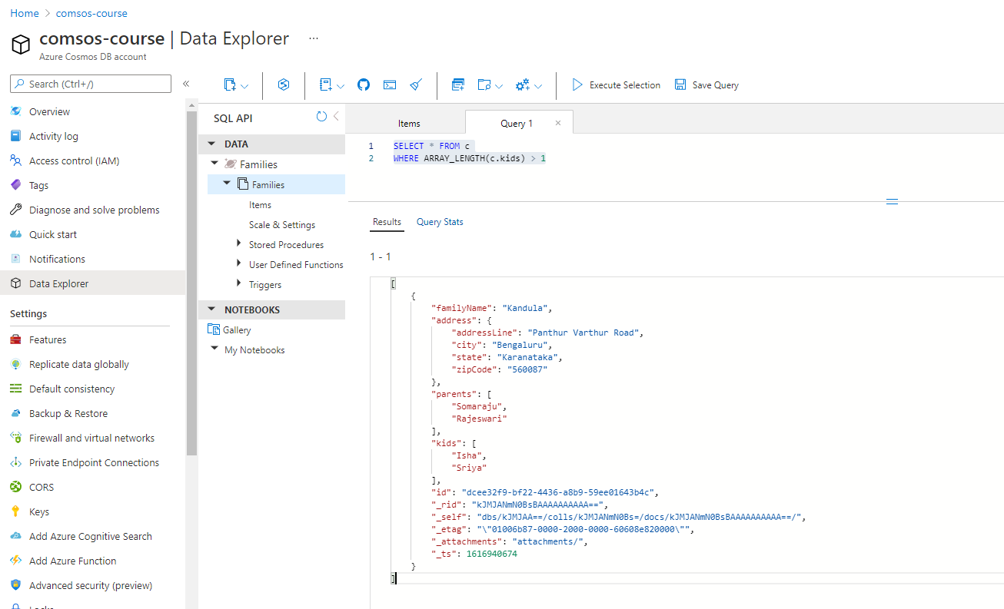
Query document - 4
Notes:
SELECT * FROM c
WHERE ARRAY_LENGTH(c.kids) > 1

Slide 24
Management options – Access cosmos db
Azure Portal
Azure CLI
PowerShell
Notebooks
REST API

Slide 25
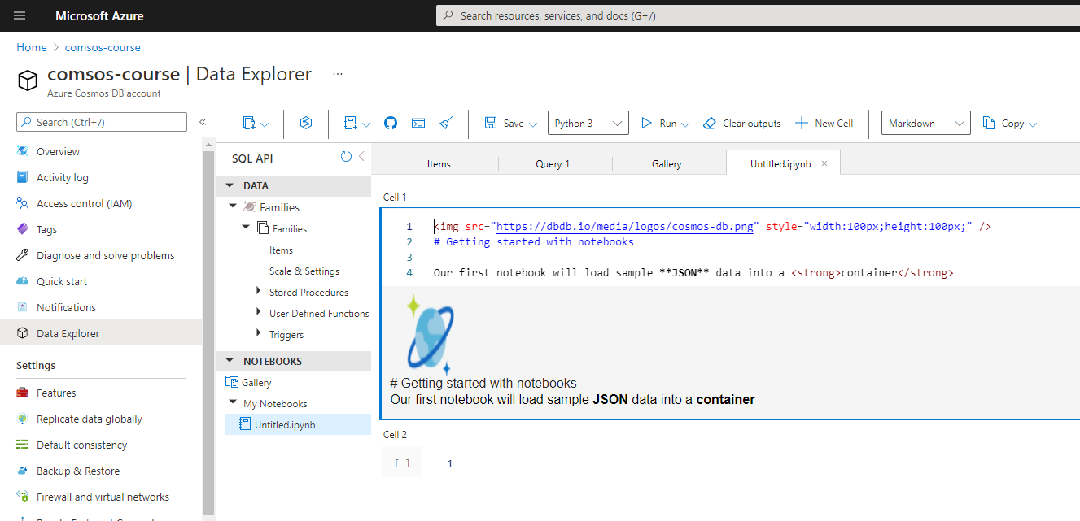
NOTEBOOKS – 1 (HTML)
Notes:
<img src="https://dbdb.io/media/logos/cosmos-db.png" style="width:100px;height:100px;" />
# Getting started with notebooks
Our first notebook will load sample **JSON** data into a <strong>container</strong>

Slide 26
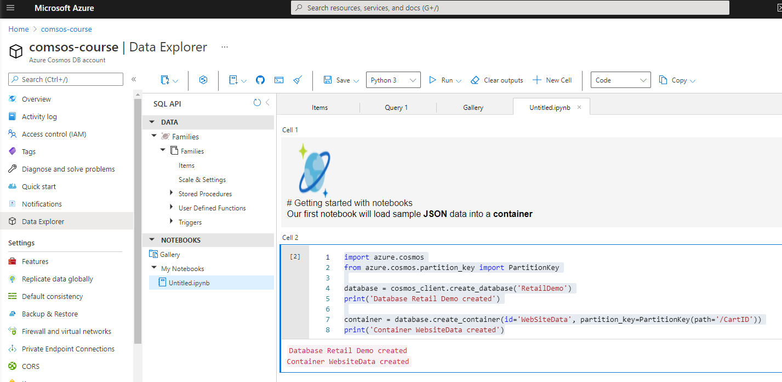
NOTEBOOKS – 2 (PYTHON)
Notes:
import azure.cosmos
from azure.cosmos.partition_key import PartitionKey
database = cosmos_client.create_database('RetailDemo')
print('Database Retail Demo created')
container = database.create_container(id='WebSiteData', partition_key=PartitionKey(path='/CartID'))
print('Container WebsiteData created')

Slide 27
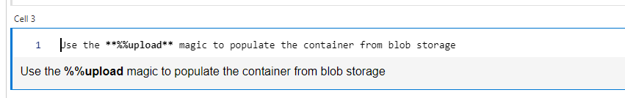
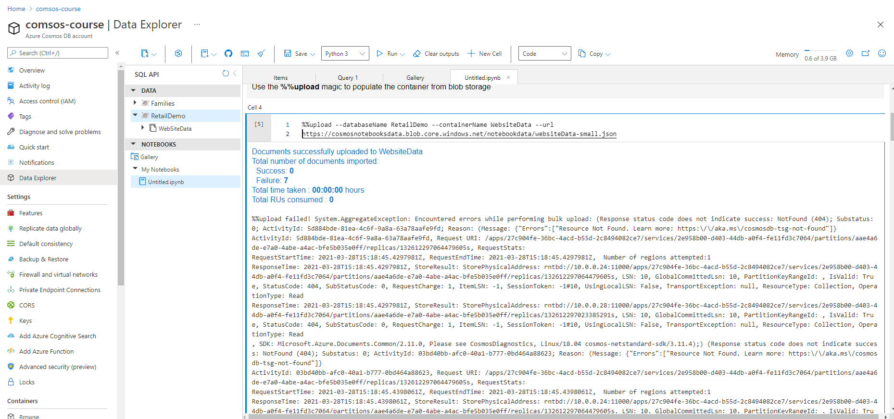
NOTEBOOKS – 3 (Magics) – need to check in future
Notes:
Use the **%%upload** magic to populate the container from blob storage

Slide 28
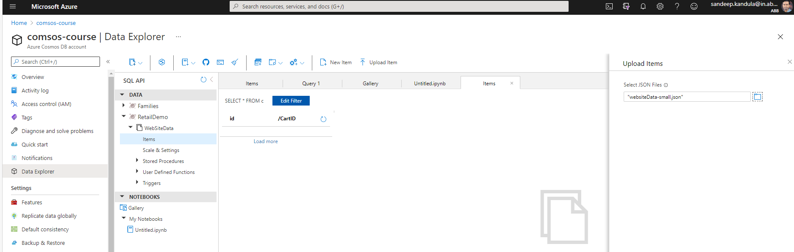
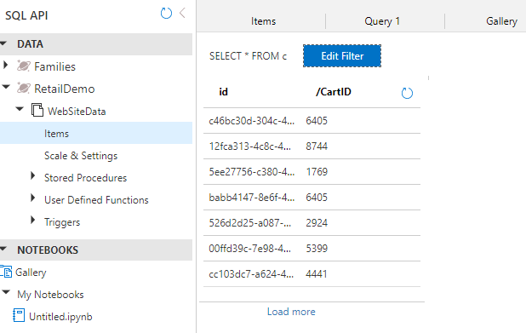
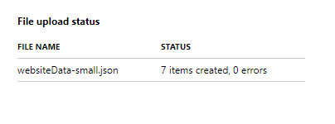
Load MANUALLY
Notes:
https://cosmosnotebooksdata.blob.core.windows.net/notebookdata/websiteData-small.json
[{"CartID":4441,"Action":"Viewed","Item":"Black Tee","Price":9,"UserName":"Xavier.Conn20","Country":"Tunisia","EventDate":"2014-02-14T00:00:00","Year":2014,"Latitude":-54.9221,"Longitude":51.0792,"Address":"964 Isabel Station, Trantowland, Tunisia","id":"cc103dc7-a624-49bf-8b47-6b6077bd839e"}, {"CartID":8744,"Action":"Viewed","Item":"Flannel Shirt","Price":19.99,"UserName":"Jadyn_Lubowitz62","Country":"Antigua and Barbuda","EventDate":"2015-07-10T00:00:00","Year":2015,"Latitude":-59.2386,"Longitude":-67.9249,"Address":"9102 Andrew Village, New Odiebury, Antigua and Barbuda","id":"12fca313-4c8c-4807-bf34-ca3cfe8afc93"}, {"CartID":6405,"Action":"Added","Item":"Socks","Price":3.75,"UserName":"Wyman9","Country":"Guinea-Bissau","EventDate":"2014-01-14T00:00:00","Year":2014,"Latitude":59.6081,"Longitude":148.6698,"Address":"36603 Schmitt Camp, West Brenda, Guinea-Bissau","id":"c46bc30d-304c-4747-b55a-46811beff59c"}, {"CartID":6405,"Action":"Viewed","Item":"Socks","Price":3.75,"UserName":"Wyman9","Country":"Guinea-Bissau","EventDate":"0001-01-01T00:00:00","Year":0,"Latitude":59.6081,"Longitude":148.6698,"Address":"36603 Schmitt Camp, West Brenda, Guinea-Bissau","id":"babb4147-8e6f-49ec-a6f1-8fe7d14e74c3"}, {"CartID":2924,"Action":"Viewed","Item":"Rainjacket","Price":55,"UserName":"Gerhard47","Country":"Czech Republic","EventDate":"2019-04-08T00:00:00","Year":2019,"Latitude":19.105,"Longitude":-60.2559,"Address":"09601 Kacey Mount, Bahringerhaven, Czech Republic","id":"526d2d25-a087-4c81-917f-504958567616"}, {"CartID":5399,"Action":"Viewed","Item":"Cosmos T-shirt","Price":350,"UserName":"Chadrick.Larkin87","Country":"Iceland","EventDate":"2015-06-25T00:00:00","Year":2015,"Latitude":-66.8673,"Longitude":-29.8214,"Address":"852 Modesto Loop, Port Ola, Iceland","id":"00ffd39c-7e98-4451-9b91-b2bcf2f9a32d"}, {"CartID":1769,"Action":"Added","Item":"Button-Up Shirt","Price":19.99,"UserName":"Leonard.Effertz","Country":"Syrian Arab Republic","EventDate":"2014-03-18T00:00:00","Year":2014,"Latitude":-45.5742,"Longitude":90.603,"Address":"361 Conroy Plain, Ullrichmouth, Syrian Arab Republic","id":"5ee27756-c380-40c6-adf0-93f48139da1e"}]

Slide 29
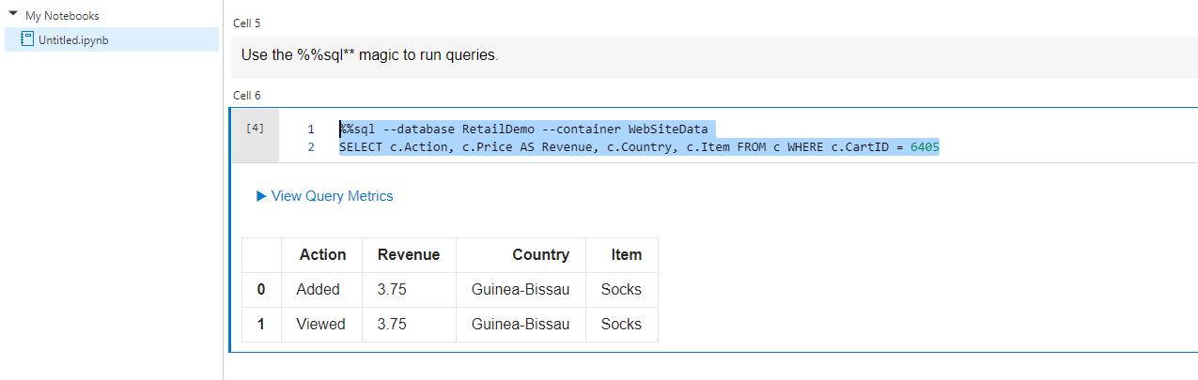
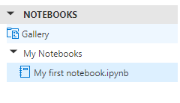
NOTEBOOKS – SQL MAGIC
Save it to notebooks
Notes:
%%sql --database RetailDemo --container WebSiteData
SELECT c.Action, c.Price AS Revenue, c.Country, c.Item FROM c WHERE c.CartID = 6405

Slide 30
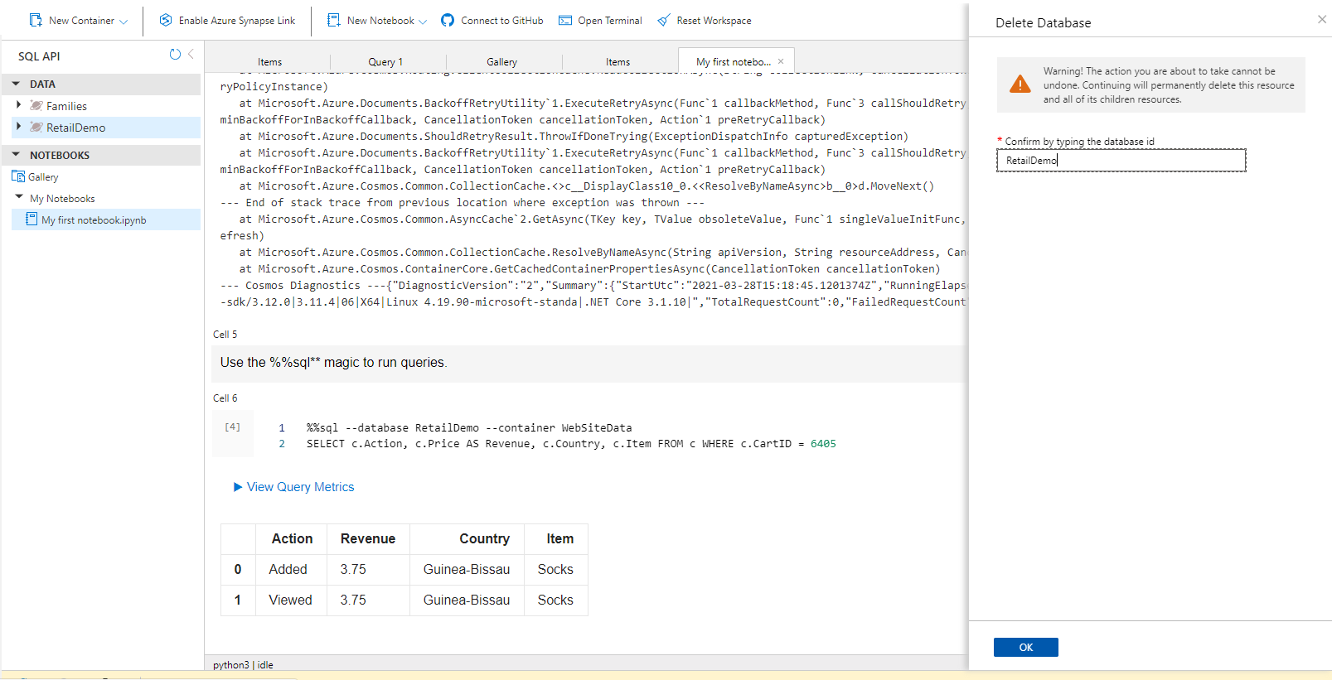
DELETE DATABASE

Slide 31
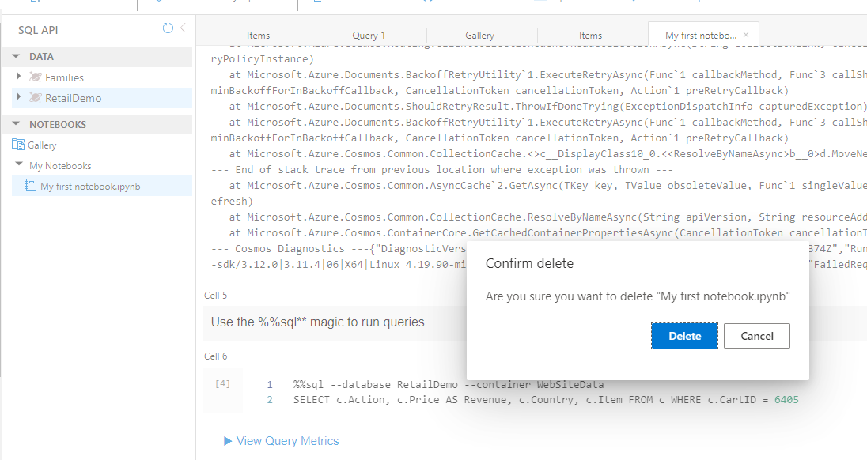
DELETE NOTEBOOK

Slide 32
Automatic indexing
In general, you don’t need to worry about indexing of items in a container because by default CosmosDB will index every
property in every item.
A document which has some nested array and objects. The JSON gets parsed into a tree structure where every property is
a leaf node in the hierarchy. The hierarchy is transformed into a flat list of keys and values where each key is expressed as
property path to a specific value and the list is simply indexed along with all other items inside a container. CosmosDB uses
this index to find the matching documents. It is a core feature in Cosmos DB, so it applies equally to all the API’s, not so just
the SQL API’s.
The result is that you have a container with no defined schema and yet it is fully indexed.
It can be further fine tuned using custom index policy.

Slide 33
API’s and DATA models
Model your data as JSON documents : You have SQL API for JSON document and SQL Queries.
Model your data as BSON documents: You have MongoDB API for BSON documents and MongoDB Queries.
Difference between these two API’s:
The SQL API is the core API and among the other unique capabilities it supports a special of SQL for querying JSON. It is the
Only API that exposes a server-side programming model for transactional stored procedures.
The MogoDB API provides wire-level support, which gives you compatibility with the standard MongoDB driver for the protocol
Used to send packets over the network.
SQL API is the most capable API and is often referred to as the Core API.
Model your data as a key value Store : Need to use Table API. A simple item with scalar values only (numbers and strings). No
Embedded objects or arrays.
Gremalin API : Uses graph database that store vertices and edges.
Cassandra API : Schema is defined upfront.

Slide 34
Universally APPLIED Concepts
Available across all API’s and data models :
Global Distribution
Horizontal Partitioning
Automatic Indexing
Provision Throughput
The API’s merely project your data as different data models Internally all your data is stored as ARS
(Atom Record Sequence), a Microsoft creation that defines persistence layer for Key-value pairs. Everything is stored as ARS

Slide 35
Measure Performance
How do you measure performance?
Performance is measured in two ways: Latency and throughput.
Latency : Latency means overall wait time, so this is users perceived performance. How long is the user waiting for a response to their request end to end?
Throughput: Throughput is all about the performance from the perspective of database service itself. How many client requests on the container can be processed concurrently by Cosmos DB?

Slide 36
REQUEST UNITS
Request units are a way of managing throughput to achieve the best performance.
Throughput Currency : Blended measure of computation cost (%memory, %CPU, %IOPS)
All request are charged in the form of request units.
All request are not equal. For example : Writes will always cost more than reads because writing updates multiple replicas,
while reading is achieved with one replica. Simple queries will always cost less than more complex queries.
Every Cosmos DB response header shows the RU charge for the request.
Request units are deterministic in Cosmos DB: The same request will always require the same number of request units.

Slide 37
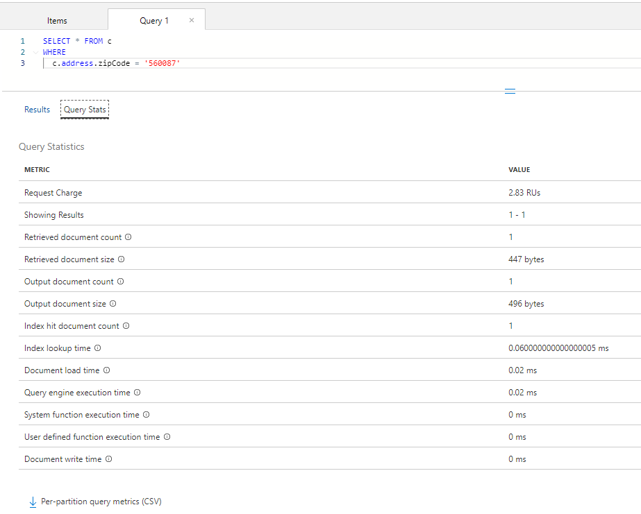
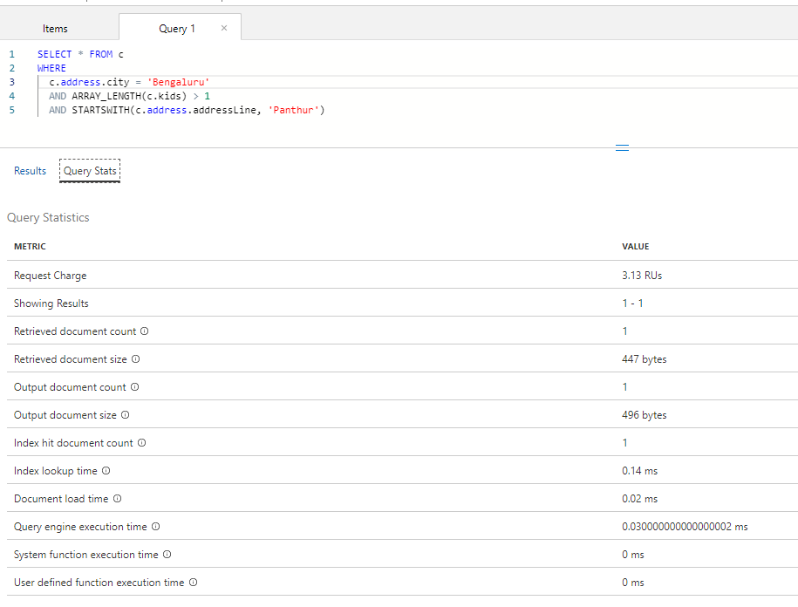
REQUEST UNITS

Slide 38
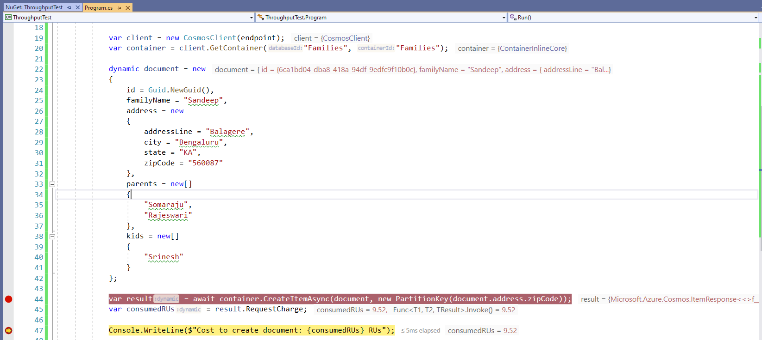
Get Rus programmatically

Slide 39
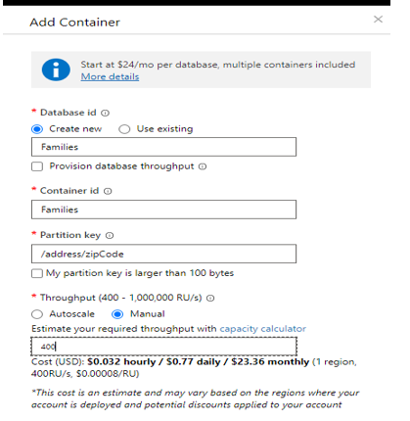
Throughput offers - Manual
Provisioned throughput (manual):
Explicitly reserve a fixed number of Rus per second that are guaranteed to be available all the time.
Here we are provisioning 400 RU’s per second. Manual provisioning is recommended for stable and predictable workloads.

Slide 40
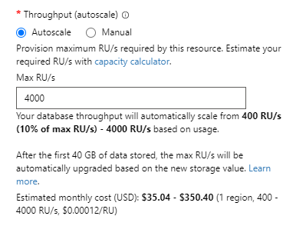
Throughput offers - autoscale
Provisioned throughput (autoscale):
Reserve max RU/sec.
Provisioned for unpredictable and variable workloads.

Slide 41
Throughput (Serverless)
You don’t provision throughput at all. Instead it is consumption based. Pay only RU’s that you use. This is perfect for those
spiky workloads where your container is mostly idle.
Autoscale is not effective w.r.t cost. So, serverless is idle choice.

Slide 42
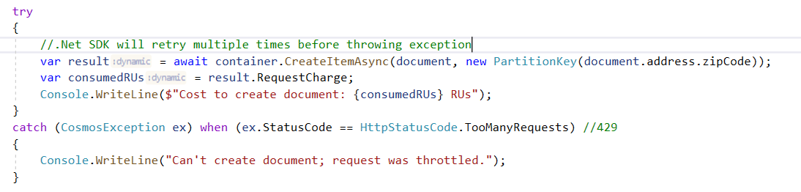
Provisioning container throughput
Reserve request units per second (RU/s) : How many request units (not requests) per second are available to your
application.
Exceeding reserved throughput limits.
Requests are throttled (HTTP 429) and it will fail. Cosmos DB will tell you inside the refused request response header
how long to wait before retrying.

Slide 43
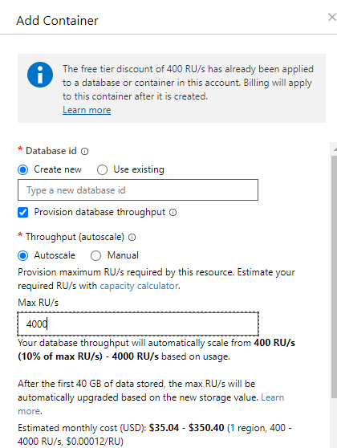
Provision database throughput
The throughput is distributed evenly across all the containers in the database.
If I have 4000 Max RU/s and 4 containers in database, then each container
will have 1000 RU/s assuming that your requests are evenly distributed across
all the containers. The throughput is also shared across all the containers if any one of the container
is not using the RU.
Migrate existing applications : May already be designed with separate containers
per type.
Differentiate solely on partition key : Containers share throughput needs but
different partition requirements.
Mix and match : Distribute database throughput across some containers.

Slide 44
Whiteboarding the cost
Baseline
Read item : 1 RU. Direct read of a single document. If you know the partition key and ID of a document and the document is
1 K or smaller than operation will cost exactly 1RU.
SQL Query: The cheapest SQL query will cost under 3 Rus. Depending on Query complexity, indexing policy and whether or
not, it is a cross partition query, the cost can go up.
Write Item : Writes are distributed to multiple replicas, cost around 10 RU’s.
Application checklist:
What does a typical item look like?
What are the typical queries that uses will run?
How many writes per second are required?
How many queries per second are required?
What is the acceptable consistency level?

Slide 45
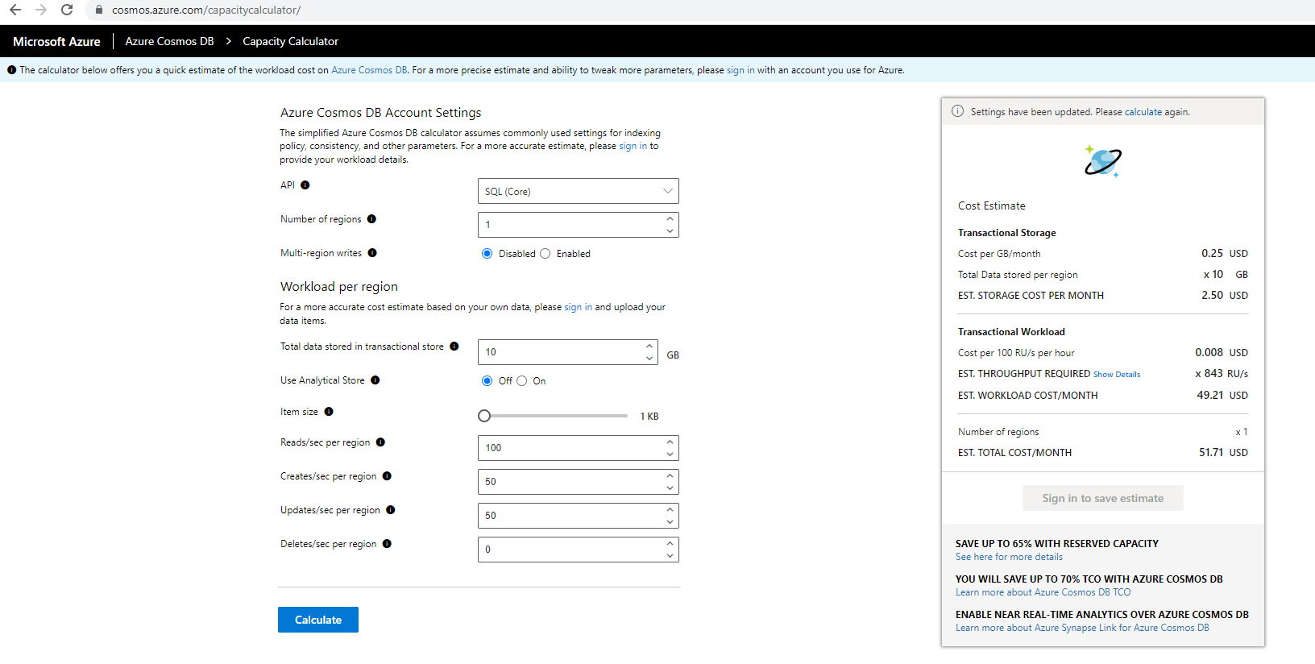
COSMOS CAPACTITY CALCULATOR
https://cosmos.azure.com/capacitycalculator/

Slide 46
PRICING
Storage : Consumption-based SSD storage.
$0.25 for 1GB per month per region.
Provisioned throughput : Manual provisioned throughput
$0.008/hr for 100RU/sec per region
Minimum 400 RU/sec.
Autoscale provision throughput : $0.012/hr for 100 RU/sec per region
Minimum 400 RU/sec.
Serverless : Consumption-based per request
$0.25 per 1 million RUs

Slide 47
Horizontal scaling
What is partitioning?
Partitioning allows you to massively scale your database. Not just in terms of storage but throughput.
You simply create a container and let Cosmos DB partition the data you store in that container to manage its growth.
Containers: You will work with one container as a single logical resource when you store your data and run your queries.
You can let container just grow and grow without worrying about the scale because Cosmo DB creates as many partitions as possible as needed behind the scenes to accommodate growth and scale for your data.
Partitions: You can think partitions as individual physical computers. It is also a unit of replication. Every physical partition
behind the container is itself distributed across multiple replicas, at least four within a single data center, in order to ensure
high availability for your database.
Automated scale out: When a partition gets too busy, Cosmos DB automatically creates another and another, thus adding more storage capacity and compute power to the container.
Under the covers, Cosmos DB manages a cluster of servers for each container which distributes the workload across multiple
physical machines. The essence of horizontal scale is that Cosmos DB will add more machines in the backend.

Slide 48
Logical partitions
We will have bank of servers or physical machines sitting behind every container. Every document you write can land on any
of these physical partitions.
How does Cosmos DB know which physical partition to use for any given document?
Logical partitions.
Partition key defines the logical partitions of the container. The partition key is some property in the document and that
could be based on a Composite, some combination of other properties, that’s used to group multiple documents together
within a single logical partition, those partitions will have a same key value.
Maximum document size is 2MB. Maximum logical partition size is 20GB.

Slide 49
Partition splits
You will just keep writing documents to the one container and depending on the value of partition key in each document,
which we have chosen, these documents are grouped together in the same logical partition.
Cosmos DB manages the physical partitions. It decides which logical partition it is going to be hosted on. Cosmos DB will
add new physical partition to accommodate more storage, throughput or both and the way this happens is with a partition
split.
The partition splits happen instantaneously, automatically and with absolutely no disruption.

Slide 50
Avoid HOT Partition
Don’t select a partition key where you want to wind up with some logical partitions that are really large and most are so
small. This imbalances create a hot partition.
Hot partitions can’t really scale out data very well.
You need to give a partition key that gives you a much more uniform distribution much more evenly across all partitions
of the container.
Horizontal scale is not all about storage, but it is about throughput.
Access patterns like how does your application read and write data?
A creation date is often a poor choice for partition key. For example : Jan 1, Jan2, Jan3, Jan4,etc. It performs well with
storage capacity and does not give well from throughput perspective. All writes of the day are always being routed to the
same partition. Queries are also more likely to be looking at more recent data rather than older data. This results in a hot
partition.
The best partition key is one that gives you the most uniform distribution of storage and throughput.
In social networking scenarios, username is a good choice as a partition key.

Slide 51
Cross Partition queries
Sandeep
Sumeet
Narayanan
JSON DOCUMENTS
JSON DOCUMENTS
JSON DOCUMENTS
SELECT * FROM c WHERE c.username = ‘Sandeep’
Here username is the partition key.
SELECT * FROM c WHERE c.favoritecolor = ‘Red’
Here partition key is not known because we are querying across all the users. It means we are querying across entire
Cluster behind the scenes.

Slide 52
CHOOSING THE RIGHT PARTITION KEY
Based on common usage patterns : The right choice will deliver massive scale.
Avoid performance bottle necks: Ensure uniform distribution of both storage and throughput.
Boundary for queries and transactions : Minimize cross partition queries. Stored procedures with ACID guarantees.
Server-side stored procedures can update multiple documents in a single transaction. So that all updates succeed or
fail together as a whole. This is only possible with a single logical partition where all documents that your updating have
the same key partition value.

Slide 53
Common partitioning patterns
/id : The id can be any string value. Good approach for reading and writing single documents at a time.
Good strategy for those write-heavy IoT scenarios where your rapidly ingesting a high volume of device information into
Cosmos DB at a very high throughput.
For example : We could store flight telemetry, speed, altitude, location and so on. In realtime, for all the planes we have in
The air.
Any kind of sensor data where imagine every device is sending you data once every in 10ms.
/type: Small lookup lists.
/other : Optimize for your queries.
Example : /customerID which is present in both Customer and Order Documents.

Slide 54
Change the partition key
Partition keys are immutable.
Always use the same property path. For example : /pk Store a copy of the desired partition key.
Always uniquely qualify the id property.

