Slide 1

Azure Event grid
Sit Dolor Amet

Slide 2
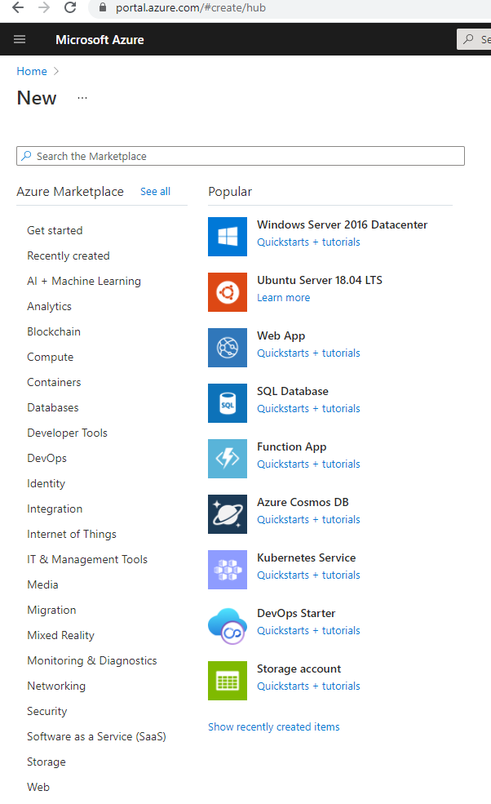
Create storage

Slide 3
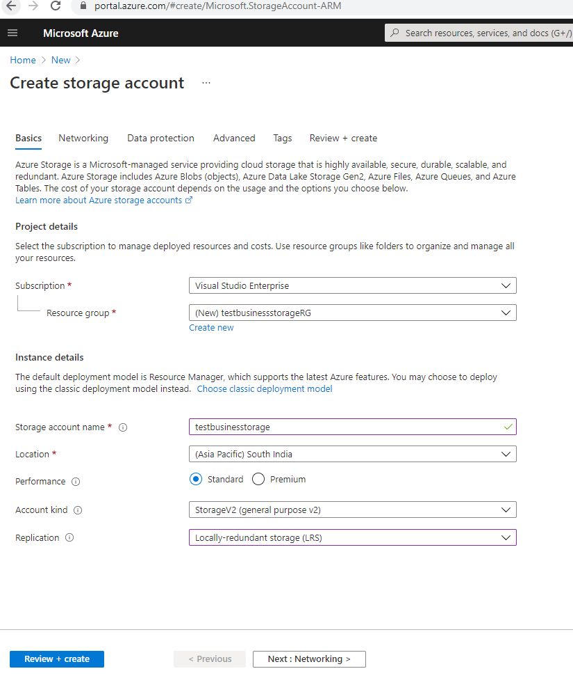
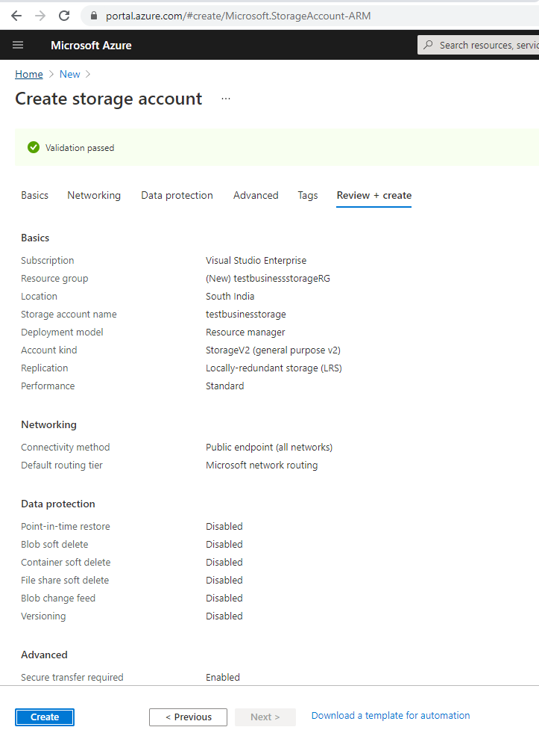
Create storage

Slide 4
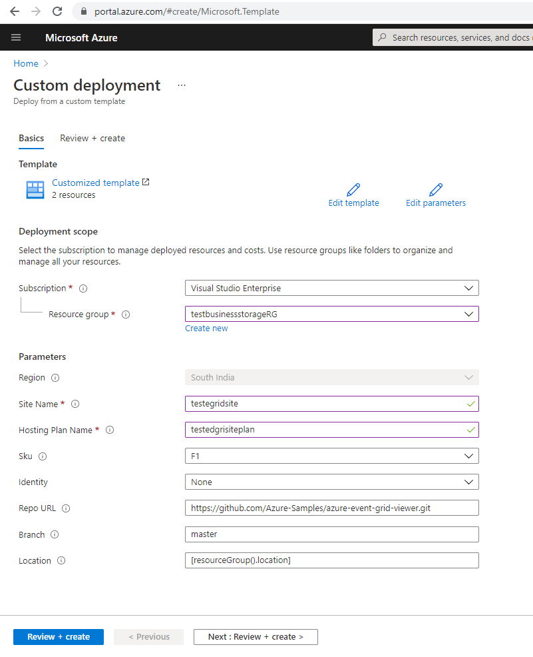
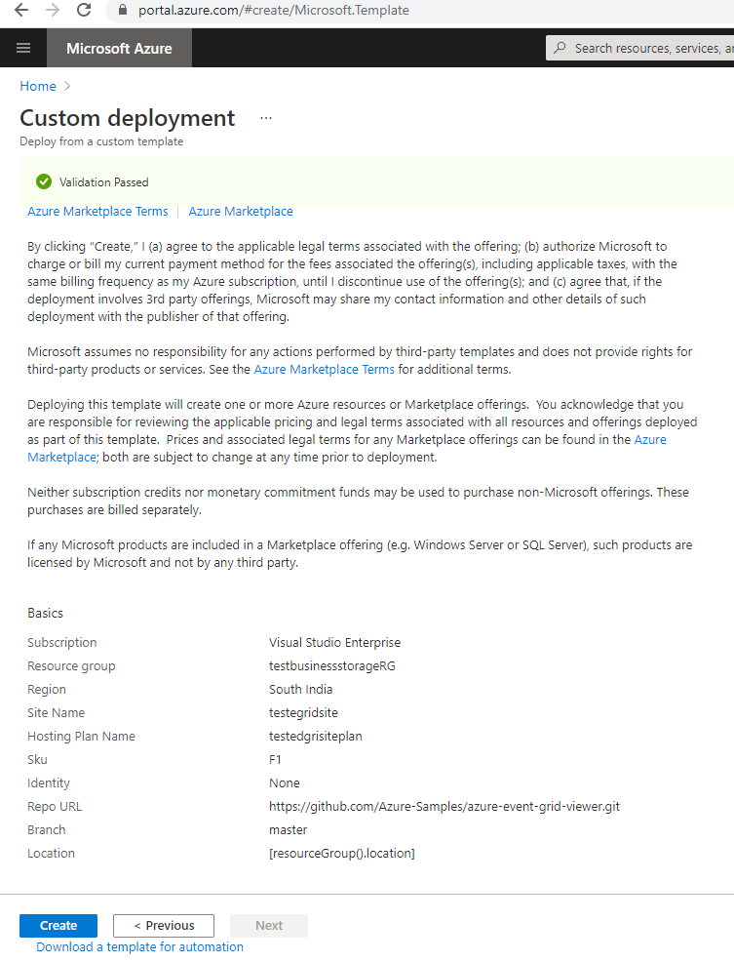
Prebuilt web app

Slide 5
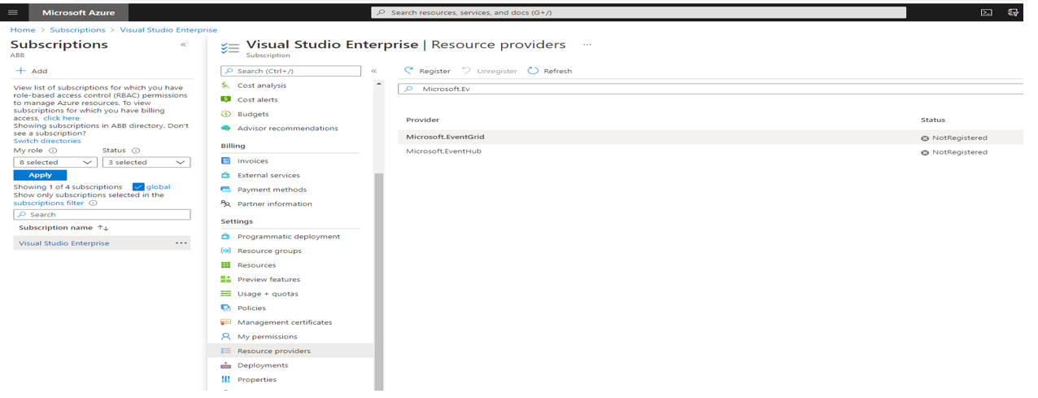
Resource providers registration for event grid

Slide 6
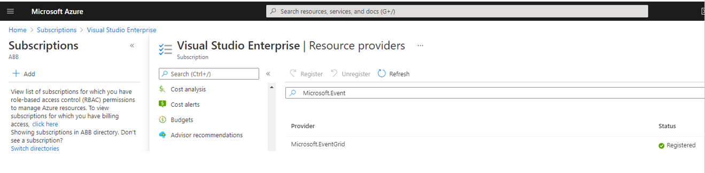
Resource providers registration for event grid

Slide 7
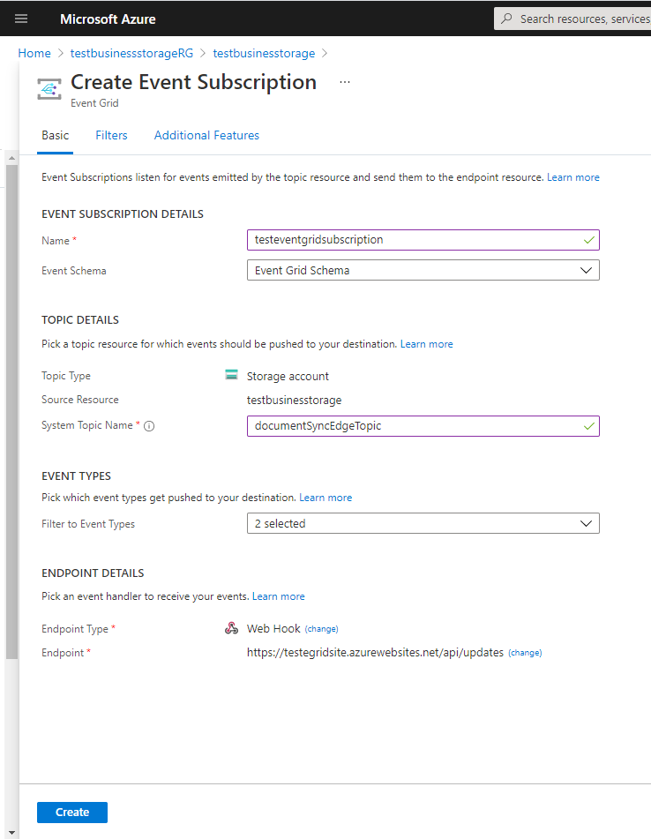
Web HOOk

Slide 8
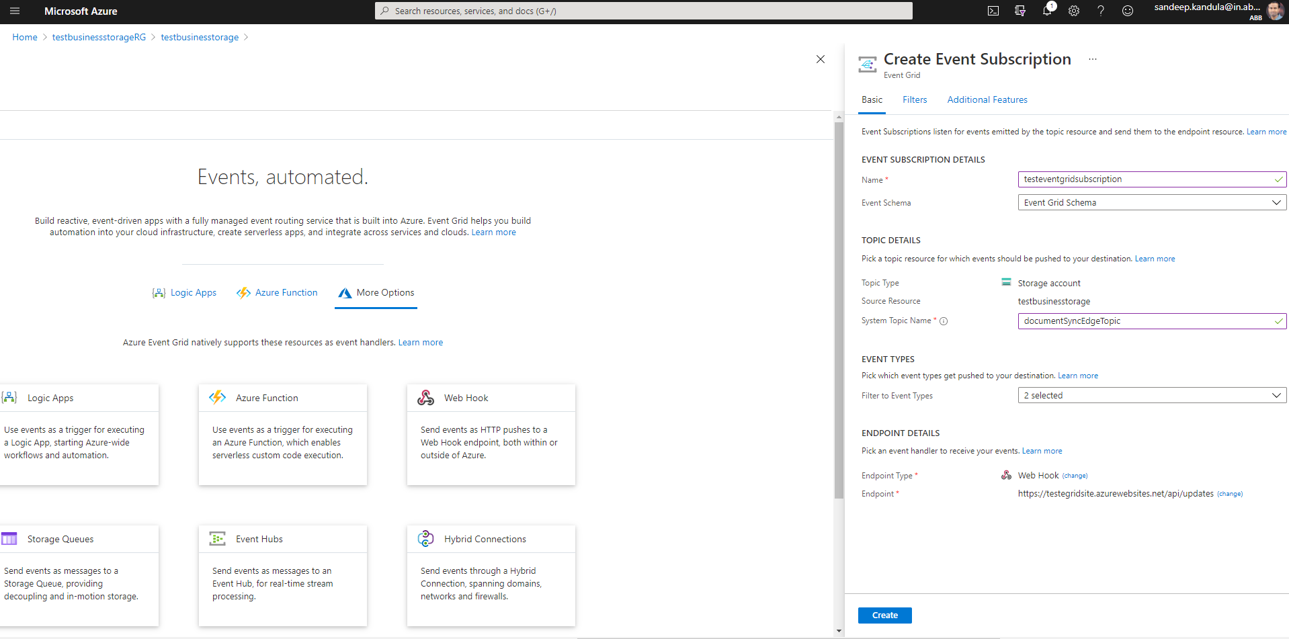
Web HOOk

Slide 9
Prebuilt Web APP
https://portal.azure.com/#create/Microsoft.Template/uri/https%3A%2F%2Fraw.githubusercontent.com%2FAzure-Samples%2Fazure-event-grid-viewer%2Fmaster%2Fazuredeploy.json

Slide 10
Azure Storage queues
It is part of Azure Storage Account. Storage Account Services (Blob Storage, Table Storage, Queue storage, Files)
Format of the queue names : https://stor-account.queue.core.windows.net/queue-name
Scalable, REST-based interface (Also available as .Net standard library) :
GET: To retrieve messages from the Queue.
PUT: To place them.
PEEK: To look at the message added to the Queue and not to pull the message or dequeue it.
Reliable, persistent messaging between services (FIFO delivery).
Maximum message size is 64KB.
Maximum lifetime of seven days.
Server-side logging.

Slide 11
Azure storage queue pricing
https://azure.microsoft.com/en-in/pricing/details/storage/queues/

Slide 12
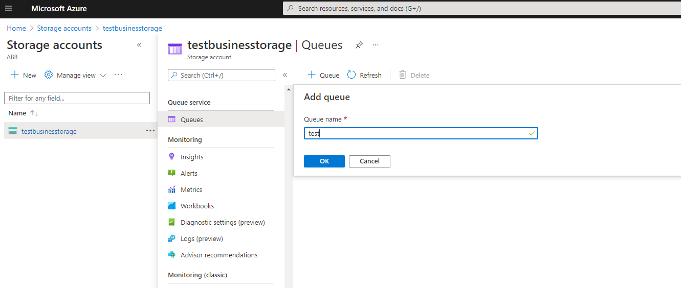
Create a queue – 1/2

Slide 13
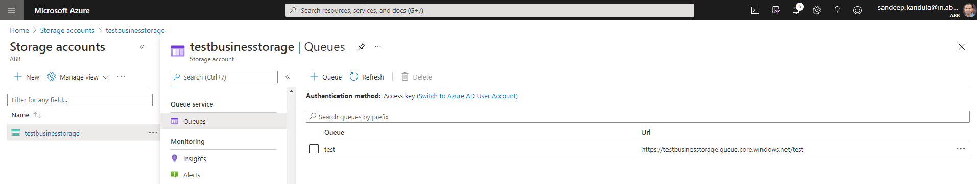
Create a queue – 2/2

Slide 14
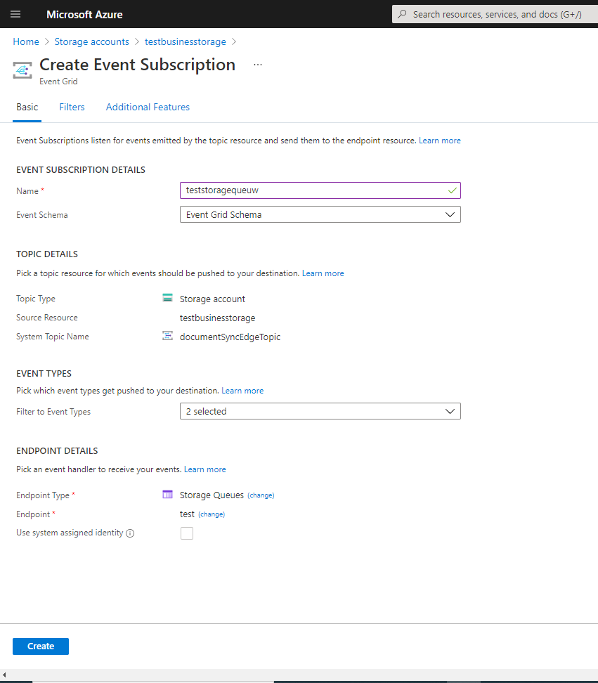
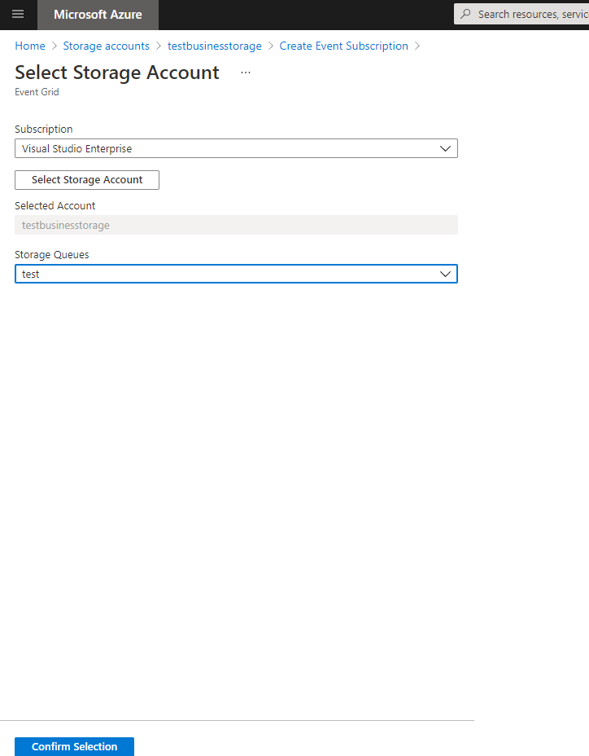
EVENT for STORAGE ACCOUNT

Slide 15
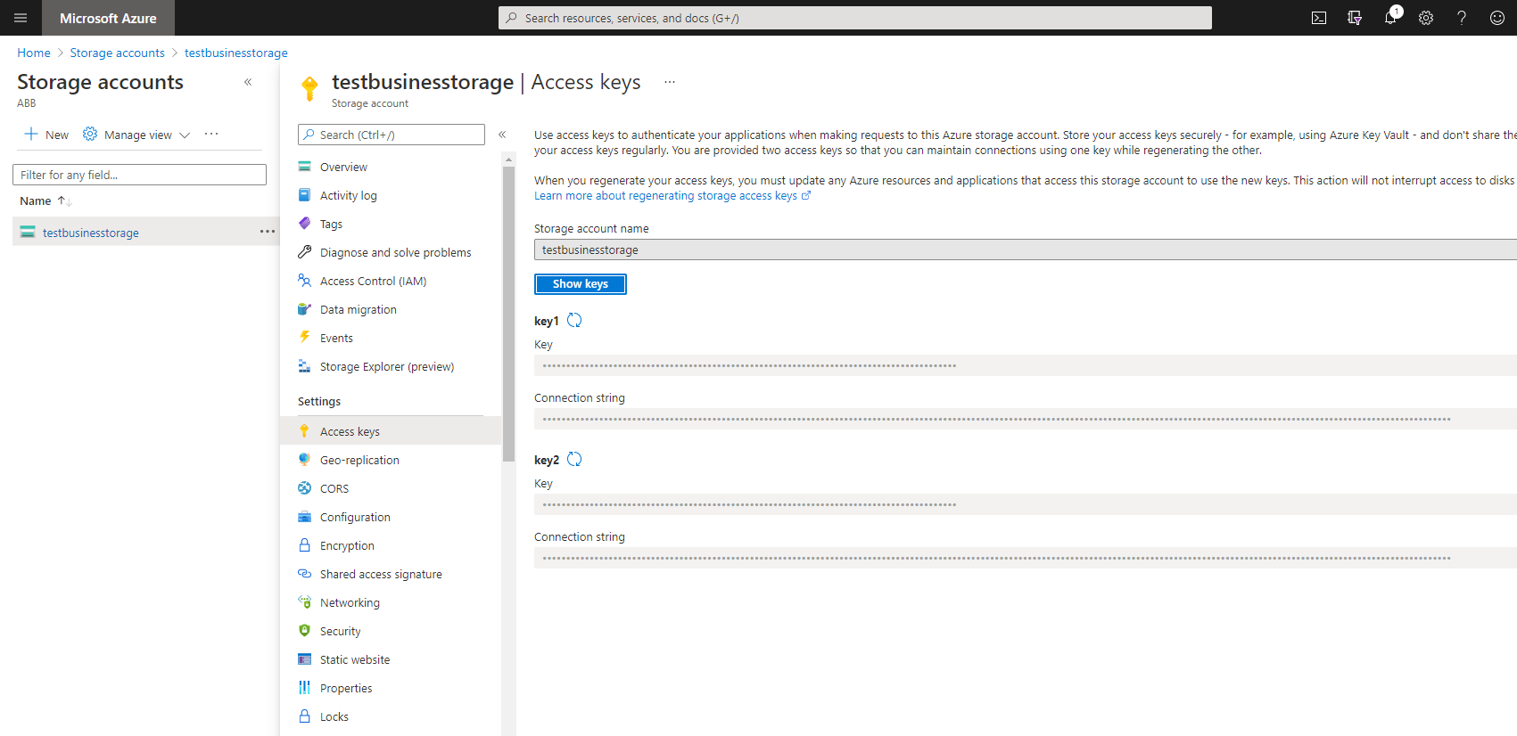
AccessKeys

Slide 16
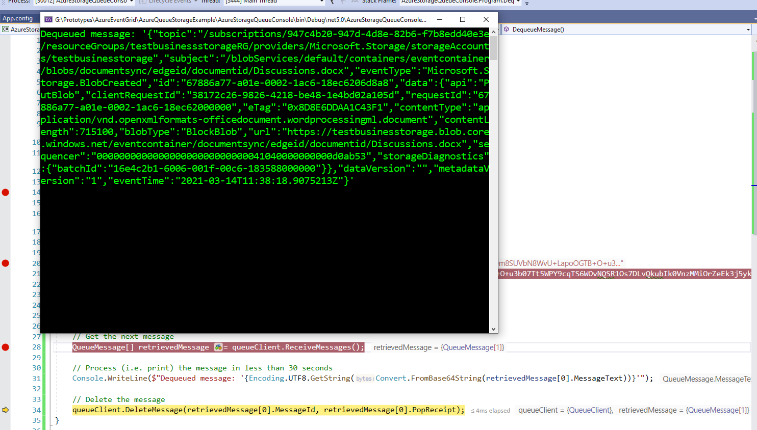
Reading from azure storage queue
https://docs.microsoft.com/en-in/azure/storage/queues/storage-dotnet-how-to-use-queues?tabs=dotnet

