Slide 1

Azure POSTGRESQL

Slide 2
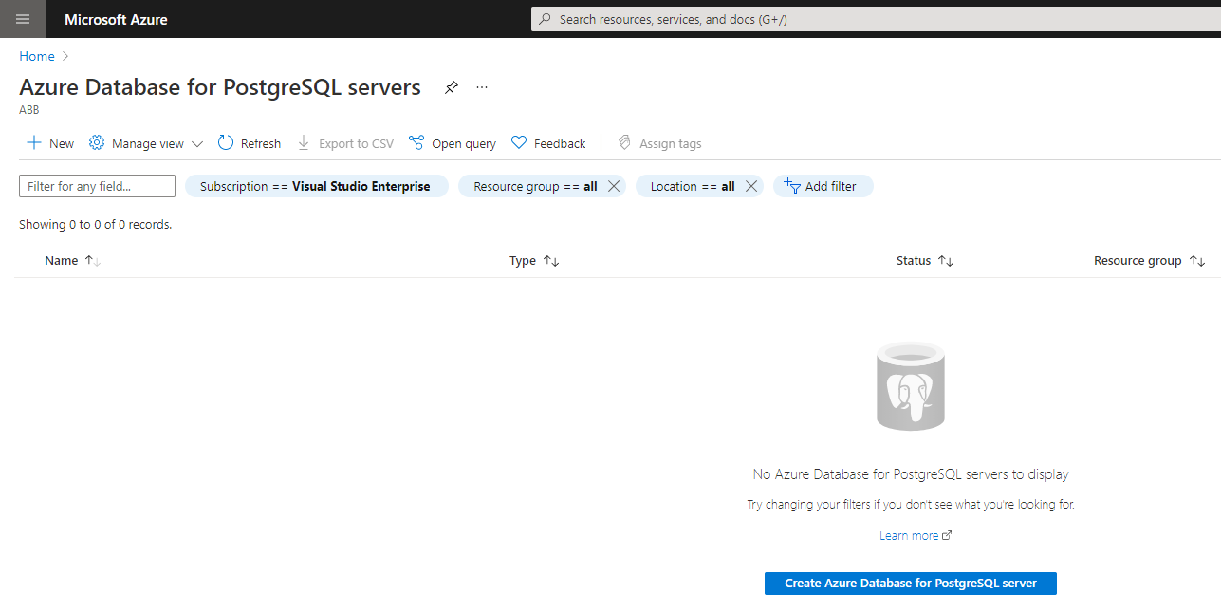
Azure Database for postgresql servers

Slide 3
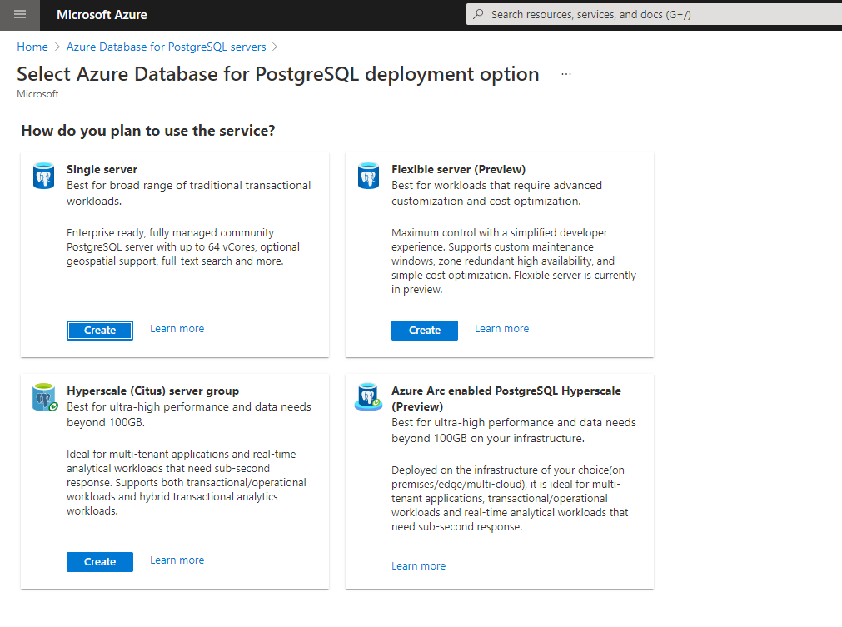
Azure Database for PostgreSQL server

Slide 4
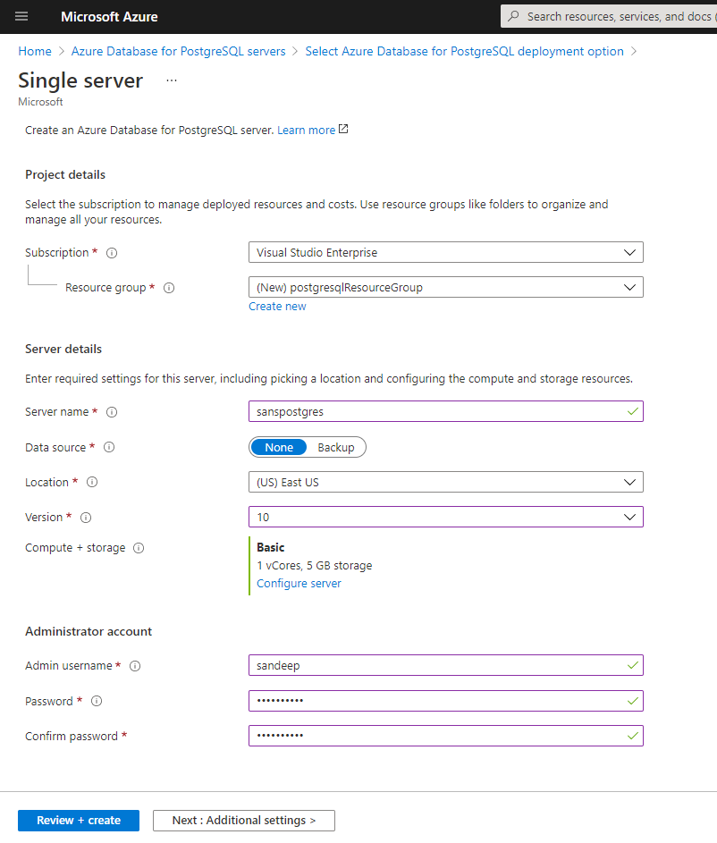
POSTGRESQL SINGLE SERVER

Slide 5
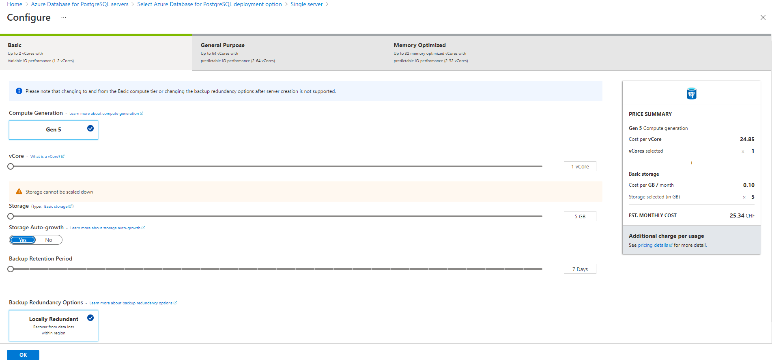
Capacity + storage

Slide 6
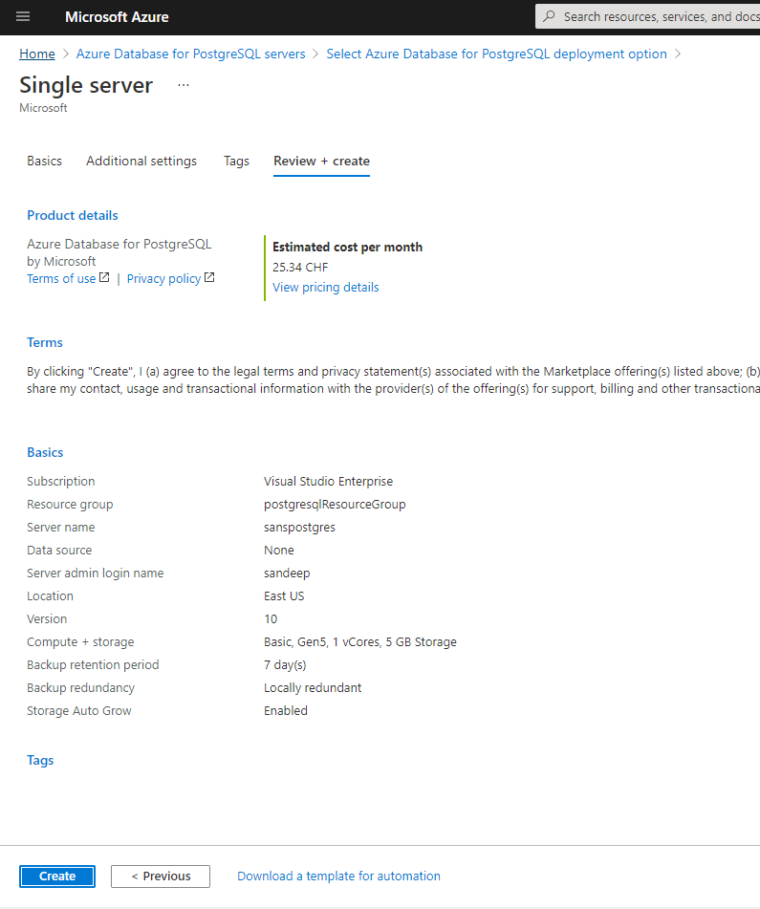
REVIEW + CREATE

Slide 7
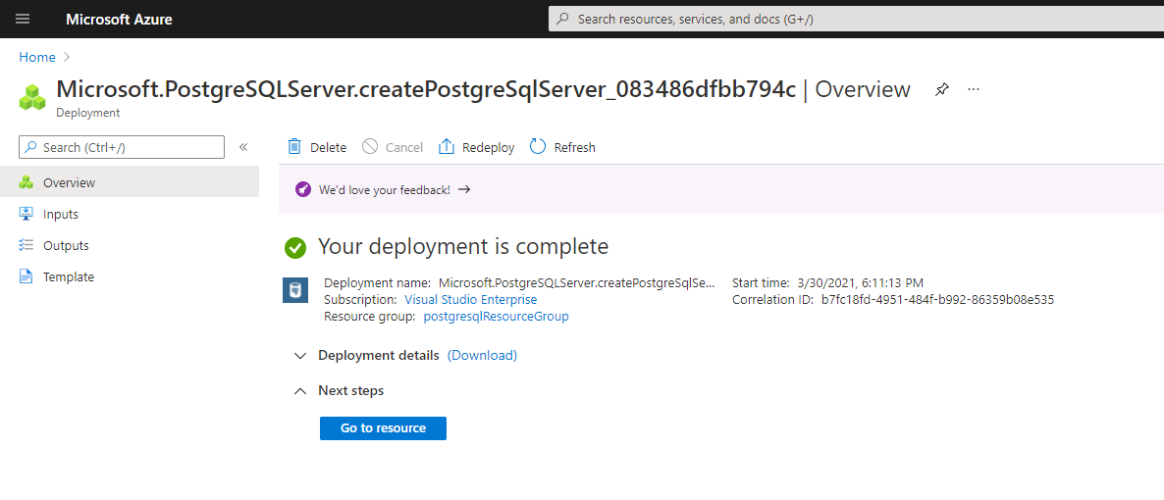
PostgresQL Deployment

Slide 8
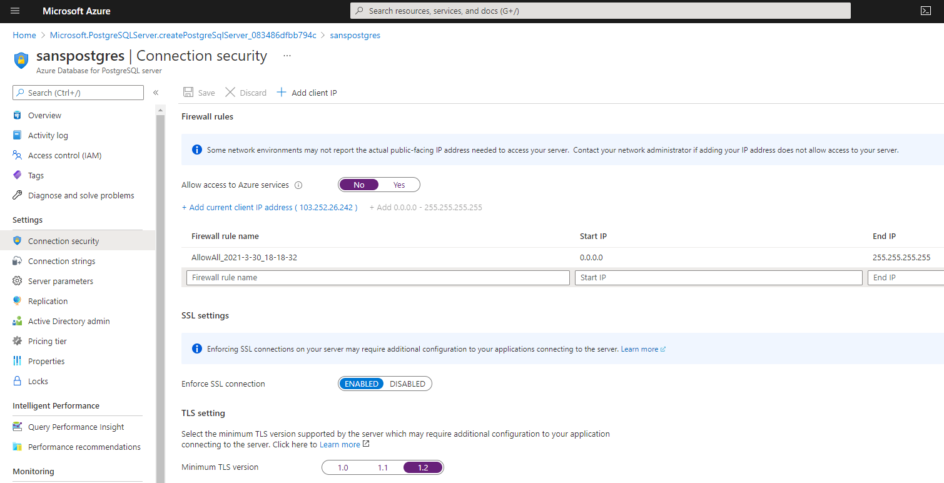
Connection security

Slide 9
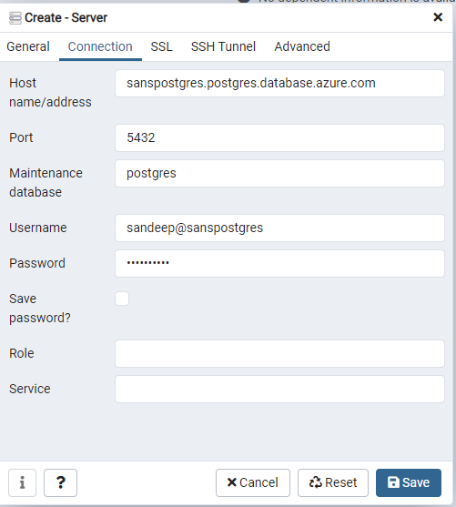
INSTALL PGADMIN
https://www.pgadmin.org/download/

