Slide 1

Azure POSTGRESQL

Slide 2
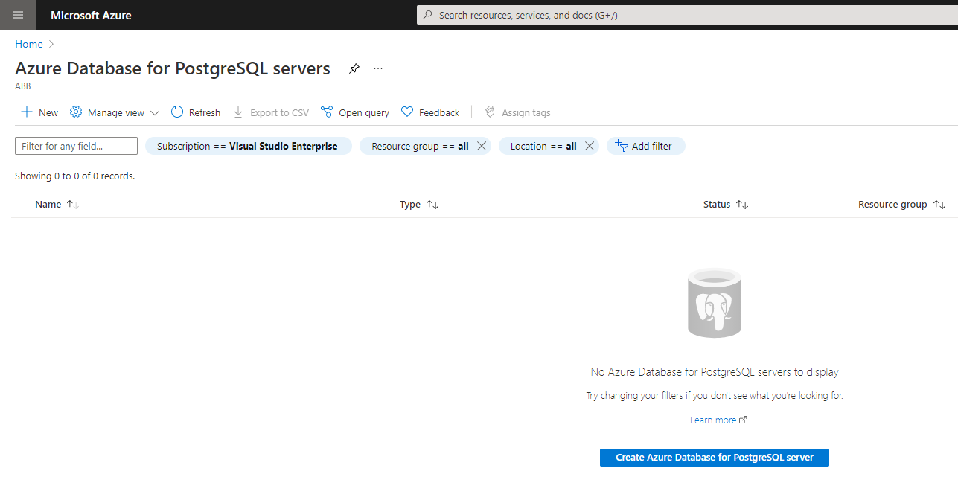
Azure Database for postgresql servers

Slide 3
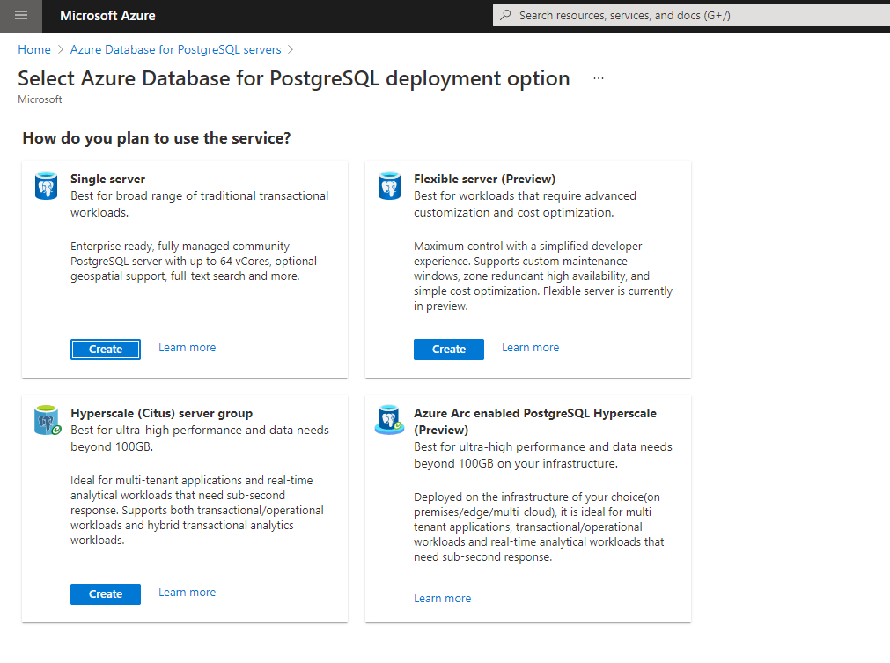
Azure Database for PostgreSQL server

Slide 4
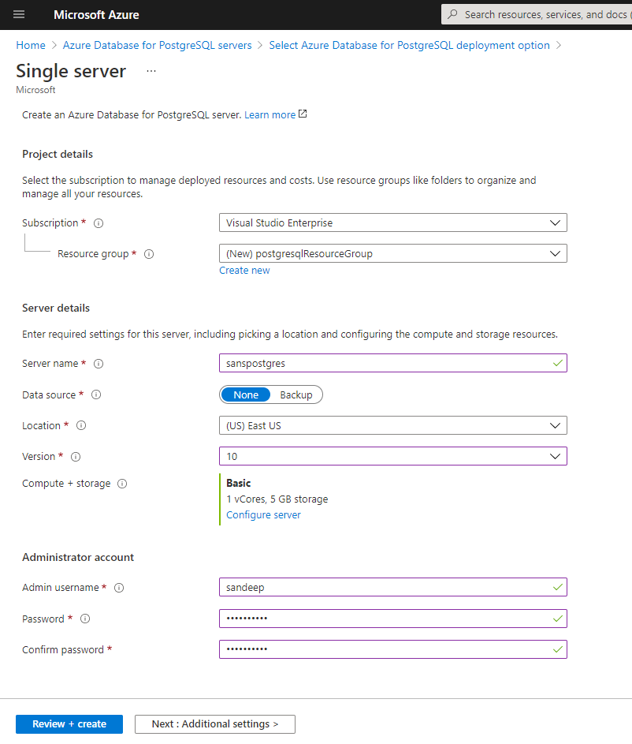
POSTGRESQL SINGLE SERVER

Slide 5
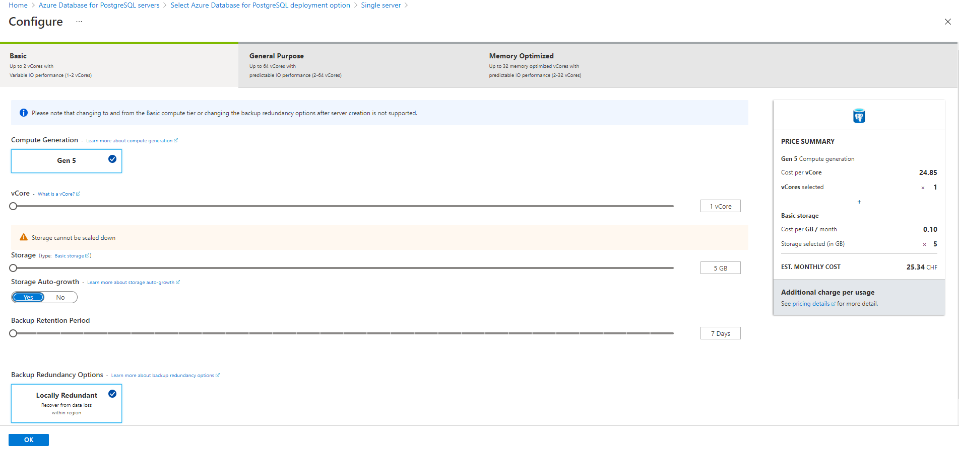
Capacity + storage

Slide 6
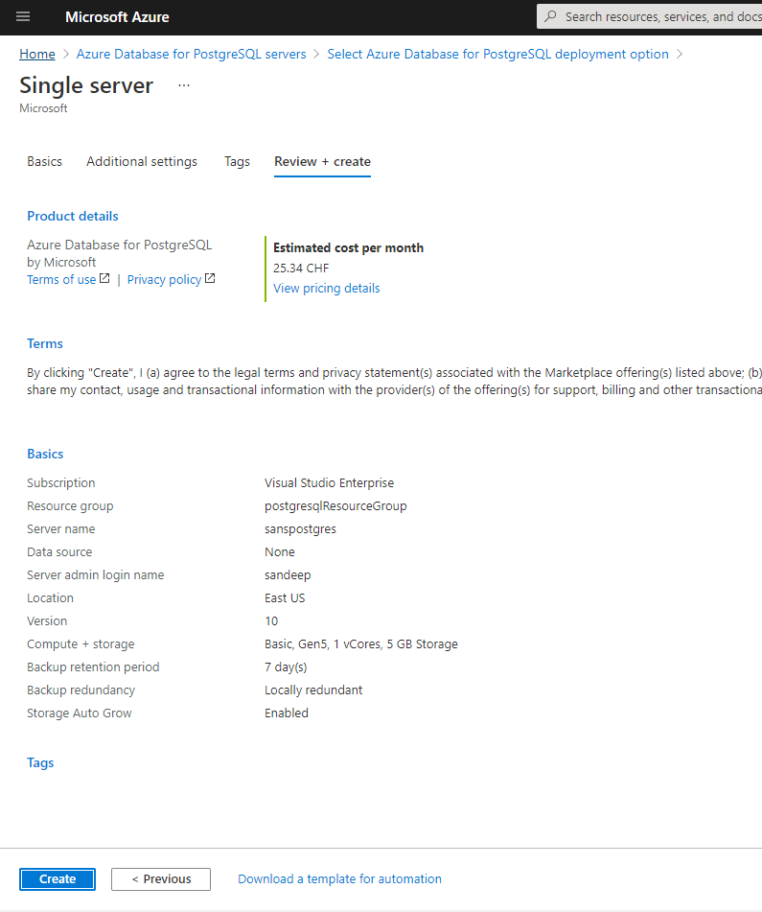
REVIEW + CREATE

Slide 7
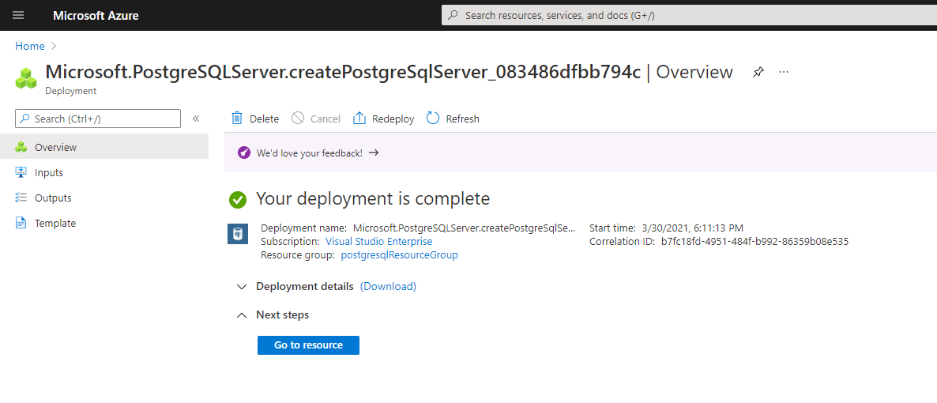
PostgresQL Deployment

Slide 8
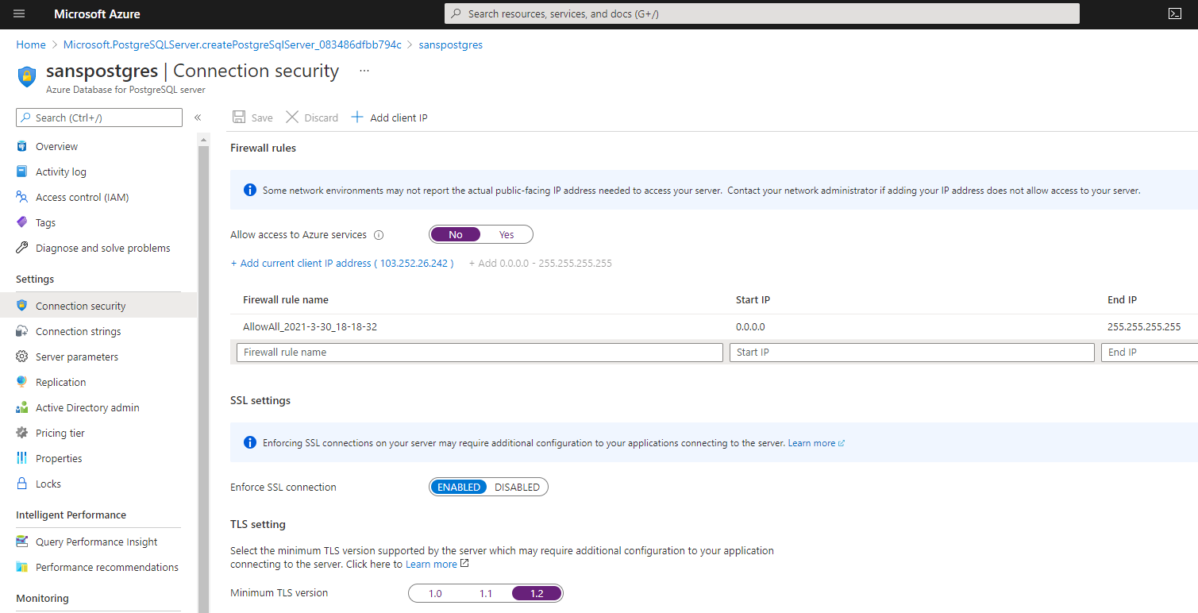
Connection security

Slide 9
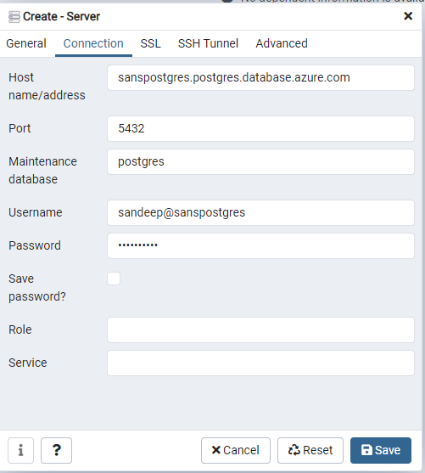
INSTALL PGADMIN
https://www.pgadmin.org/download/

Slide 10
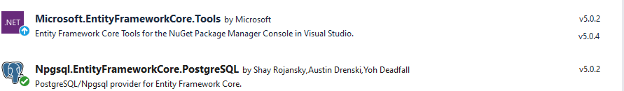
NPGSQL and Microsoft.ENTITYFRAMEWORKCORE.TOOLS
The version should be same.

Slide 11
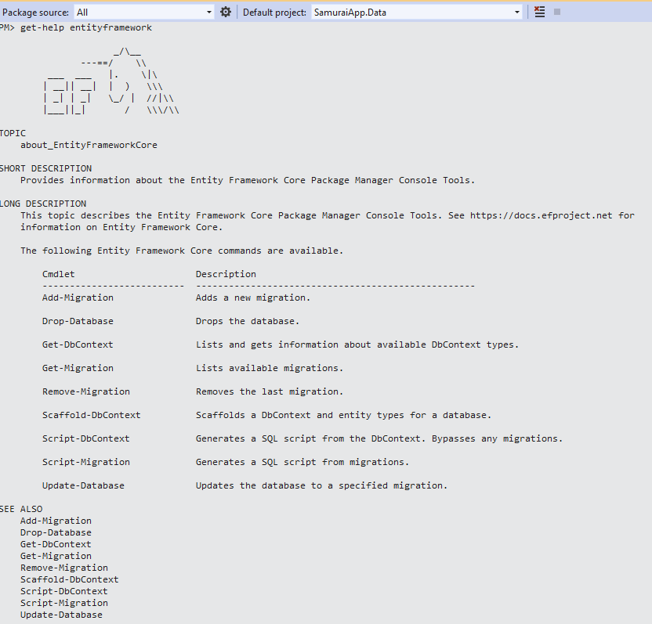
Entity framework
Get-Migration is new to Entity Framework Core 5.

Slide 12
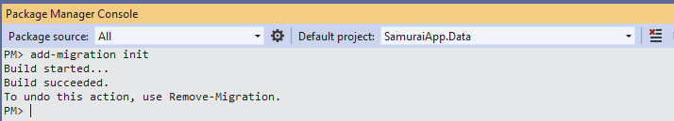

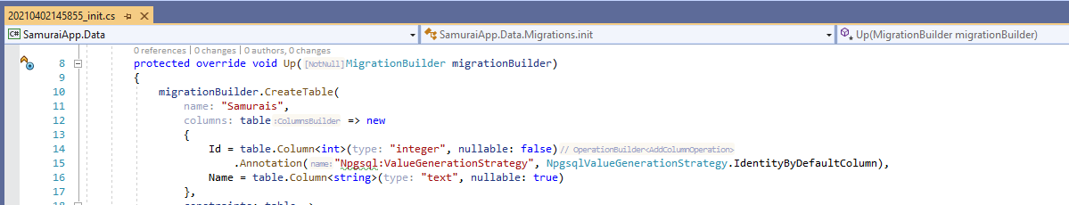
Entity framework – Migrations - 1
Data library project targets .Net 5, so can run migrations, unlike earlier libraries targeting .NET standard.
The snapshot is used to determine how to migrate from one model version to next.
Set to Npgsql identity

Slide 13
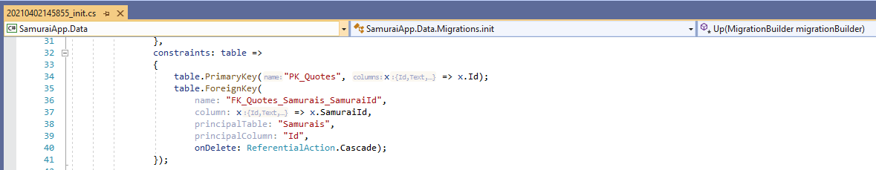
Entity framework – Migrations - 2
EF Core recognized one to many relationship. It also inferred the primary key and foreign key constraints.
It creates index for every foreign key that describes in the model

Slide 14
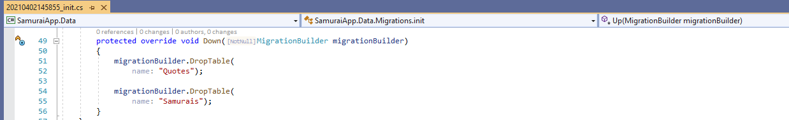
Entity framework – Migrations - 3
Ever if we want to unwind the migration.
Development database : update-database
Production database : script-migration

Slide 15
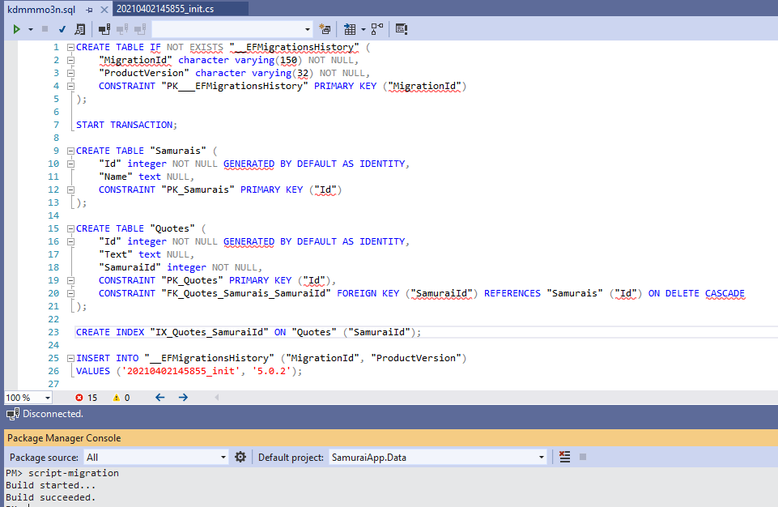
Production-script migration

Slide 16
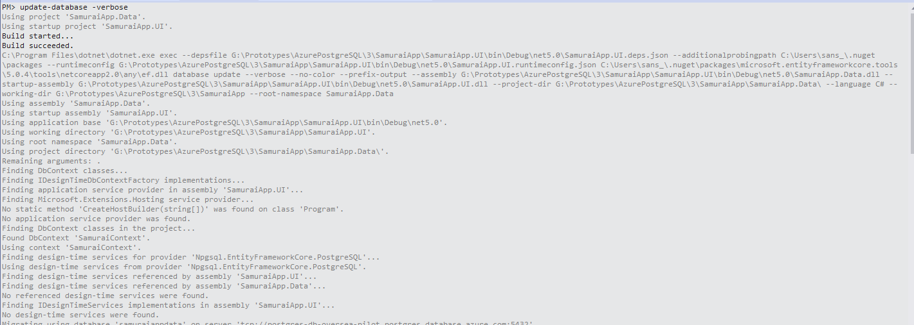
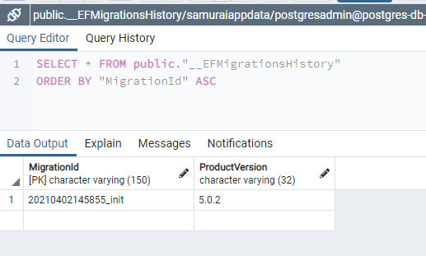


Update database

Slide 17
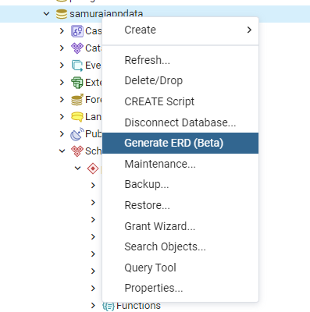
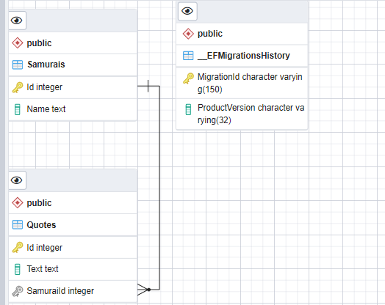
GENERATE ER DIAGRAM

Slide 18
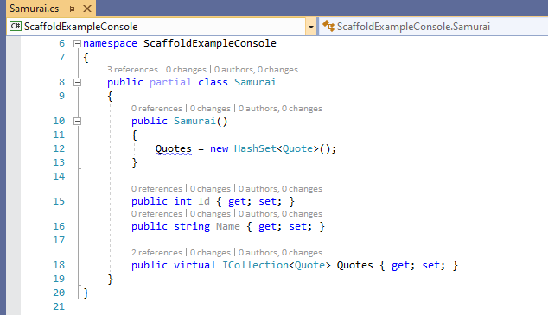
Reverse engineer an existing database - 1
Create DBContext and Classes from database.
Updating model is not currently supported whenever database changes.
Transition to migrations is not pretty.
Workarounds: https://cmatskas.com/ef-core-migrations-with-existing-database-schema-and-data/
EF Core default to ICollection and initializing the Quotes.

Slide 19

Reverse engineer an existing database - 2
EF Core 5 scaffolding now defaults to creating singular names for the entity classes
EF Core uses “Conventions” when creating classes which are the “Default assumptions”.
Sometimes, those convention don’t fall under real intent. This can be overridden using fluent mappings. So that the classes
can be mapped correctly to the database.
Another way to override conventions is to use Data Annotations. This can be achieved in Entity classes but mappings are
Limited.

Slide 20


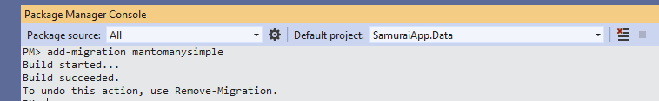
relationships
public List<Quote> Quotes { get; set; } = new();
EF Core will also recognize Collection<T> and Enumerable<T>
With EF Core 5, the addition of a join entity will not complicate the EF’s understanding of your relationship.
https://www.codemag.com/Article/2010042/EF-Core-5-Building-on-the-Foundation

Slide 21
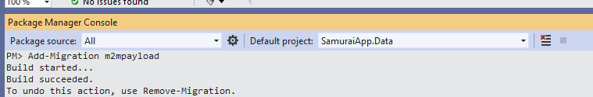
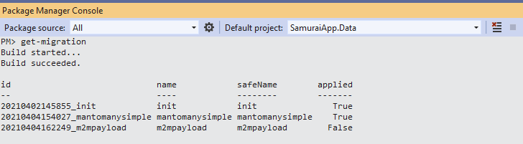
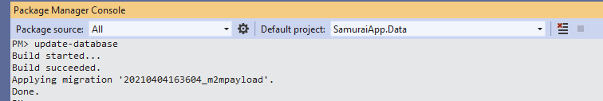
Many to Many with payload

Slide 22
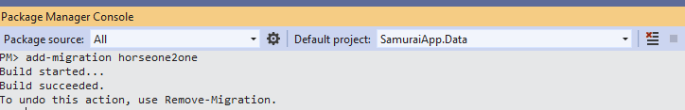

One to one

Slide 23
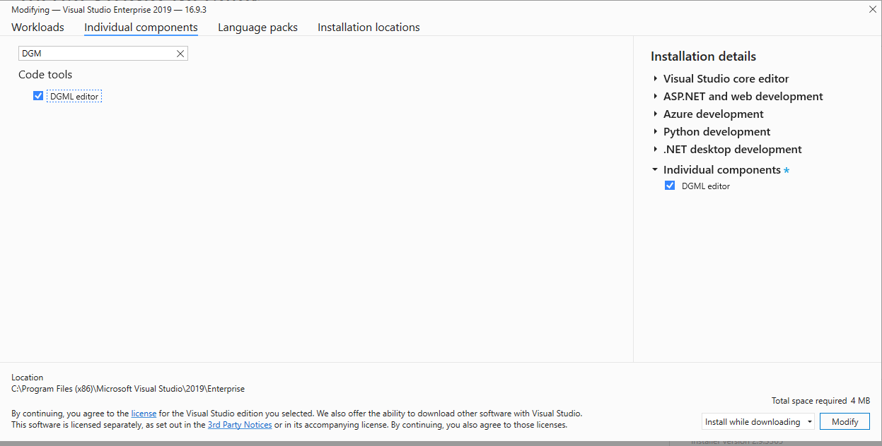
EF Core POWER TOOLS – 1/2
EF core Power Tools also relies on Microsoft.EntityFrameworkCore.Design

Slide 24
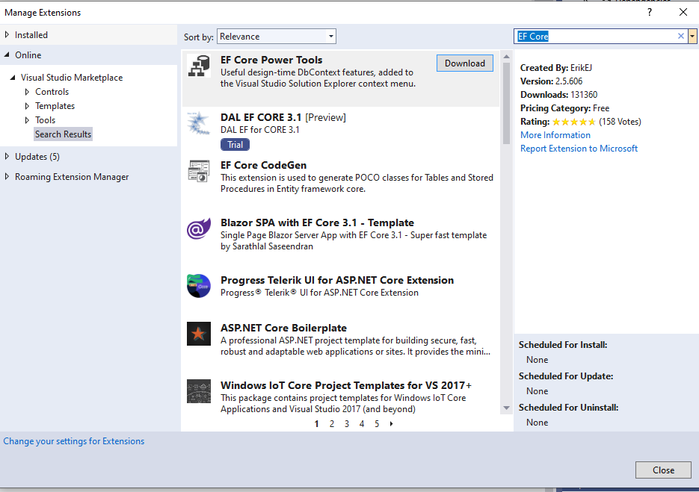
EF Core POWER TOOLS – 2/2

Slide 25
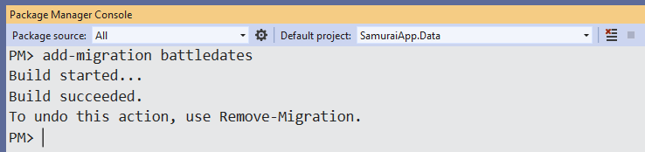
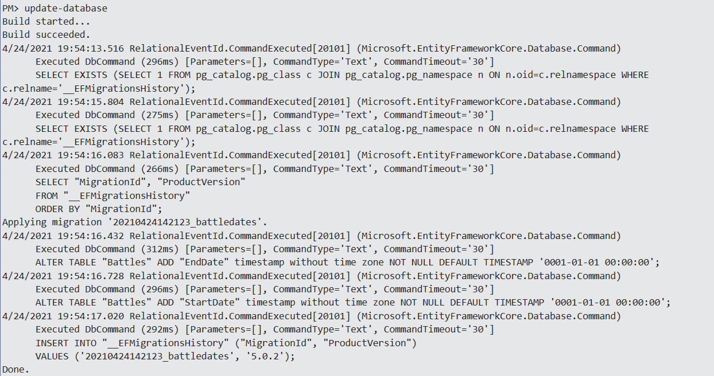
Add Migration (Persist data in disconnected scenarios) - 1

Slide 26
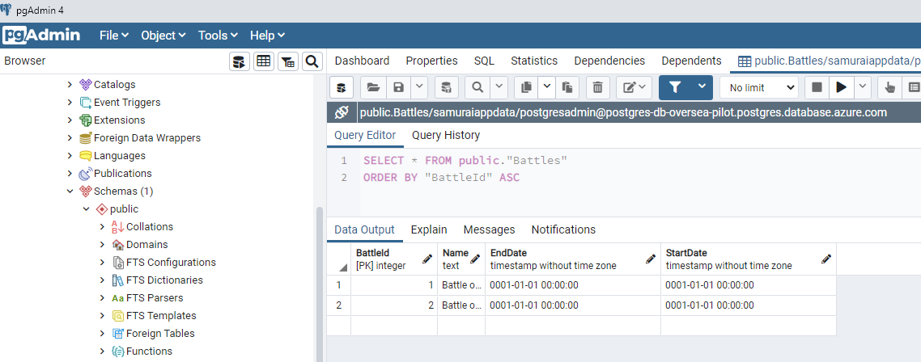
Add Migration (Persist data in disconnected scenarios) - 2
DateTime values are not nullable. So PostgreSQL added default values.

