Slide 1

Azure Storage QUEUEs
Getting started

Slide 2
Azure Messaging services – 1/2
Service Bus :
Messages are persisted in durable data store. Also called as durable brokered messaging.
Point to Point messaging using Queues.
Publish-Subscribe messaging using Topics and Subscriptions.
Provides sophisticated enterprise messaging functionality such as duplicate detection, sessions, scheduling
queue times and message expiration.
On standard tier, it is cost efficient.
Event Hub
Meant for large scale telemetry ingestion. Typically used for telemetry and IoT applications.
Provides buffered storage for events.
Because of the storage architecture, they are massively scalable. Usage scenarios are 10’s, 1000’s and millions
of events.
Event Grid
Provides HTTP routing and delivery.
Can be used for generating near real-time notifications in cloud applications and microservice architectures.
Supported by many Azure Services means applications can subscribe to the events generated by these services.

Slide 3
Azure Messaging services – 2/2
Relay Service
Securely exposes on-premises services.
In affect, it generates secure endpoint in the cloud.
Relay's request and response calls from cloud-based endpoint to on-premises service.
Storage Queues
Simple point to point messaging
Very cost effective
Limited functionality when compared to messaging

Slide 4
Messaging benefits
First in First Out message delivery. Discrete messages are in order.
Temporal decoupling. Producer and consumer don’t need to be online at the same time.
Load leveling.
Message transfer at different rates.

Slide 5
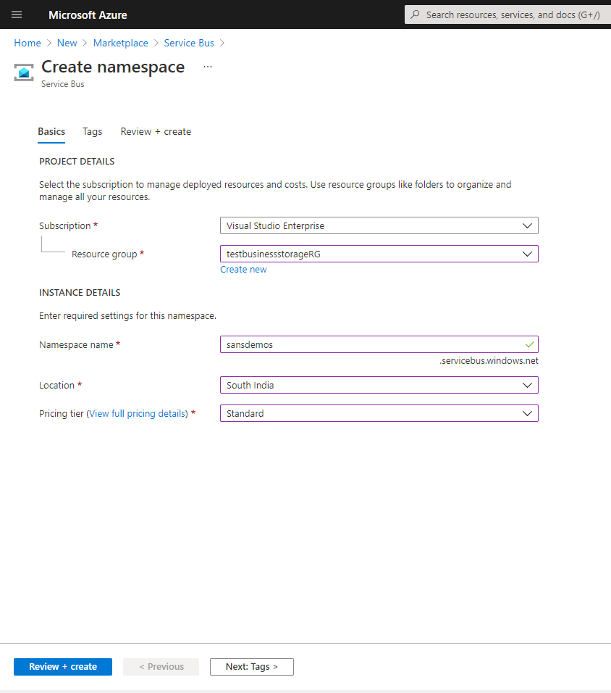
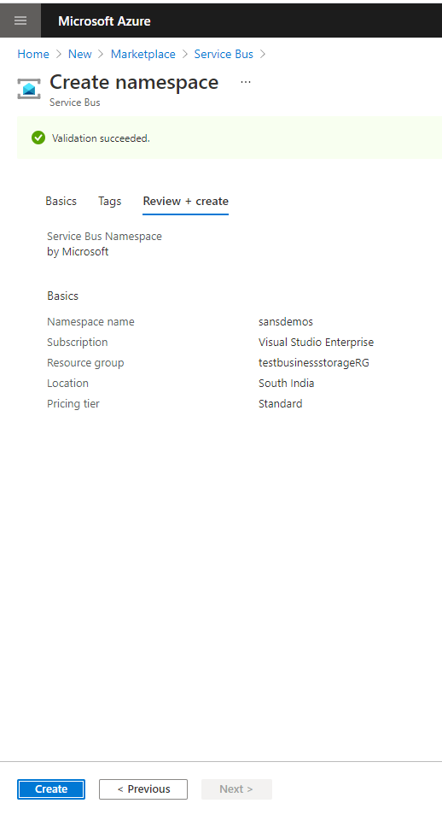
Service bus namespace

Slide 6
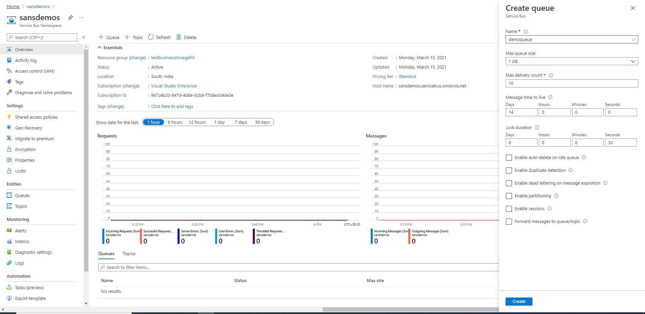
Create queue

Slide 7
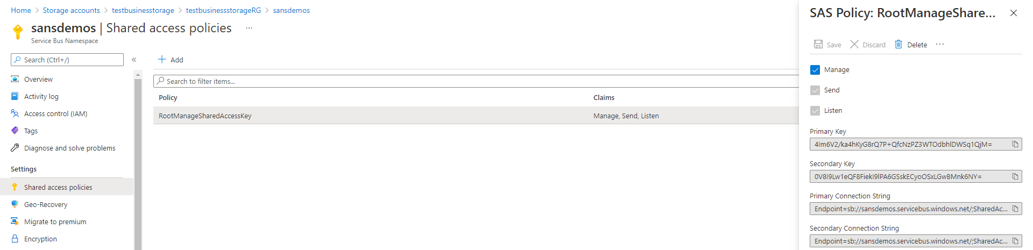
CONNECTION STRING
Copy the Primary Connection String.

Slide 8
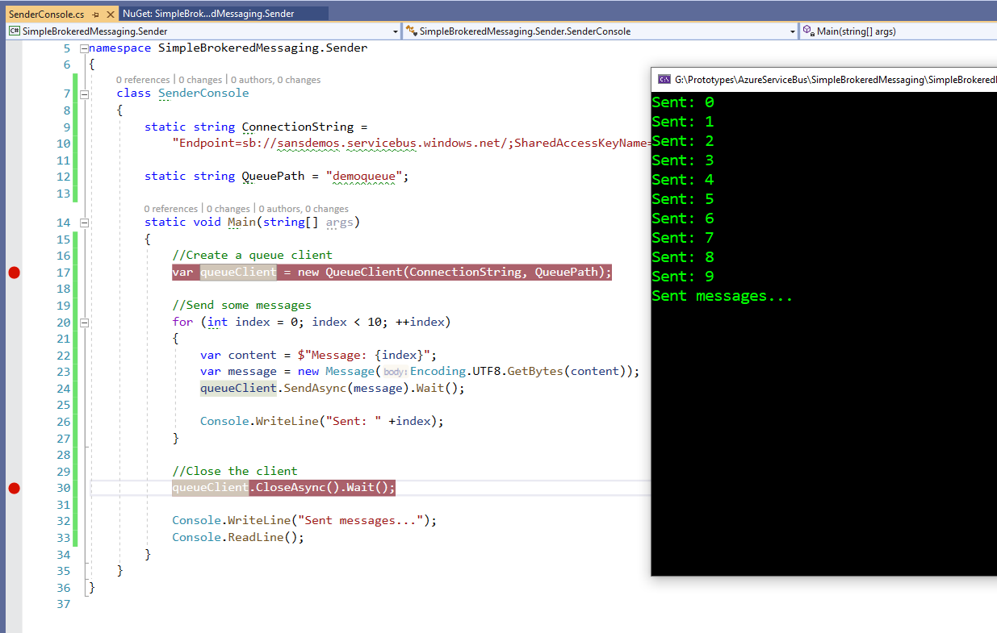
Sender Messages

Slide 9
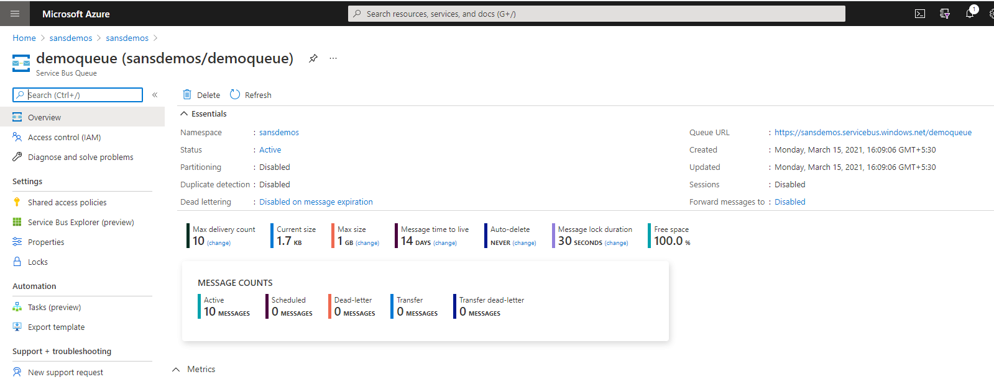
See the messages in azure

Slide 10
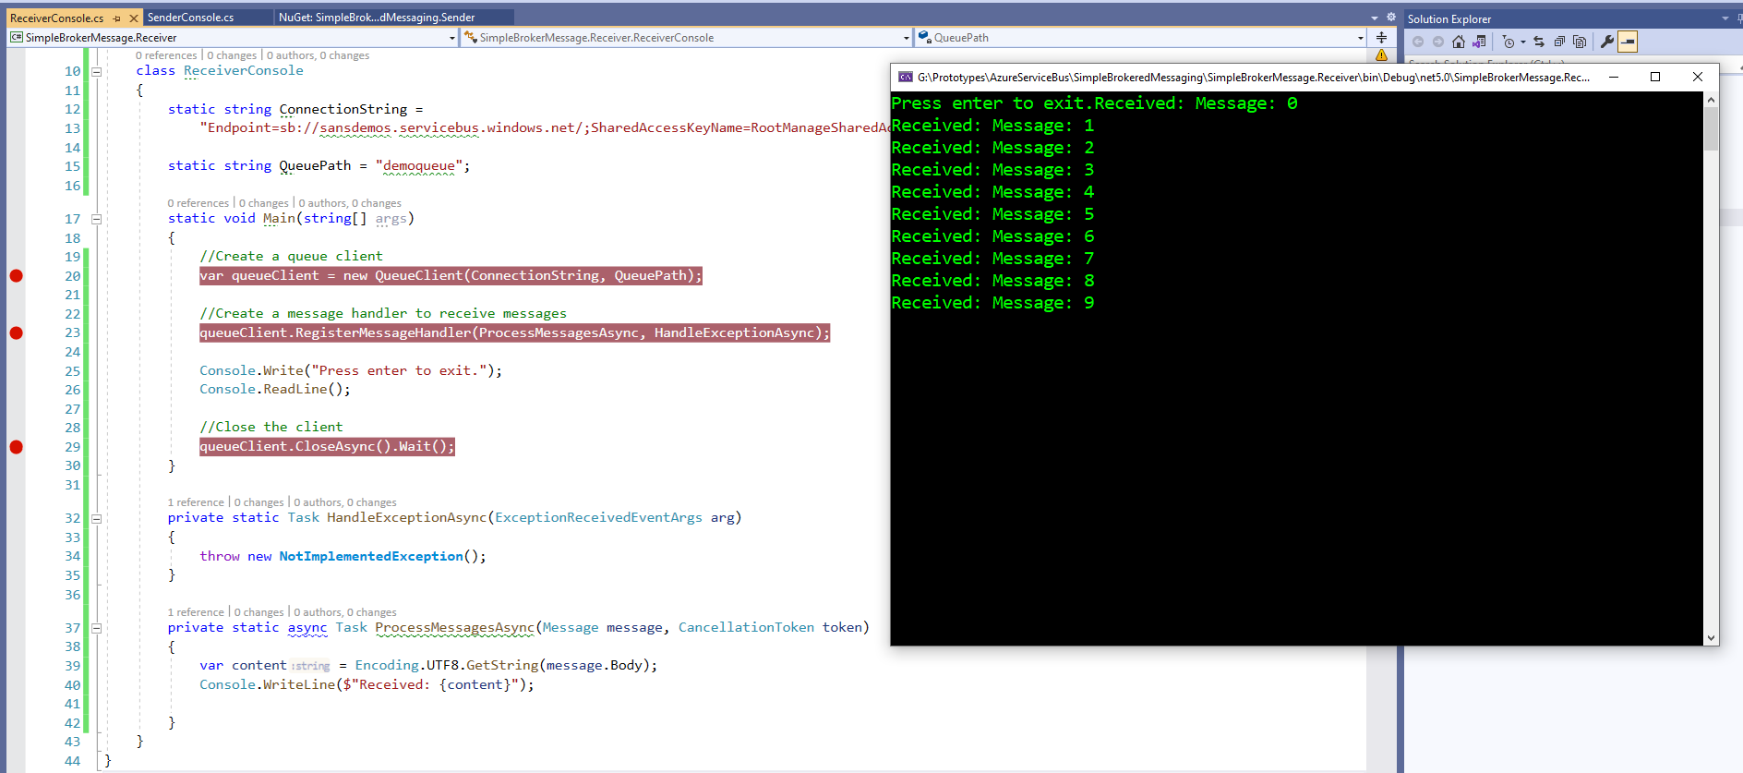
Receive the messages in queue

Slide 11
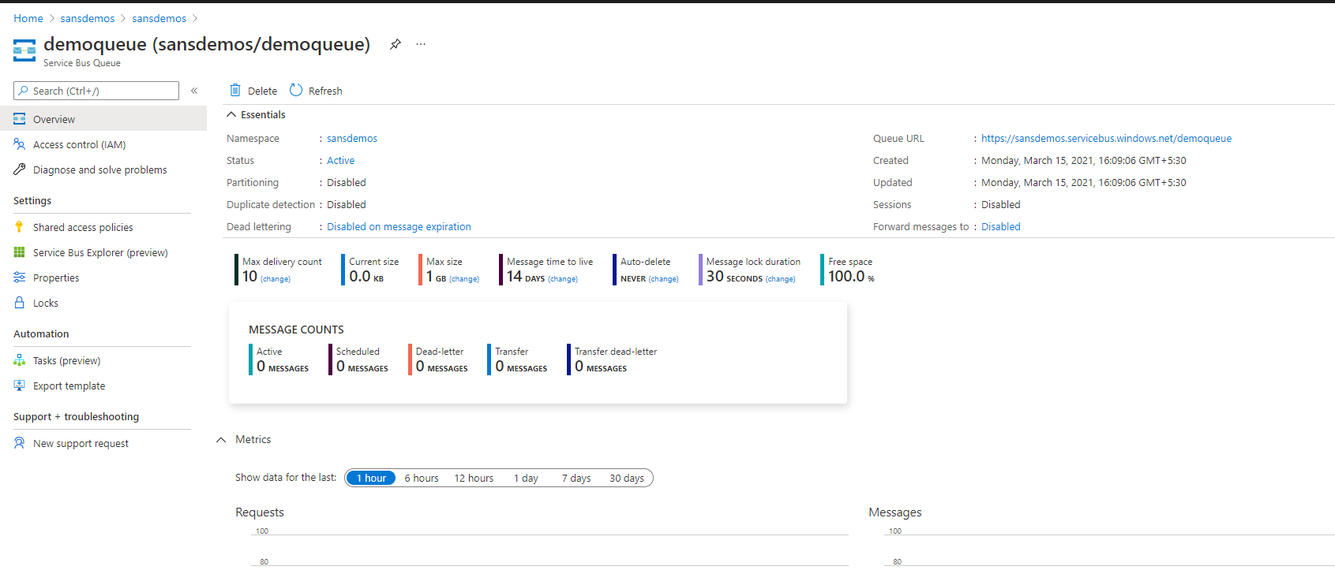
See the messages in azure

Slide 12
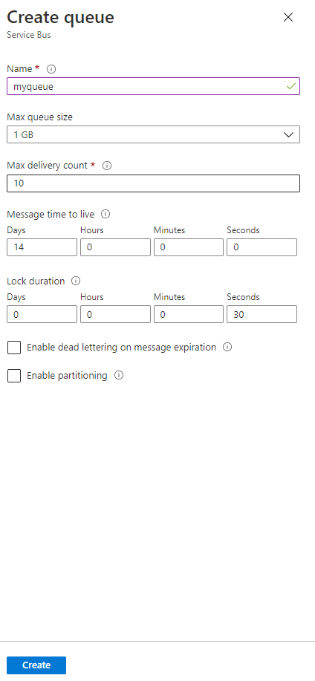
Create a QUEUE

