Slide 1

Data access patterns
Sit Dolor Amet

Slide 2
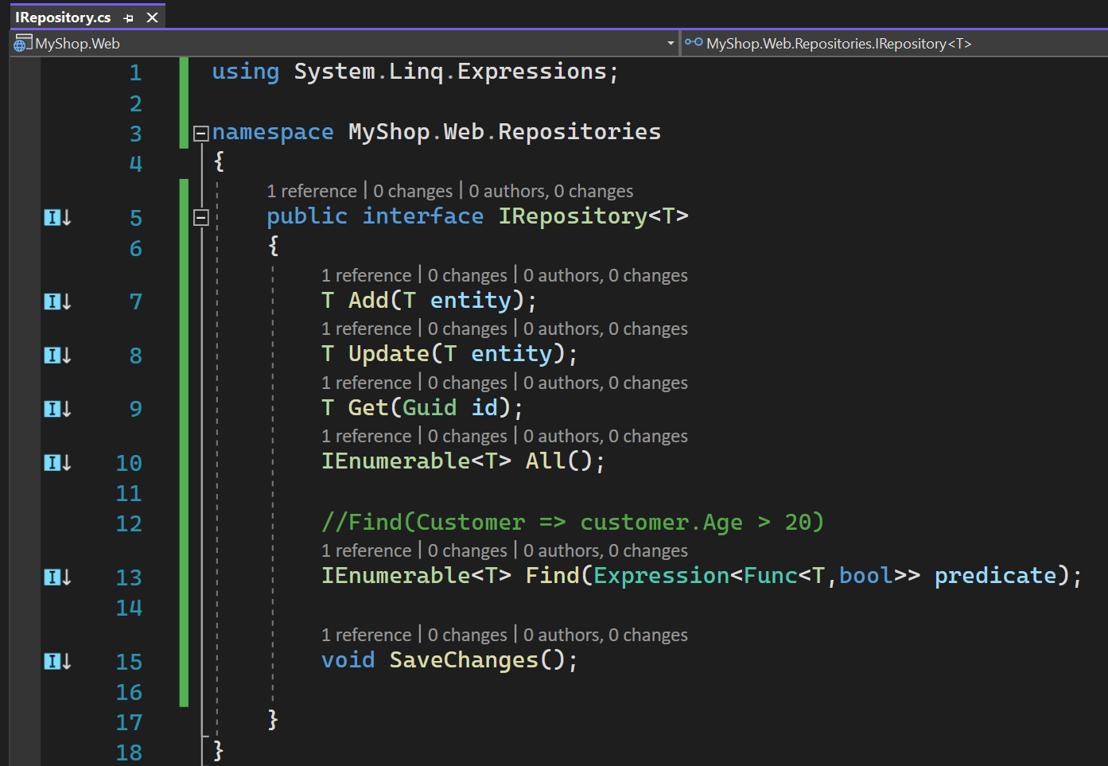
Repository pattern

