Slide 1

Entity Framework CORE 6
Sit Dolor Amet

Slide 2
First Application using EF CORE

Slide 3
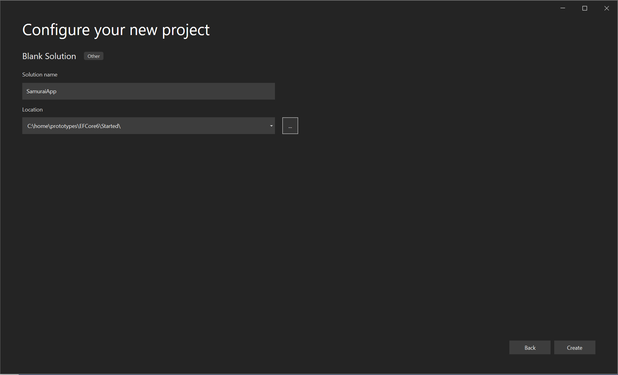
Blank solution

Slide 4
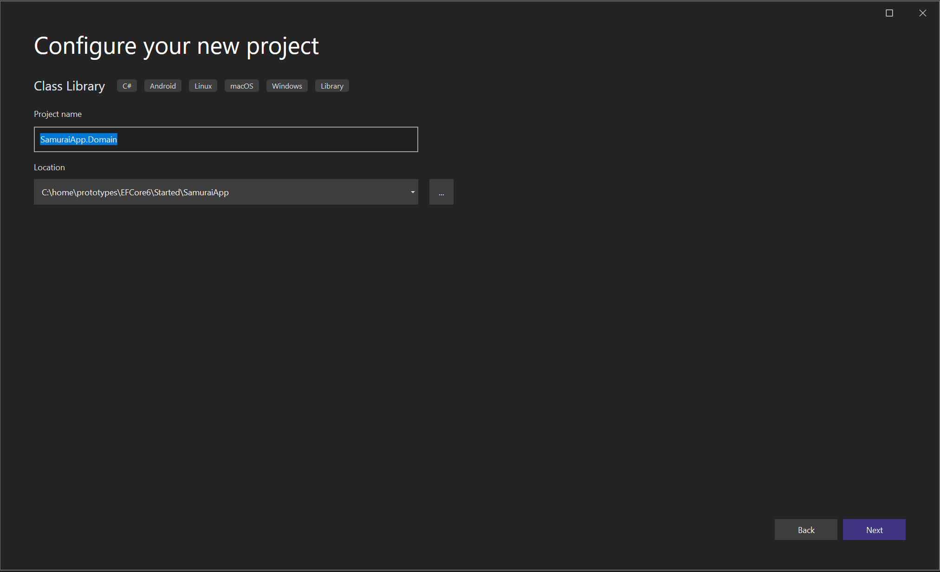
Create domain classes

Slide 5
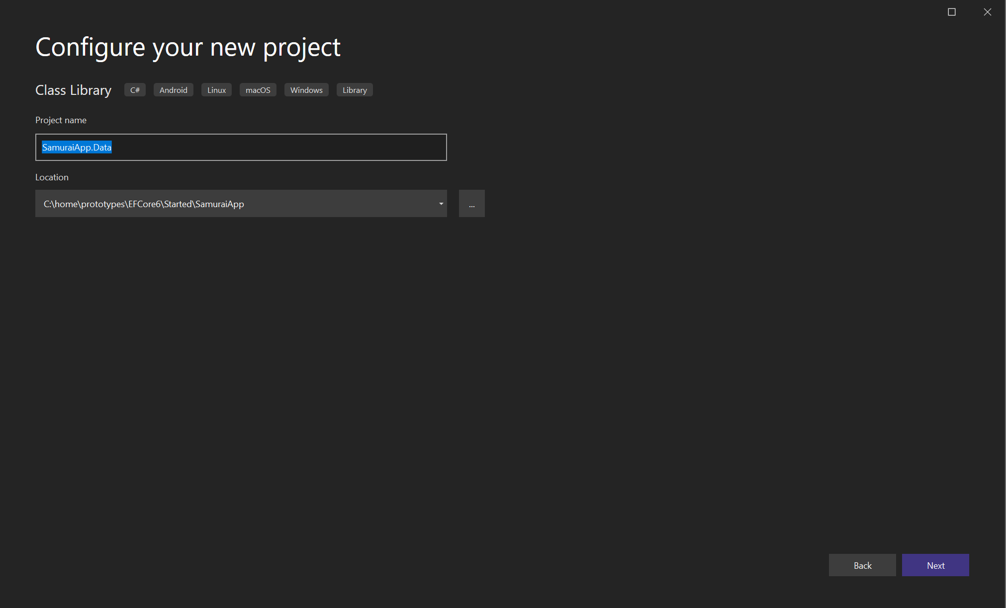
DATA

Slide 6
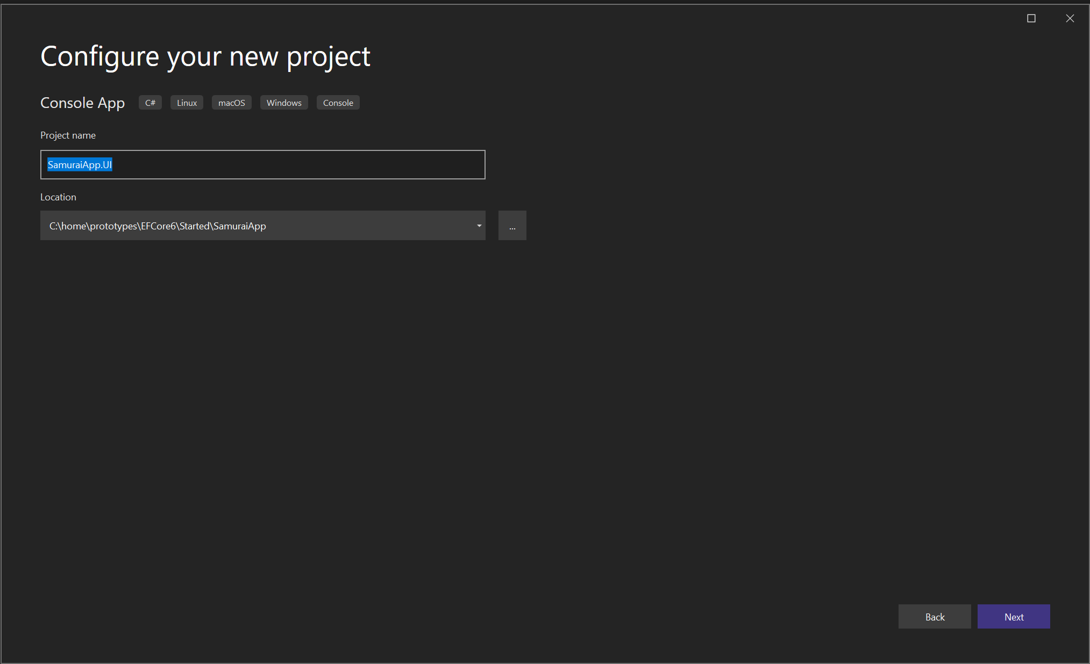
UI

Slide 7
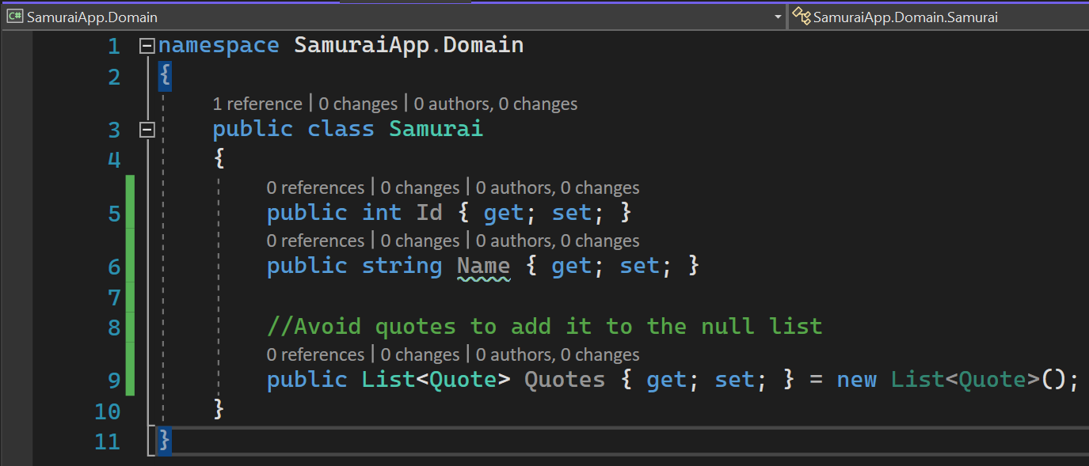
Domain class samurai

Slide 8
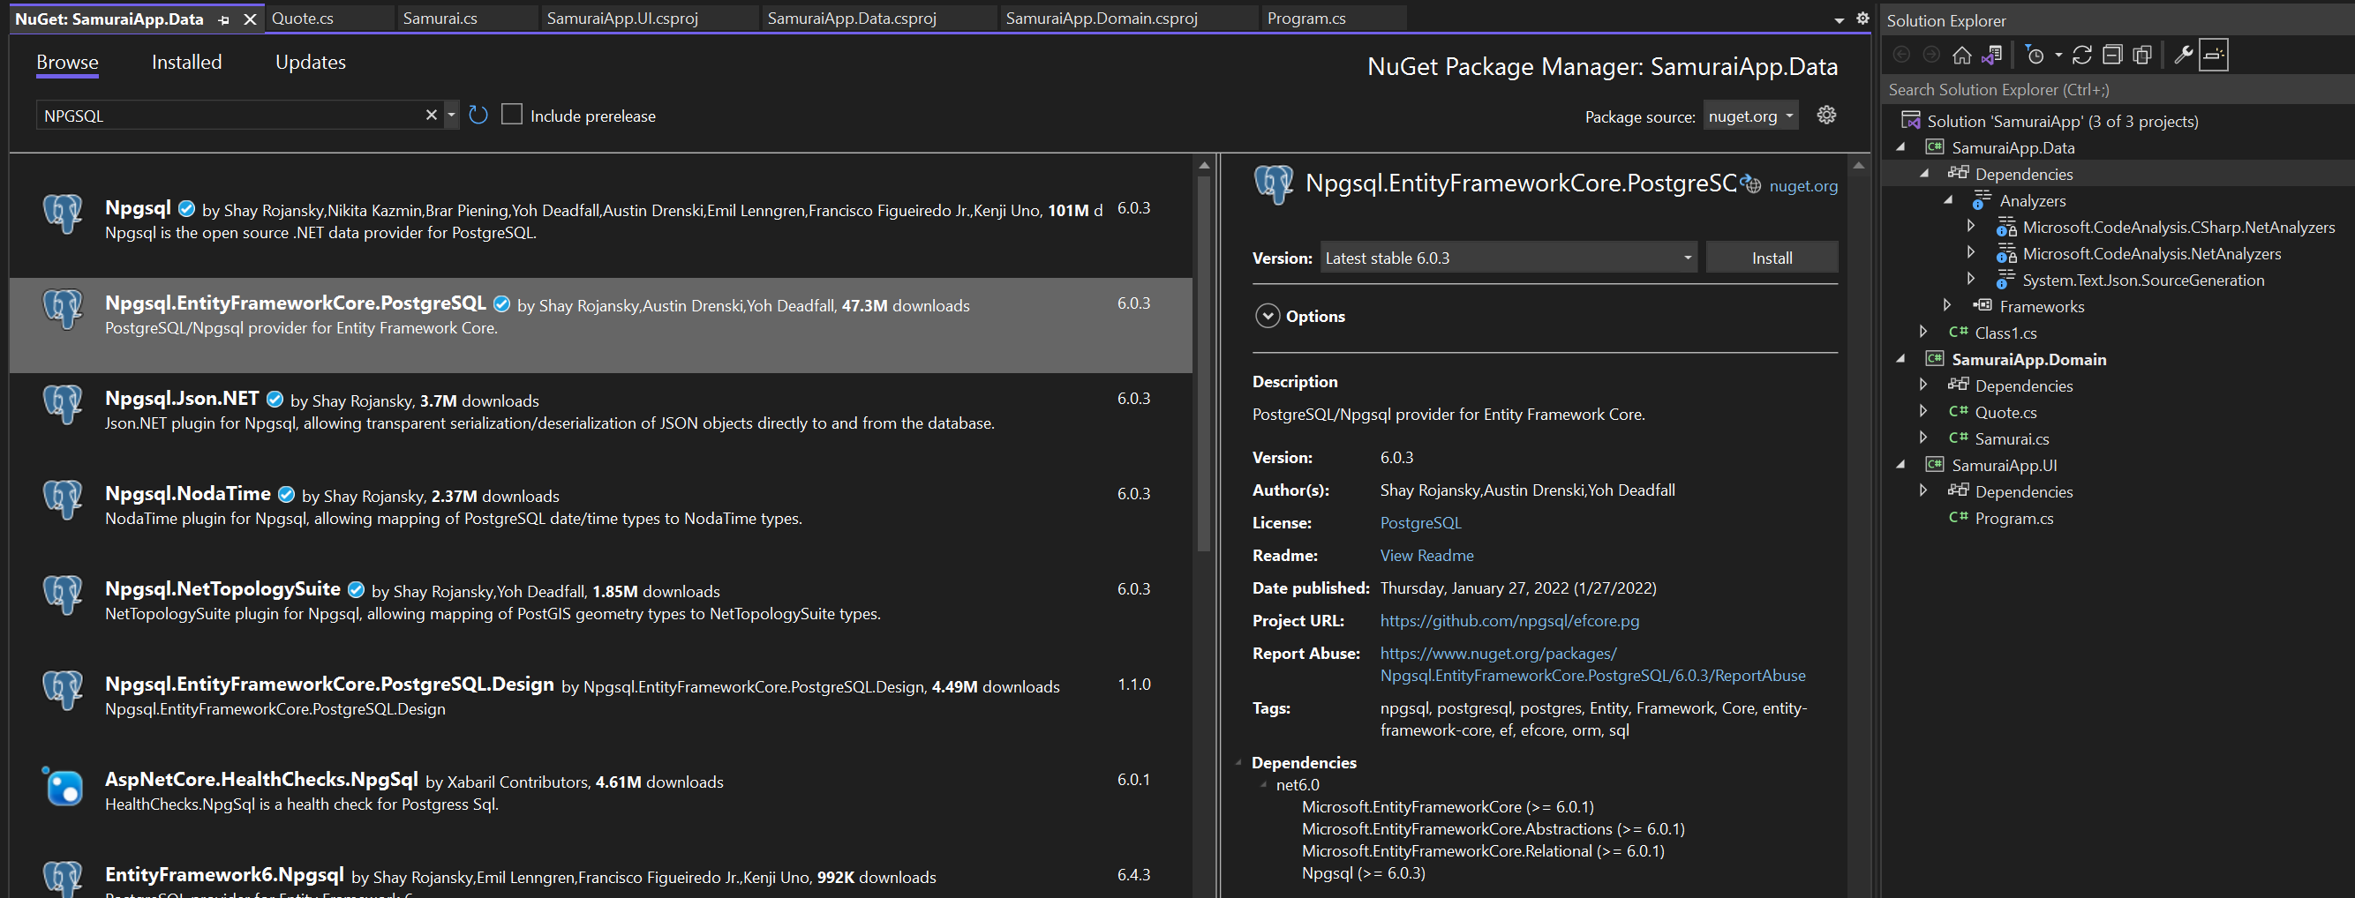
EF CORE

Slide 9
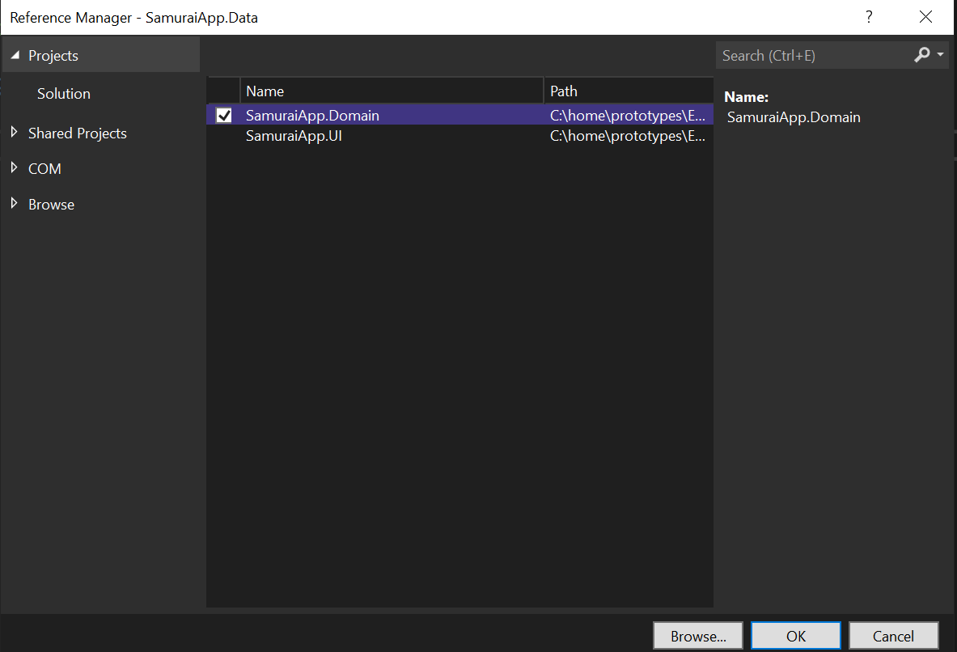
ADD PROJECT REFERENCE

Slide 10
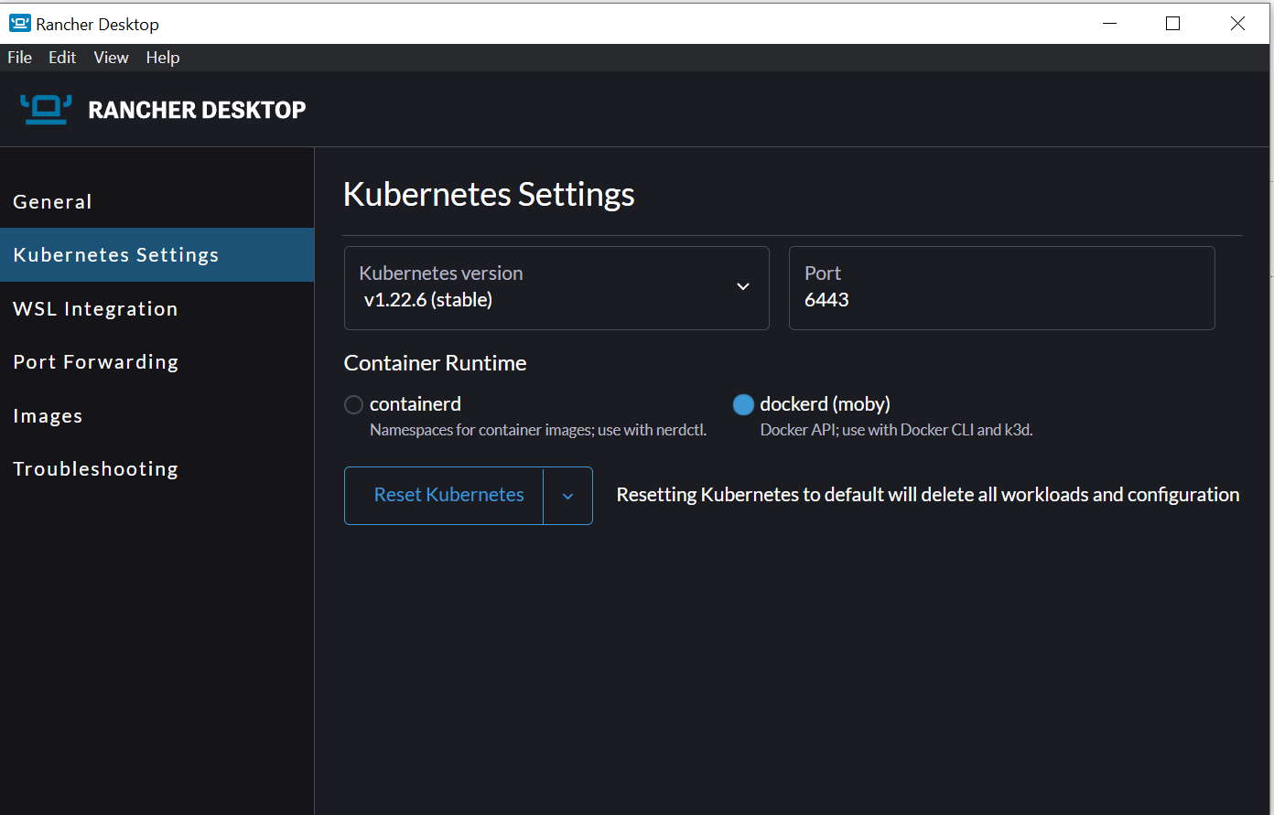
Install rancher
docker run --name postgres_proto -e POSTGRES_PASSWORD=sandeep -p 5435:5432 -d postgres

Slide 11
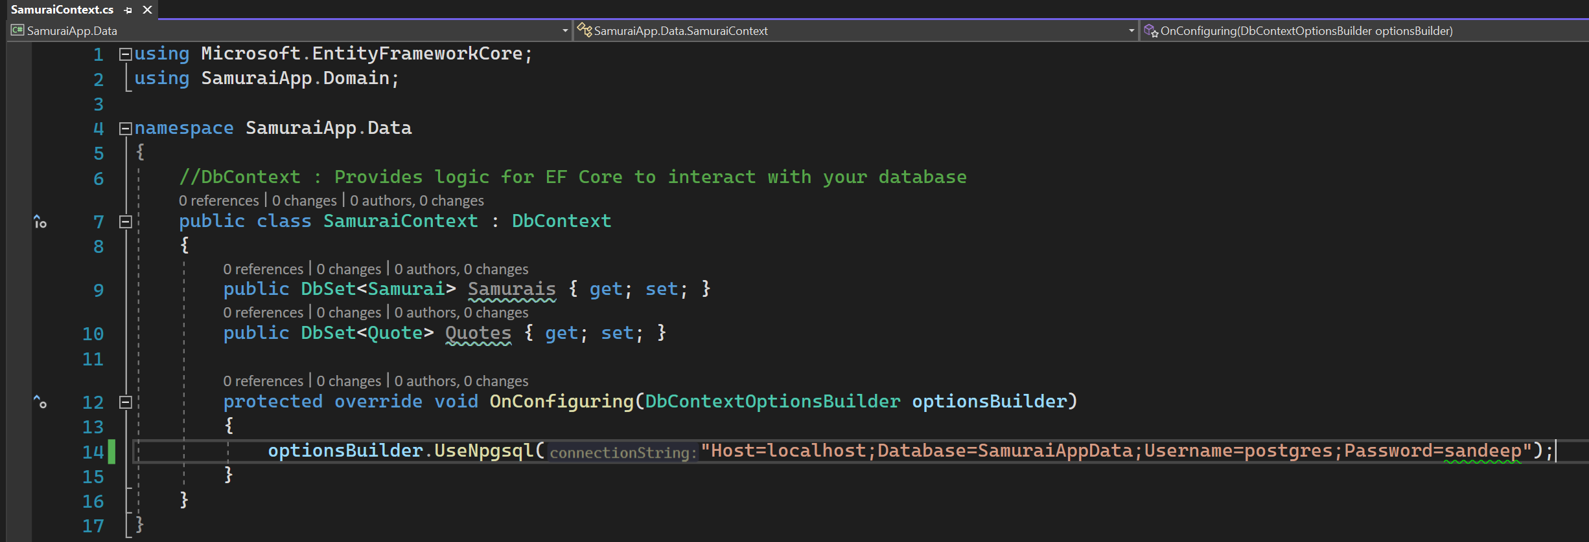
Samurai context

Slide 12
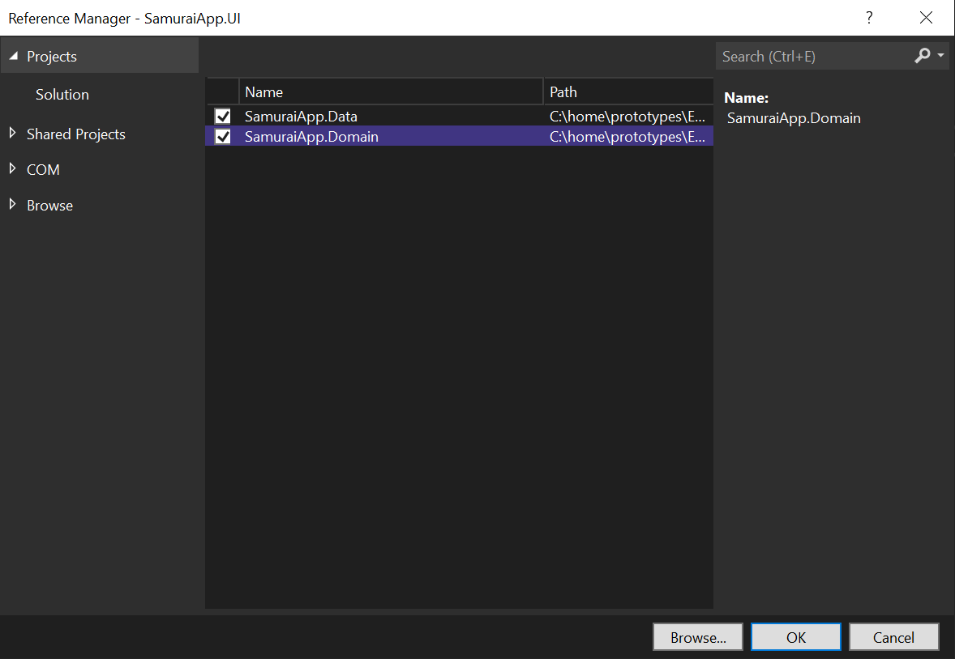
Adding context

Slide 13
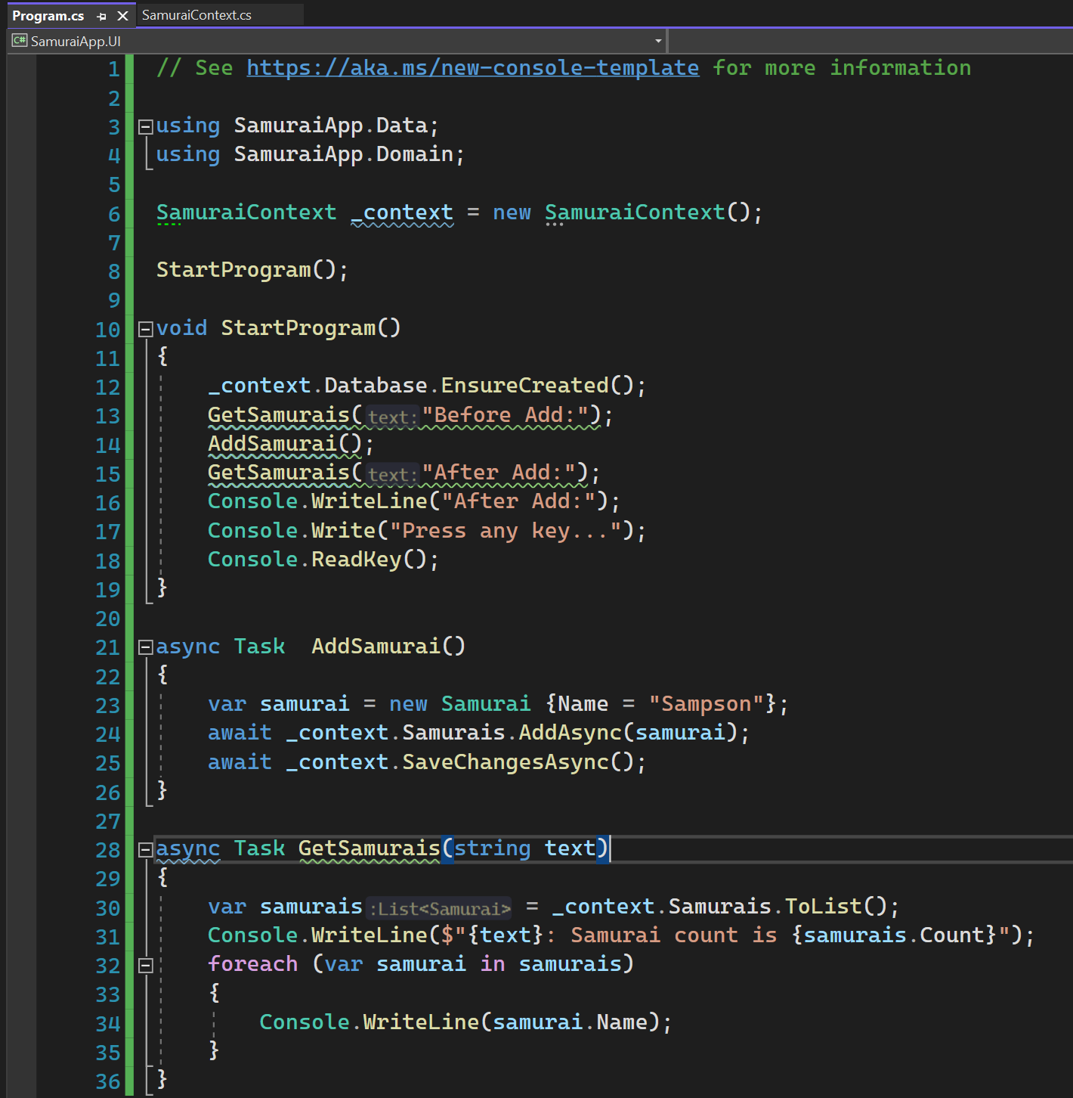
SAMURAI UI

Slide 14
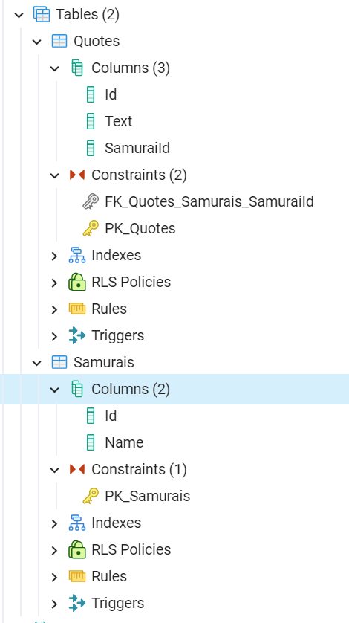
Constraints

Slide 15
ExTRAS

Slide 16
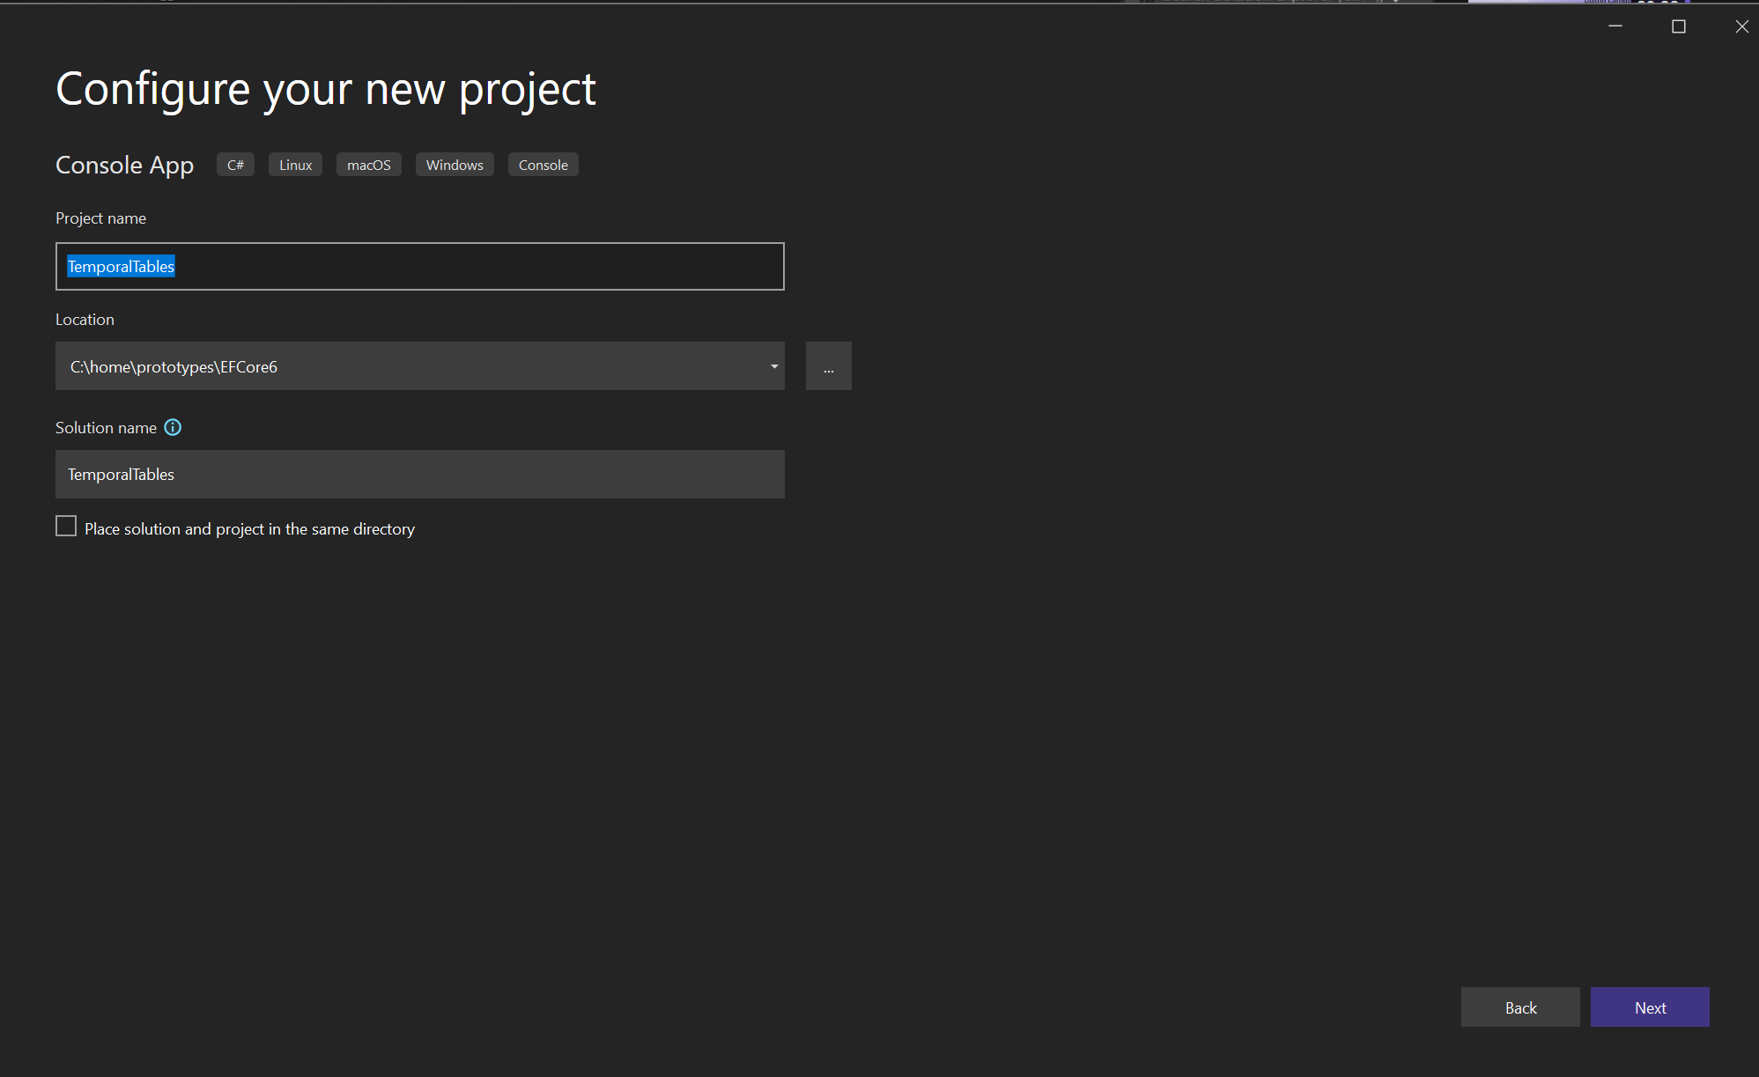
Temporal tables

Slide 17
dotnet

Slide 18
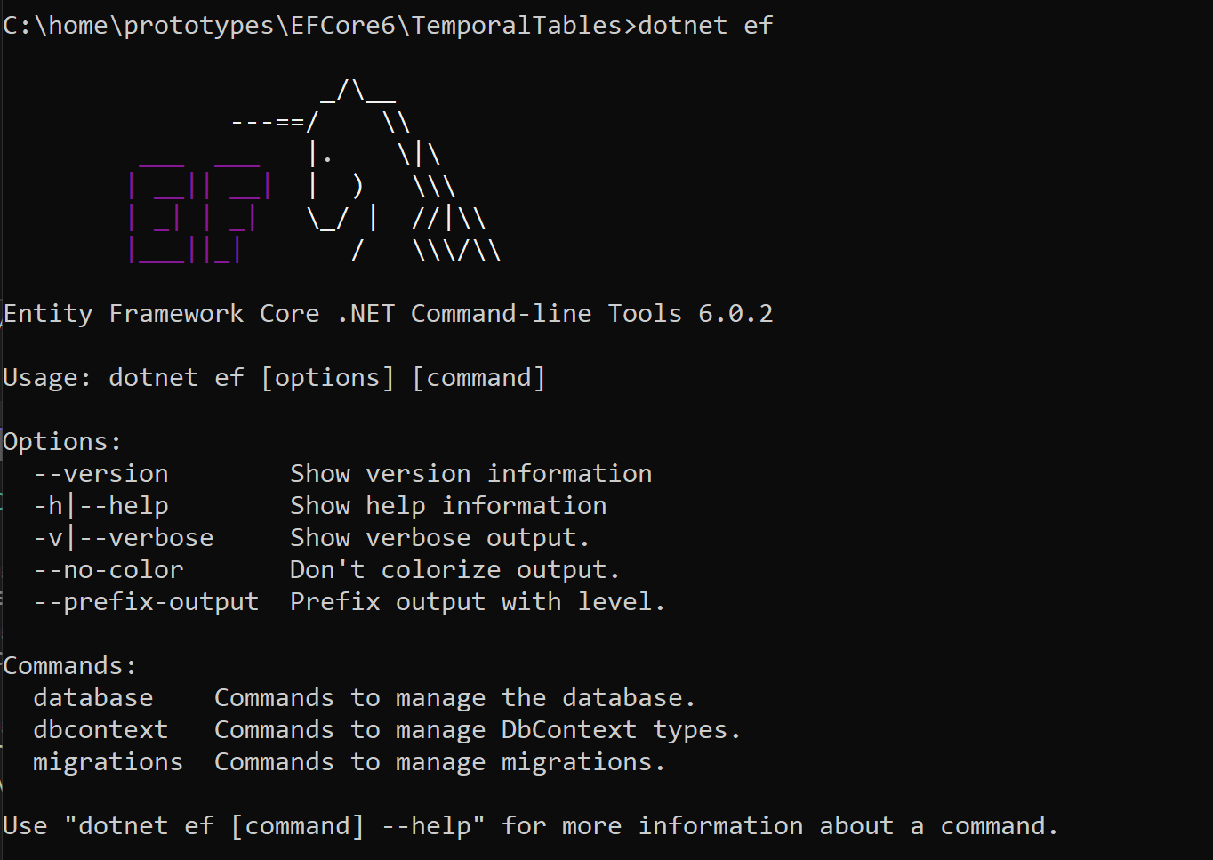
Dotnet tool

Slide 19
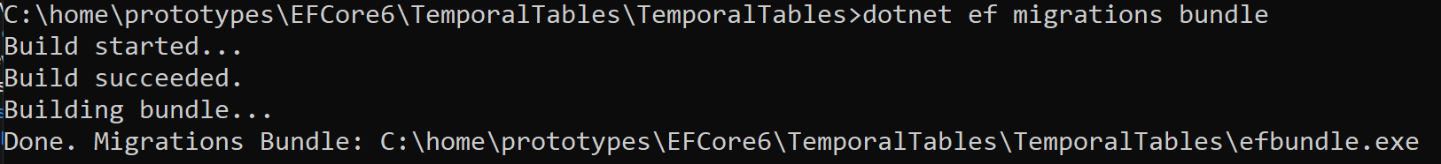
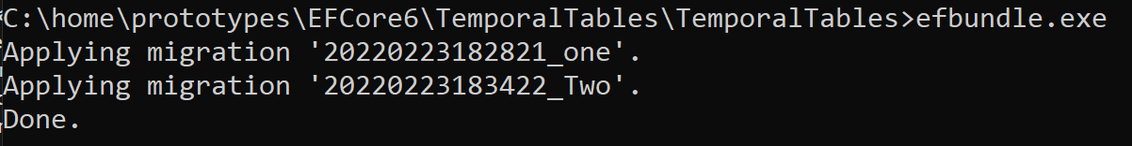
Migration bundle

