Slide 1

MANAGING KEY SYSTEMS WITH PROMETHEUS EXPORTERS
Sit Dolor Amet

Slide 2
Prometheus exporter
Prometheus exporters extend existing systems that are already gathering metrics and translate those metrics into a format
that Prometheus can understand.
For example :
To monitor a Linux system, need to install the Node exporter to gather a wide variety of CPU, RAM, disk, and network metrics.
For a PostgreSQL database, need to use the PostgreSQL exporter.
RabbitMQ have a Prometheus exporter built in,
Prometheus exporters:
https://prometheus.io/docs/instrumenting/exporters/
Some exporters are official, meaning they are maintained as part of the official Prometheus GitHub organization, while
others are maintained by external contributors.
Exporters are listed by category. For example, Databases, Hardware related, Issue trackers, Messaging systems, Storage,
HTTP, APIs, Logging, and Other monitoring systems.

Slide 3
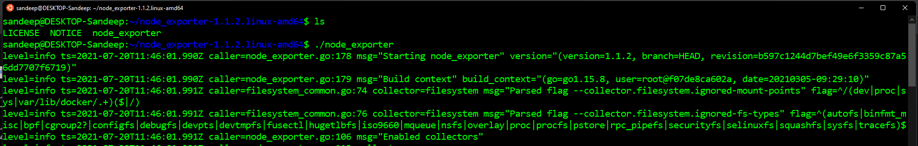
NODE EXPORTER – 1/4
The Node Exporter gathers system metrics for Linux‑based systems using native utilities, then exposes those metrics in a
format that Prometheus instance can pull and record. This is useful for overall machine health and performance, such as
CPU, memory, disk, and network activity.

Slide 4
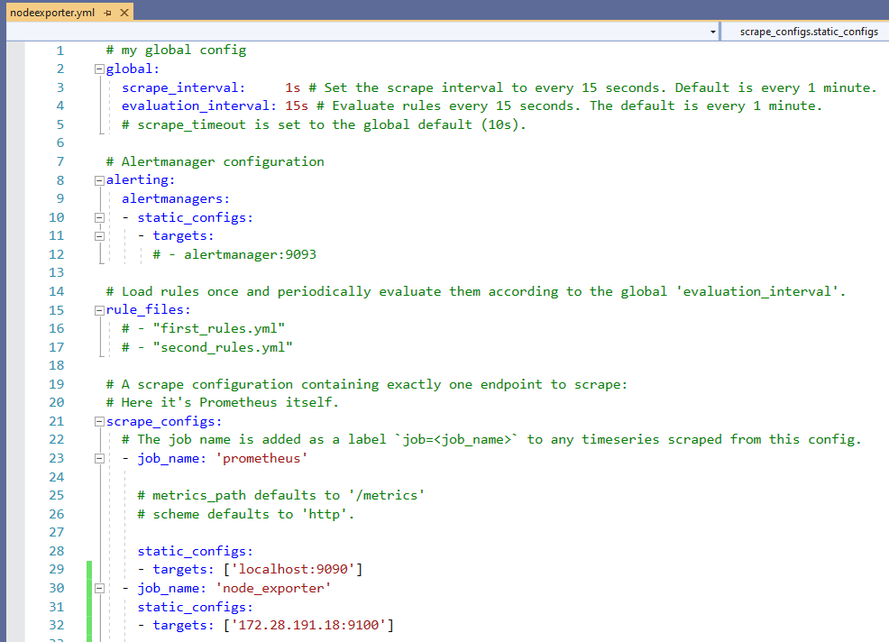
Node EXPORTER – 2/4

Slide 5
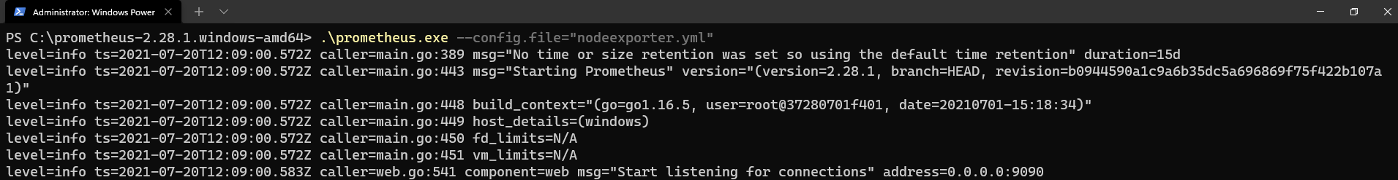
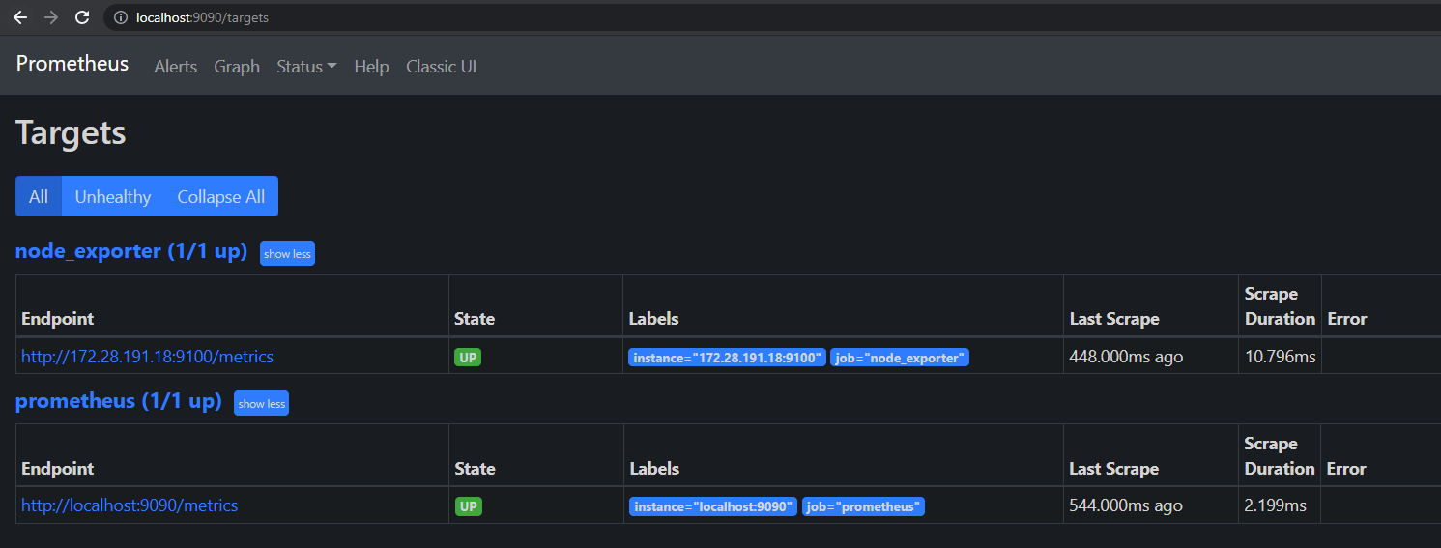
Node EXPORTER – 3/4

Slide 6
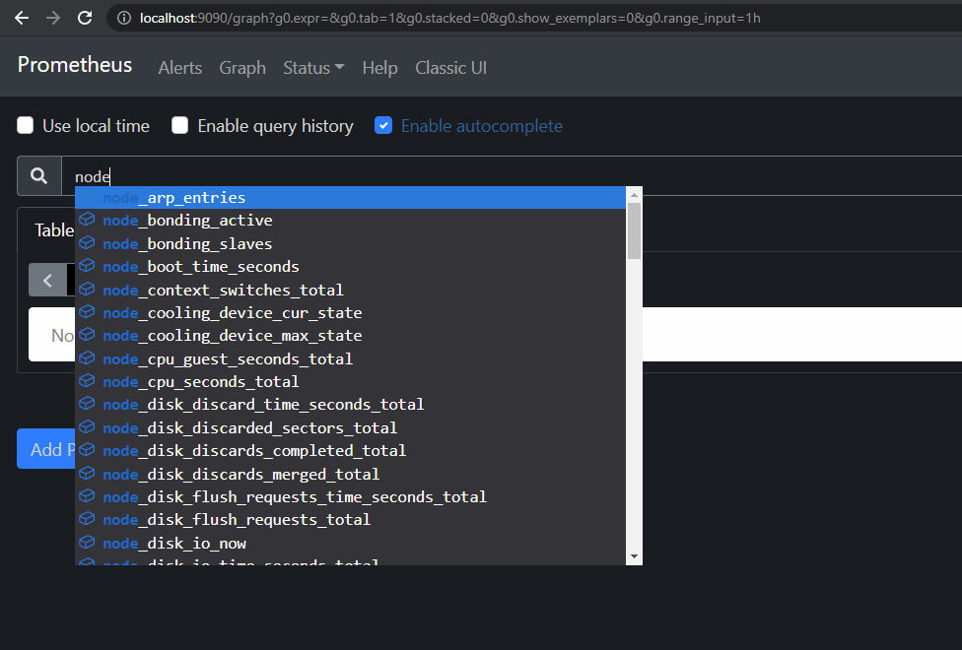
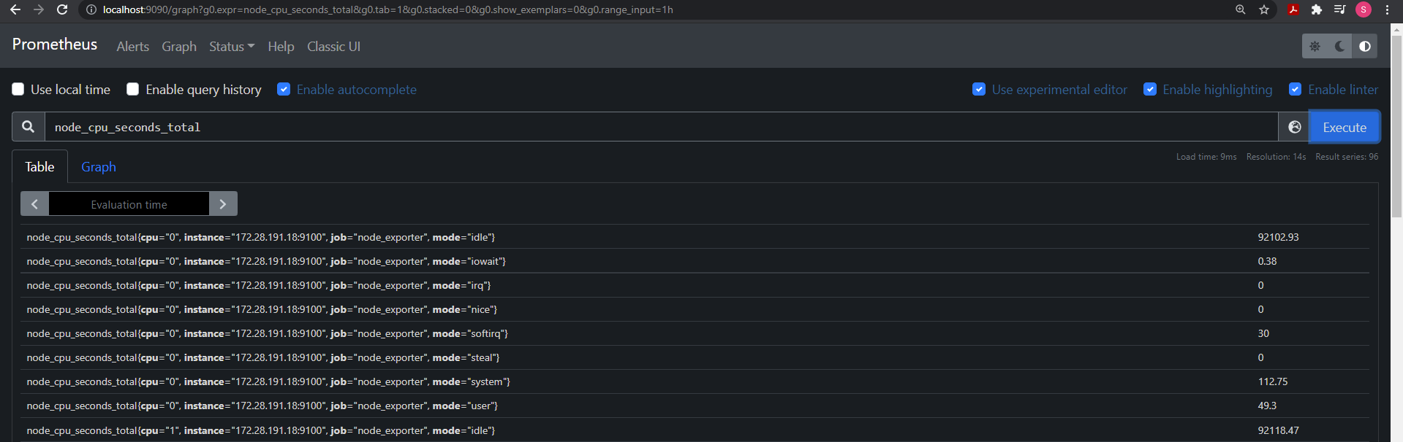
Node EXPORTER – 4/4
Anything that starts with node is node exporter.

Slide 7
MONITORING DATABASE
Database‑specific metrics measured by the database engine are key to getting a view into database performance.
Prometheus has various database exporters to help gather database metrics and make them available in Prometheus.
Prometheus exporters:
https://prometheus.io/docs/instrumenting/exporters/#databases
Some third-party software exposes metrics in the Prometheus format, so no separate exporters are needed:
Apache Jena Fuseki

Slide 8
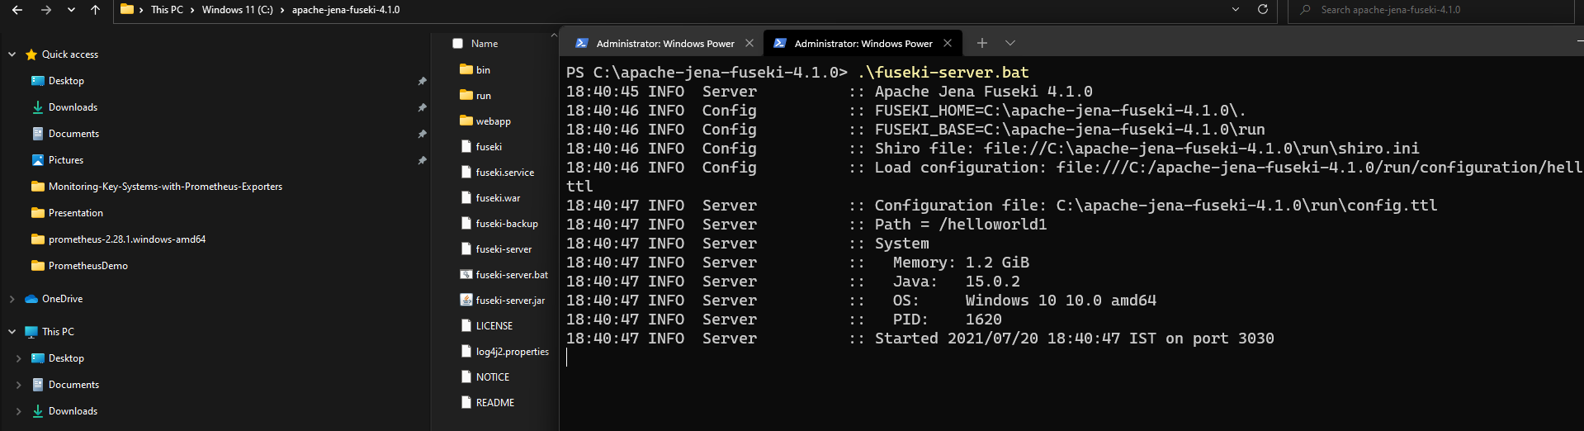
RUN Apache jena FUSEKI

Slide 9
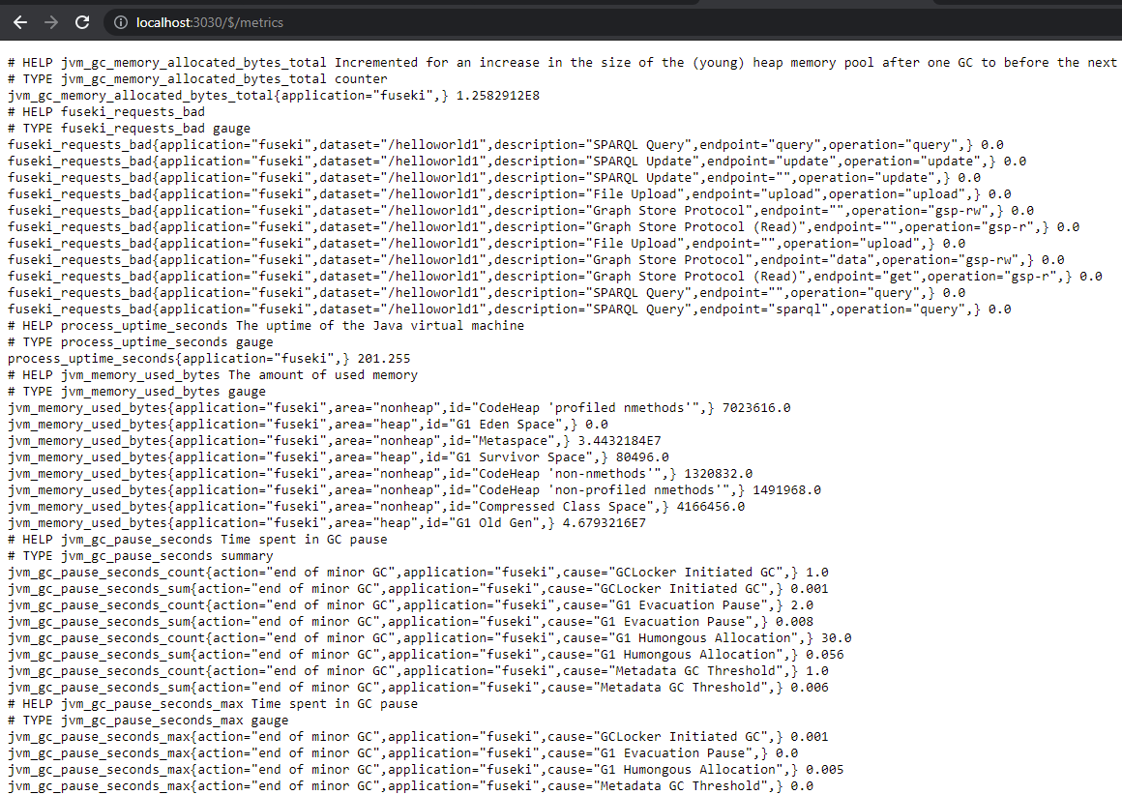
Apache jena FUSEKI Metrics endpoint
http://localhost:3030/$/metrics
Check for Apache
Jena Fuseki metrics
in the PDF.

Slide 10
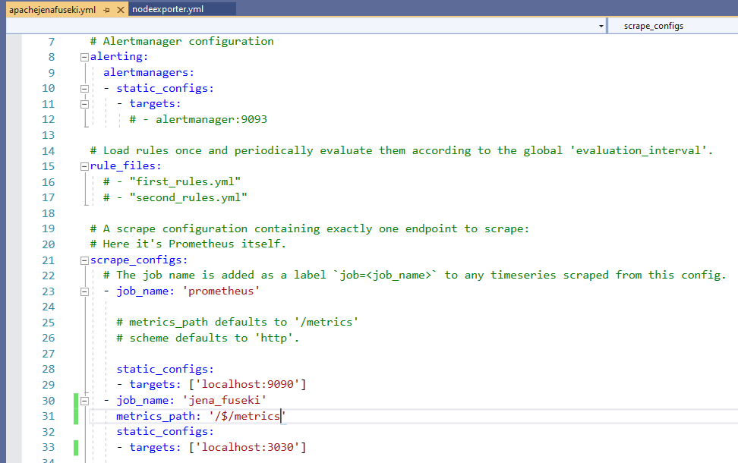
APACHE JENA FUSEKI – Prometheus FILE

Slide 11
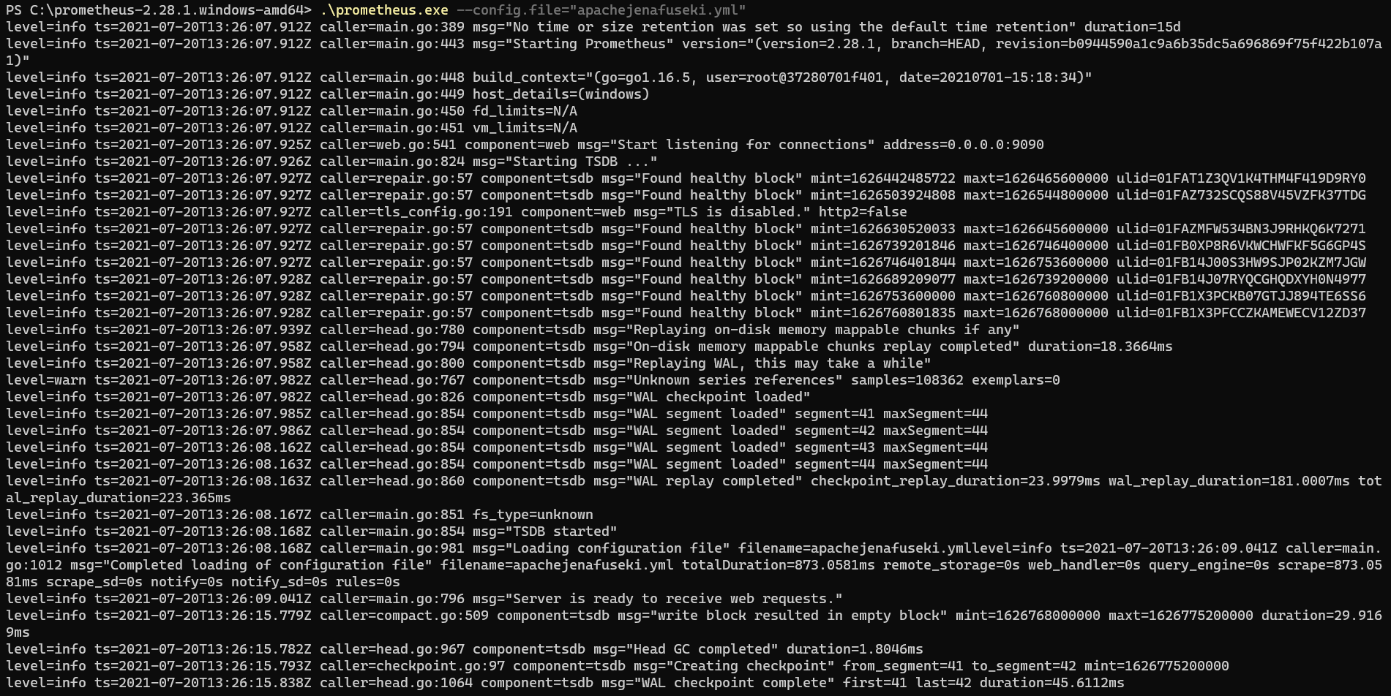
APACHE JENA FUSEKI –Load Prometheus FILE

Slide 12
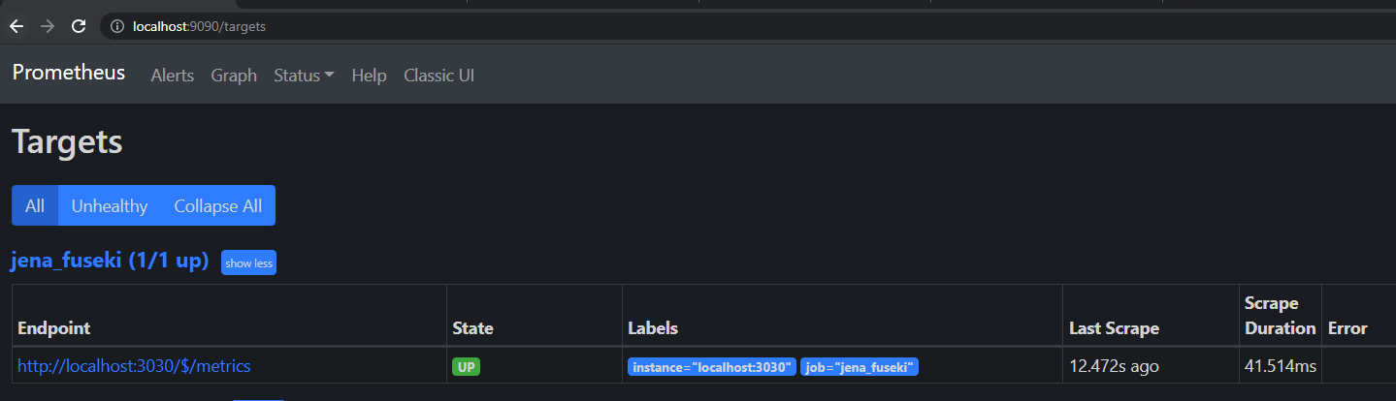
Prometheus targeting apache jena fuseki

Slide 13
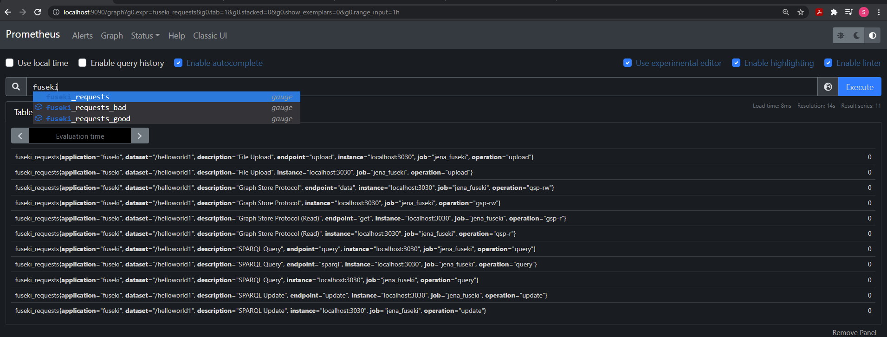
FUSEKI Queries IN Prometheus

Slide 14
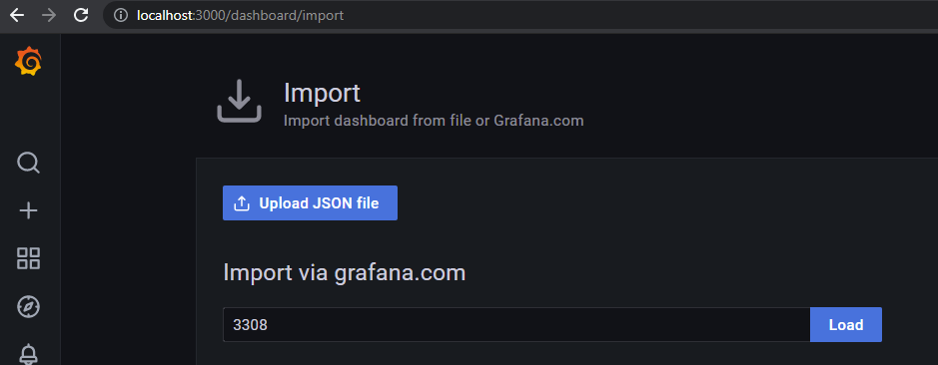
GRAFANA DASHBOARD for jena fuseki (partial) – 1/2
https://grafana.com/grafana/dashboards/3308

Slide 15
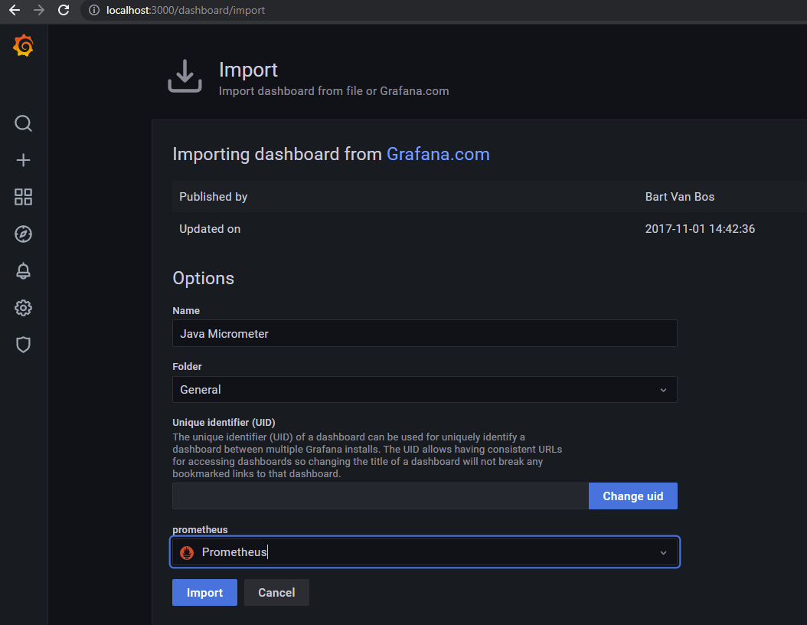
GRAFANA DASHBOARD for jena fuseki (partial)

Slide 16
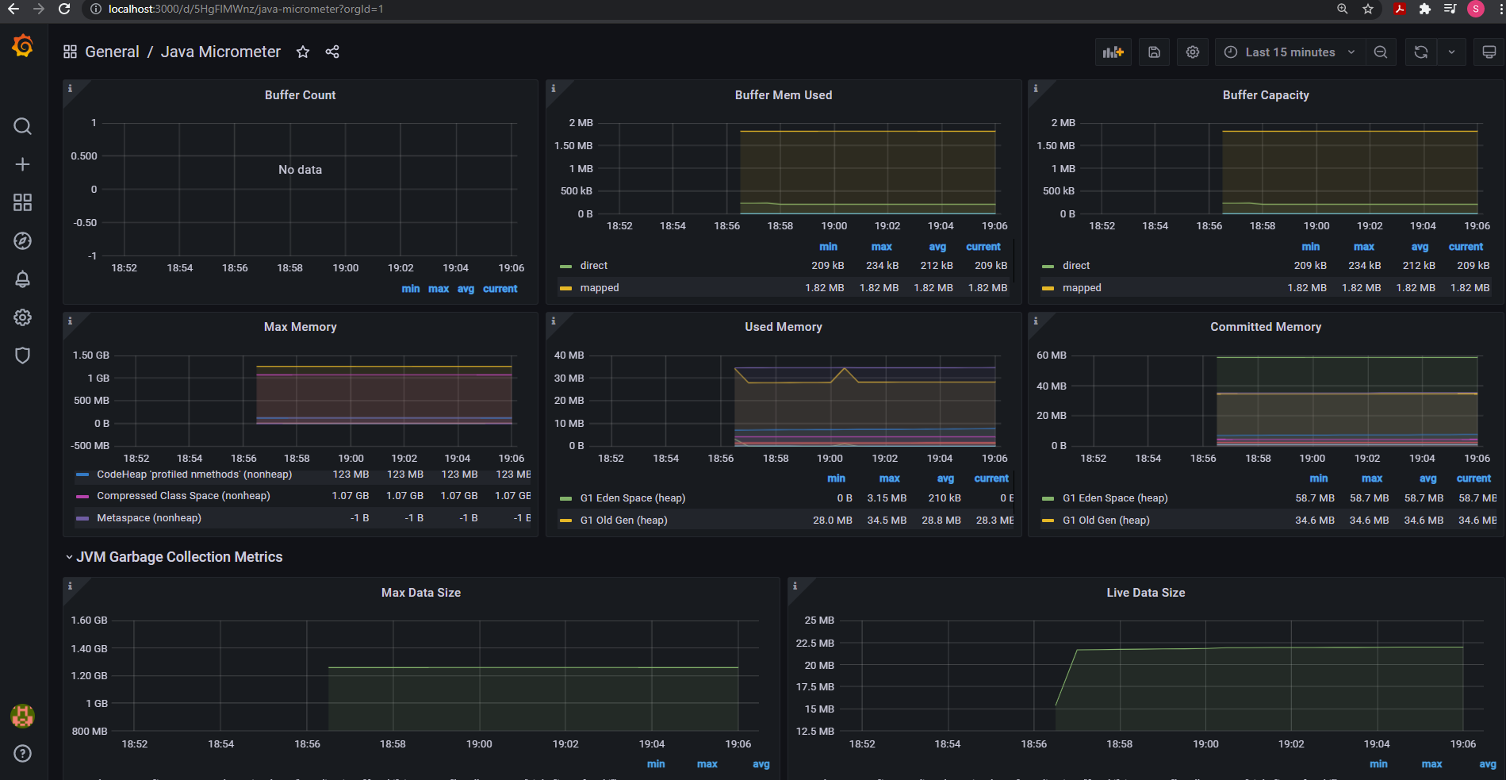
GRAFANA DASHBOARD for jena fuseki (partial)

Slide 17
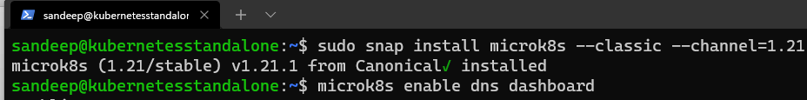
RabbitMQ Operator - 1
Install Kubernetes
Also set https://microk8s.io/docs/working-with-kubectl
Set a storage class
Install krew : https://krew.sigs.k8s.io/docs/user-guide/setup/install/#bash

Slide 18
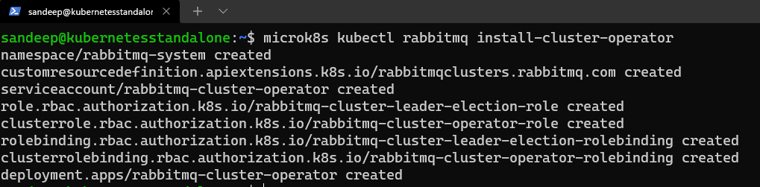
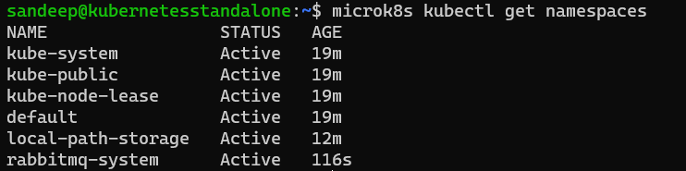
RabbitMQ Operator - 2

Slide 19
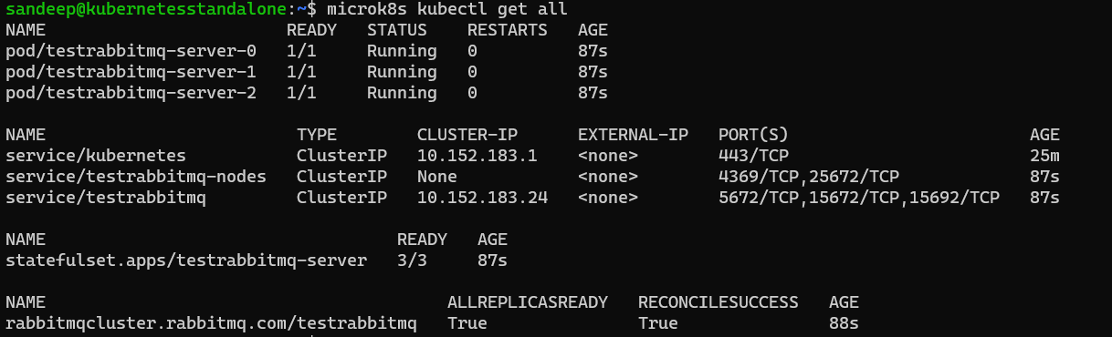
Create rabbitmq INSTANCE with three replicas

Slide 20
Monitoring network end points
Sometimes a server might be up internally, but not available externally where users access it. Having an external monitor to
check the service help determine real availability.
The Prometheus Blackbox Exporter allows to probe different endpoints, including HTTP, HTTPS, TCP, DNS, and ICMP.
Can determine following things :
Service is up or down.
Service availability.
Measure HTTP latency.
DNS lookup latency.
Monitor SSL certificate expiration.
The Blackbox Exporter is a standalone tool. Simply checking the availability of that service from the outside world.
Can monitor multiple endpoints with a single Blackbox Exporter since Prometheus will send the instructions as part of a
request to the exporter.

Slide 21
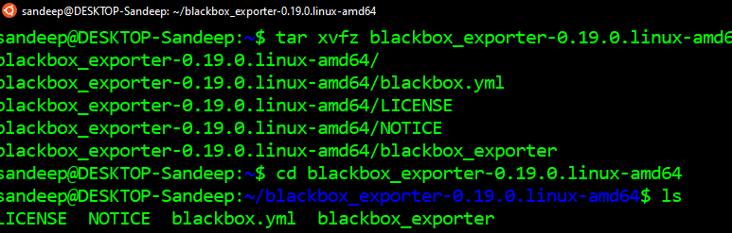
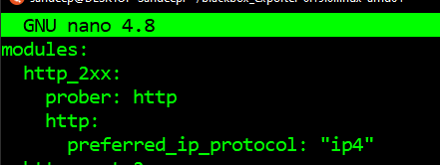
INSTALLATION
https://prometheus.io/download/#blackbox_exporter
https://github.com/prometheus/blackbox_exporter/blob/master/CONFIGURATION.md

Slide 22
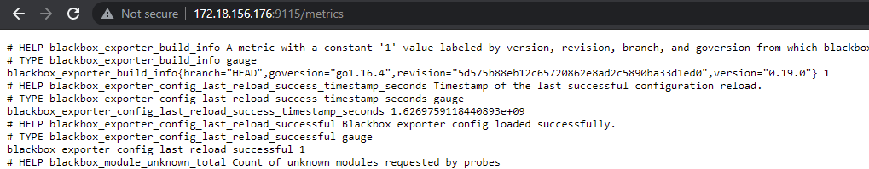
RUNNNING

Slide 23
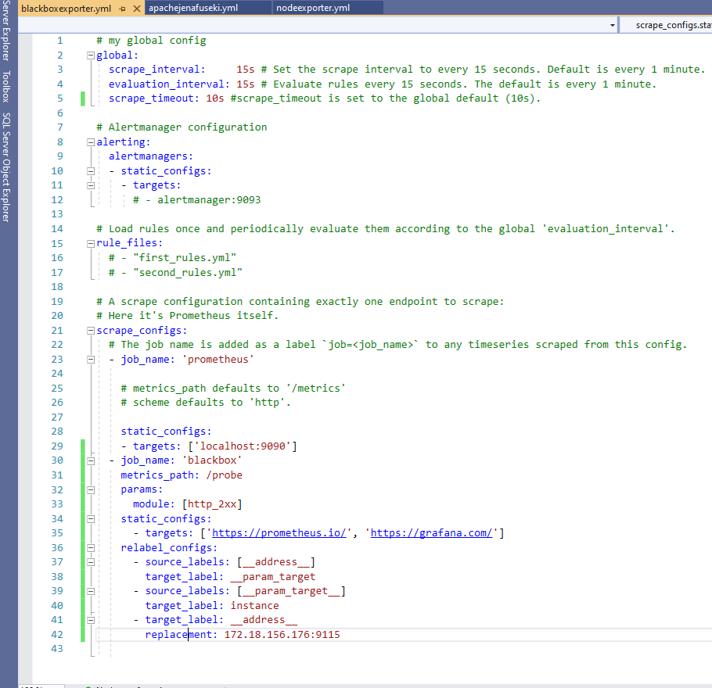
POMETHEUS CONFIGURATION

Slide 24
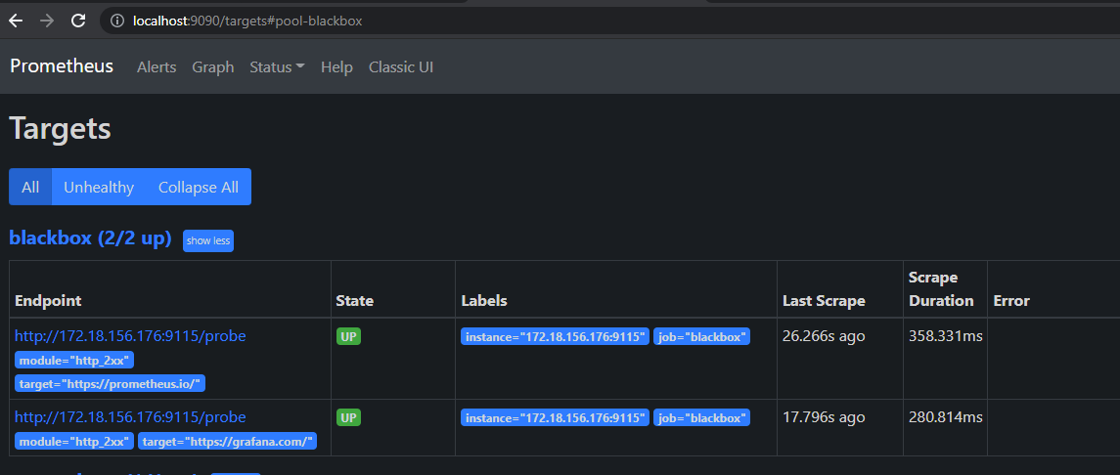
Observe Prometheus tARGETS

Slide 25
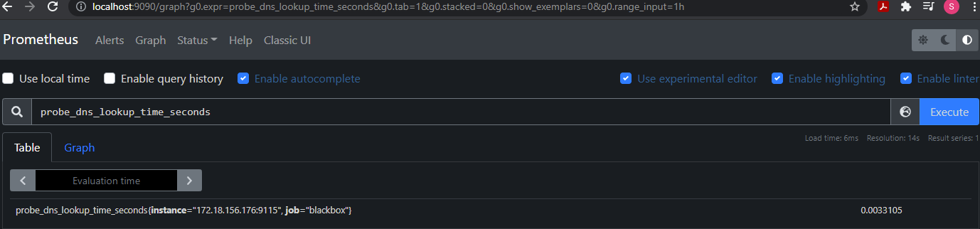
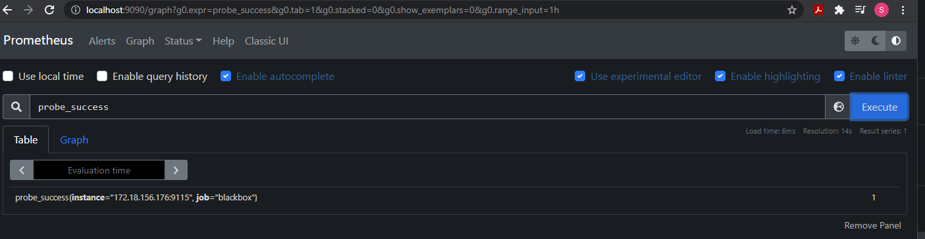
Starts with PROBE

