Slide 1

Performance profiling
Sit Dolor Amet

Slide 2
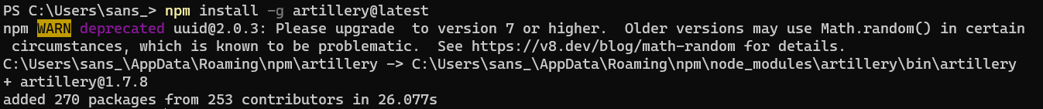
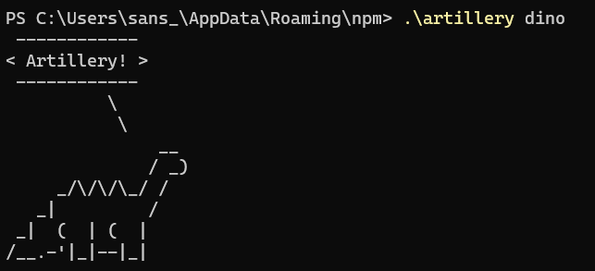
ARTILLERY - 1
Notes:
https://artillery.io/docs/guides/getting-started/installing-artillery.html
npm install -g artillery@latest
Set-ExecutionPolicy RemoteSigned
.\artillery quick -c 15 -n 100 -k https://localhost:5001/big-json-content-1

Slide 3
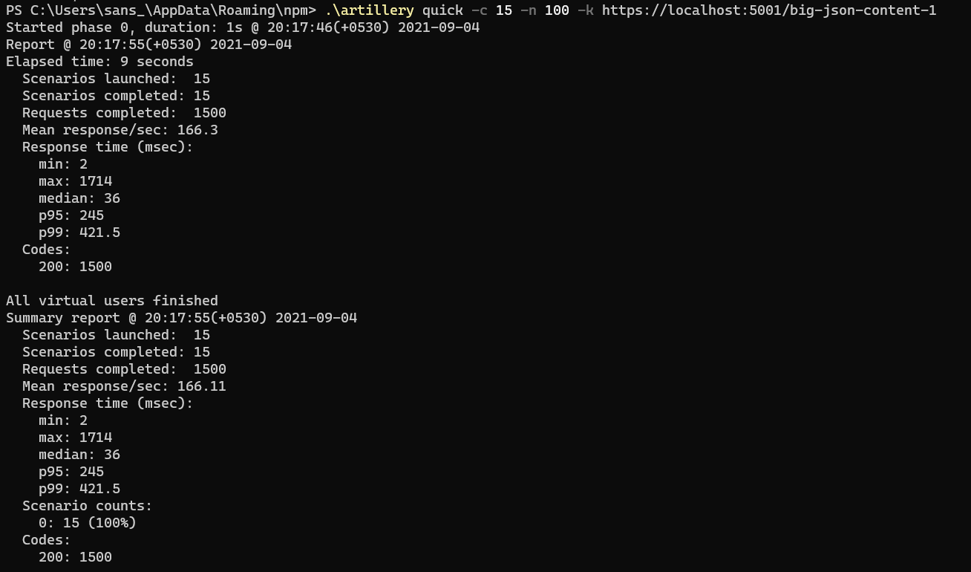
ARTILLERY - 2
Notes:
.\artillery quick -c 15 -n 100 -k https://localhost:5001/big-json-content-1
.\artillery quick -c 15 -n 100 -k https://localhost:5001/httpclient-1

Slide 4
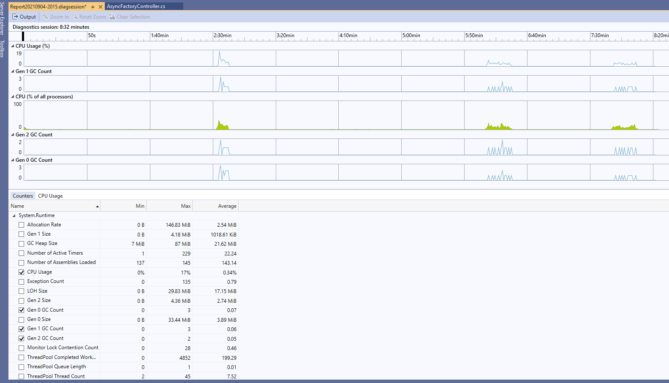
GEN COUNT – Profiling .NET counters

