Slide 1

Knowledge modelling
Sit Dolor Amet

Slide 2
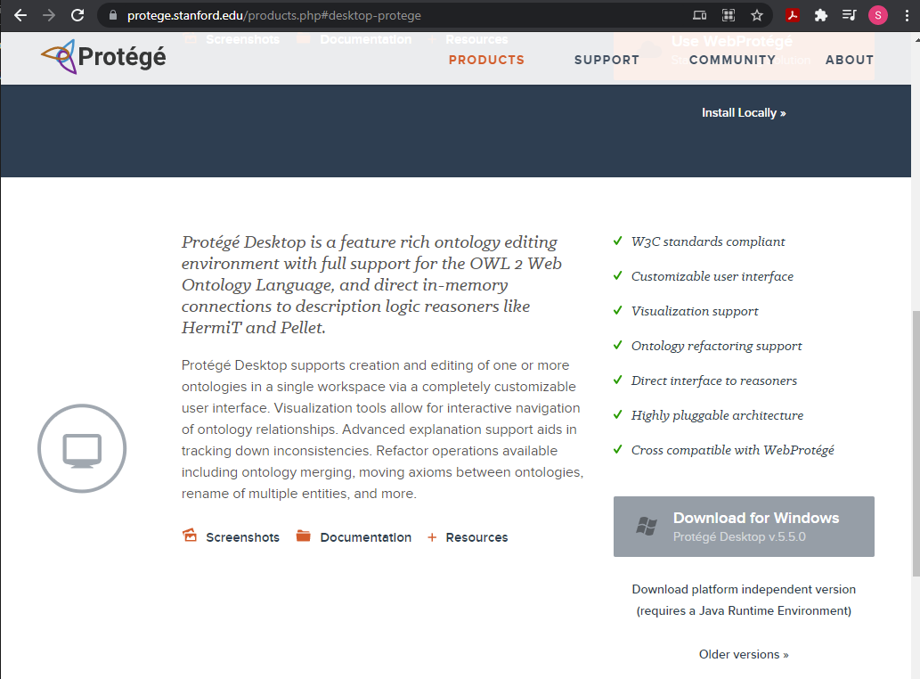
Editor

Slide 3
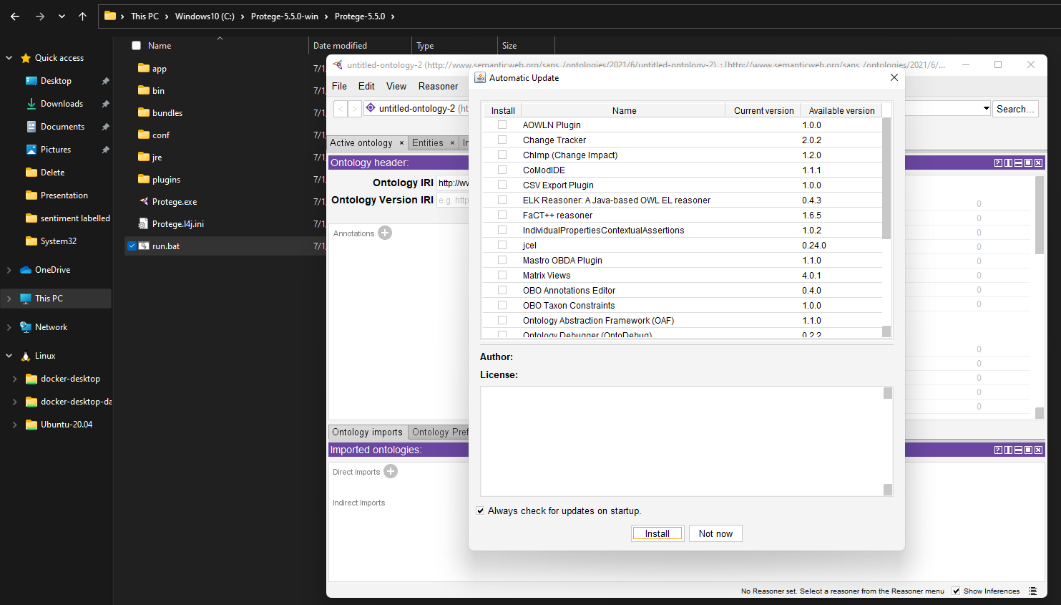
Run Protege

Slide 4
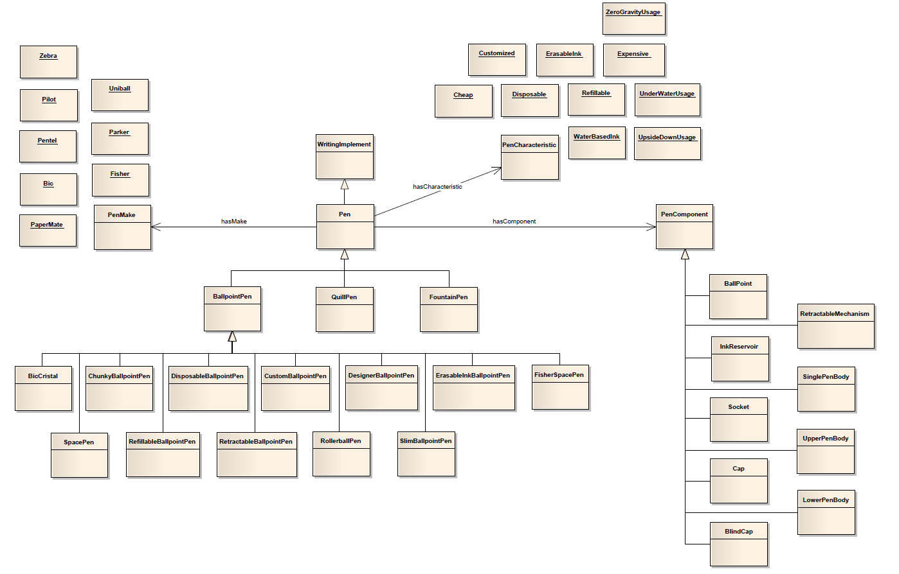
UML Model

Slide 5
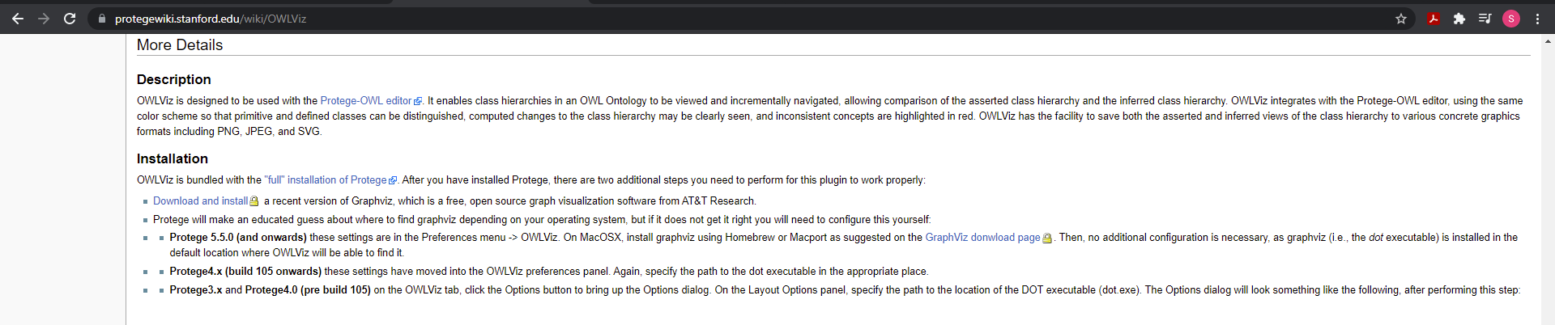
Graphwiz

Slide 6
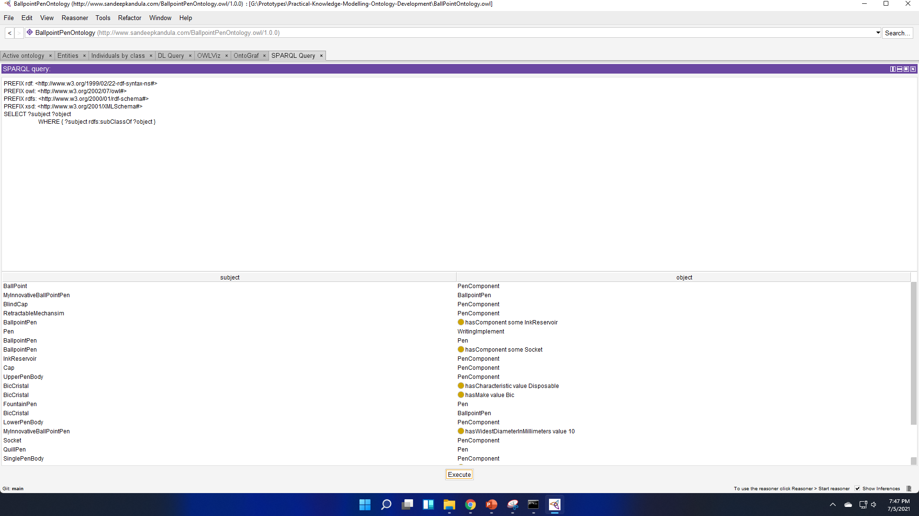
Execute SPARQL query

Slide 7
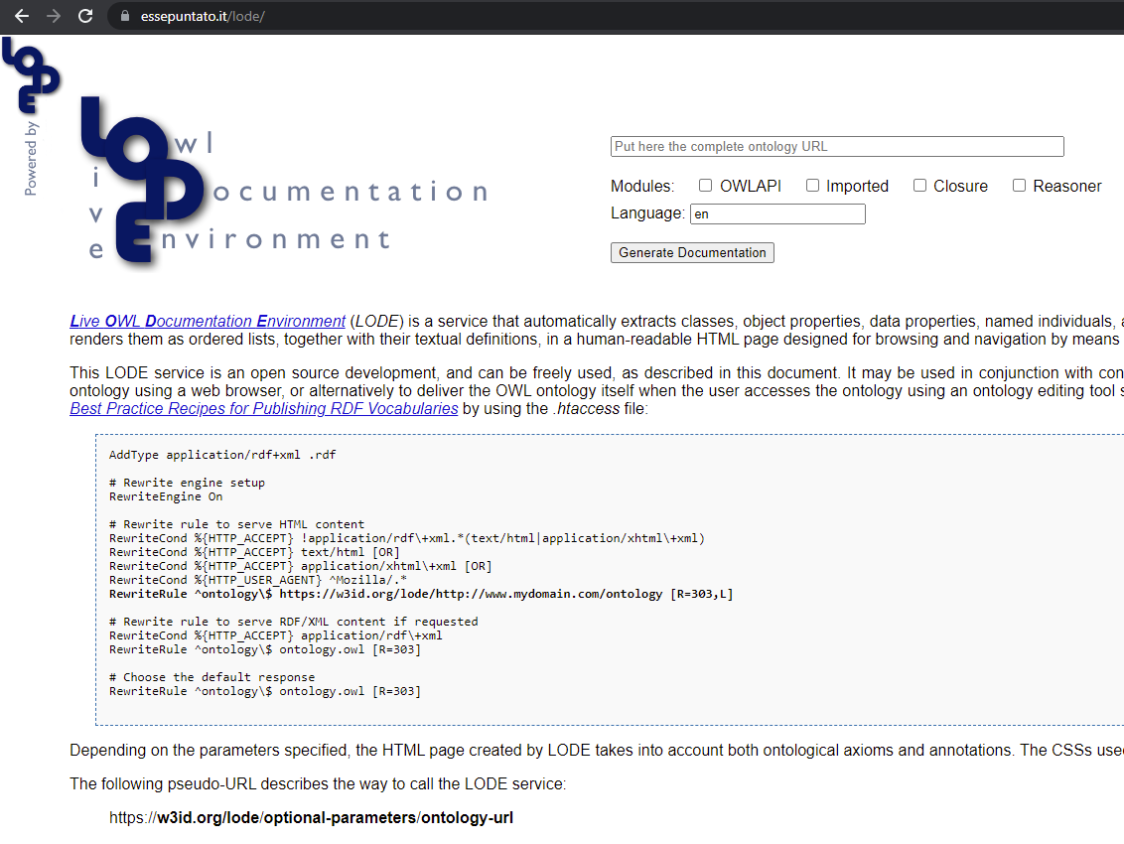
OWL Documentation
https://essepuntato.it/lode/

Slide 8
OWL Visualization
http://owlgred.lumii.lv/
http://vowl.visualdataweb.org/protegevowl.html

