Slide 1

SOLID PRINCIPLES

Slide 2
Single responsibility principle - What and how?

Slide 3
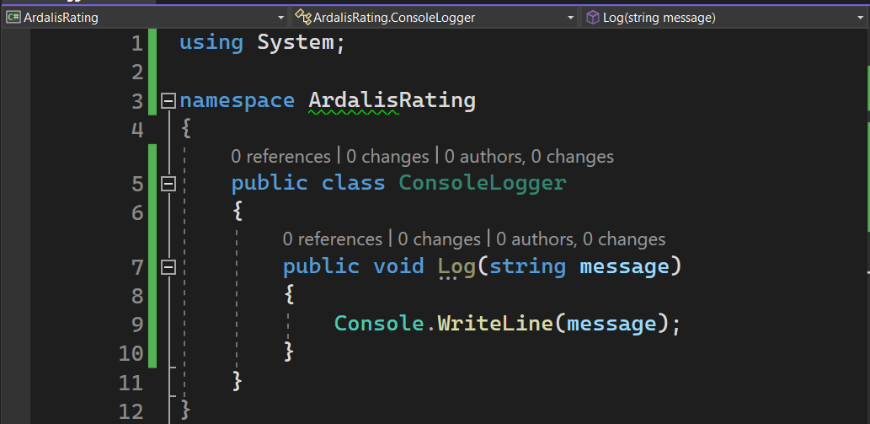
Logging - 1

Slide 4
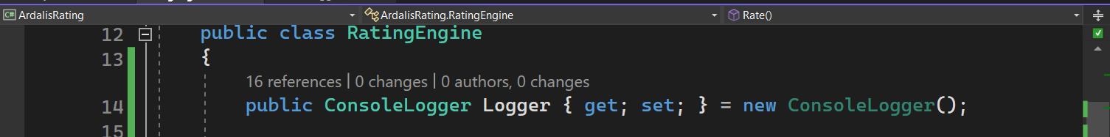
Logging - 2

Slide 5
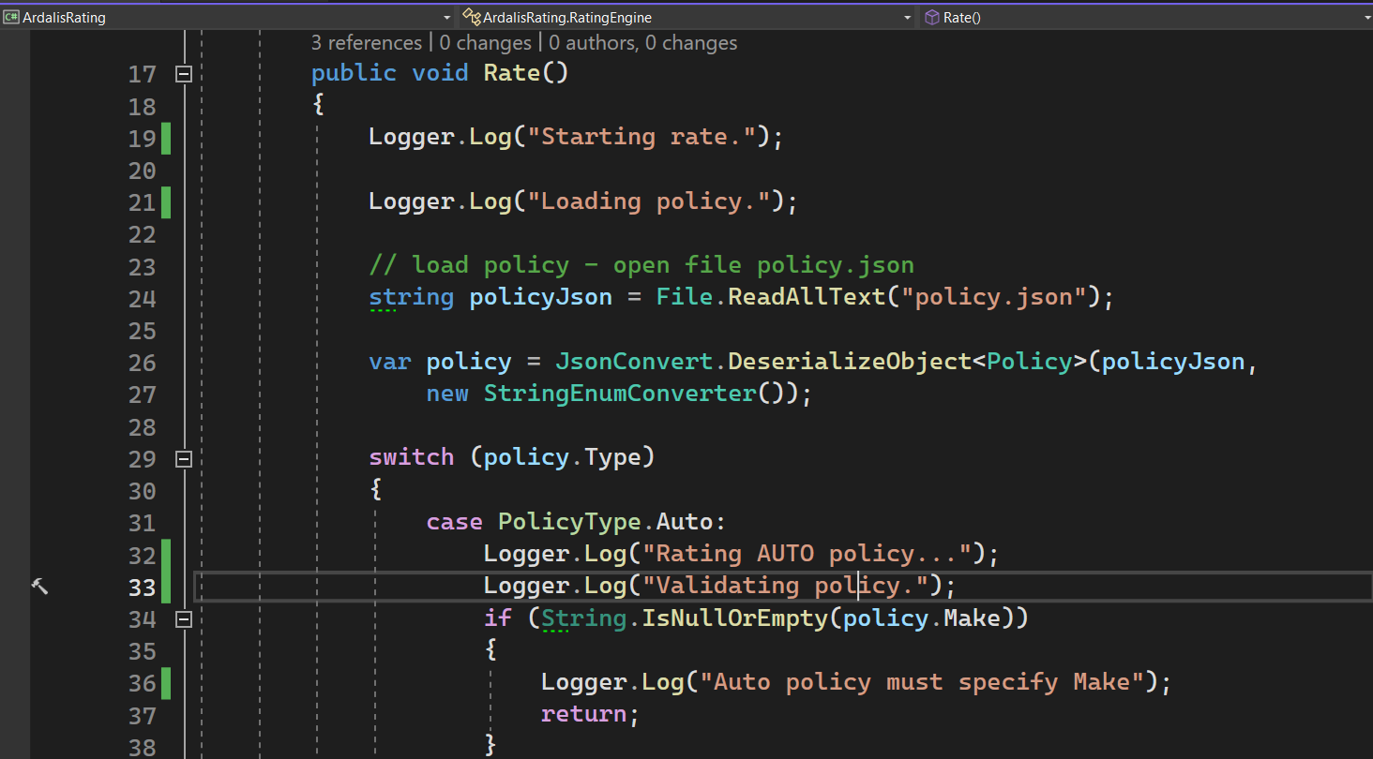
Logging - 3

Slide 6
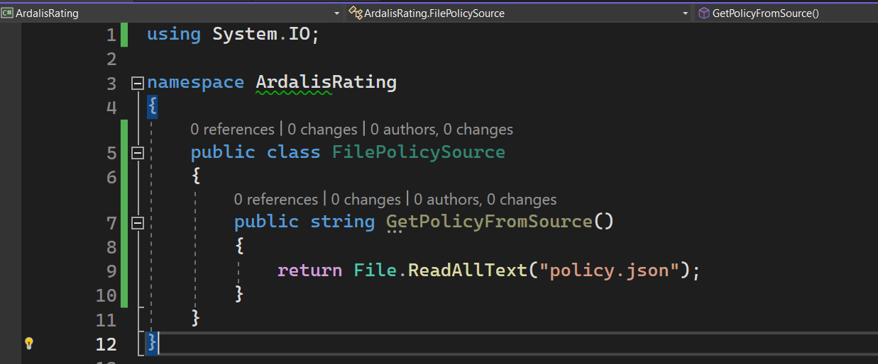
Persistence - 1

Slide 7
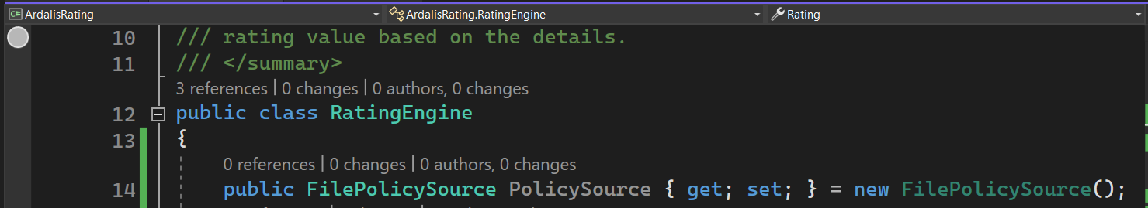
Persistence - 2

Slide 8
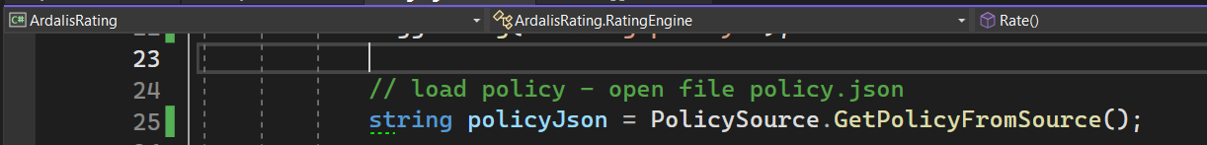
Persistence - 3

Slide 9
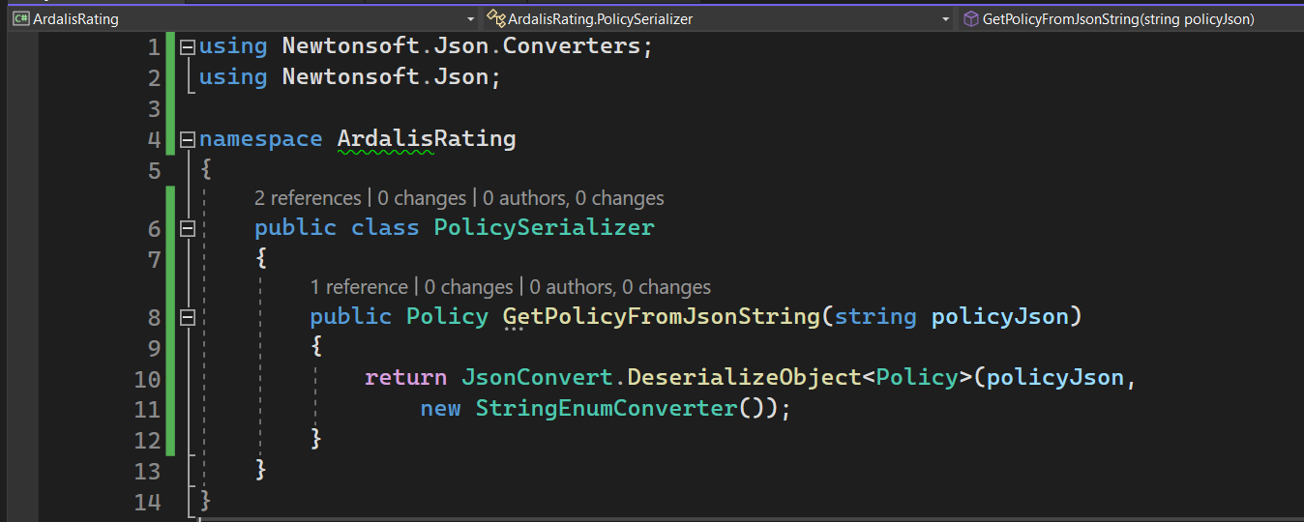
Encoding format - 1

Slide 10
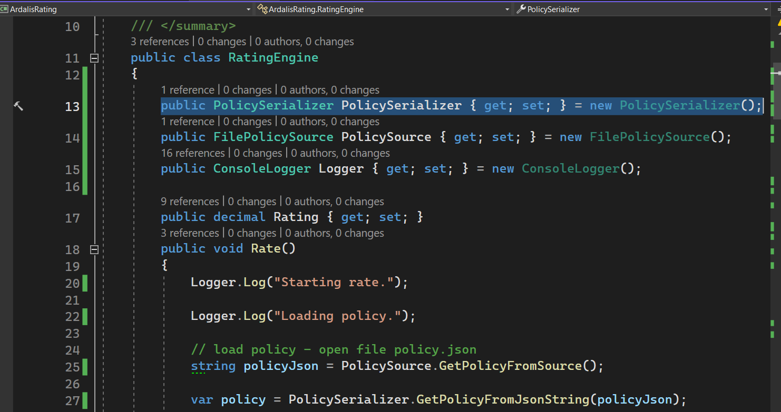
Encoding format - 2

Slide 11
OPEN / CLOSED PRINCIPLE

