Slide 1

Active MQ
Getting started

Slide 2
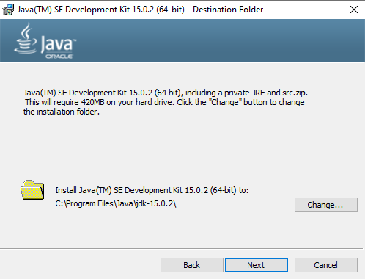
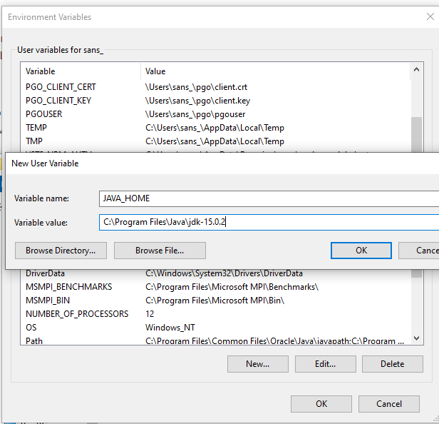
ActiveMQ – Getting STARTED
http://activemq.apache.org/version-5-getting-started.html
https://www.oracle.com/in/java/technologies/javase-jdk15-downloads.html

Slide 3
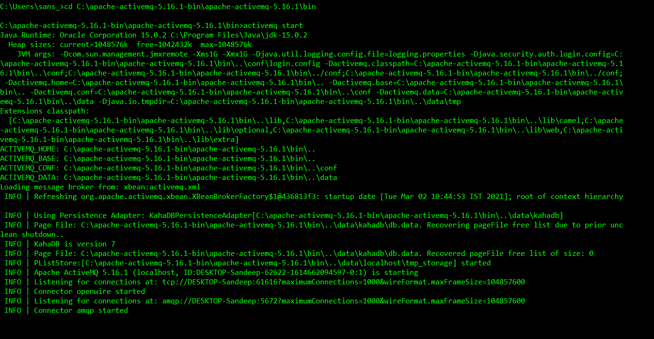
ActiveMQ START

Slide 4
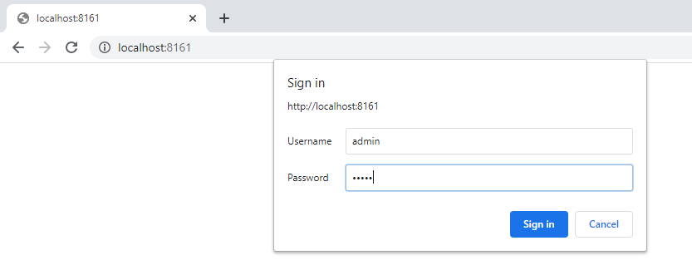
ActivemQ admin page
User name and password : admin, admin

Slide 5
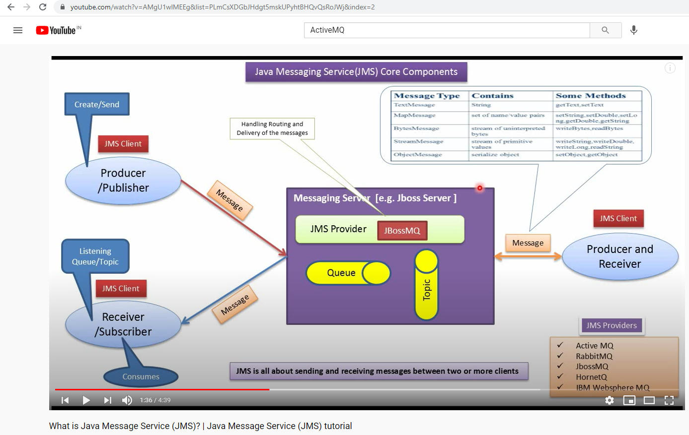
Message Types

Slide 6
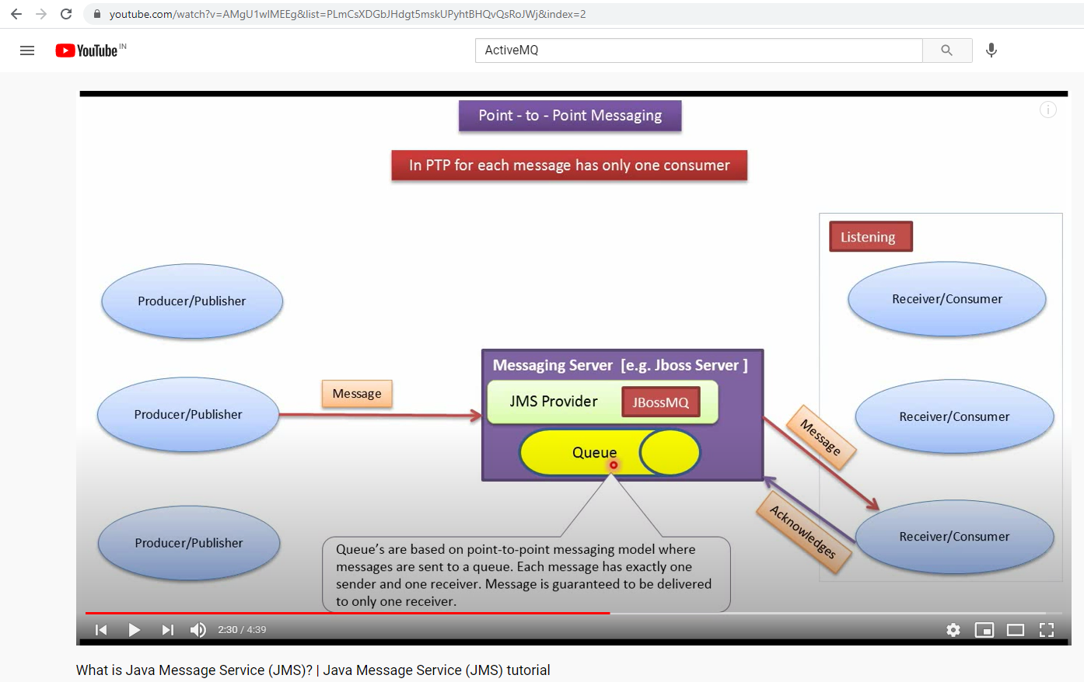
Queue

Slide 7
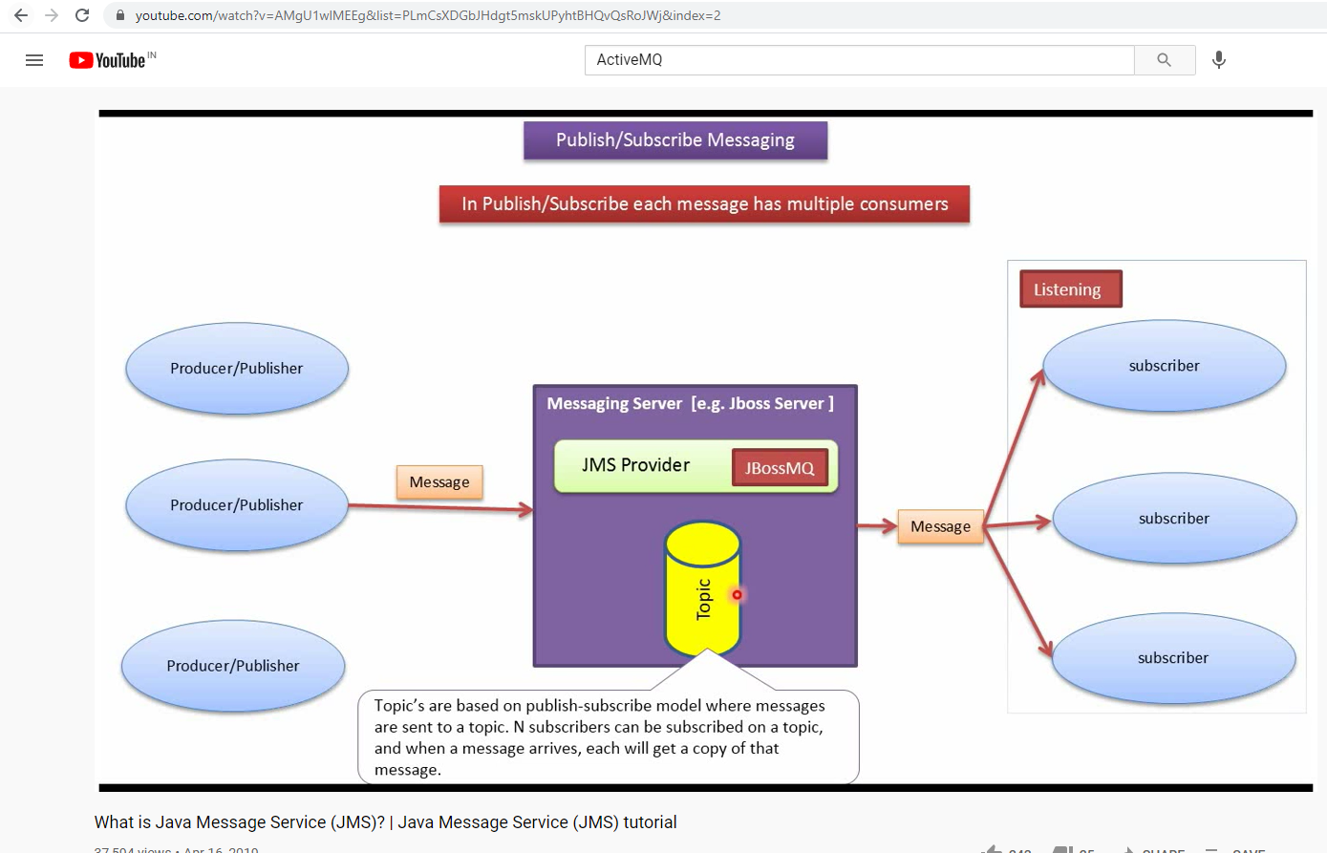
TOPIC

Slide 8
AMQP 1.0 library for .Net
http://azure.github.io/amqpnetlite/
https://www.nuget.org/packages/amqpnetlite

