Slide 1

Active MQ
Getting started

Slide 2
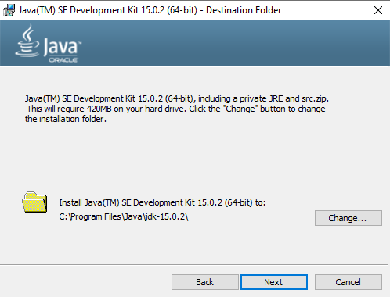
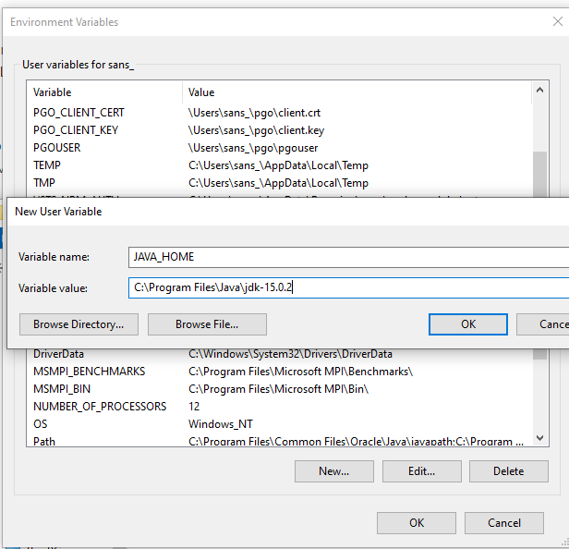
ActiveMQ – Getting STARTED
http://activemq.apache.org/version-5-getting-started.html
https://www.oracle.com/in/java/technologies/javase-jdk15-downloads.html

Slide 3
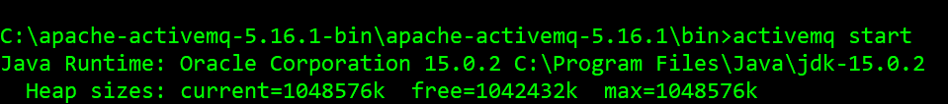
ActiveMQ START

