Slide 1

Active MQ
Getting started

Slide 2
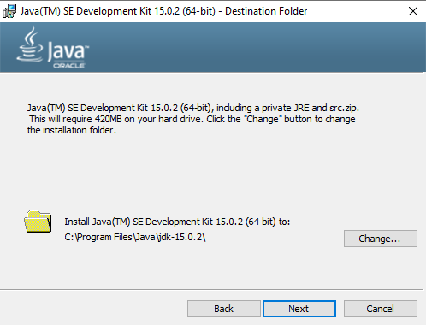
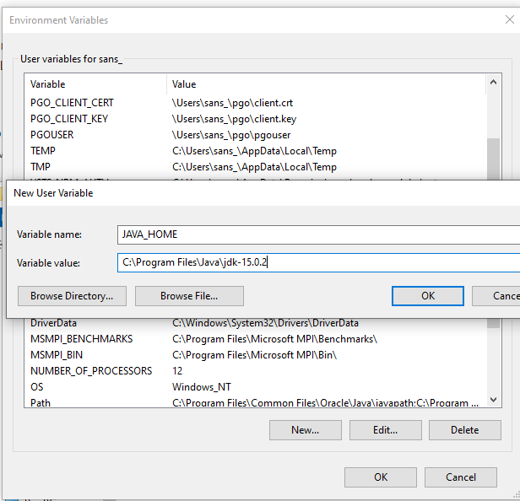
ActiveMQ – Getting STARTED
http://activemq.apache.org/version-5-getting-started.html
https://www.oracle.com/in/java/technologies/javase-jdk15-downloads.html

Slide 3
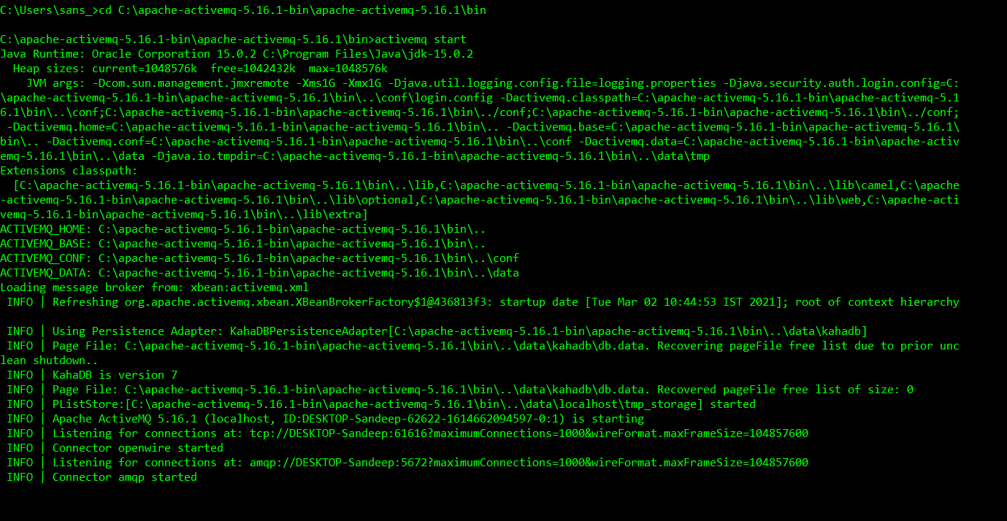
ActiveMQ START

Slide 4
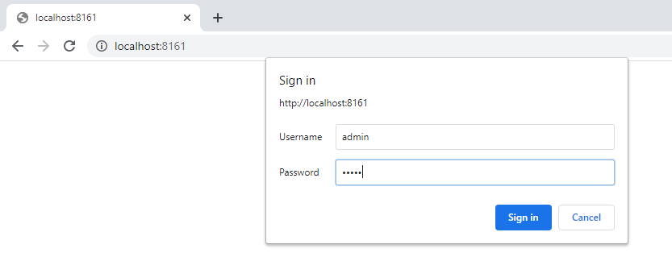
ActivemQ admin page
User name and password : admin, admin

Slide 5
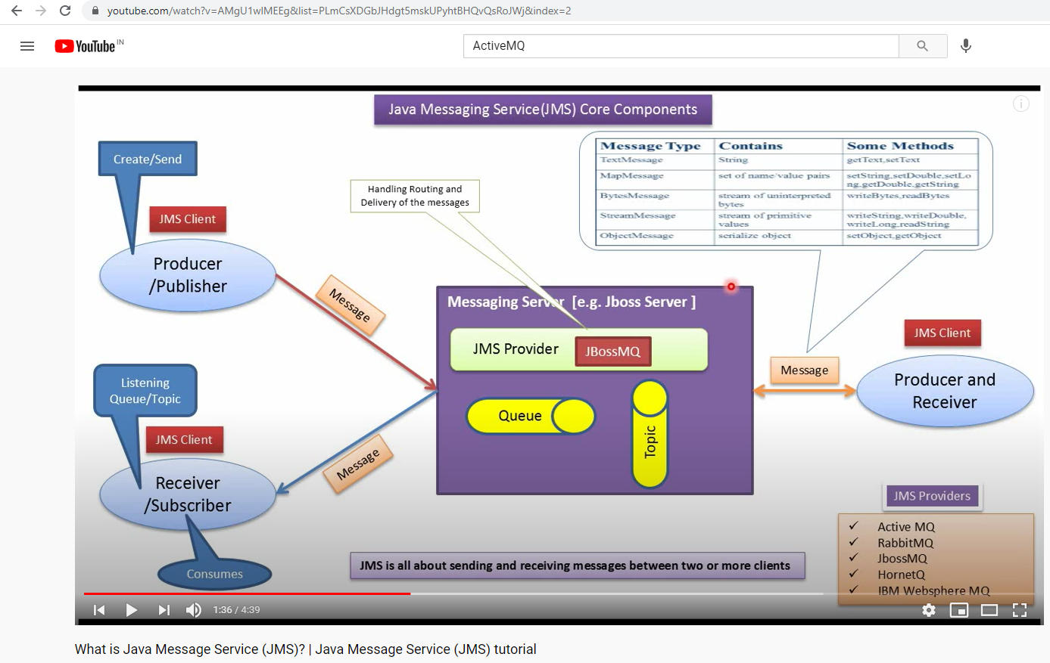
Message Types

Slide 6
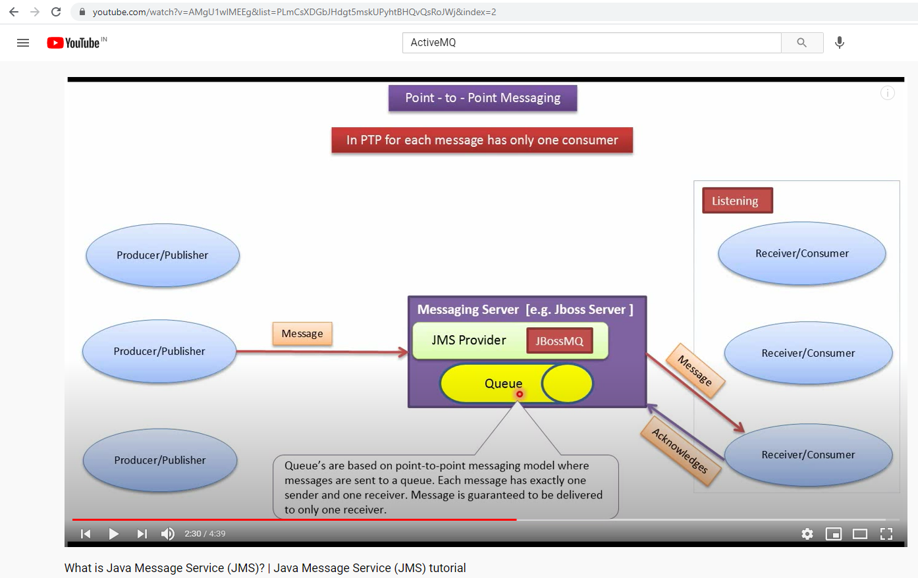
Queue

Slide 7
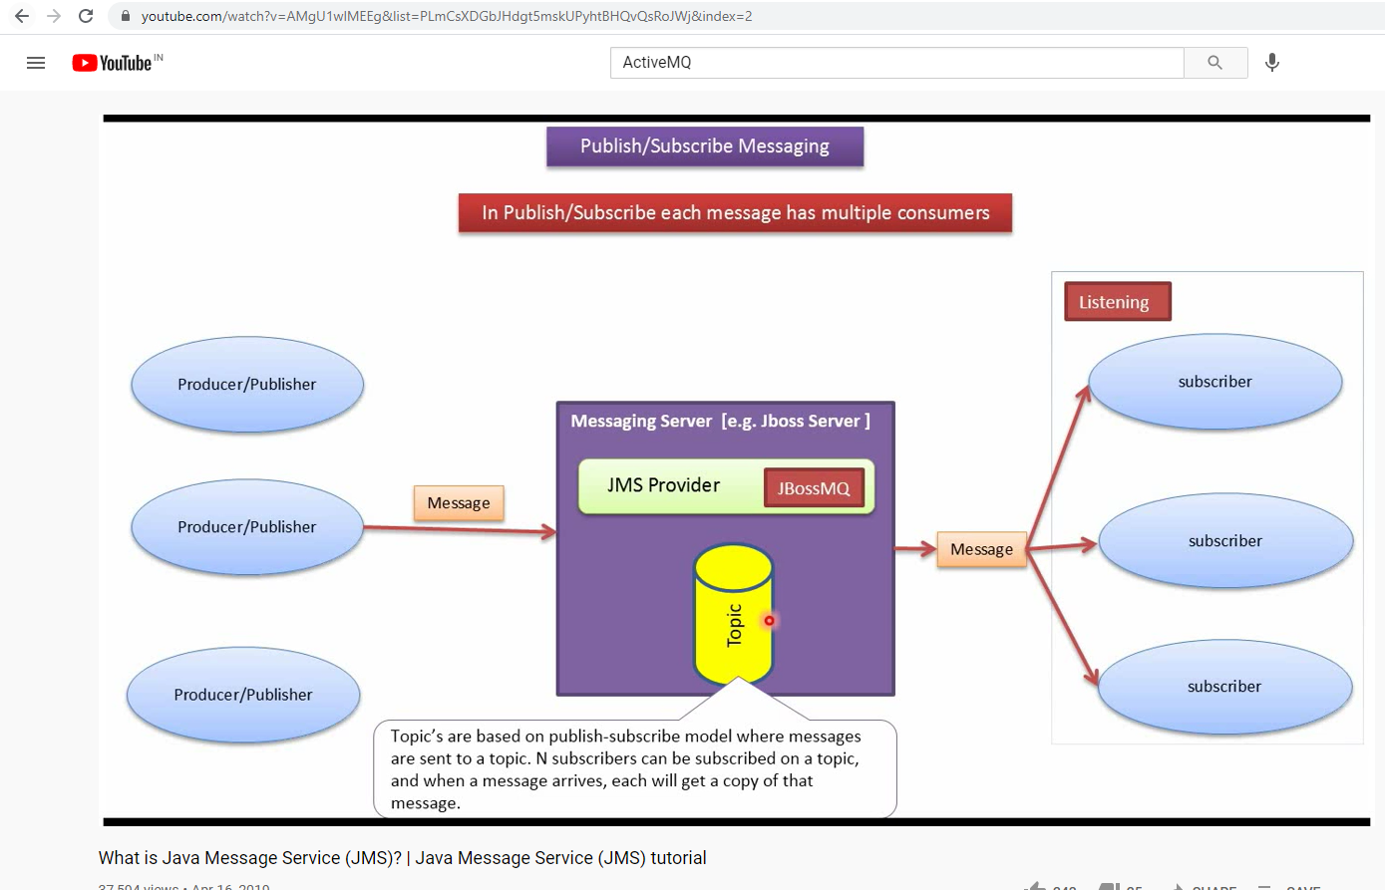
TOPIC

Slide 8
Queue versus topic
TOPIC : These are effectively a way to communicate between two end points; the important thing here is that there must be
for it to work. When you publish a topic message, it is published to any “listeners”.
If your app wasn’t listening, then that’s hard luck. The use cases here are situations whereby a message might be time
sensitive; for example, a stock price had just changed or a server needs the client to refresh because there is more data.
There are such things as durable topics, but for now.
CAVEAT : The topic messages are only sent to active subscribers.
Queue: Queues on the other hand have a persistent nature. Once you add a message to the queue, it will remain there until
it is handled. Use cases for this might include a notification to send an e-mail, a chat program, or a request to place a sales
order. The queue will be read on a first in, first out basis, and so you can load balance a queue: that is, you can have n
listeners, and they will all process the messages in order from the queue.
https://www.pmichaels.net/2016/09/29/a-c-programmers-guide-to-installing-running-and-messaging-with-activemq/

Slide 9
AMQP 1.0 library for .Net
http://azure.github.io/amqpnetlite/
https://www.nuget.org/packages/amqpnetlite

