Slide 1
Entity Framework Core 8

Slide 2
Creating Your First Application Using EF Core

Slide 3

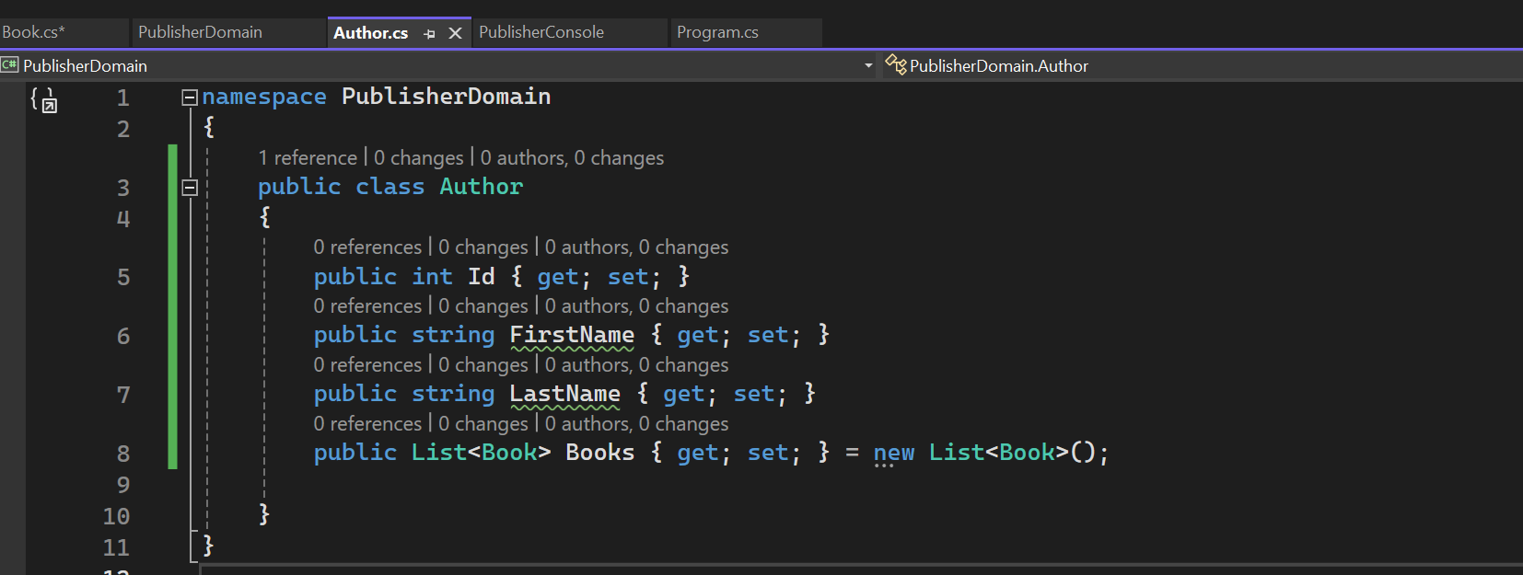
Publisher Domain - 1

Slide 4
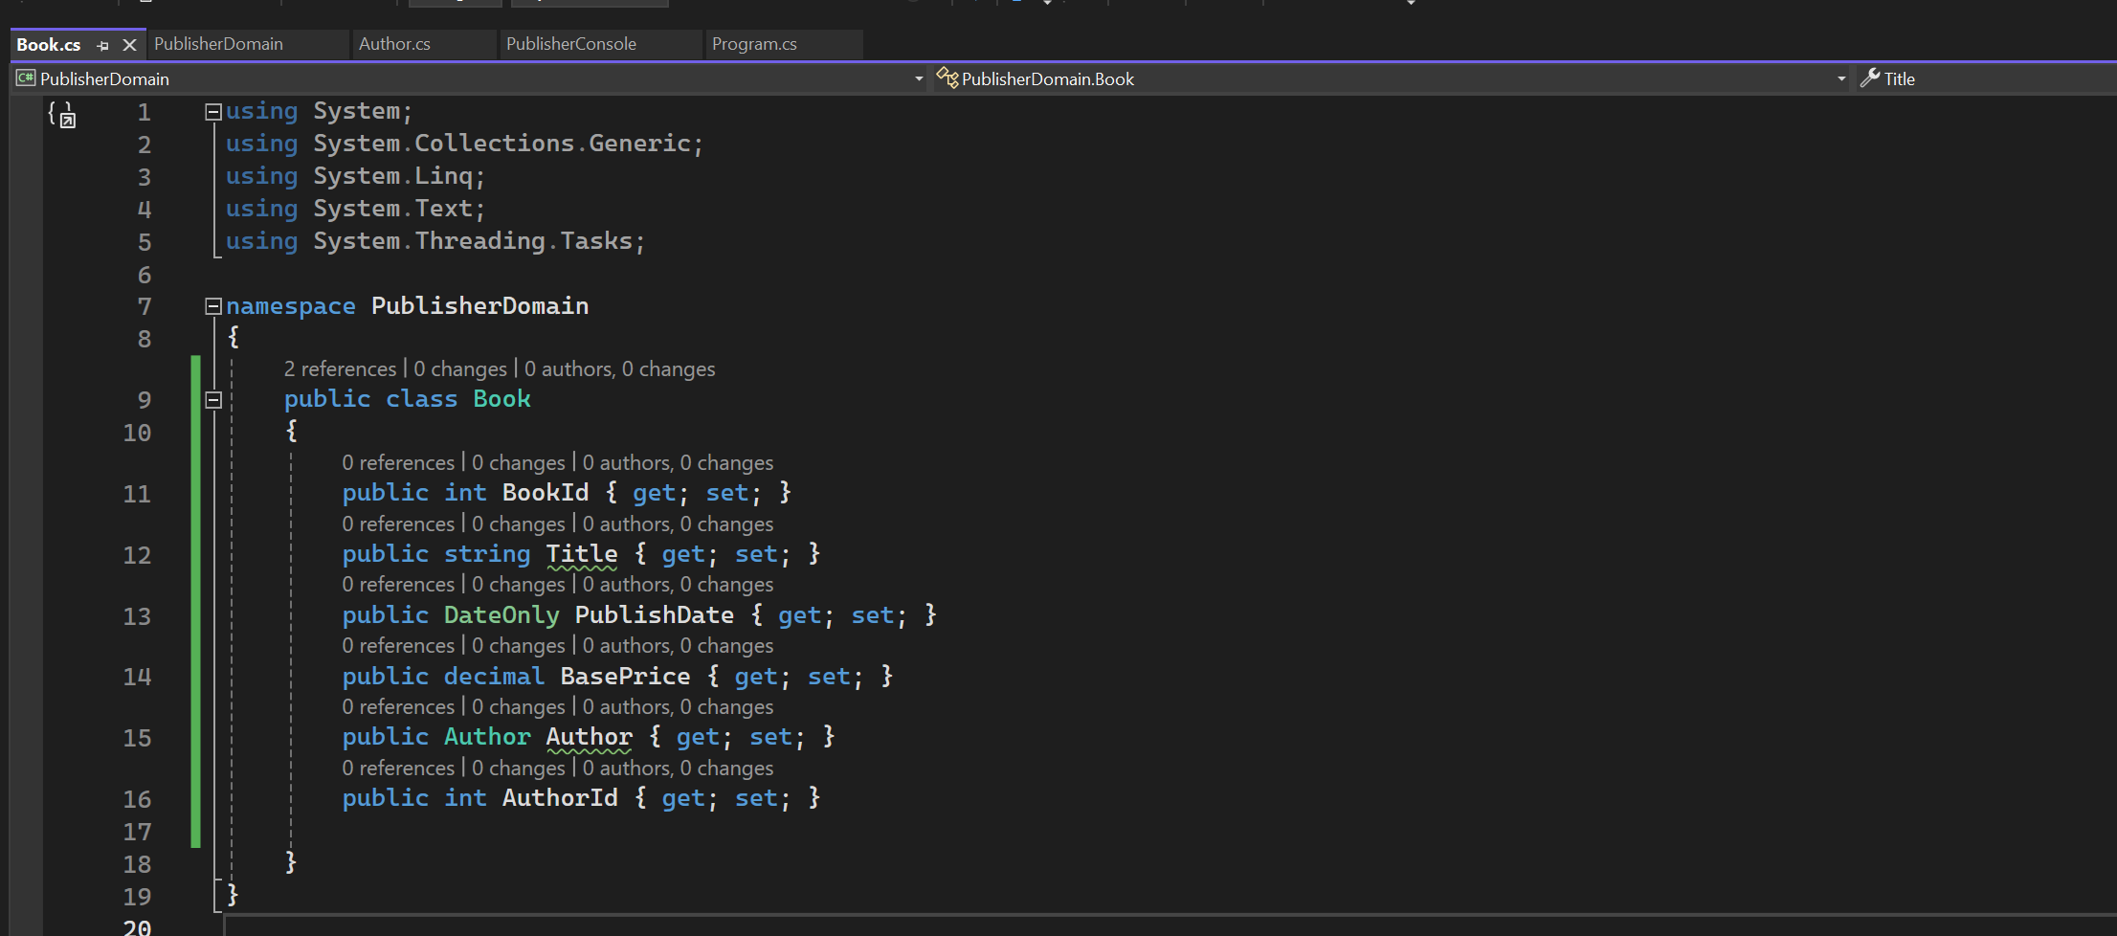
Publisher Domain - 2

Slide 5


PublisherConsloe

Slide 6
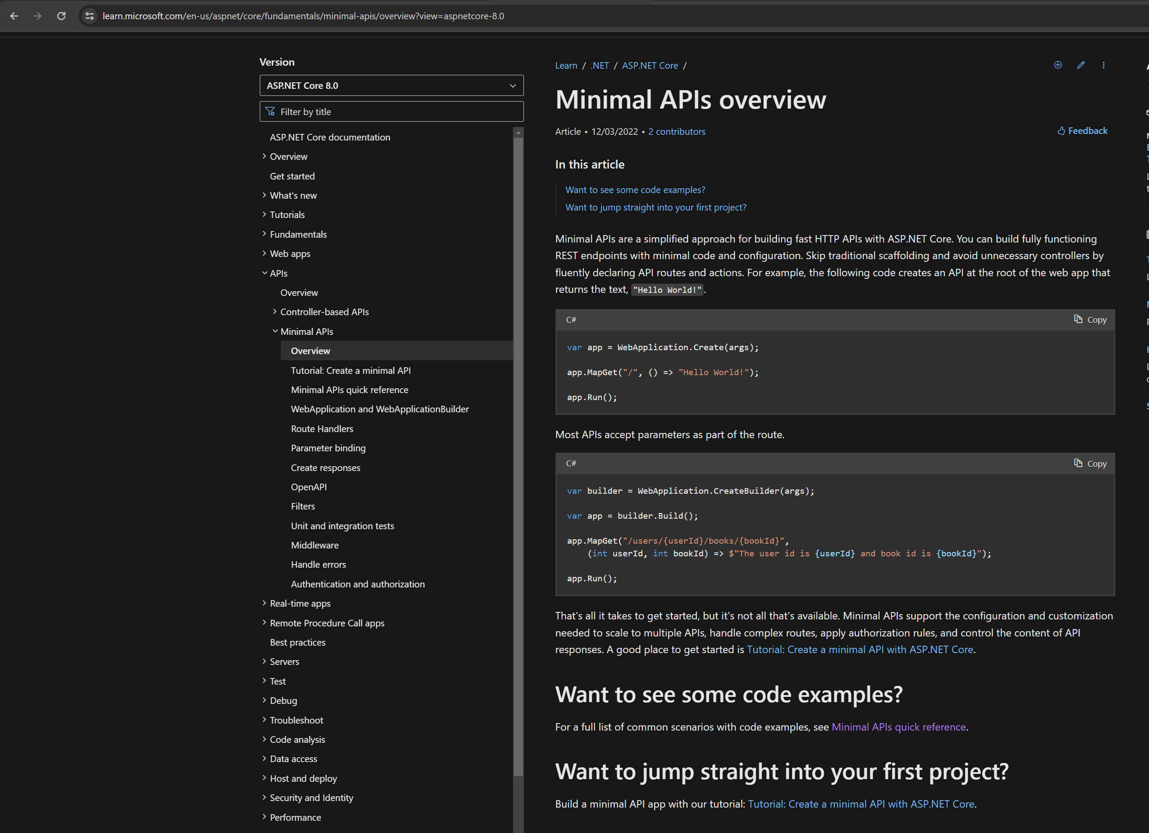
Minimal APIs

Slide 7

Depends on Microsoft.EntityFrameworkCore.Relational

Slide 8
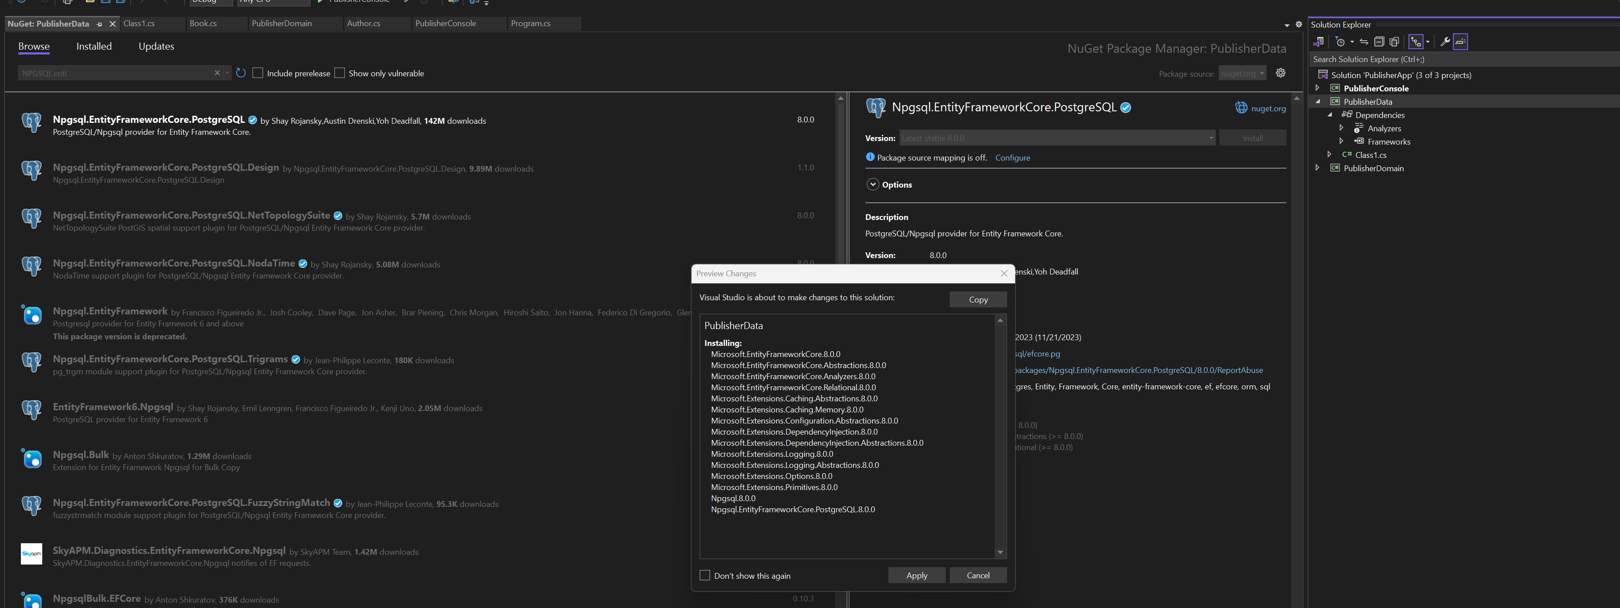
PublisherData - 1

Slide 9

PublisherData - 2

Slide 10
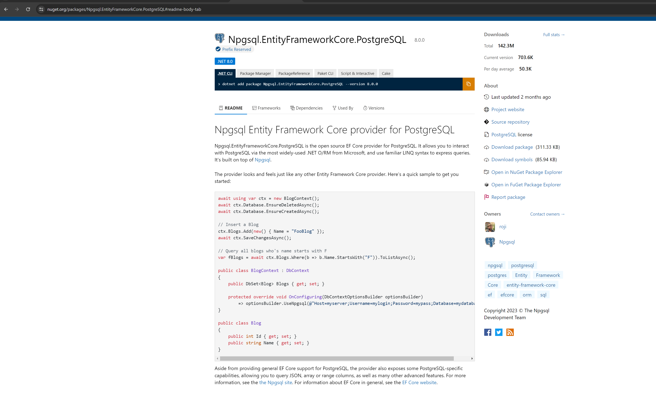
PublisherData - 3

Slide 11
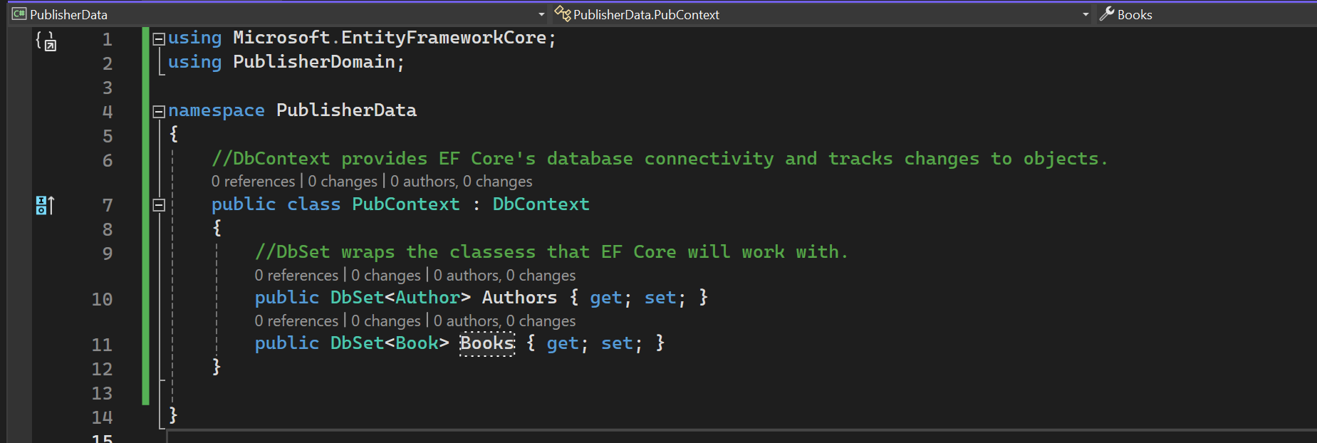
Creating Data Model with EF Core

Slide 12
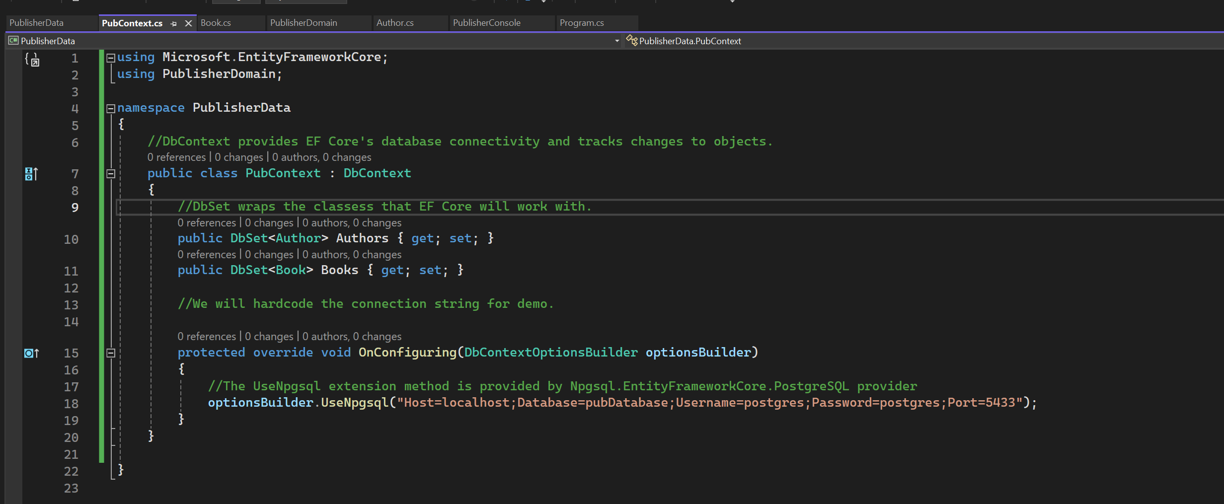
Postgres connection string

Slide 13
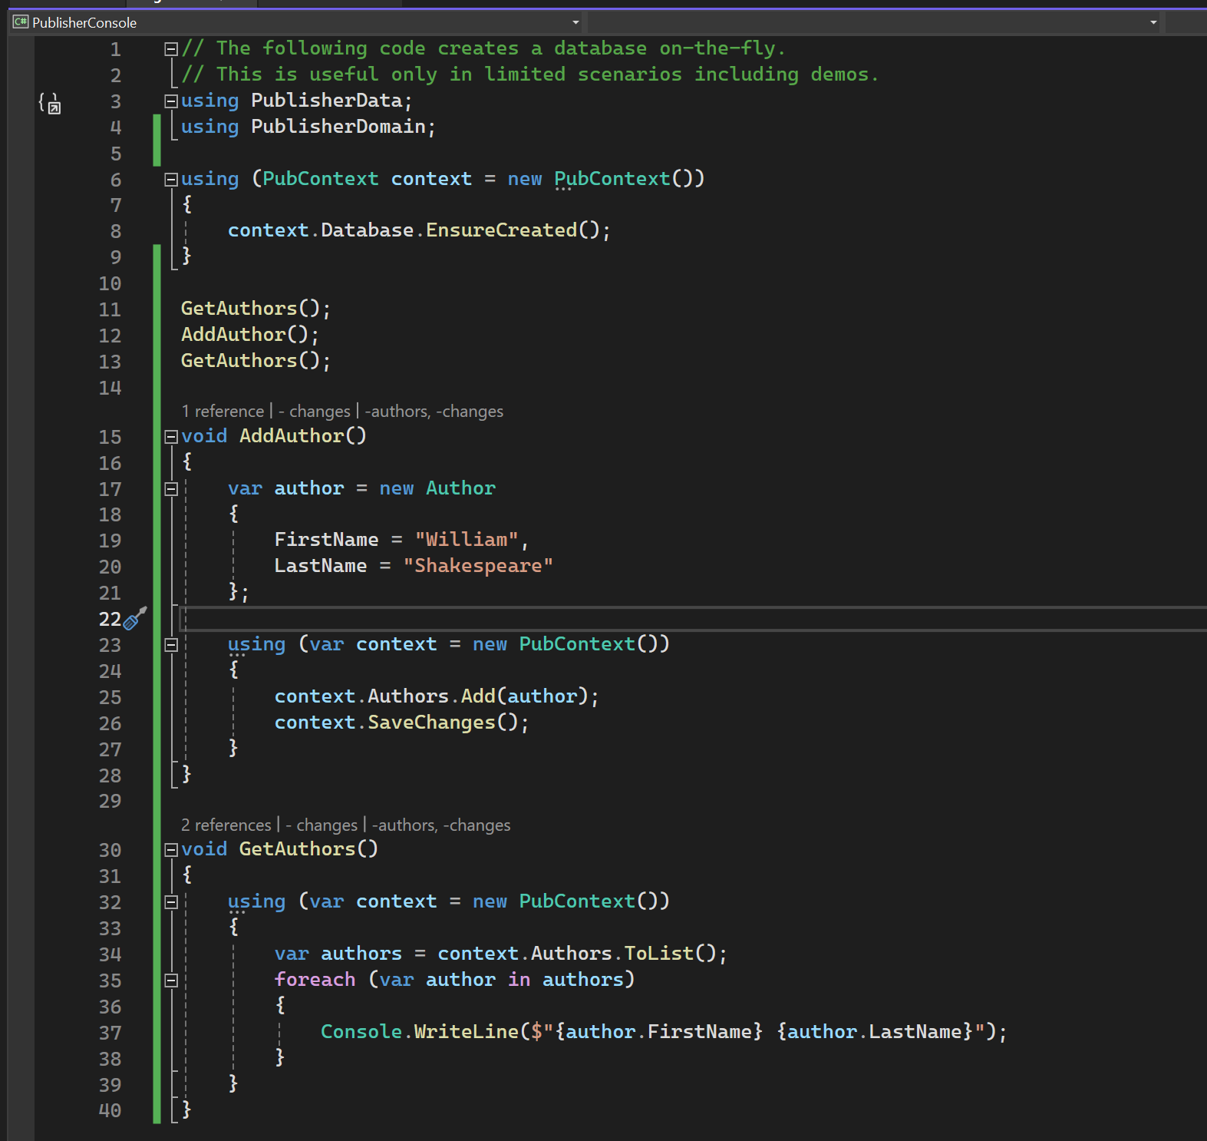

Reading and Writing Some Data

Slide 14
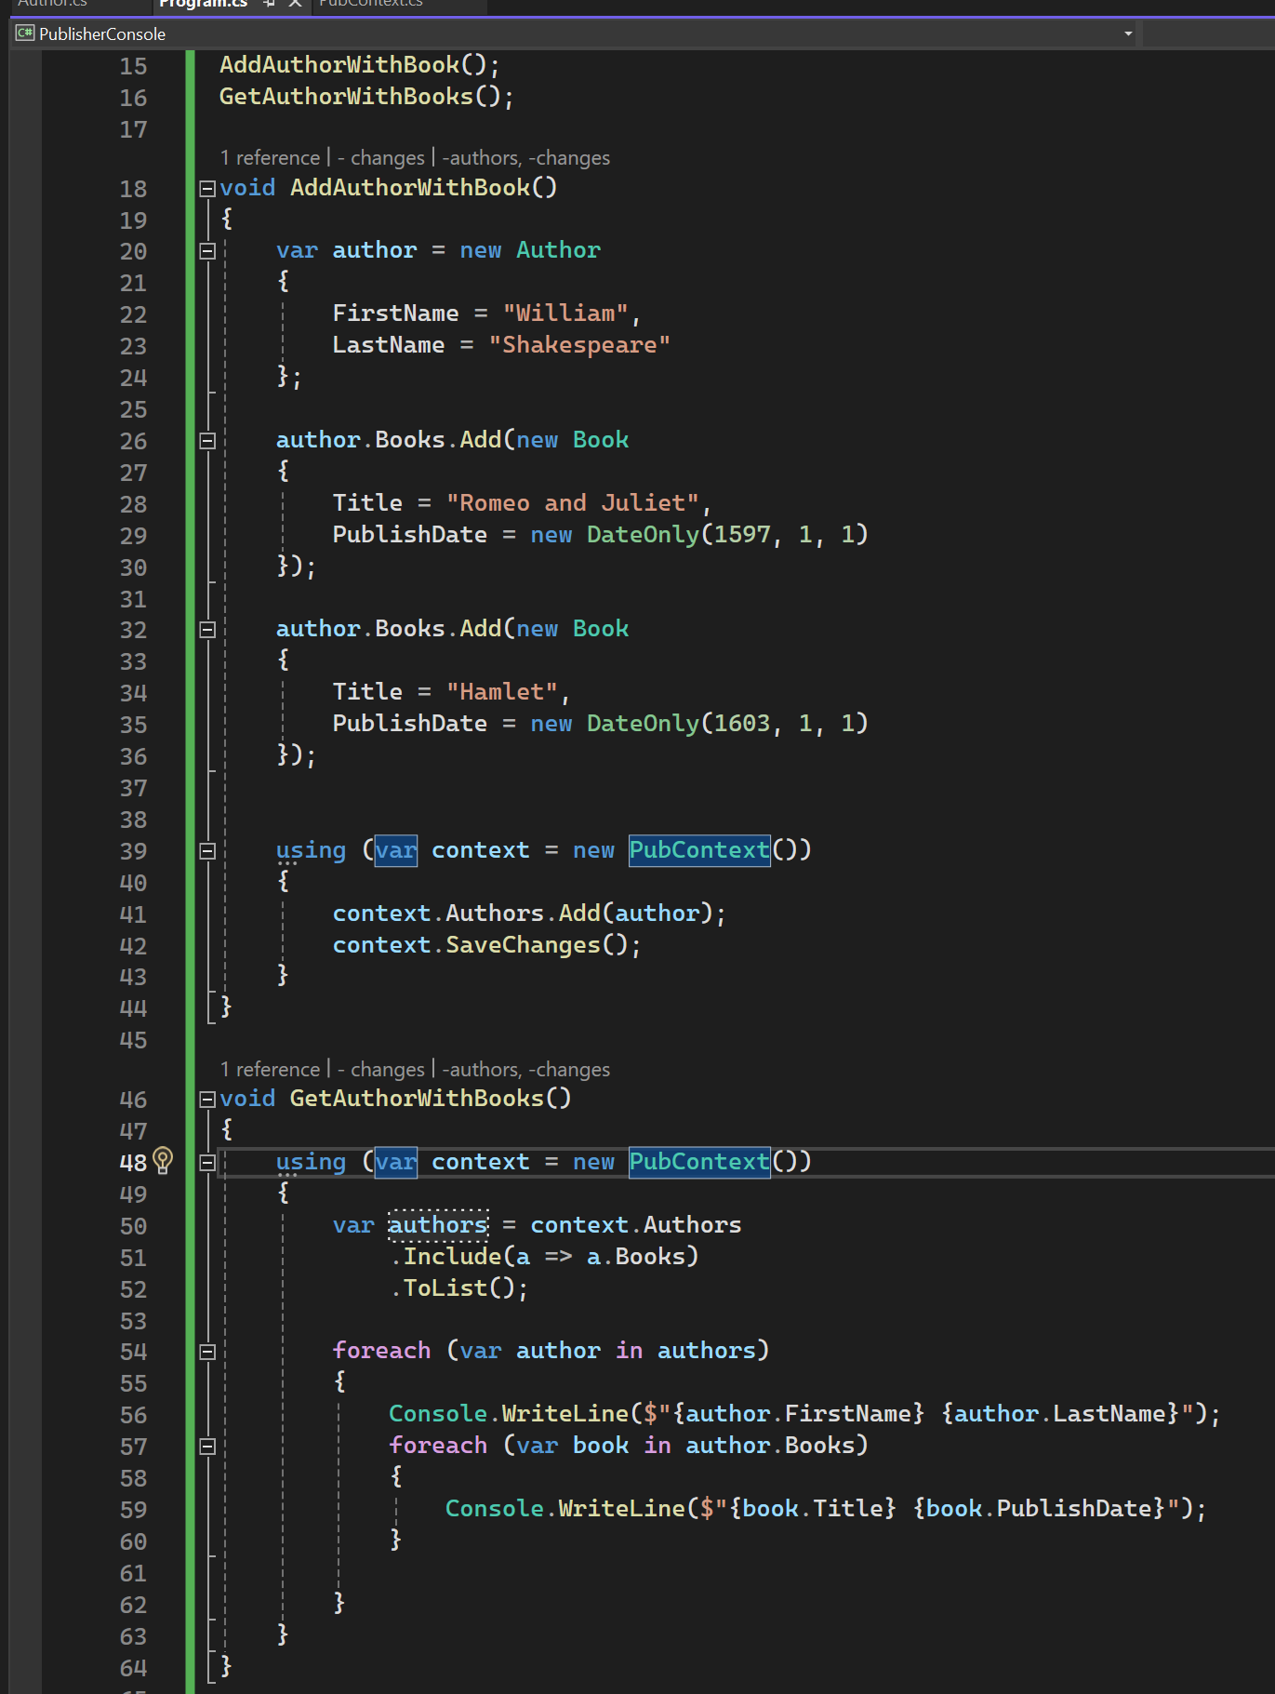
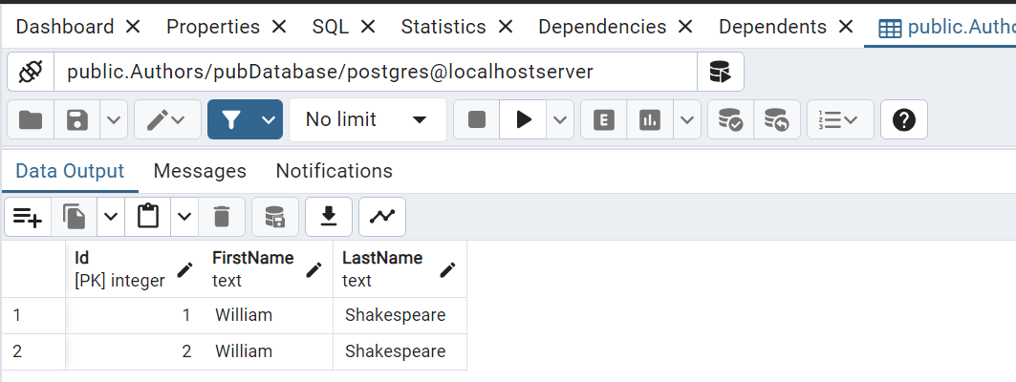

Reading and Writing Some Related Data

