Slide 1

ASP.Net Core GRPC
Sit Dolor Amet

Slide 2
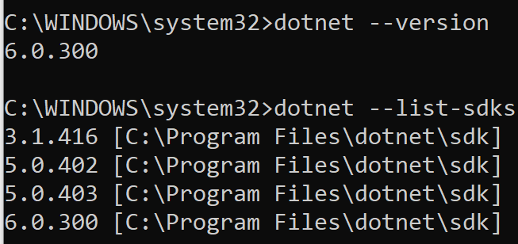
Setting up your machine
https://github.com/bloomrpc/bloomrpc
https://github.com/bloomrpc/bloomrpc/releases

Slide 3
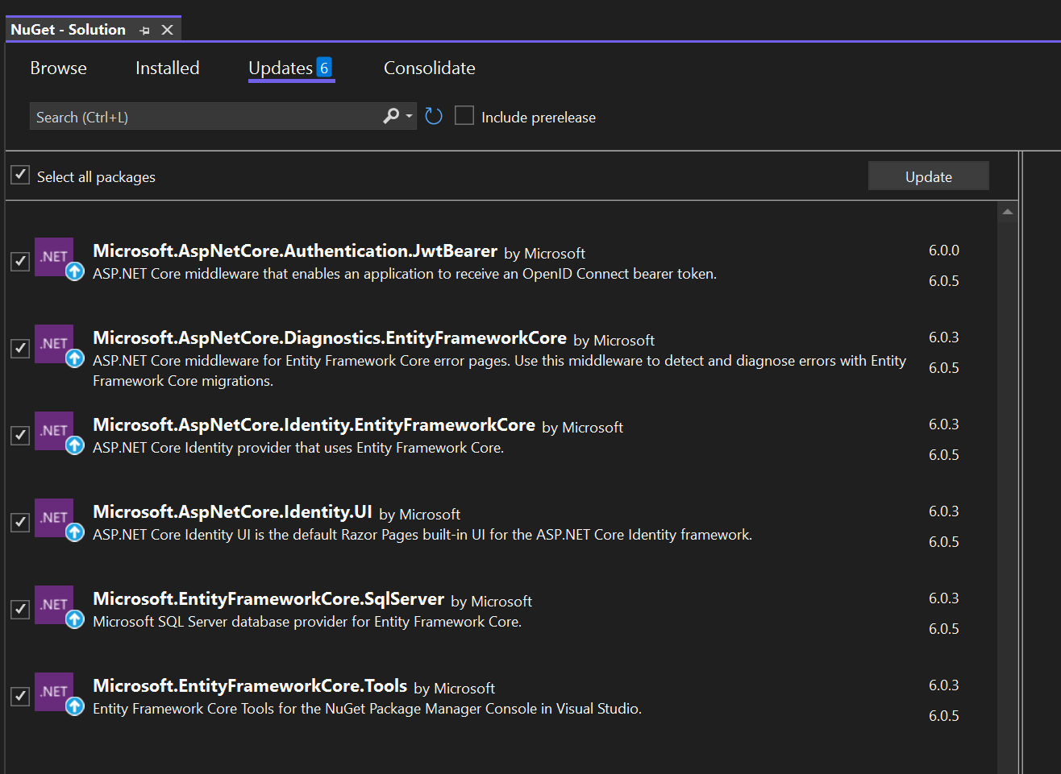
Source CODE
https://github.com/psauthor/MeterReader/tree/net6

Slide 4
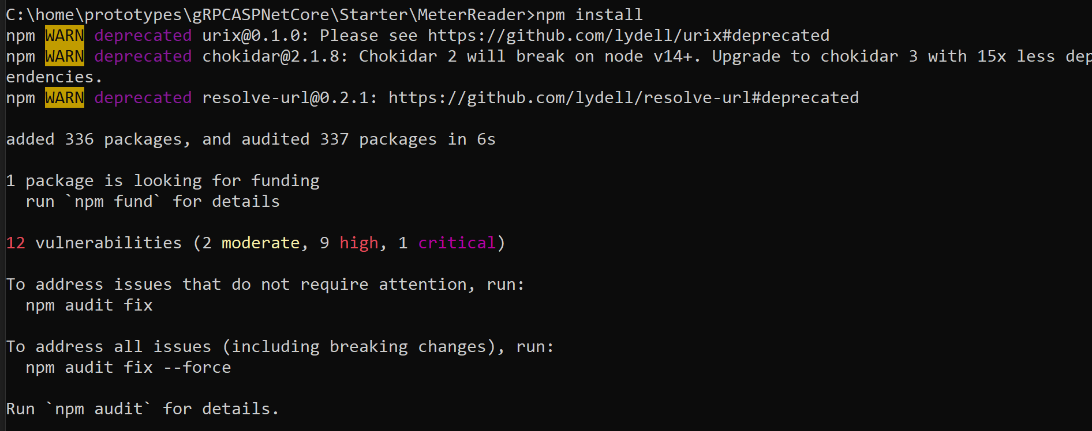
NPM INSTALL

Slide 5
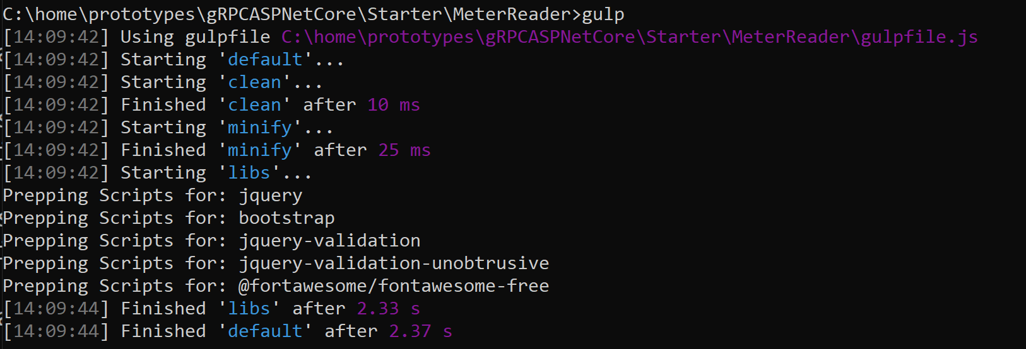
gulp

Slide 6
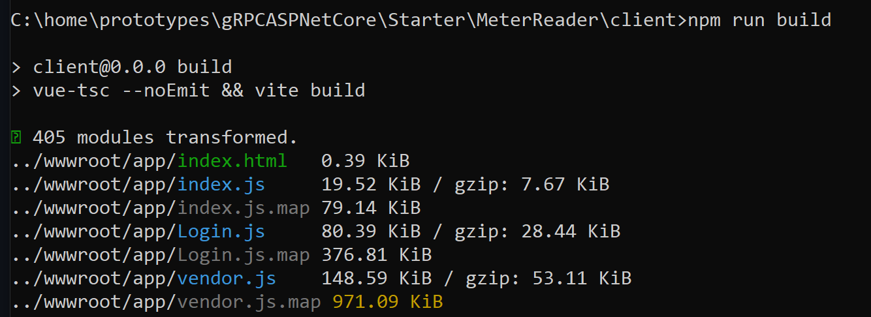
BULD THE CLIENT

Slide 7
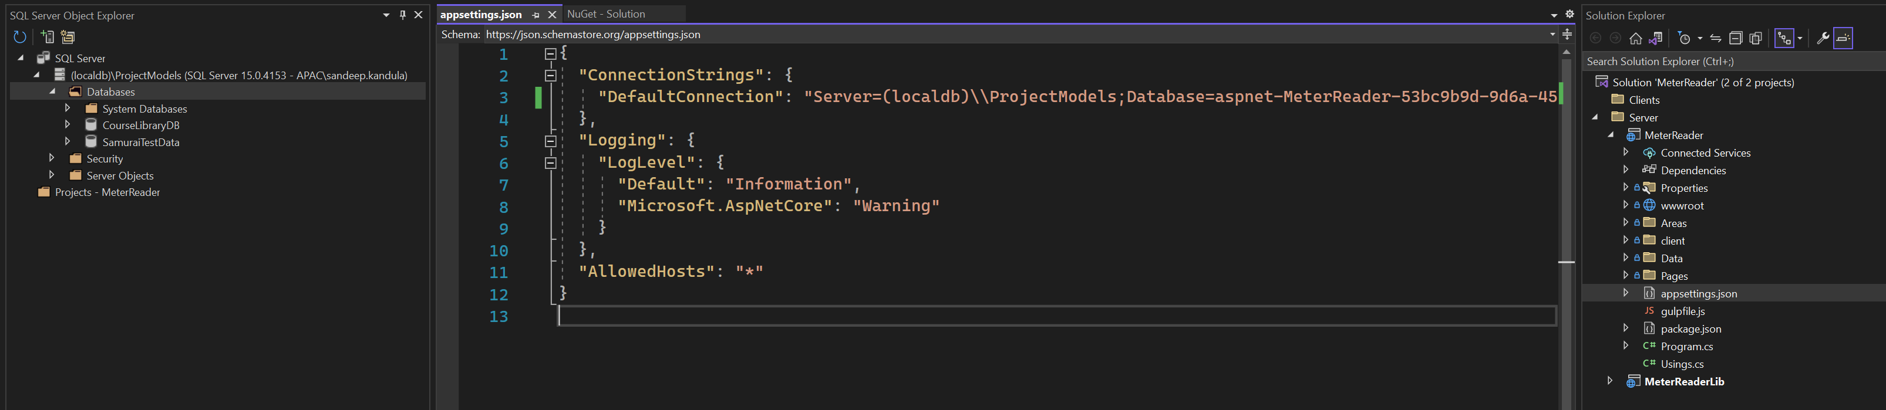
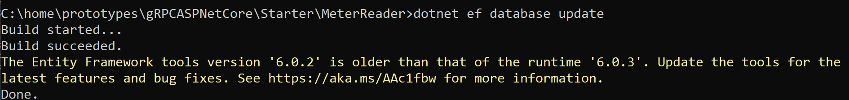
Update connection string

Slide 8
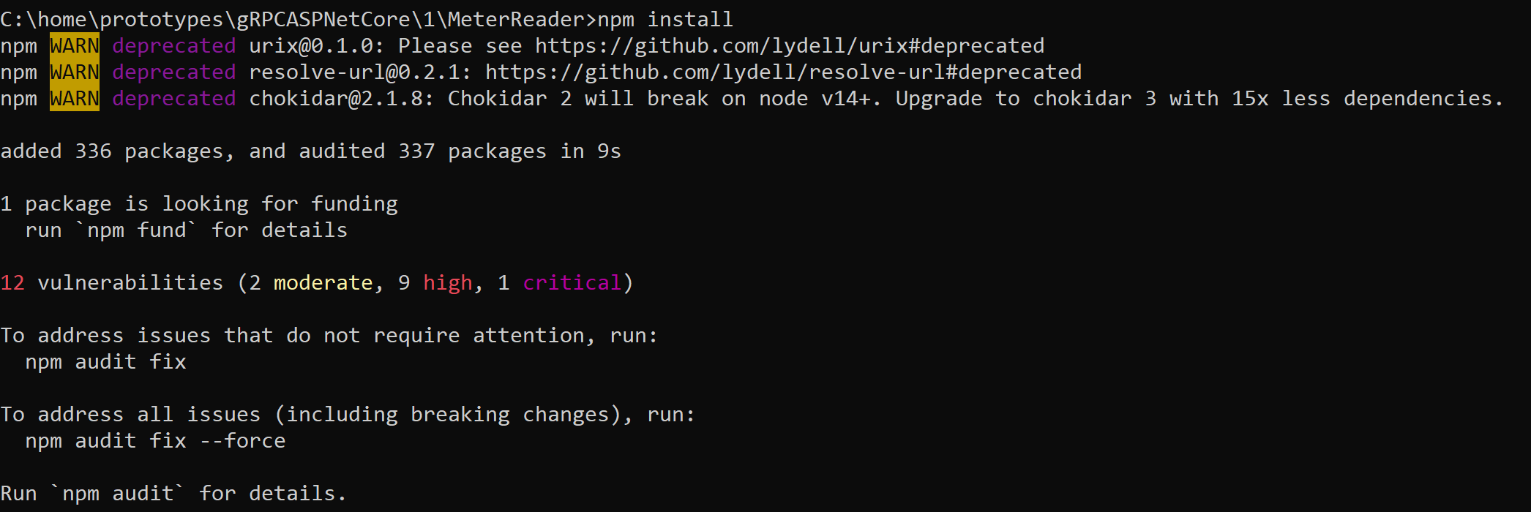

Slide 9
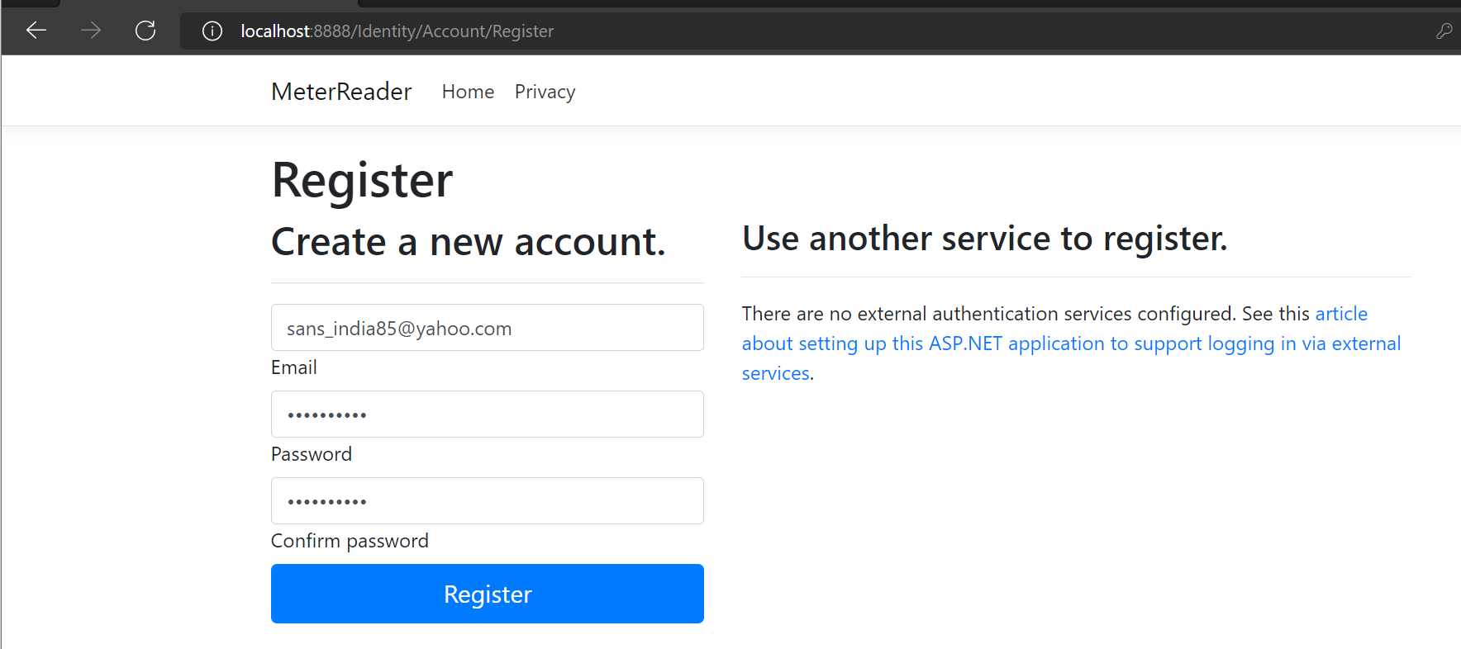
REGISTER
Notes:
sans_india85@yahoo.com
Windows10#

Slide 10
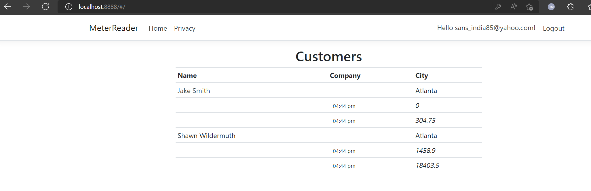
METER READER

Slide 11
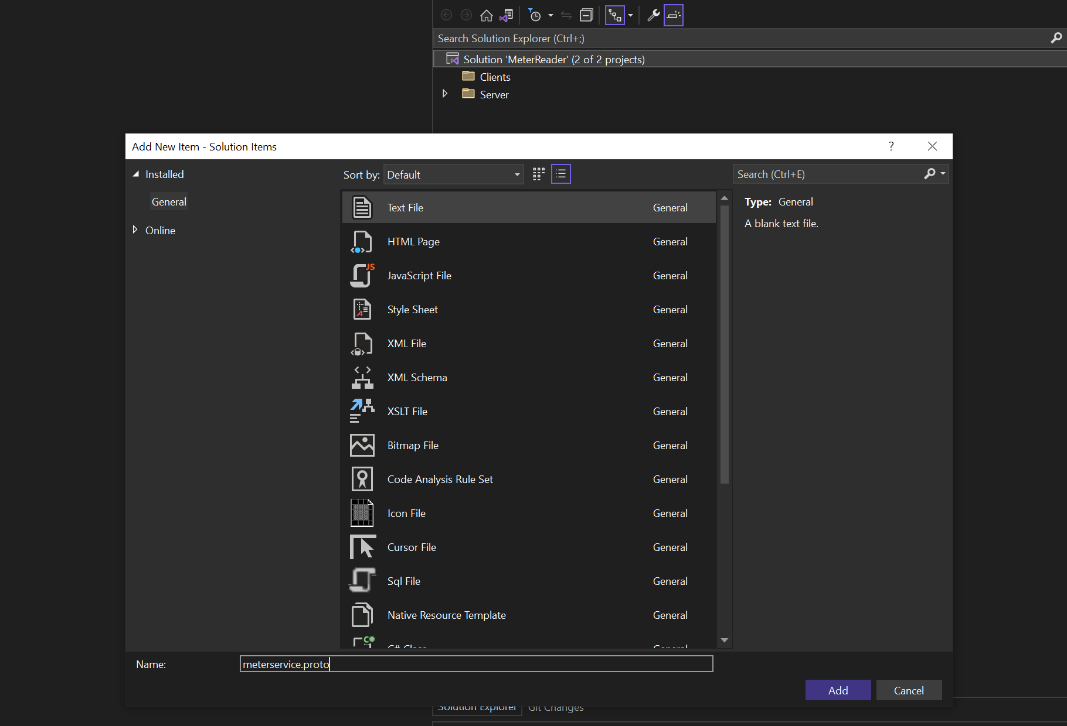
METER SERVICE

Slide 12
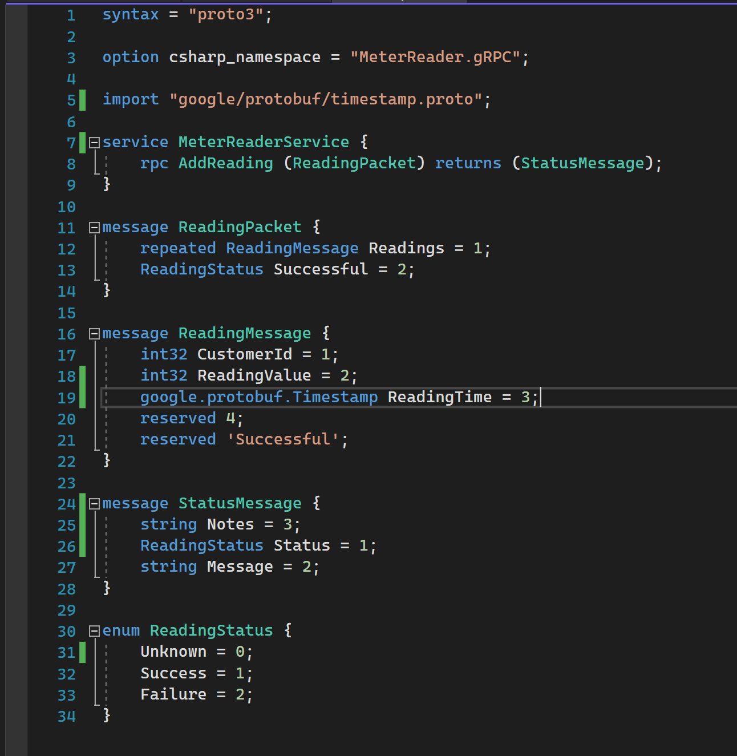
ADD PROTO

Slide 13
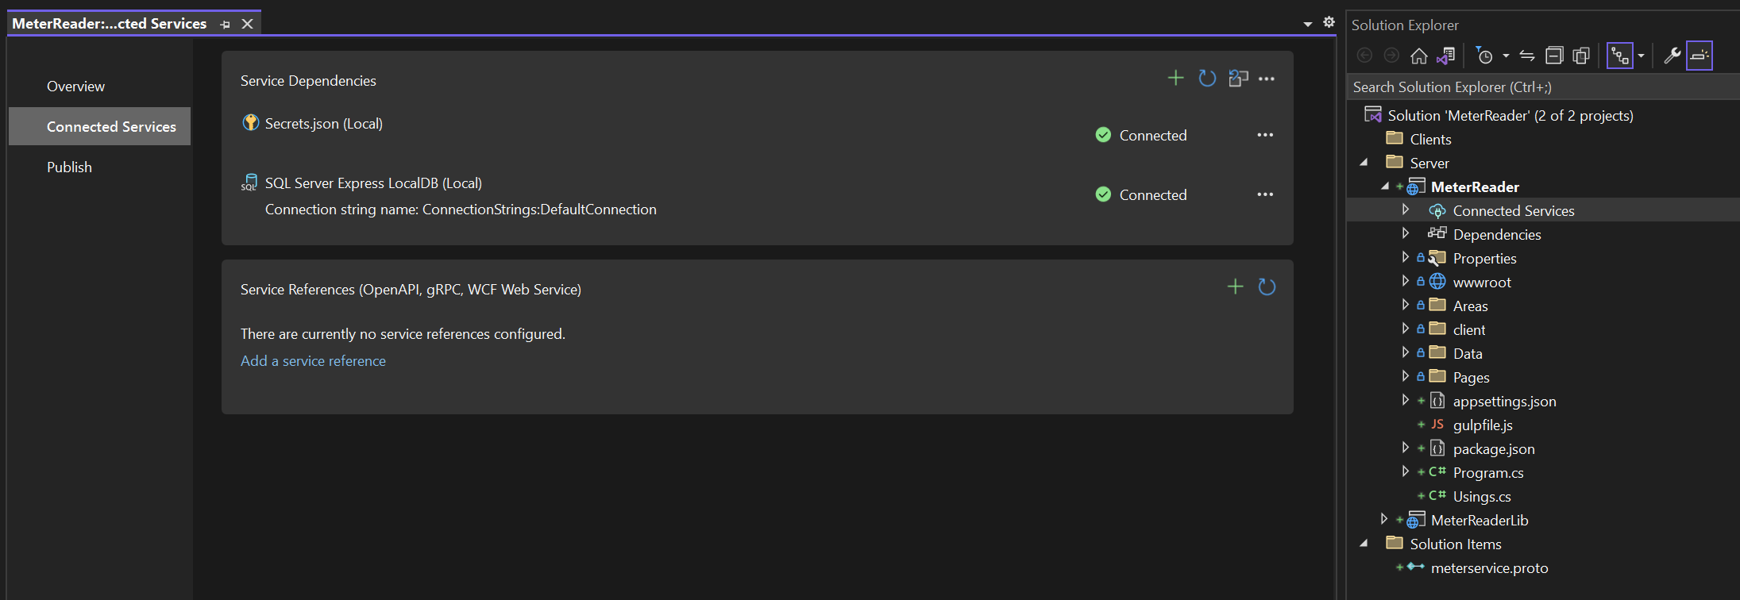
Connected service

Slide 14
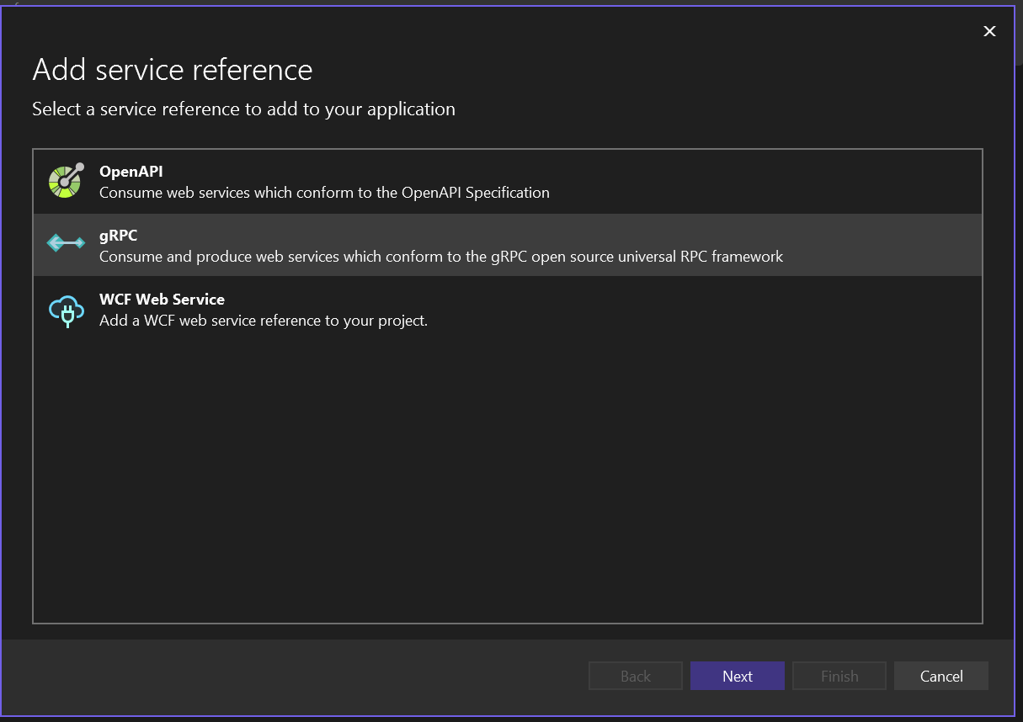
Connected service

Slide 15
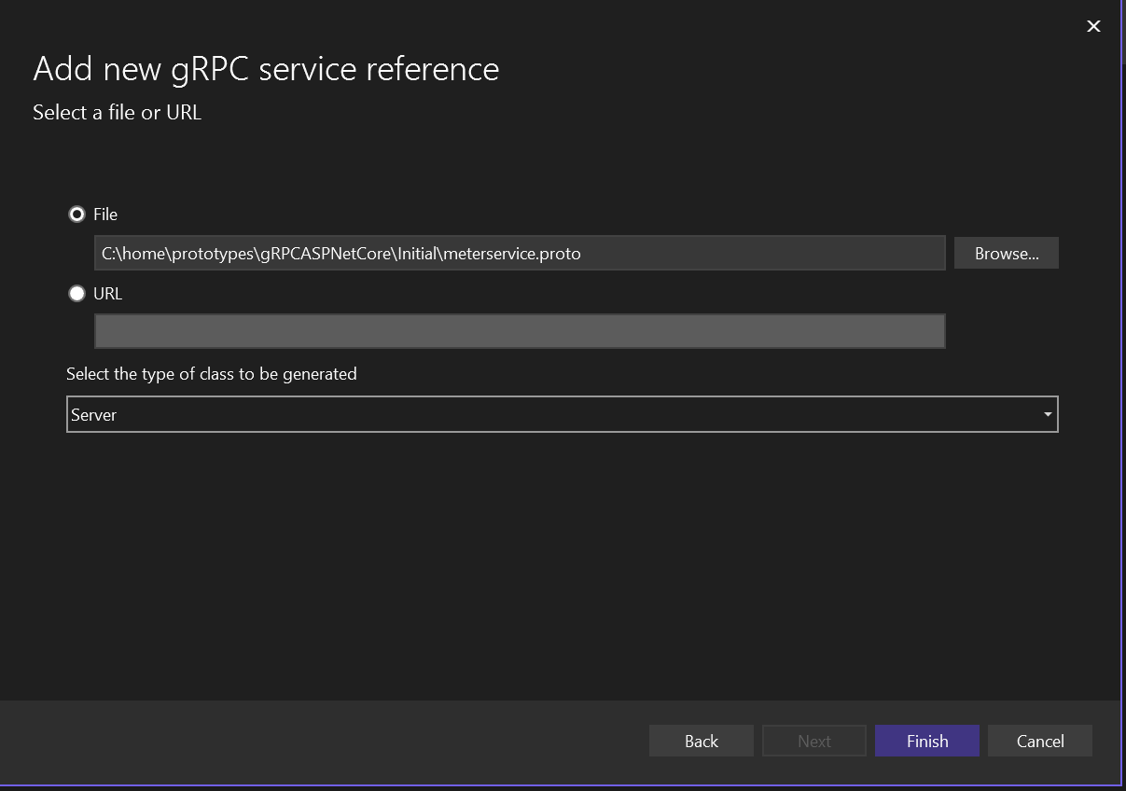
Connected service - proto

Slide 16
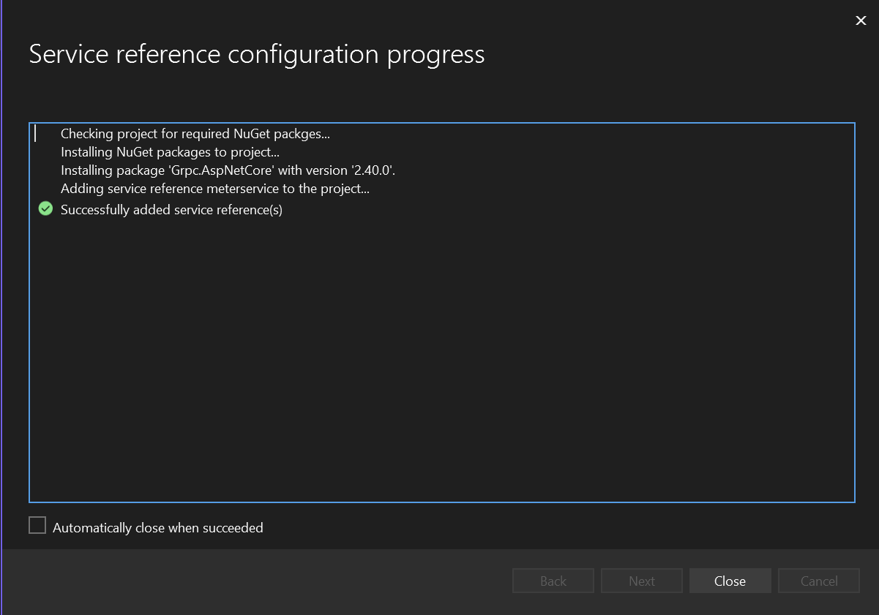

Slide 17
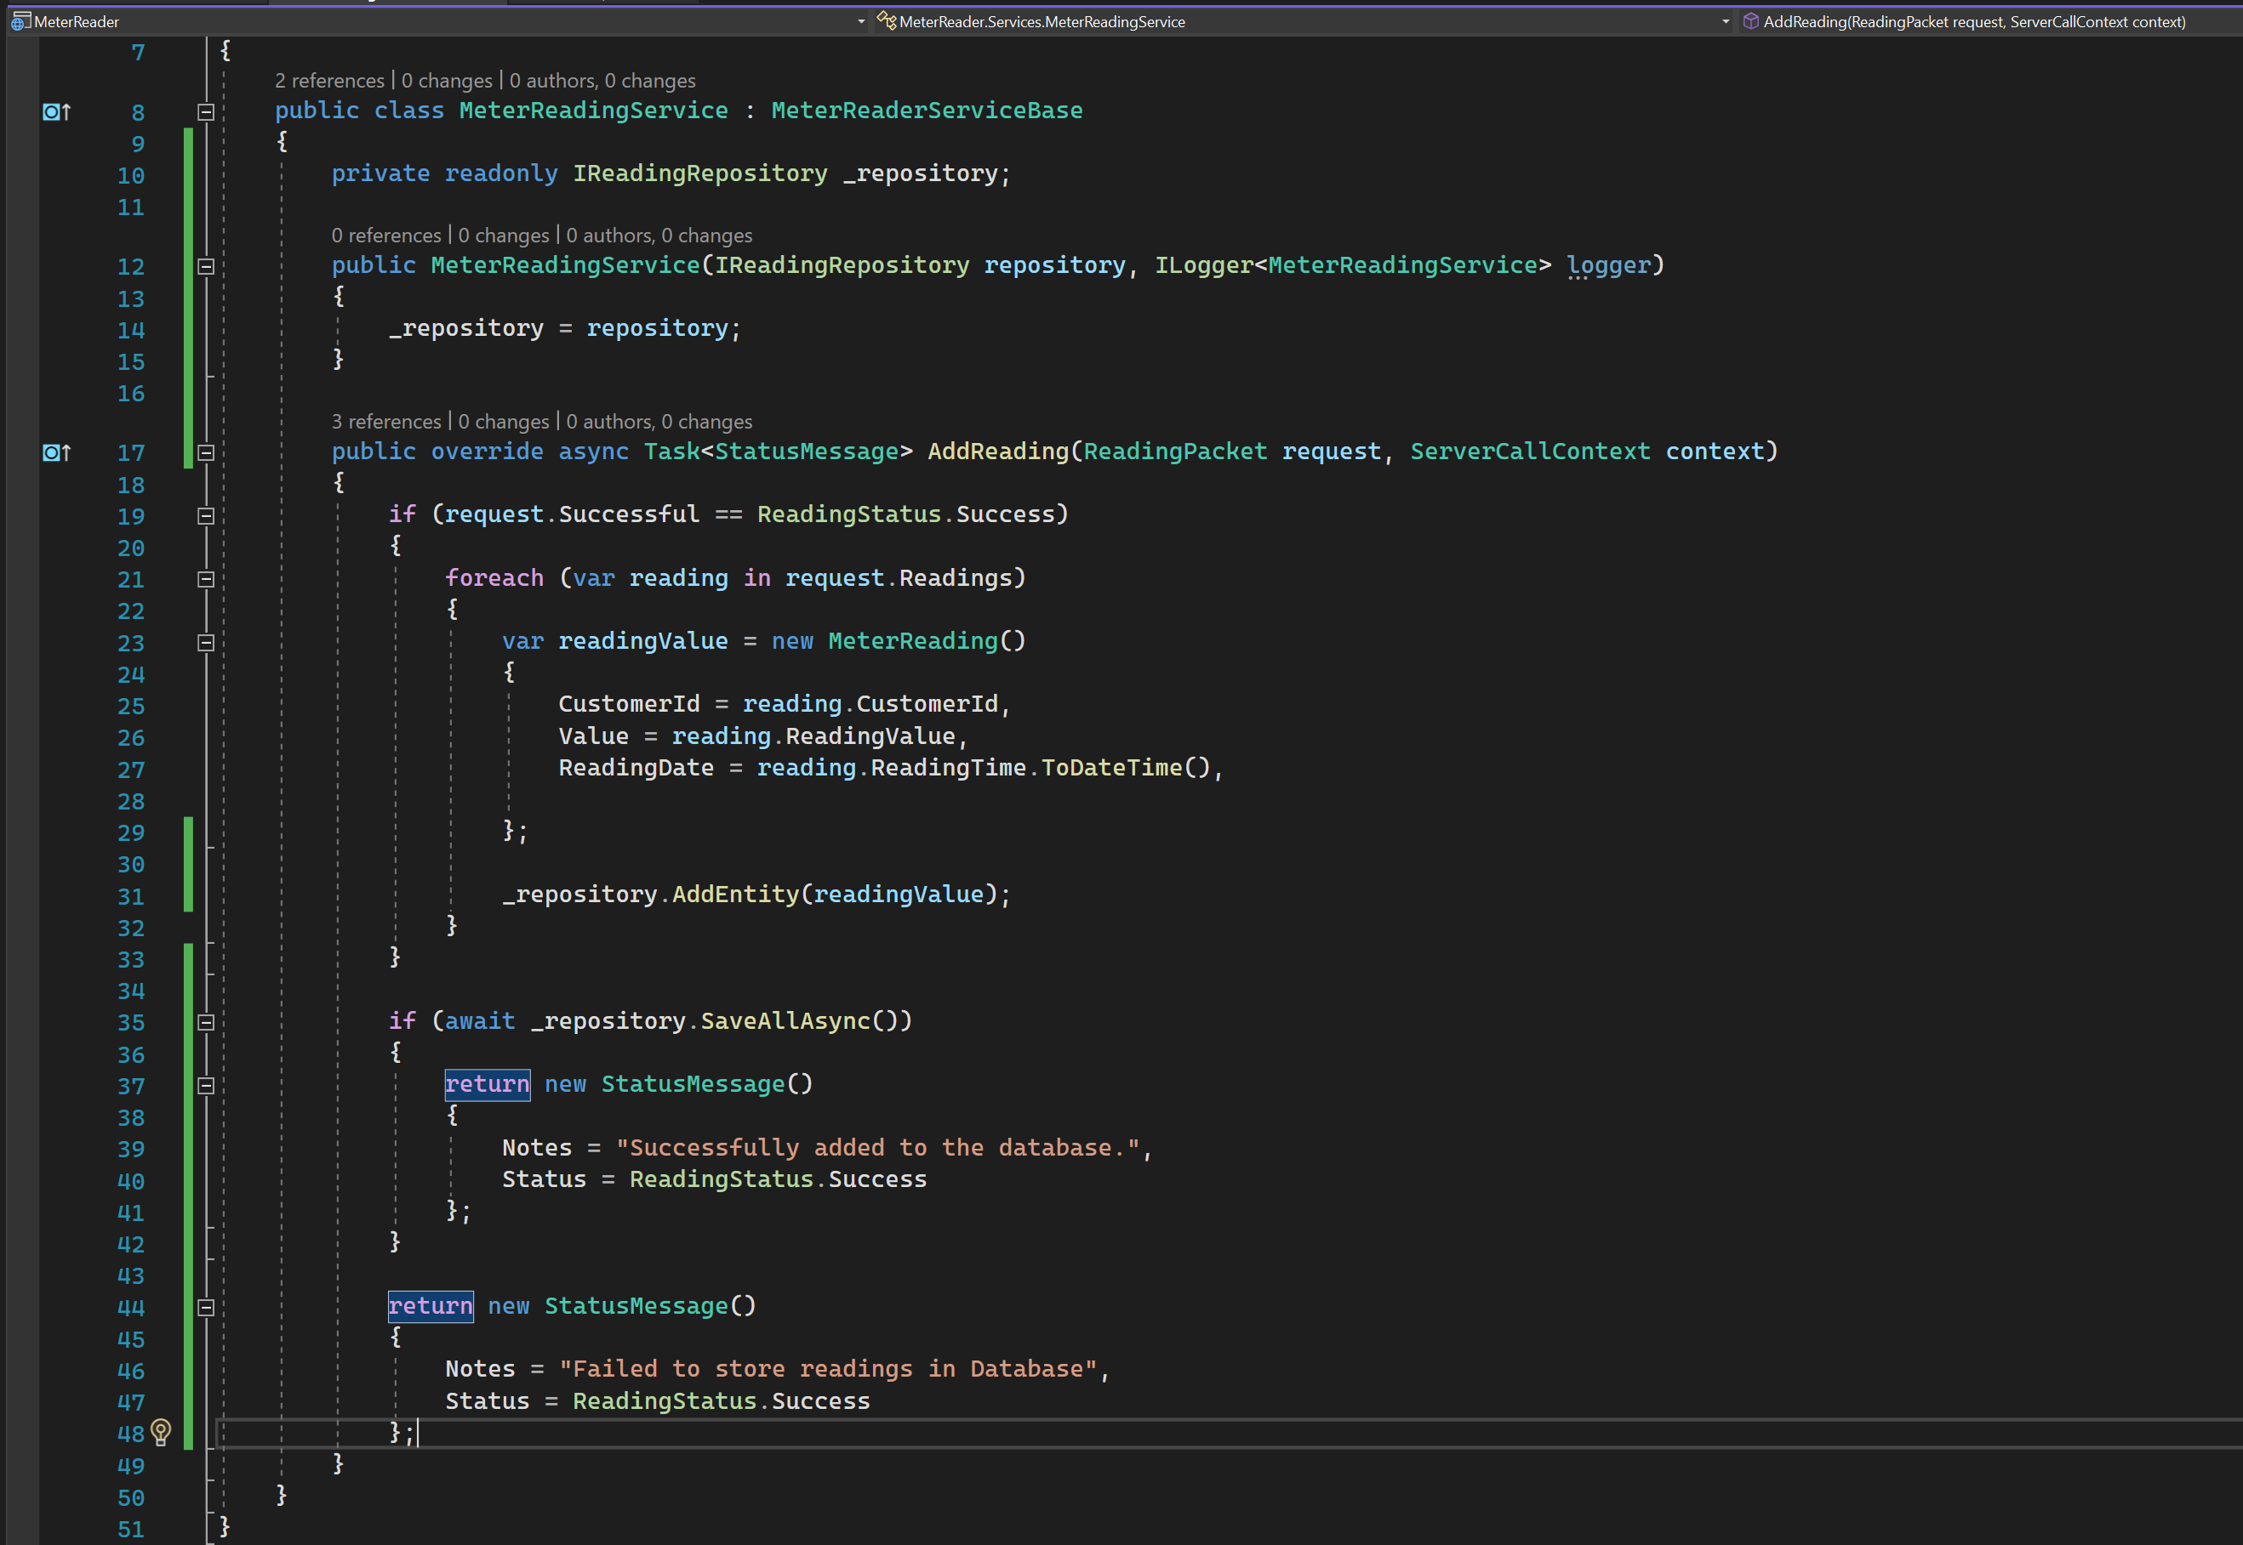
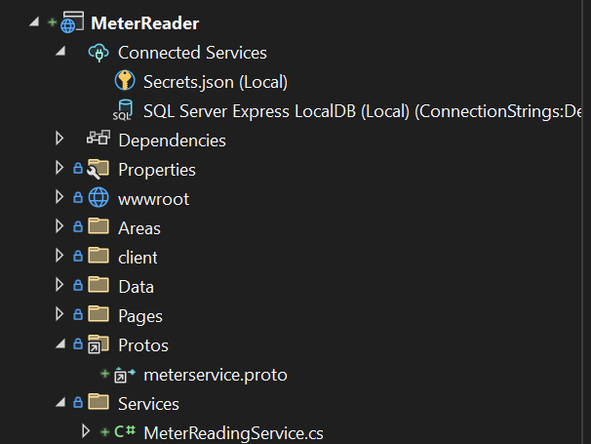

Slide 18
