Slide 1

Mosquito
Getting started

Slide 2
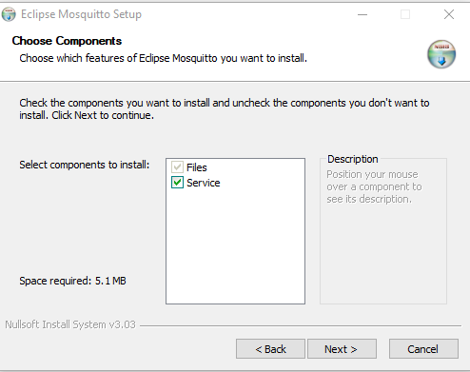
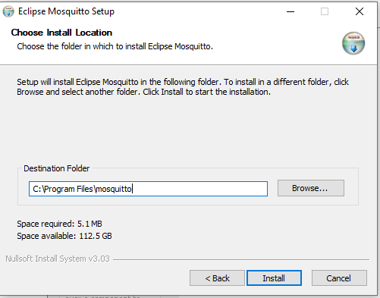
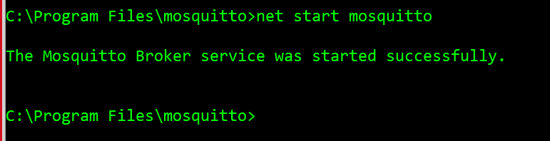
MOSQUITTO - WIndows
https://mosquitto.org/download/

Slide 3
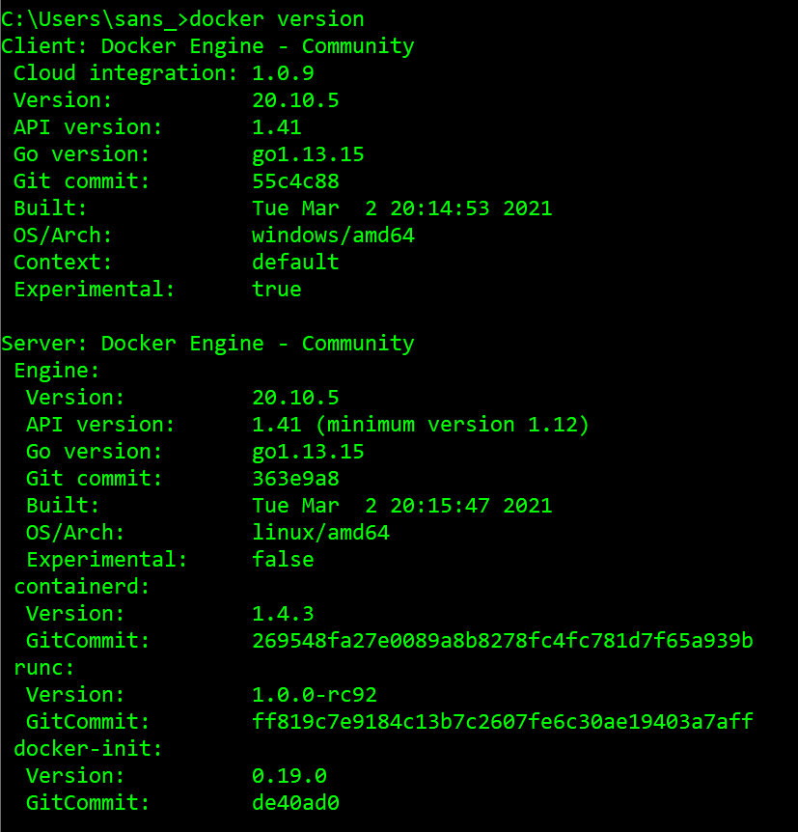
MOSQUITTO-DOCKER- 1/

Slide 4
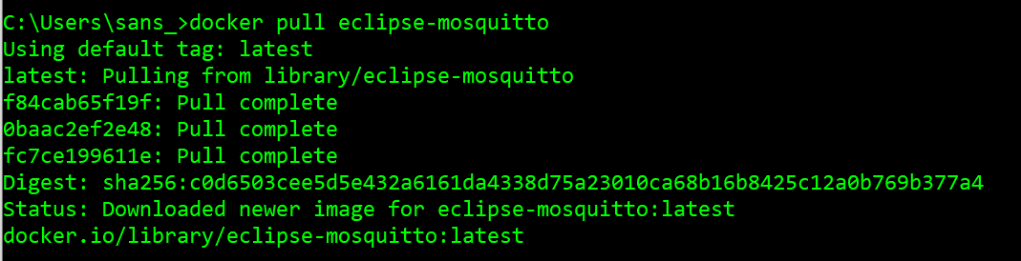
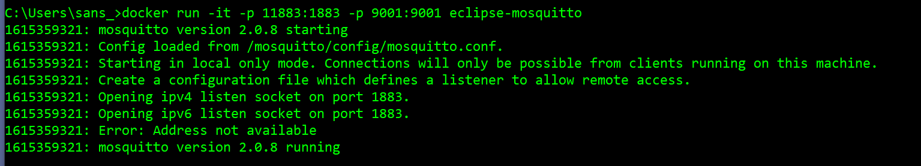
MOSQUITTO-DOCKER- 2 /

Slide 5
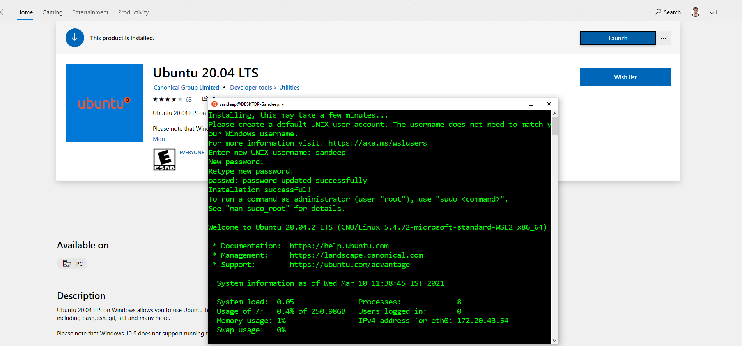
MOSQUITTO-DOCKER- 3/

Slide 6
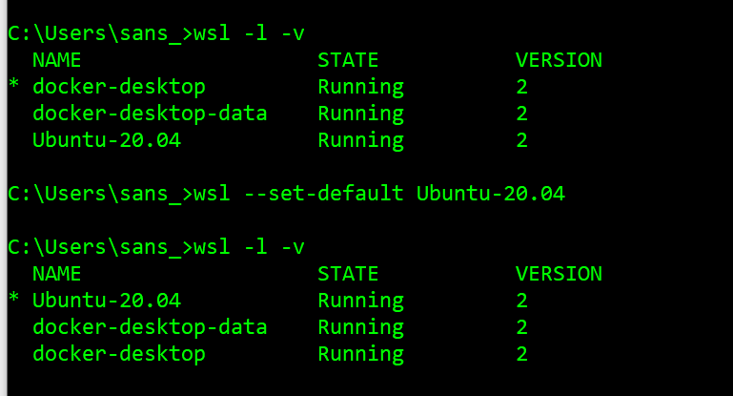
MOSQUITTO-DOCKER- 4/

Slide 7
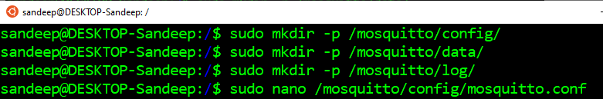
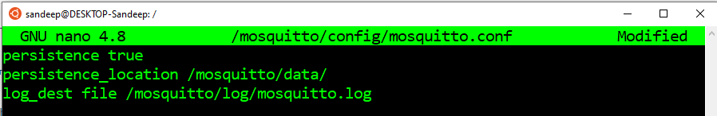
MOSQUITTO-DOCKER- 5/
Notes:
docker run -it -p 11883:1883 -p 9001:9001 -v /mosquitto/:/mosquitto/ eclipse-mosquitto

Slide 8
MQTT
https://www.codeproject.com/Articles/5283088/MQTT-Message-Queue-Telemetry-Transport-Protocol-wi

