Slide 1

Mosquito
Getting started

Slide 2
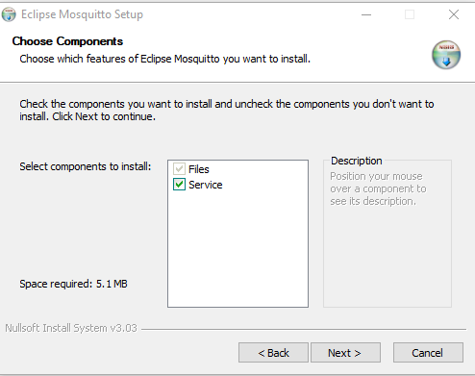
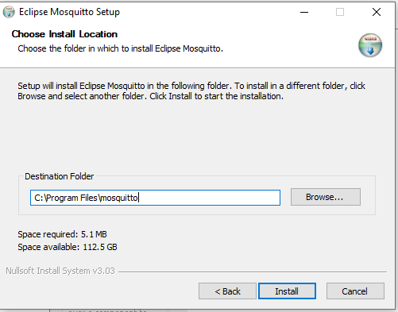
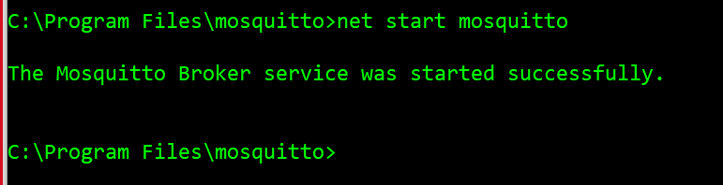
MOSQUITTO
https://mosquitto.org/download/

Slide 3
MQTT
https://www.codeproject.com/Articles/5283088/MQTT-Message-Queue-Telemetry-Transport-Protocol-wi

