Slide 1
Image Captioning Using Attention Mechanism
Sanjay Singh
san.singhsanjay@gmail.com

Slide 2
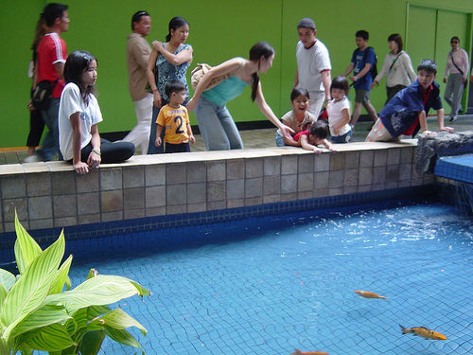
Introduction
Automated Image Captioning (or simply Image Captioning) can be defined as generating a textual description for a given image.
This problem was well researched by Andrej Karpathy in his PhD at Stanford University.
Deep Learning has achieved state-of-art result in Image Captioning.
In this project, the advanced solution (i.e., Attention Mechanism or to be more specific, Visual Attention Mechanism) for Image Captioning is implemented. A classical solution for Image Captioning is Encoder/Decoder based
Attention Mechanism is also quite useful in Neural Machine Translation, i.e., translating text from one natural language to another.
Following is an example of Image Captioning:
1. Children sit and watch the fish moving in the pond. 2. people stare at the orange fish. 3. Several people are standing near a fish pond. 4. Some children watching fish in a pool. 5. There are several people and children looking into water with a blue tiled floor and goldfish.

Slide 3
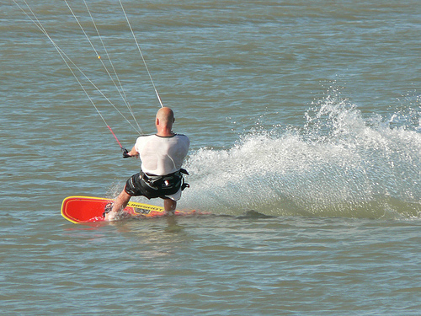

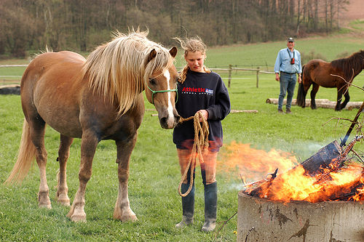
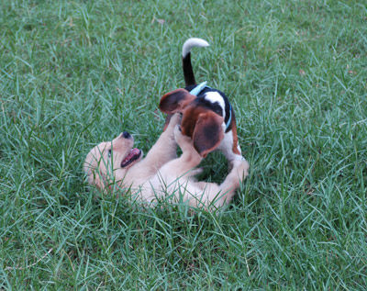
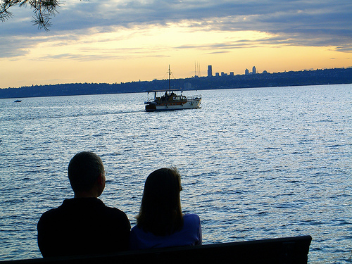
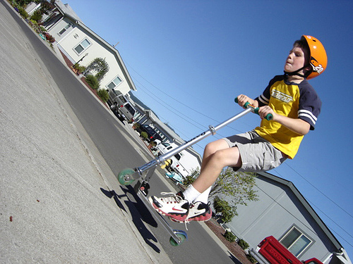
Introduction…
Some other sample images are:

Slide 4
Introduction…
Following are some of the applications of Image Captioning:
Self Driving Cars
Aid to blind people: It can guide blind people by generating text for the scene in front and speaking it by using TTS (Text to Speech) systems.
CCTV cameras are everywhere, but along with viewing the world, it can generate relevant captions, then we can raise alarms as any malicious activity take place.
Image Captioning can make Google Image Search better.

Slide 5
Dataset
Flickr8k dataset is used here. Following is the link of this dataset:
https://www.kaggle.com/adityajn105/flickr8k
Flickr8k has 8,091 images with caption.txt file containing five captions for each image. All these five captions are written by different people. Thus,
8,091 Images x 5 Captions = 40,455 Image-Captions
Size of this dataset: 1.04 GB
A training file and testing file containing name of images to be used in training and testing is downloaded from the Internet (source is missing).
Other than Flickr8k dataset, some other datasets for Image Captioning are:
Flickr30k: It contains 30,000 images
MS-COCO: It contains 1,80,000 images. This is the largest dataset for Image Captioning.
We will work Flickr8k dataset as this is sufficient to learn the implementation of Automatic Image Captioning using Attention Mechanism.

Slide 6
Technology
In this project, advanced solution (i.e., Attention Mechanism or Visual Attention Mechanism) for Image Captioning is implemented.
A naive approach is also there, called as Classical Encoder/Decoder based approach. This advanced solution is also Encoder/Decoder based, however it has an additional layer for Attention Mechanism.
Attention Mechanism is also quite useful for Neural Machine Translation (i.e., translating text from one natural language to another natural language). To be more specific, Attention Mechanism for Image Captioning is called as Visual Attention Mechanism.
This project is at the intersection of two technologies:
Computer Vision (CV): To understand the content of a given image.
Natural Language Generation (NLG): NLG transforms data into plain English text.
Applications of Natural Language Generation (NLG):
Freeform text generation: User provides an input, like a phrase, sentence or paragraph and the NLG model generates continuation of this input as output. For instance, Google Smart Compose predicts a phrase following a word input in Gmail.
Question Answering: This is a system that can answer questions posed by humans. These systems can be open-ended or close-ended (domain specific).

Slide 7
Technology…
Summarization: Summarization reduces the amount of information while capturing the most important details in a narrative. This is of two types:
Extractive Summarization: It takes the most important phrases or sentences from the given text and stitches them together to form a summarized narrative.
Abstractive Summarization: This is equivalent of a human writing a summary in his / her own words. For instance, headline generation, abstract for journals / whitepaper / etc.
Image Captioning
How NLG is different from NLP: NLP is focussed on deriving analytic insights from textual data. Whereas, NLG is used to synthesize textual content by combining analytic output with contextualized narratives. In short, NLP reads while NLG writes.

Slide 8
Attention Mechanism
Attention Mechanism is one of the most influential ideas in the Deep Learning.
Initially, this idea was designed for Neural Machine Translation. However, today it can be used in various problems, like Image Captioning, etc.
As we know, there is a classical Encoder / Decoder based solution for Image Captioning. The drawback with that classical approach is:
Since each word of the caption would be defining a part of the image, thus by considering the whole representation of image to generate the next word of caption which will be describing a part of the image would not be efficient, especially for long captions or descriptions.
Attention mechanism is a complex cognitive ability that human possess. When people receive information, they consciously ignore some of the secondary information. This ability of self selection is called Attention.
Attention Mechanism allows the neural networks to have the ability to focus on its subset of inputs to select specific features.
Neural Network architecture with Attention Mechanism for Image Captioning is also an Encoder / Decoder like classical Encoder / Decoder solution but with an additional layer, called as Attention Mechanism.

Slide 9
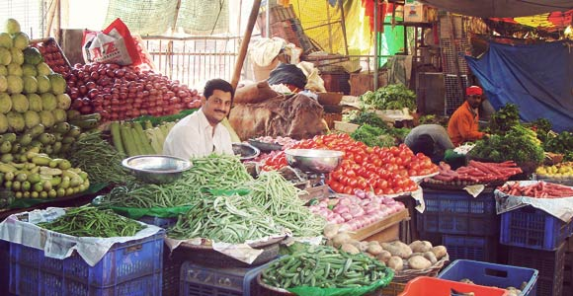
Attention Mechanism…
Attention Mechanism was actually developed for Neural Machine Translation (i.e., translating text from one natural language to another). For this, Attention Mechanism gets text in one natural language and translate it into another natural language, as depicted below:
Thus, in case of Neural Machine Translation, input and output, both are text.
Whereas, in case of Image Captioning, input is an image and output is text. That’s why Attention Mechanism was modified to take an image as input. This modified version of Attention Mechanism is known as Visual Attention Mechanism because it takes an image as input.
Neural Machine Translation with Attention Mechanism
A dog is running fast over the beach.
Visual Attention Mechanism
A smiling man is sitting in his vegetable shop

Slide 10
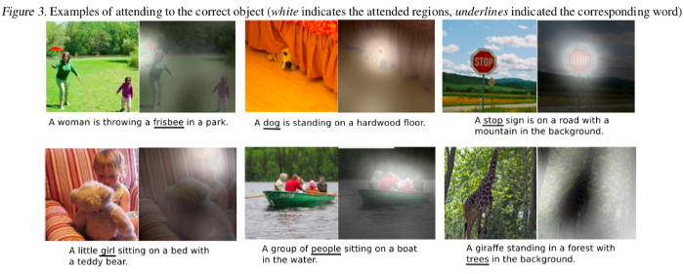
Attention Mechanism…
With Attention Mechanism for Image Captioning, the image is first divided into n parts and we compute representation of each part (representation of each part is denoted by h₁, h₂, h₃, …, h_{n}) by a CNN (Convolutional Neural Network).
When the RNN (Recurrent Neural Network) is generating a new word, the Attention Mechanism focuses on the relevant part of the image. So, the decoder uses the specific parts of input image while generating a new (or next) word. Following is the example:

Slide 11
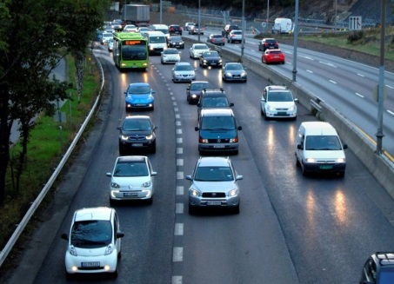
Attention Mechanism…
Following is the architecture of our Neural Network with Attention Mechanism for Image Captioning (similar to Classical Encoder / Decoder architecture but with an additional layer of Attention Mechanism AM):
h₀
y₁
AM
LSTM
many
h₁
y₂
AM
LSTM
cars
VGG-16
h₂
y₃
AM
LSTM
are
h₃
AM
: Attention Mechanism
h₀: “startseq”
h_{k-1}
y_{n}
AM
LSTM
road

Slide 12
Attention Mechanism…
Following is how this advanced solution works:
If network has predicted i words, then the hidden state of LSTM would be h_{i}. This h_{i} would be passed to the AM (i.e., Attention Mechanism) which will select the relevant part of the image by using h_{i} as context and pass this relevant part of image (say, z_{i}) to LSTM to predict the next word which will make the hidden state of LSTM as h_{i+1}.
There are two types of Attention Mechanism:
Global Attention Mechanism (aka Luong’s Attention): Attention is placed on all source position.
Local Attention Mechanism (aka Bahdanu’s Attention): Attention is placed only on a few source positions.
Both the types of Attention Mechanisms differ from the classical Encoder / Decoder architecture only in the decoding phase due to presence of AM (i.e., Attention Mechanism layer).
Both Global and Local Attention Mechanism differ in the way that they compute context vector (aka thought vector, i.e., the output of Encoder), can be represented by c(t).

Slide 13
Attention Mechanism…
Global Attention (i.e., Luong’s Attention) takes into consideration all encoder hidden states to derive the context vector c(t).
This can be further simplified as in case of Neural Machine Translation, Global Attention focuses on all source side words to derive all target words. Similarly in case of Image Captioning, Global Attention considers all divided parts of input image to generate the caption (or textual description) for image.
Thus, it is computationally very expensive and is impractical when translating for long sentences.
Therefore, we will see implementation of only Local Attention (i.e., Bahdanu’s Attention).
Local Attention (or Bahdanu’s Attention):
Suppose, we have divided our input image into an input sequence of 5 parts. Now, before we start decoding, we first need to encode the input sequence into a set of internal states (h₁, h₂, h₃, h₄, h₅).
Now, the next word in the output sequence is dependent on the current state of the decoder as well as on the hidden state of the encoder. Thus, at each time step, we consider these two things and follow the below steps:

Slide 14
Attention Mechanism…
We want our decoder to pay more attention to the states h₁ and h₂ (assume) while paying less attention to the remaining states of the encoder. For this reason, we train a feed forward neural network which will learn to identify relevant encoder states by generating a high score for the states for which attention is to be paid while low score for the states which are to be ignored.
Let s₁, s₂, s₃, s₄, s₅ be the scores generated for the states h₁, h₂, h₃, h₄, h₅. Since, we want to pay attention to h₁ and h₂ (assume) and ignore (h₃, h₄, h₅), thus s₁ and s₂ will be high while (s₃, s₄, s₅) are relatively low.
Once these scores are generated, we apply a softmax on these scores to produce the attention weights (e₁, e₂, e₃, e₄, e₅).
The advantage of applying softmax is as below:
All the weights lie between 0 and 1, i.e., (e₁, e₂, e₃, e₄, e₅) ϵ [0, 1].
All the weights sum to 1, i.e., e₁ + e₂ + e₃ + e₄ + e₅ = 1.
Suppose, following are the values of attention weights:
Thus, due to large values of e₁ and e₂, attention will be on h₁ and h₂, others (i.e., h₃, h₄, h₅) will be ignored due to small values of (e₃, e₄, e₅).
e₁ = 0.75 | e₂ = 0.2 | e₃ = 0.02 | e₄ = 0.02 | e₅ = 0.01

Slide 15
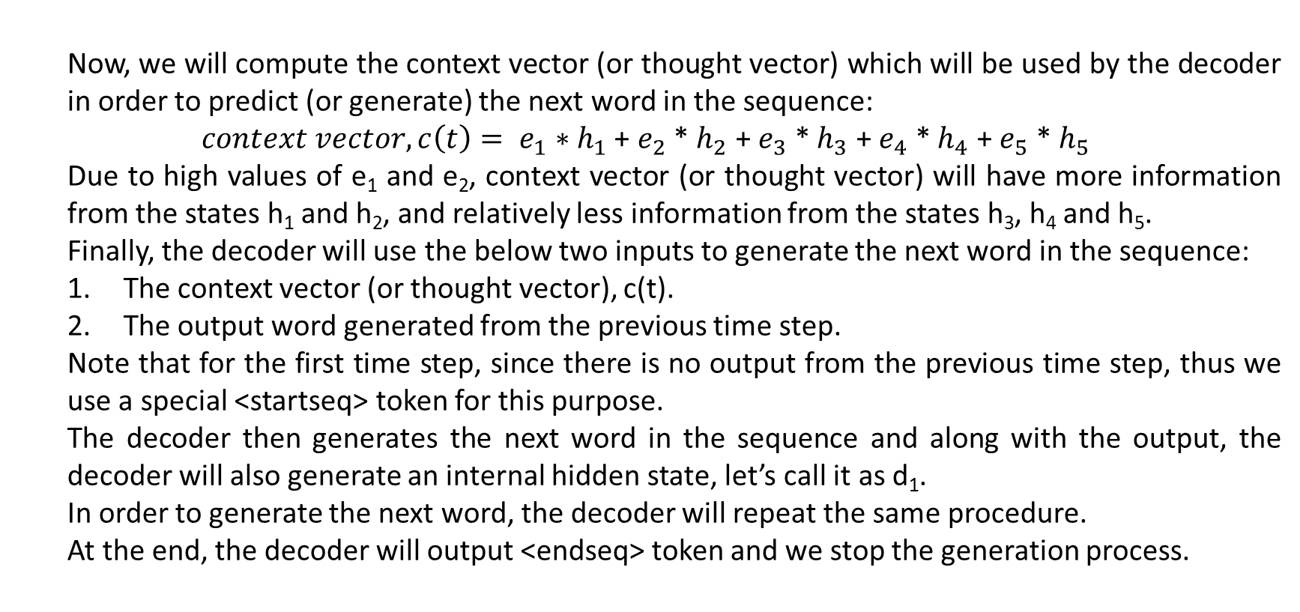
Attention Mechanism…
Now, we will compute the context vector (or thought vector) which will be used by the decoder in order to predict (or generate) the next word in the sequence:
$context vector, c\left(t\right)= e_{1}∗h_{1}$ + $e_{2}$ * $h_{2}$ + $e_{3}$ * $h_{3}$ + $e_{4}$ * $h_{4}$ + $e_{5}$ * $h_{5}$
Due to high values of e₁ and e₂, context vector (or thought vector) will have more information from the states h₁ and h₂, and relatively less information from the states h₃, h₄ and h₅.
Finally, the decoder will use the below two inputs to generate the next word in the sequence:
The context vector (or thought vector), c(t).
The output word generated from the previous time step.
Note that for the first time step, since there is no output from the previous time step, thus we use a special <startseq> token for this purpose.
The decoder then generates the next word in the sequence and along with the output, the decoder will also generate an internal hidden state, let’s call it as d₁.
In order to generate the next word, the decoder will repeat the same procedure.
At the end, the decoder will output <endseq> token and we stop the generation process.

Slide 16
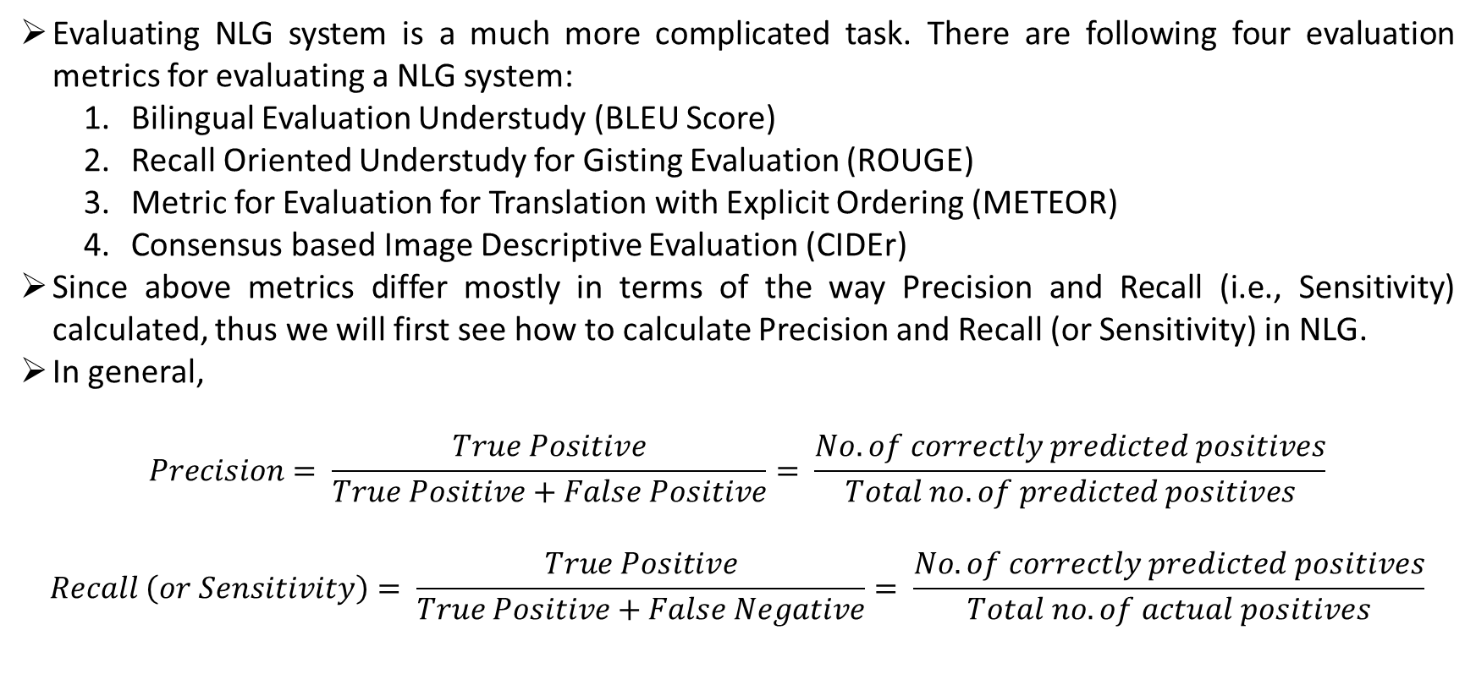
Evaluation Metric
Evaluating NLG system is a much more complicated task. There are following four evaluation metrics for evaluating a NLG system:
Bilingual Evaluation Understudy (BLEU Score)
Recall Oriented Understudy for Gisting Evaluation (ROUGE)
Metric for Evaluation for Translation with Explicit Ordering (METEOR)
Consensus based Image Descriptive Evaluation (CIDEr)
Since above metrics differ mostly in terms of the way Precision and Recall (i.e., Sensitivity) calculated, thus we will first see how to calculate Precision and Recall (or Sensitivity) in NLG.
In general,
$$Precision= \frac{True Positive}{True Positive+False Positive}= \frac{No. of correctly predicted positives}{Total no. of predicted positives}$$
$$Recall \left(or Sensitivity\right)= \frac{True Positive}{True Positive+False Negative}= \frac{No. of correctly predicted positives}{Total no. of actual positives}$$

Slide 17
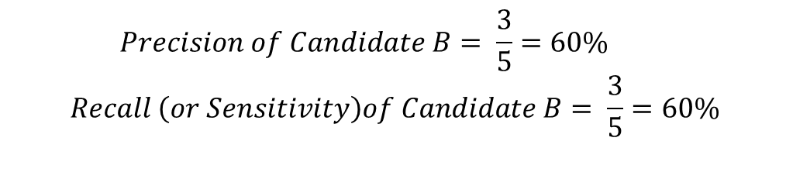
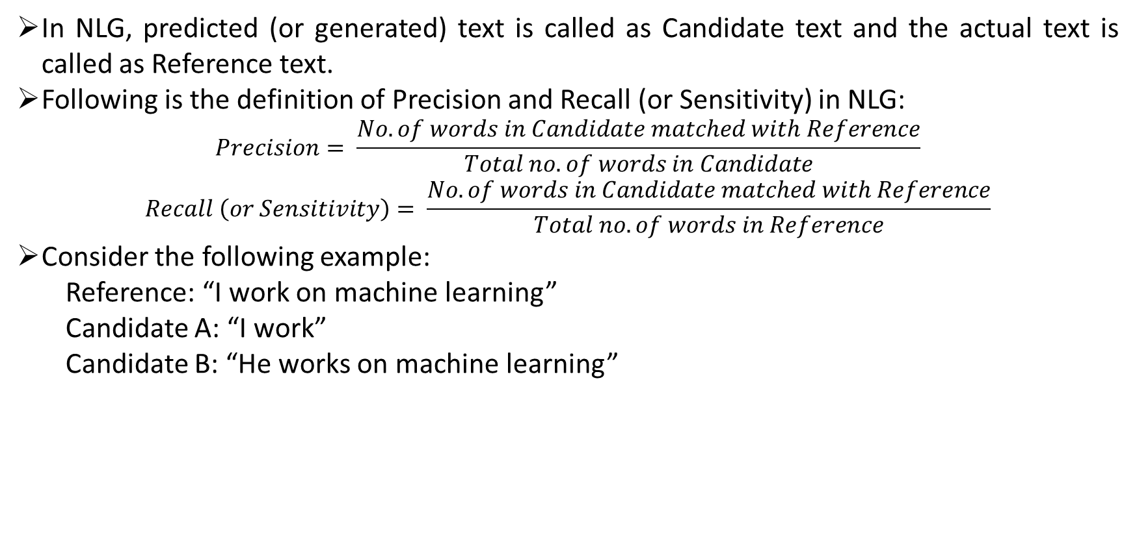
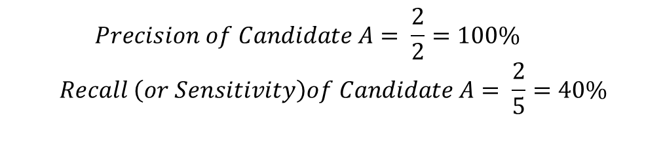
Evaluation Metric…
In NLG, predicted (or generated) text is called as Candidate text and the actual text is called as Reference text.
Following is the definition of Precision and Recall (or Sensitivity) in NLG:
$$Precision= \frac{No. of words in Candidate matched with Reference}{Total no. of words in Candidate}$$
$$Recall \left(or Sensitivity\right)= \frac{No. of words in Candidate matched with Reference}{Total no. of words in Reference}$$
Consider the following example:
Reference: “I work on machine learning”
Candidate A: “I work”
Candidate B: “He works on machine learning”
$$Precision of Candidate A= \frac{2}{2}=100\%$$
$$Recall \left(or Sensitivity\right)of Candidate A= \frac{2}{5}=40\%$$
$$Precision of Candidate B= \frac{3}{5}=60\%$$
$$Recall \left(or Sensitivity\right)of Candidate B= \frac{3}{5}=60\%$$

Slide 18
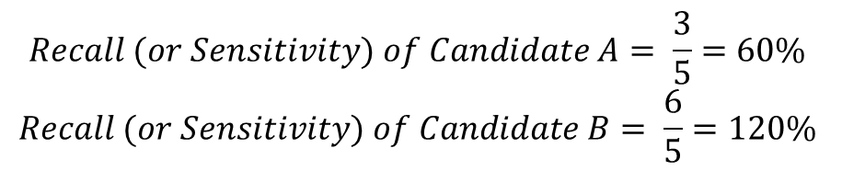
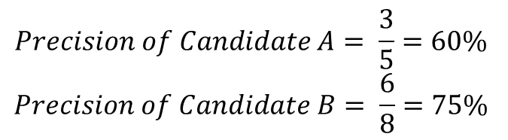
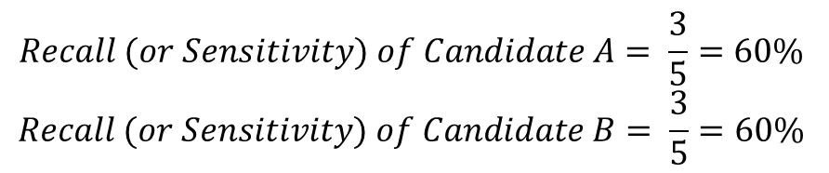
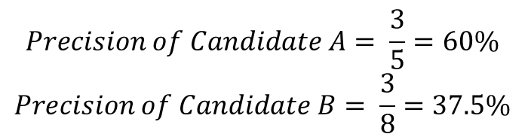
Evaluation Metric…
All previous calculations are done by using unigrams (i.e., no. of words, n = 1). These calculation can also be done by using bigrams (n = 2), trigrams (n = 3) and so on.
Consider the following example:
Reference: “I work on machine learning”
Candidate A: “He works on machine learning”
Candidate B: “He works on on machine machine learning learning”
In case of unigram (i.e., n = 1):
There is a modified n-gram scheme in which we match candidate’s n-grams only as many times as they are present in any of reference text. Thus, “on”, “machine” and “learning of Candidate B will get match only once in unigram (i.e., n = 1).
$$Precision of Candidate A= \frac{3}{5}=60\%$$
$$Precision of Candidate B= \frac{6}{8}=75\%$$
$$Recall (or Sensitivity) of Candidate A= \frac{3}{5}=60\%$$
$$Recall (or Sensitivity) of Candidate B= \frac{6}{5}=120\%$$
$$Precision of Candidate A= \frac{3}{5}=60\%$$
$$Precision of Candidate B= \frac{3}{8}=37.5\%$$
$$Recall (or Sensitivity) of Candidate A= \frac{3}{5}=60\%$$
$$Recall (or Sensitivity) of Candidate B= \frac{3}{5}=60\%$$

Slide 19
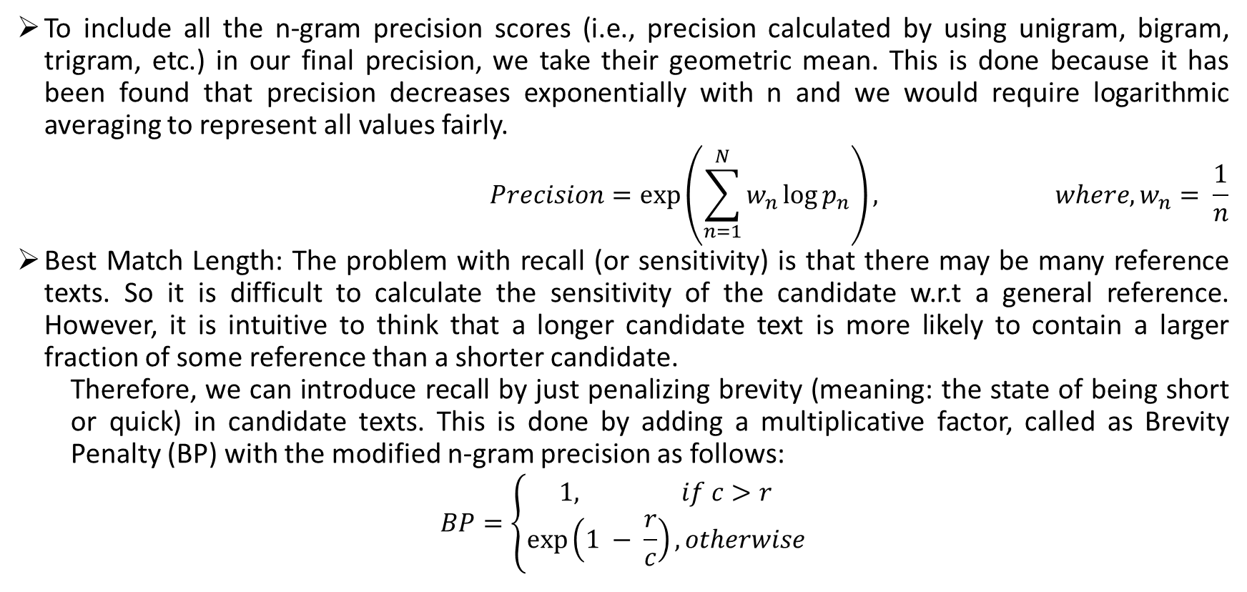
Evaluation Metric…
To include all the n-gram precision scores (i.e., precision calculated by using unigram, bigram, trigram, etc.) in our final precision, we take their geometric mean. This is done because it has been found that precision decreases exponentially with n and we would require logarithmic averaging to represent all values fairly.
$$Precision=\exp\left(\sum_{n=1}^{N}{w_{n}\log{p_{n}}}\right), where, w_{n}= \frac{1}{n}$$
Best Match Length: The problem with recall (or sensitivity) is that there may be many reference texts. So it is difficult to calculate the sensitivity of the candidate w.r.t a general reference. However, it is intuitive to think that a longer candidate text is more likely to contain a larger fraction of some reference than a shorter candidate.
Therefore, we can introduce recall by just penalizing brevity (meaning: the state of being short or quick) in candidate texts. This is done by adding a multiplicative factor, called as Brevity Penalty (BP) with the modified n-gram precision as follows:
$$BP=\left\{\begin{aligned}1, if c>r \\ \exp\left(1 − \frac{r}{c}\right), otherwise\end{aligned}\right.$$

Slide 20
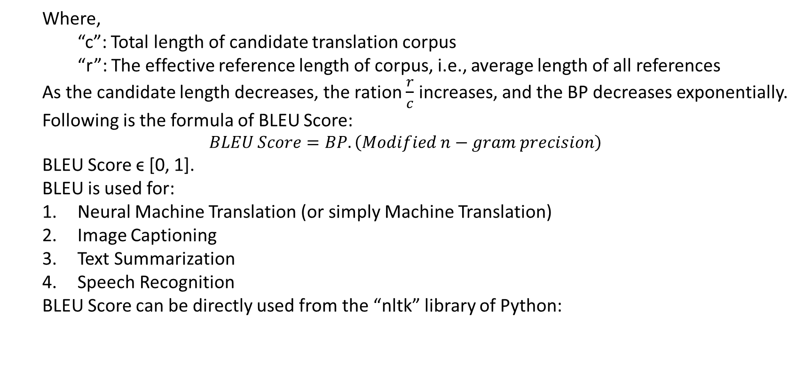
Evaluation Metric…
Where,
“c”: Total length of candidate translation corpus
“r”: The effective reference length of corpus, i.e., average length of all references
As the candidate length decreases, the ration $\frac{r}{c}$ increases, and the BP decreases exponentially.
Following is the formula of BLEU Score:
$$BLEU Score=BP. \left(Modified n−gram precision\right)$$
BLEU Score ϵ [0, 1].
BLEU is used for:
Neural Machine Translation (or simply Machine Translation)
Image Captioning
Text Summarization
Speech Recognition
BLEU Score can be directly used from the “nltk” library of Python:
1 | import nltk.translate.bleu_score as bleu
2 | bleu_sc = bleu.sentence_bleu(reference, candidate) # for one reference text
3 | bleu_sc = bleu.corpus_bleu(reference, candidate) # for multiple reference text

Slide 21
Evaluation Metric…
We have seen how to calculate modified n-gram precision for one reference. However, practically we have multiple references. Thus, let us see how to calculate it for multiple references:
Candidate 1: It is a guide to action which ensures that the military always obeys the commands of the party.
Reference 1: It is a guide to action that ensures that the military will forever heed party commands.
Reference 2: It is the guiding principle which guarantees the military forces always being under the command of the party.
Reference 3: It is the practical guide for the army always to heed the directions of the party.
We will calculate following:
Count: Count the maximum number of times a candidate n-gram occurs in the candidate.
Ref1 Count, Ref2 Count and Ref3 Count: For each reference sentence, count the number of times a candidate n-gram occurs.
Max Ref Count: Take the maximum number of n-grams occurrences in reference count.
Count Clip: Take the minimum number of Count and Max Ref Count.
Count Clip = min(Count, Max Ref Count)
Divide the Clipped Count by the total unclipped number of candidate n-grams to get the modified precision score (p_{n}).

Slide 22
Evaluation Metric…
Candidate n-gram | Count | Ref1 Count | Ref2 Count | Ref3 Count | Max Ref Count | Count Clip
“It” | 1 | 1 | 1 | 1 | 1 | 1
“is” | 1 | 1 | 1 | 1 | 1 | 1
“a” | 1 | 1 | 0 | 0 | 1 | 1
“guide” | 1 | 1 | 0 | 1 | 1 | 1
“to” | 1 | 1 | 0 | 1 | 1 | 1
“action” | 1 | 1 | 0 | 0 | 1 | 1
“which” | 1 | 0 | 1 | 0 | 1 | 1
“ensures” | 1 | 1 | 0 | 0 | 1 | 1
“that” | 2 (1) | 2 | 0 | 0 | 2 | 2 (1)
“the” | 3 | 1 | 4 | 4 | 4 | 3
“military” | 1 | 1 | 1 | 0 | 1 | 1
“always” | 1 | 0 | 1 | 1 | 1 | 1
“obeys” | 0 (1) | 0 | 0 | 0 | 0 | 0
“commands” | 1 | 1 | 0 | 0 | 1 | 1
“of” | 0 (1) | 0 | 1 | 1 | 1 | 0 (1)
“party” | 1 | 0 | 0 (1) | 1 | 1 | 1
18 |  |  |  |  |  | 17

Slide 23
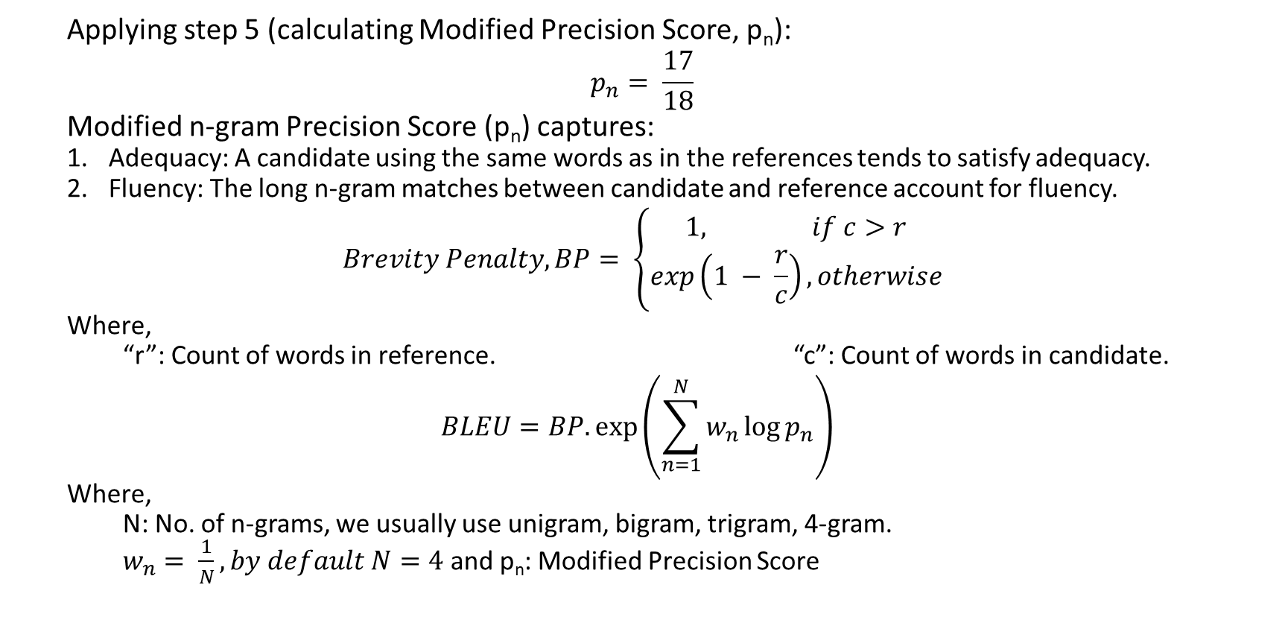
Evaluation Metric…
Applying step 5 (calculating Modified Precision Score, p_{n}):
$$p_{n}= \frac{17}{18}$$
Modified n-gram Precision Score (p_{n}) captures:
Adequacy: A candidate using the same words as in the references tends to satisfy adequacy.
Fluency: The long n-gram matches between candidate and reference account for fluency.
$$Brevity Penalty, BP= \left\{\begin{aligned}1, if c>r \\ exp\left(1 − \frac{r}{c}\right), otherwise\end{aligned}\right.$$
Where,
“r”: Count of words in reference. “c”: Count of words in candidate.
$$BLEU=BP. exp\left(\sum_{n=1}^{N}{w_{n}\log{p_{n}}}\right)⁡$$
Where,
N: No. of n-grams, we usually use unigram, bigram, trigram, 4-gram.
$w_{n}= \frac{1}{N}, by default N=4$ and p_{n}: Modified Precision Score

Slide 24
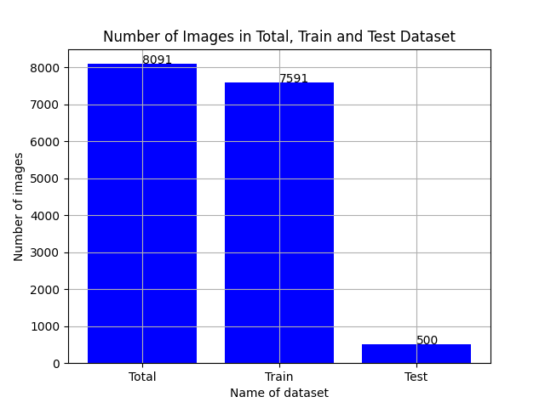
Scripts Execution Flow
Script “scripts/check_training_val_test.py” does following tasks:
Verifies that the name of images given in training and testing .txt files (i.e., Flickr_8k.trainImages.txt and Flickr_8k.testImages.txt) are in captions.txt file or not.
It also creates a file Flickr8k.valImages.txt which has name of images that are not in training and not in testing .txt file (i.e., Flickr_8k.trainImages.txt and Flickr_8k.testImages.txt). These images can be used for validation purpose, as the name of file suggests.
At last, this script generates and saves following plot which summarizes the number of images in the entire dataset; training, validation and testing subsets.

Slide 25
Scripts Execution Flow…
Script “scripts/segregate_train_val_test.py” does following tasks:
This script reads image filenames from Flickr_8.trainImages.txt, Flickr_8k.valImages.txt and Flickr_8k.testImages.txt; extracts these filenames and their captions (5 captions per file) from captions.txt; and save it in train_image_caption.csv, val_image_caption.csv and test_image_caption.csv.
All these files (i.e., train_image_caption.csv, val_image_caption.csv and test_image_caption.csv) have two columns: “image” and “caption”.
All five caption of an image are in a single row corresponding to its image filename, separated by “<>”. These captions are yet not cleaned.
Script “scripts/preprocessing_train.py” does following tasks:
It reads train_image_caption.csv file. Extracts image filenames and their five captions (joint by “<>”).
It takes out each caption of each image file and perform these operations: converts into lower case, removes all special characters, removes all single characters (like ‘a’, ‘s’, etc.) and removes numerical figures (such as ‘1’, ‘2’, etc.). This part is well known as Data Cleaning or Data Pre-processing.
Then, it put “startseq” and “endseq” before and after each processed caption, join them by “#” and save it with its image filename in file train_image_caption_processed.csv. “startseq” and “endseq” are special tokens.
Along with this, it also saves following files: max_caption_length.txt, vocabulary.txt & WordFreq.csv.

Slide 26
Scripts Execution Flow…
Script “scripts/preprocessing_val_test.npy” does following tasks:
This script reads val_image_caption.csv and test_image_caption.csv file. Extracts image filenames and their five captions (joint by “<>”).
It takes out each caption of each image file and perform these operations: converts into lower case, removes all special characters, removes all single characters (like ‘a’, ‘s’, etc.) and removes numerical figures (such as ‘1’, ‘2’, etc.). This part is well known as Data Cleaning or Data Pre-processing. This entire processing will be done by referring vocabulary.txt file as words not in vocabulary will be deleted from captions.
Then, it joins them by “#” and save it with its image filename in file val_image_caption_processed.csv and test_image_caption_processed.csv. “startseq” and “endseq” special tokens are not required for validation and test data because we have to directly match with generated captions which will not have “startseq” and “endseq” tokens.
Script “scripts/gen_image_features.csv” does following tasks:
This script loads each image which is in train_image_caption_processed.csv, resize it for the pre-trained model to generate bottleneck features (here, we have used VGG-16, discussed in later slides).
Then, it passes each of these images through our chosen pre-trained model (here it is VGG-16) and generates bottleneck feature of dimension (7, 7, 512). Then, script is reshaping it to (49, 512) and saving it as a npy file. Script has done this task image by image, i.e., one image at a time. In this manner, it will save 6,000 npy files (since we have 6,000 file names in Flickr_8k.trainImages.txt file).

Slide 27
Scripts Execution Flow…
Script “scripts/training_GColab.py” does following tasks:
Upload following files on Google Drive:
All files mentioned above are generated in previous steps except “glove.6B.200d.txt”. It is a pre-trained model from NLP (Natural Language Processing) that we will discuss later.
First thing that this script does is reading above mentioned files. It will create dictionary type variable for i. and ii. with image file name as key; and captions and bottleneck features as values for quick access during training.
After reading “vocabulary.txt”, it creates a dictionary, “wordtoix” (i.e., word-to-index). This dictionary type variable has all words of our cleaned captions as key and their line indices (from 0) in vocabulary.txt as value. This variable (i.e., “wordtoix”) is helpful for training process as it provides a numerical representation of our textual captions (since our algorithm processes only numbers).
Similarly, we also create one more variable “ixtoword”. This variable is also of dictionary type but has line indices (from 0) as key and word as value. This variable will be helpful during inference.
Script will save “wordtoix” and “ixtoword” as csv file for later use (when you will make inference without running this training script).
i. train_image_caption_processed.csv | ii. train_imagename_bottleneck_feat.csv
iii. vocabulary.txt | iv. max_caption_length.txt
v. glove.6B.200d.txt

Slide 28
Scripts Execution Flow…
Script is also creating a variable “embedding_matrix”. It’s a numpy.ndarray type variable of dimension (vocab_size, EMBEDDING_DIMENSION), where vocab_size is the number of words in file vocabulary.txt and EMBEDDING_DIMENSION is 200 which is the dimension of embeddings (or bottleneck features) generated by GloVe model.
Thus, we pass each word of vocabulary.txt file to GloVe model, it will generate a vector of 200 dimensions that we will store in embedding_matrix and at last we will save this variable as a csv file. So, the 200 dimensional embedding (or vector) of i^{th} word in vocabulary.txt file is at i^{th} index in embedding_matrix variable and also in the saved csv file, “embedding_matrix.csv”.
We will use this variable (or values) in our encoder-decoder neural network architecture.
Due to memory limitations, we cannot fed the entire data on encoder-decoder neural network architecture. Thus, a function called as “data_generator” is created which will prepare data and pass in batches to our encoder-decoder neural network architecture for training. Following tasks are performed by this “data_generator” function:
Pick an image name, extract its all five captions and bottleneck features from dictionary created in 5.ii. step.
Prepare training variable X (i.e., independent variable) and Y (i.e. dependent variable) as follows:

Slide 29
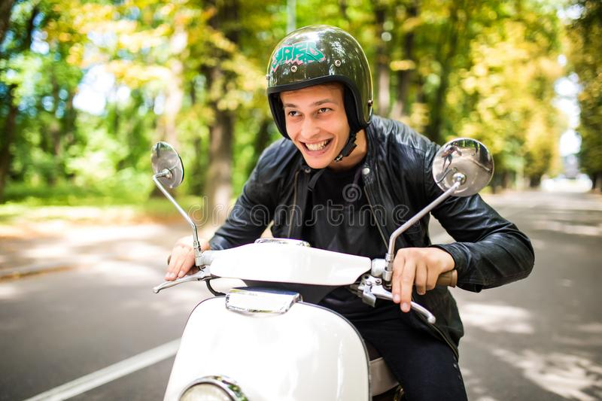
Scripts Execution Flow…
Suppose following are the five processed captions for i^{th} image:
For now, assume that this is the only image and these are the only five captions in our entire dataset. Thus, our vocabulary (and also wordtoix dictionary variable) will look like:
Following are the lengths of above captions: 5, 5, 7, 6, 6. Thus, max caption length is 7 (“max_caption_length”).
Now, the 2048 dimensional bottleneck feature generated by a pre-trained model (VGG-16, here) of above image is: [f₁, f₂, f₃, …., f₂₀₄₈].
Now, we will create numerical representation of above captions by using wordtoix dictionary variable and pad zeros in them to make length of each caption equal to max_caption_length (i.e., 7):
Zeros are padded to make length of each caption equal to max_caption_length because our neural network will take input of a fixed size.
1. “startseq man driving scooter endseq” | 2. “startseq man on scooter endseq”
3. “startseq man wearing helmet driving scooter endseq” | 4. “startseq man enjoying driving scooter endseq”
5. “startseq happy man driving scooter endseq”
1. “startseq” | 2. “man” | 3. “driving” | 4. “scooter” | 5. “endseq”
6. “on” | 7. “wearing” | 8. “helmet” | 9. “enjoying” | 10. “happy”
1. (1, 2, 3, 4, 5, 0, 0) | 2. (1, 2, 6, 4, 5, 0, 0) | 3. (1, 2, 7, 8, 3, 4, 5)
4. (1, 2, 9, 3, 4, 5, 0) | 5. (1, 10, 2, 3, 4, 5, 0)

Slide 30
Scripts Execution Flow…
Since, our model will generate captions word by word, thus we will train our image captioning model word by word, as shown below:
S.No. | Caption Input | X (Training Independent Variable) | Y (Dependent Variable)
1 | “startseq” | [f₁, f₂, f₃, …., f₂₀₄₈], [1, 0, 0, 0, 0, 0, 0] | “man” (2)
2 | “startseq man” | [f₁, f₂, f₃, …., f₂₀₄₈], [1, 2, 0, 0, 0, 0, 0] | “driving” (3)
3 | “startseq man driving” | [f₁, f₂, f₃, …., f₂₀₄₈], [1, 2, 3, 0, 0, 0, 0] | “scooter” (4)
4 | “startseq man driving scooter” | [f₁, f₂, f₃, …., f₂₀₄₈], [1, 2, 3, 4, 0, 0, 0] | “endseq” (5)
5 | “startseq” | [f₁, f₂, f₃, …., f₂₀₄₈], [1, 0, 0, 0, 0, 0, 0] | “man” (2)
6 | “startseq man” | [f₁, f₂, f₃, …., f₂₀₄₈], [1, 2, 0, 0, 0, 0, 0] | “on” (6)
7 | “startseq man on” | [f₁, f₂, f₃, …., f₂₀₄₈], [1, 2, 6, 0, 0, 0, 0] | “scooter” (4)
8 | “startseq man on scooter” | [f₁, f₂, f₃, …., f₂₀₄₈], [1, 2, 6, 4, 0, 0, 0] | “endseq” (5)
9 | “startseq” | [f₁, f₂, f₃, …., f₂₀₄₈], [1, 0, 0, 0, 0, 0, 0] | “man” (2)
10 | “startseq man” | [f₁, f₂, f₃, …., f₂₀₄₈], [1, 2, 0, 0, 0, 0, 0] | “wearing” (7)
11 | “startseq man wearing” | [f₁, f₂, f₃, …., f₂₀₄₈], [1, 2, 7, 0, 0, 0, 0] | “helmet” (8)
12 | “startseq man wearing helmet” | [f₁, f₂, f₃, …., f₂₀₄₈], [1, 2, 7, 8, 0, 0, 0] | “driving” (3)

Slide 31
Scripts Execution Flow…
S.No. | Caption Input | X (Training Independent Variable) | Y (Dep.Var.)
13 | “startseq man wearing helmet driving” | [f₁, f₂, f₃, …., f₂₀₄₈], [1, 2, 7, 8, 3, 0, 0] | “scooter” (4)
14 | “startseq man wearing helmet driving scooter” | [f₁, f₂, f₃, …., f₂₀₄₈], [1, 2, 7, 8, 3, 4, 0] | “endseq” (5)
15 | “startseq” | [f₁, f₂, f₃, …., f₂₀₄₈], [1, 0, 0, 0, 0, 0, 0] | “man” (2)
16 | “startseq man” | [f₁, f₂, f₃, …., f₂₀₄₈], [1, 2, 0, 0, 0, 0, 0] | “enjoying”(9)
17 | “startseq man enjoying” | [f₁, f₂, f₃, …., f₂₀₄₈], [1, 2, 9, 0, 0, 0, 0] | “driving” (3)
18 | “startseq man enjoying driving” | [f₁, f₂, f₃, …., f₂₀₄₈], [1, 2, 9, 3, 0, 0, 0] | “scooter” (4)
19 | “startseq man enjoying driving scooter” | [f₁, f₂, f₃, …., f₂₀₄₈], [1, 2, 9, 3, 4, 0, 0] | “endseq” (5)
20 | “startseq” | [f₁, f₂, f₃, …., f₂₀₄₈], [1, 0, 0, 0, 0, 0, 0] | “happy” (10)
21 | “startseq happy” | [f₁, f₂, f₃, …., f₂₀₄₈], [1, 10, 0, 0, 0, 0, 0] | “man” (2)
22 | “startseq happy man” | [f₁, f₂, f₃, …., f₂₀₄₈], [1, 10, 2, 0, 0, 0, 0] | “driving” (3)
23 | “startseq happy man driving” | [f₁, f₂, f₃, …., f₂₀₄₈], [1, 10, 2, 3, 0, 0, 0] | “scooter” (4)
24 | “startseq happy man driving scooter” | [f₁, f₂, f₃, …., f₂₀₄₈], [1, 10, 2, 3, 4, 0, 0] | “endseq” (5)
“data_generator_function” generates data for a particular number of images at a time (to prevent Memory Overflow error) in the above manner and pass it to the neural network for training.
After completion of training, script will save model in “output” directory.

Slide 32
Scripts Execution Flow
After successful completion of training, one can use the saved model by any of the following scripts:
Script “scripts/inference_one_image_GColab.ipynb” to get caption of one image at a time. User has to keep the test image in a “single_test_image” directory, and enter its name when script ask.
Script “scripts/inference_test_images_GColab.ipynb” to get captions generated (or predicted) by trained model for all images saved under “test_image” directory. This script will save all those generated (or predicted) captions in a .txt file under “output/test_image_generated_captions/” directory.

Slide 33
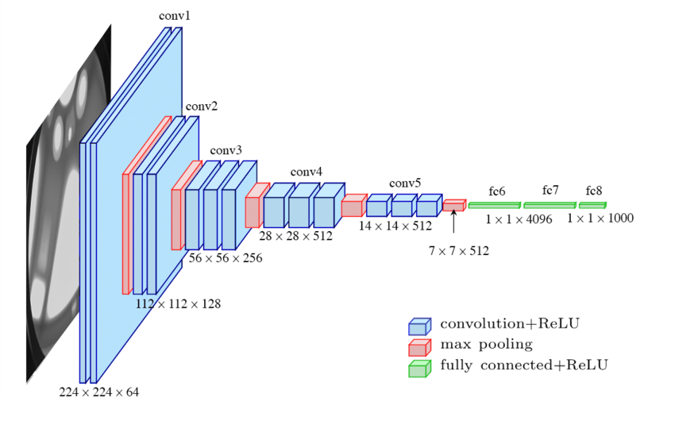
Pre-Trained Models
We are using two pre-trained models in this project:
VGG-16: To generate bottleneck features for images.
GloVe: To generate word embeddings for captions.
VGG-16:

Slide 34
Pre-Trained Models…
GloVe (Global Vectors):
GloVe is a word vector technique and an Unsupervised Learning algorithm.
Word Vectors put words to a nice vector space where similar words cluster together and different words repet.
The advantage of GloVe is that unlike Word2Vec, GloVe doesn’t rely just on local statistics (i.e., local context information of words), but it incorporates global statistics (word co-occurrence) to obtain word vectors.
Thus, GloVe captures both, global and local statistics of a corpus in order to come up with word vectors.
GloVe method is built on an important method: Co-occurrence Matrix.
Co-occurrence Matrix is very helpful to derive semantic relationships. Following is an example:
“the cat sat on the mat”
Co-occurrence Matrix is:
 | “the” | “cat” | “sat” | “on” | “mat”
“the” | 0 | 1 | 0 | 1 | 1
“cat” | 1 | 0 | 1 | 0 | 0
“sat” | 0 | 1 | 0 | 1 | 0
“on” | 1 | 0 | 1 | 0 | 0
“mat” | 1 | 0 | 0 | 0 | 0

Slide 35

Training & Neural Networks Specific
Neural Network Framework: Keras (version: 2.4.3)
Pre-trained models used: 1. VGG-16 2. GloVe
It is clear from the previous tables (X and Y) that the data is time-series based where sequence matters a lot (as it builds context of captions, every next word is dependent on the current word), thus RNN with LSTM (Long Short Term Memory) cells is used here.
As it is said earlier that the classical Encoder-Decoder solution is implemented here. Following is the architecture of this solution:
Epchs: 20 | Number of images (with 5 captions) per batch: 3
Loss Function: “categorical_crossentropy” | Optimization Function: Adam
ENCODER
“h”: Entire output of Encoder, also called as Context Vector or Thought Vector
Partial Caption
RNN
DECODER
Feed Forward Neural Network with a Softmax
Predicted Next Word
h
VGG-16
Input Image

Slide 36
Training & Neural Networks Specific…
Following is the code of neural network used here:
“embedding_matrix” created in 5.vi. under “Scripts Execution Flow” is used here as weights:
1 | inputs1 = Input(shape=(2048,))
2 | fe1 = Dropout(0.5)(inputs1)
3 | fe2 = Dense(256, activation=‘relu’)(fe1)
4 | inputs2 = Input(shape=(max_caption_length,))
5 | se1 = Embedding(vocab_size, EMBEDDING_DIM, mask_zero=True)(inputs2) # EMBEDDING_DIM=200
6 | se2 = Dropout(0.5)(se1)
7 | se3 = LSTM(256)(se2)
7 | decoder1 = add([fe2, se3])
8 | decoder2 = Dense(256, activation=‘relu’)(decoder1)
9 | outputs = Dense(vocab_size, activation=‘softmax’)(decoder2)
10 | model = Model(inputs=[inputs1, inputs2], outputs=outputs)
1 | model.layers[2].set_weights([embedding_matrix])
2 | model.layers[2].trainable = False

Slide 37
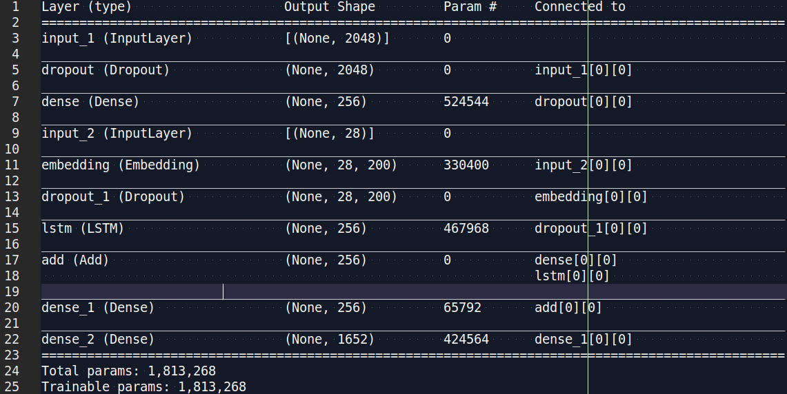
Training & Neural Networks Specific…
Following is the summary of this model:

Slide 38
Training & Neural Networks Specific…
In the previous neural network code, there is an “Embedding” layer in which we have loaded the embedding_matrix which has GloVe bottleneck features (200 dimensional) of all words in our vocabulary.txt file. Following is the purpose of “Embedding” layer:
Embedding Layer is one of the available layers in Keras.
This layer is mainly useful in Natural Language Processing (NLP), and thus in Natural Language Generation (NLG).
In NLP (or NLG), one can use pre-trained word embeddings such as GloVe. Alternatively, one can also train our own embeddings using Keras embedding layer.
Word Embeddings can be thought of as an alternate to one-hot encoding along with dimensionality reduction.
As we know that while dealing with textual data, we need to convert it into numbers before feeding into any machine learning model. This can be simply done by considering each word as a class (or category) and transforming every word into one-hot vectors). Thus, if we have 10,000 words in our vocabulary (i.e., 10,000 unique words, then a matrix of 10,000 x 10,000 will form where each row will have only one “1” and rest are zero. Following are the two issues with this approach:
This will require a lot of storage space.
This will reduce model’s efficiency as there will not be any mathematical justification for such representation

Slide 39
Training & Neural Networks Specific…
Embedding layer enables us to convert each word into a fixed length vector of defined size (reduced dimension).
The resultant vector have real values instead of just 0s and 1s.
This way “Embedding” layer works like a lookup table. The words (or their indices) are the keys in this table while the dense word vectors are the values.

Slide 40
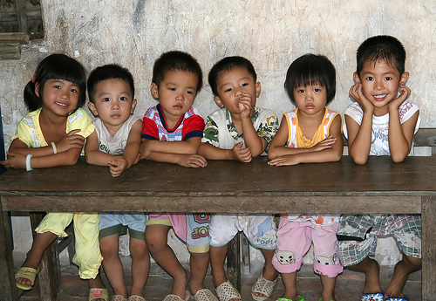
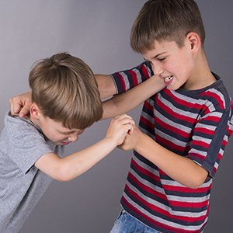
Result
Following are some results obtained from model:
woman woman woman woman woman woman woman woman woman woman woman woman woman woman woman woman woman woman woman woman woman woman woman woman woman woman woman
little girl in pajamas is playing with little boy in blue shirt

Slide 41

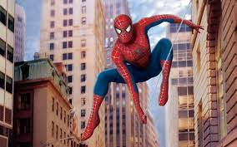
Result…
man in blue shirt and blue jeans is sitting on the sidewalk next to woman woman woman woman woman woman woman woman woman woman woman woman woman
boy in blue shirt is jumping on his skateboard

Slide 42
Result…
Trained model is tested on images marked for validation. There were 1,091 images with 5 captions for each image. Model generated a caption for each image. Since, it has become a kind of document where each reference has five texts, thus corpus bleu is used to measure the performance. Corpus BLEU Score obtained is: 0.06536756465955354

Slide 43
Conclusion
Model is predicting (or generating) “woman” many times because “0” was padded in each train caption to make its length equal to “max_caption_length”. We added “0” with thought that it means nothing, however in our vocabulary (vocabulary.txt), indexing has started from zero and the word at 0th index is “woman”. Thus, for all those images where model is not getting anything, it is generating 0 as output and since “woman” is at 0th index, therefore we are getting “woman” several times in some predictions.
Since model is trained for less number of epochs and also on insufficient data, thus the BLEU Score is quite less on validation images. However, if we see model’s performance on a single image, then it seems that the model has learnt something during training and it verifies the technique used here for Image Captioning.

Slide 44
Future Work
Remove the issue of many “woman” words in captions. This can be done by adding <UNK> (“unknown”) at 0th index of vocabulary.
Training on huge dataset, such MSCOCO, the largest open source dataset for Image Captioning, in order to improve BLEU Score of the model.

Slide 45
Template
Template

Slide 46
Thank You

