Slide 1
Python Tensorflow-Keras Trained Model For MNIST Hand Written Digits
Sanjay Singh
san.singhsanjay@gmail.com

Slide 2
Introduction & Dataset
The MNIST database (Modified National Institute of Standards and Technology database) is a large database of handwritten digits that is commonly used for training various image processing systems. The database is also widely used for training and testing in the field of machine learning.
Following are some of its sample images:

Slide 3
Introduction & Dataset…
This dataset is downloaded from:
https://www.kaggle.com/scolianni/mnistasjpg
The size of this dataset is 38 MB.
This dataset has total 70,010 images, out of which 28,000 images are given test set and 42,010 images are given in train set.
Dimension of each given image is (28 x 28 x 3).

Slide 4
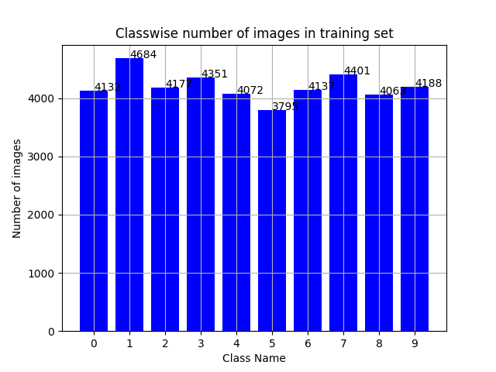
Introduction & Dataset…
Following is a plot of provided training dataset:
In case of test set, provided images are not labeled, thus it is hard to make classwise plot for test set.

Slide 5
Scripts Execution Flow
Following is the script execution flow:
“train_data_plot.py”: This script is generating a classwise plot of number of images in training set.
“make_train_val_test_set.py”: This script is segregating images for training, validation and test set. While doing this, this script is ensuring that the classes of the training and the validation dataset should be balanced.
“gen_train_val_plot.py”: This script is generating a plot for classwise number of images in training and validation dataset.
“train.py” and “train.ipynb”: This script is for training CNN on this MNIST hand written digits dataset. Final training is done by using “train.ipynb”, thus “train.ipynb” would be more updated than “train.py”.

Slide 6
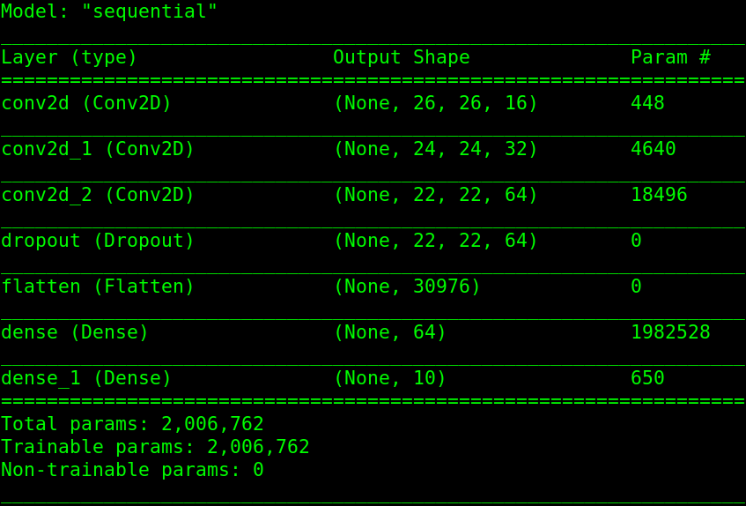
CNN Architecture
Following is the CNN Architecture of model:

Slide 7
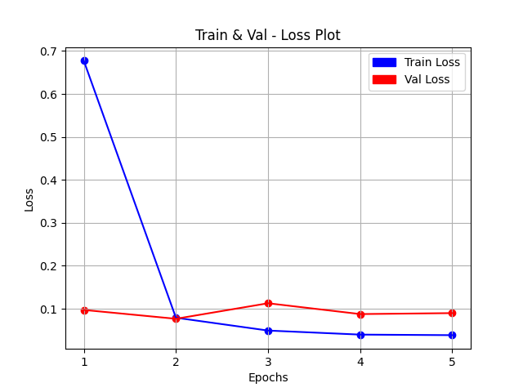
Training & Result
Following is the plot of train loss and validation loss:

Slide 8
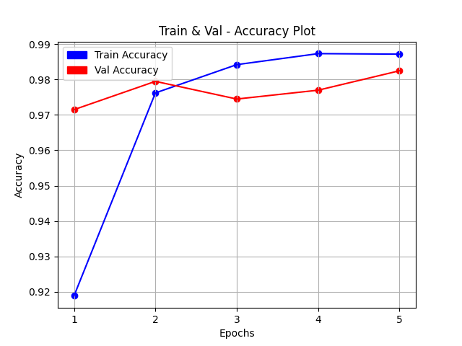
Training & Result…
Following is the training and validation accuracy:

Slide 9
Training & Result…
The model trained for 5 epochs.
Following is the status after training of 5 epochs:
Train Accuracy: 98.72 %
Train Loss: 0.03841
Validation Accuracy: 98.25 %
Validation Loss: 0.08973

Slide 10
Template
Template

Slide 11
Thank You

