Slide 1
Task 2
Predicting customer buying behaviour

Slide 2
Analysis of the model
The developed customer buying behaviour prediction machine learning model is based on random forest algorithm
The prediction model has been trained with 75% size of the dataset
To clean the data following variable values have been replaced by the mentioned integer values,
sales_channel -> {Internet:0,mobile:1}
trip_type -> {RoundTrip:0,CircleTrip:1,OneWay:2}
flight_day -> {Sat:0,Sun:1,Mon:2,Tue:3,Wed:4,Thu:5,Fri:6}

Slide 3
Analysis of the model
The following input variables are accepted by the prediction model,
num_passengers
sales_channel
trip_type
purchase_lead
length_of_stay
flight_hour,
flight_day
wants_extra_baggage
wants_preferred_seat
wants_in_flight_meals
flight_duration
The target outcome of the prediction model is booking_complete

Slide 4
Evaluation of the model
The prediction model has been tested with 25% size of the dataset
The model accurately predicted 10481 out of 12500 test cases which shows that accuracy of the predictive model is approximately equivalent to 83.848% and inaccuracy of the predictive model is approximately equivalent to 16.152%

Slide 5
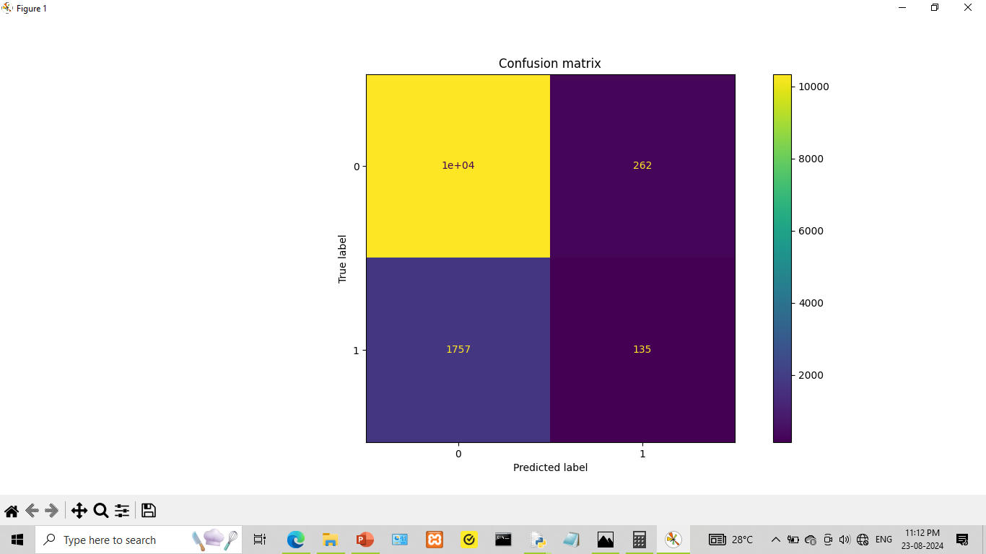

Slide 6
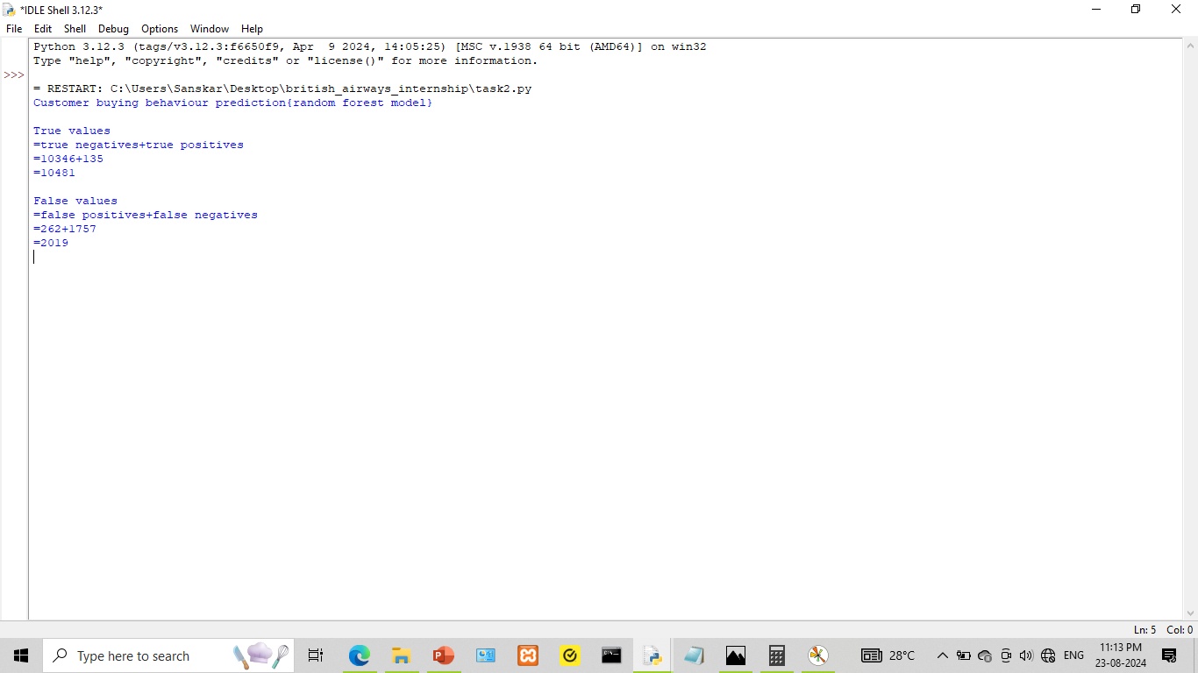

Slide 7
Additional details
The source code and dataset for this task can be viewed by following the link mentioned below,
https://github.com/sanskar-projects/british_airways_internship
Thank You !

