Slide 1
Task 1
Web scraping to gain company insights

Slide 2
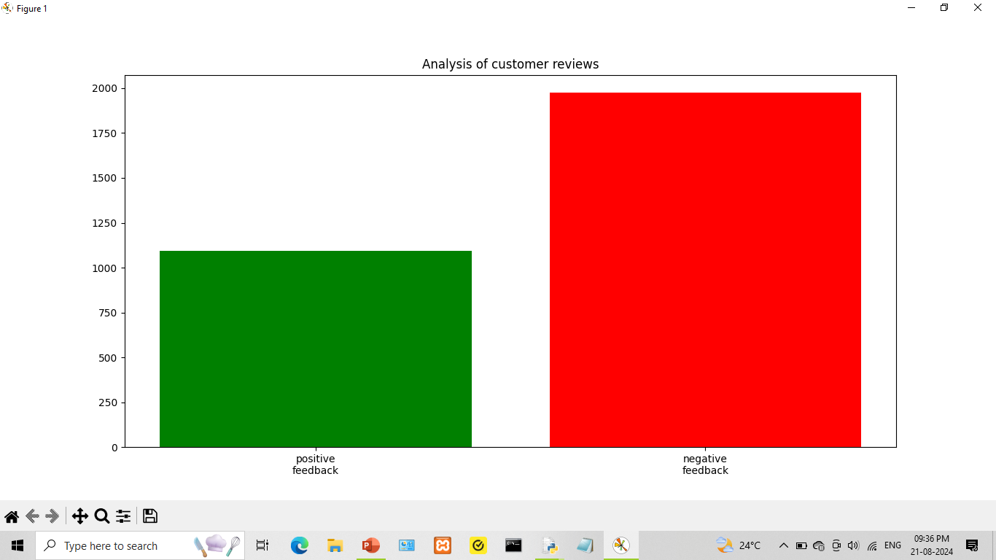

Slide 3
Analysis of customer reviews by Traveller_type
Solo leisure traveller type accounts for maximum positive feedback
Couple leisure traveller type accounts for maximum negative feedback
Family leisure traveller type accounts for both minimum positive feedback and minumum negative feedback

Slide 4
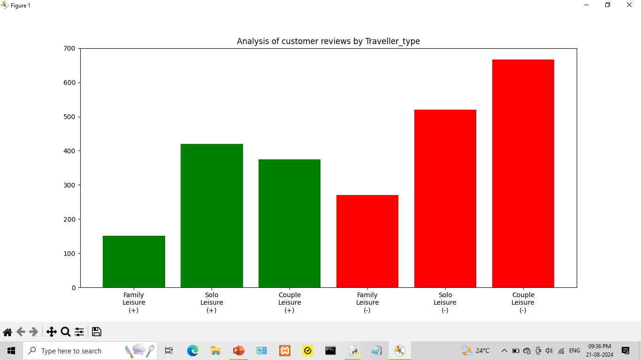

Slide 5
Analysis of customer reviews by Seat_type
Economy class seat type accounts for both maximum positive feedback and maximum negative feedback
First class seat type accounts for both minimum positive feedback and minimum negative feedback
Business class stands in the middle in terms of both positive feedback and negative feedback

Slide 6
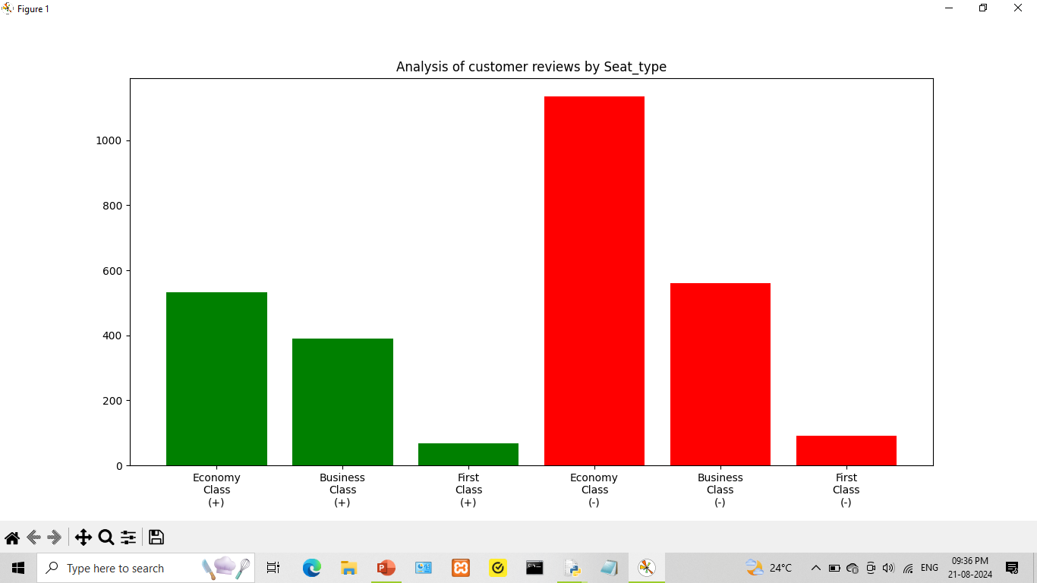

Slide 7
Additional details
The review data for analysis has been scraped from skytrax using python with the help of beautiful soup library
The dataset prepared for analysis consists of 3068 reviews
The reviews in dataset have been posted between 01/05/2015 and 1/8/2024
The source code and dataset for this task can be viewed by following the link mentioned below,
https://github.com/sanskar-projects/british_airways_internship
Thank You !

