Slide 1

TSSM’S
Padmabhooshan Vasantdada Patil Institute of Technology, Bavdhan, Pune-21
Department of Computer Engineering
Second Year Computer Engineering
Project Based Learning Presentation
(Thursday & 08/02/24:)
TITLE : Three Level Password Authentication System
15: Sanskar Darekar
05: Ritesh Auti
23:Hrishikesh Garje
24:Abhishek Gavand
Guided By
Prof.A. A. Patel

Slide 2
Content
Introduction
Objectives
Motivation
Literature Survey
Methodology/Proposed System Block Diagram
Software/Hardware Requirement
Output
Conclusion
Future Scope

Slide 3
INTRODUCTION
Authentication is considered a very important verification method when someone is trying logging into computer resources, such as networks, applications, or devices. Several popular web services such as google and amazon employ multi-factor authentication as an optional feature that is deactivated by default. In IT industry, developers also face serious challenges for securing their systems, wherein unauthorized persons may easily damage many hours of software development, and since fall into consequences of breaking down the system. Consequently, authentication is the process or the action that decides whether a person or an application is allowed to access the system or not.
The three phases that are: simple login id and password based security which is basic authentication, after this system will advance to its second phase, which is bot-attack detection/Image detection, where system will detect if you are a real human user or bot, if passed then and only then the final phase will come into action, which is graphical based password authentication will protect brute force and one directory attack. With three completely different phases the chance of breaking into application are negligible. A simple bot attack or fake user can not just break into the system.

Slide 4
OBJECTIVES
To Improve/Enhances Security:- The primary objective is to significantly improve security by requiring users to pass through three distinct layers of authentication. This makes it more challenging for unauthorized individuals to gain access, as they would need to breach multiple barriers
To Defend Against Unauthorized Access:- By requiring users to pass through multiple authentication stages, the system provides a robust defense against unauthorized access attempts. Even if one level of authentication is compromised, the attacker would still need to bypass the remaining levels to gain access.
To Protect Against Password Based Attack:- Mitigate the risks associated with password-related vulnerabilities. Passwords are susceptible to various attacks like brute force and dictionary attacks. Multiple authentication levels reduce the impact of compromised passwords.
To Increase Data Confidentiality And Integrity:- Ensure the confidentiality and integrity of sensitive information. By strengthening user authentication, the system contributes to maintaining the confidentiality of data and prevents unauthorized alterations.

Slide 5
MOTIVATION
Multilevel security, often used in computer systems and networks, is inspired by the need to protect sensitive information at different classification levels within an organization or government. The inspiration comes from the desire to prevent unauthorized access to classified or sensitive data while allowing appropriate access to authorized users based on their security clearance or need-to-know basis. This approach aims to mitigate the risk of information leakage or unauthorized disclosure by enforcing access controls and ensuring data integrity and confidentiality.
The primary motivation is to ensure that information is accessible only to authorized individuals while preventing unauthorized access or leaks across different security levels. This concept emerged from the increasing complexity of information systems and the need to manage classified data securely in various government and military contexts.

Slide 6
Literature Survey
SR.NO. | Title of Papers | Author | Publishing Year | Technology Used | Advantages | Disadvantages
1 | Multi factor authentication | Bandar Omar ALSalee | 2021 | 1.SMS Services 2.2FA Libraries:Google Authenticator , etc. | 1.Enhanced Security. 2.Phishing resistance. | 1.Cost of Implementation 2.Over reliance on Devices.
2 | IRJMETS - Three level Password Authentication System | N Chaitra , Pratibha, Dr. Rajashree V Biradar | 2022 | 1.Hashing Algorithms : -Technology : bcrypt , Argon2 or similar . 2.Database Technology : MySQL,SQLite or others. | 1.Long Term Security. Investment 2.Protection Against Credential Theft. 3.User Friendly Experience. | 1.User Training And Education 2.Dependancy On External Factors 3.Biometric Data Privacy Concerns. 4.Limited Accessibility.

Slide 7
System Block Diagram
User input
Level 1
(Basic)
Username & password
Level 2
(Intermediate)
Pattern Based Password
Level 3
(Advanced)
Graphical Based Password
Success or Failure

Slide 8
Software Requirements
Development Environment:
Software: Integrated Development Environment (IDE) such as Visual Studio Code, PyCharm.
Purpose: Write, test, and debug the application code.
Web Development:
Software:Languages like Python and Javascript.
Purpose: Develop web interfaces for user registration, login, and authentication.
Hashing and Encryption Libraries:
Software: bcrypt, Argon2 (for password hashing), OpenSSL (for encryption).
Purpose: To Hash and encrypt sensitive information.

Slide 9
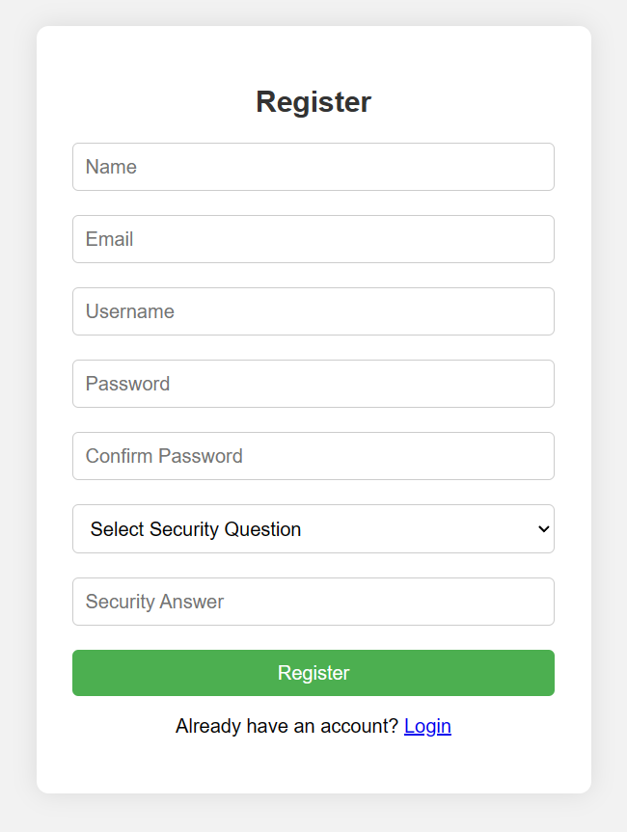
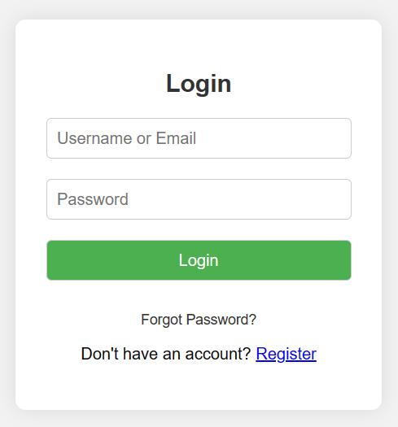
Output:

Slide 10
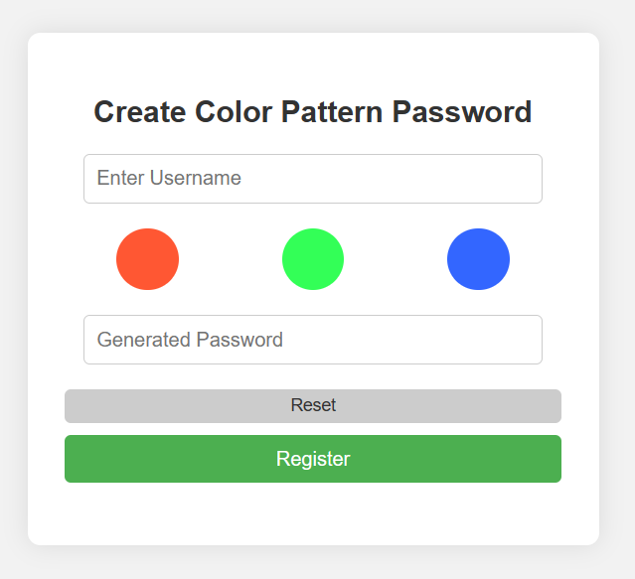
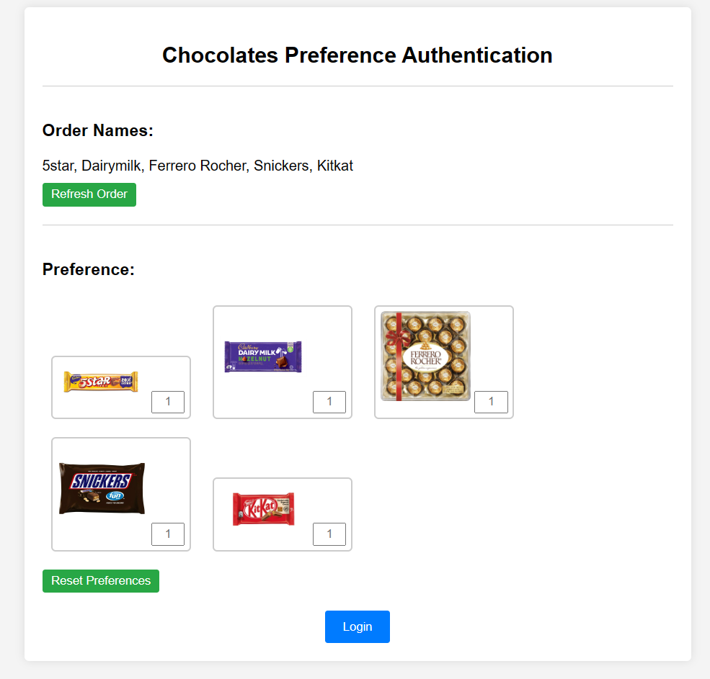

Slide 11
Conclusion
A multi-factor authentication system that combines the ease of use and the low-cost factors is proposed. The system did not need any special settings or infrastructure. It was designed depending on graphical passwords. In registration phase, the user might need to memorize color to generate password. In the login phase, the user needed only to arrange the correct images that user has chosen during the registration process in a specific order. The proposed system might overcome many different security threats, such as key-loggers, screen capture attack or shoulder surfing.
The three-level password system is a smart way to keep online accounts safe. By using multiple layers of security, it's much harder for anyone to get in. Even though it's more secure, it's still easy for you to log in. It's a good solution for anyone who wants to protect their online stuff better.

Slide 12
Future Scope
Biometric Enhancements: Integrating more advanced biometric authentication methods beyond fingerprints, such as facial recognition, iris scanning, voice recognition, or even behavioral biometrics like keystroke dynamics or gait recognition. These biometric factors can provide additional layers of security and convenience.
Contextual Authentication: Implementing contextual authentication based on factors such as user location, time of access, device characteristics, and behavior patterns. This approach can help dynamically adjust authentication requirements based on the risk associated with the context of access
Continuous Authentication: Moving away from static authentication methods towards continuous authentication mechanisms that continuously monitor user behavior and interactions throughout a session. This can involve analyzing typing patterns, mouse movements, touch gestures, or other behavioral biometrics to ensure that the authenticated user remains the same throughout the session..

Slide 13
.
Zero Trust Architecture (ZTA): Implementing a Zero Trust Architecture approach, which assumes that no user or device should be trusted by default, regardless of their location or credentials. This involves implementing strict access controls, continuous monitoring, and least privilege principles to minimize the risk of unauthorized access.

