Slide 1

Bike Sharing Demand Analysis Using Excel
Analysis of Bike Rental Patterns Using Weather, Time & User Data
Name: Sanskar Pandey Tool: Microsoft Excel

Slide 2
Problem Statement
Bike-sharing demand varies with time, weather, and user behavior.
Understanding these patterns is essential for operational and business planning.
This project analyzes bike rental data using Excel to uncover demand trends and relationships.

Slide 3
Dataset & Scope of Analysis
Dataset 1: Time, date, season, weather, temperature
Dataset 2: User type and rental count data
Dataset 3: Additional contextual variables
pre_final_sheet: Dataset 1 + Dataset 2 combined
final_sheet: Dataset 1 + Dataset 2 + Dataset 3 combined

Slide 4
Data Preparation & Feature Engineering
Cleaned and standardized merged datasets
Removed duplicates and inconsistencies
Created categorical columns for BI analysis:
Day type (weekday / weekend)
Weather category (clear, mist, dark sky, heavy rain)
Daytime (morning, afternoon, evening, night)
Temperature, humidity, demand (low / medium / high)
Dominant user (casual / registered)

Slide 5
Data Visualization & Business Intelligence Approach
All charts created using Pivot Tables
Focused on clarity, patterns, and insights
Visualizations used:
Line chart
Bar chart
Pie chart
Column chart
Weather relationship chart
Interactive slicers added for dynamic filtering

Slide 6
Bike Demand Pattern
Demand peaks during morning and afternoon hours
Indicates commute-driven usage behavior

Slide 7
Weather Impact & User Type Distribution
Clear weather significantly increases rentals
Registered users dominate overall demand

Slide 8
Day Type and Weather Relationship Analysis
Weekday demand is higher due to commuting
Certain weather combinations perform better

Slide 9
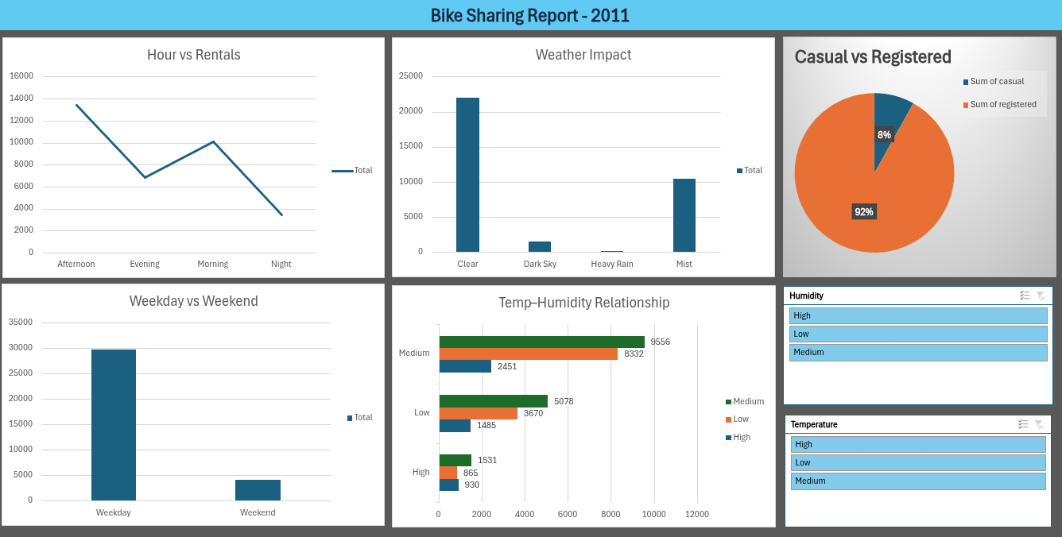
Interactive Dashboard — Pre Final
Built using Dataset 1 and Dataset 2
Uses pivot charts and slicers
Highlights demand trends, weather impact, and user behavior

Slide 10
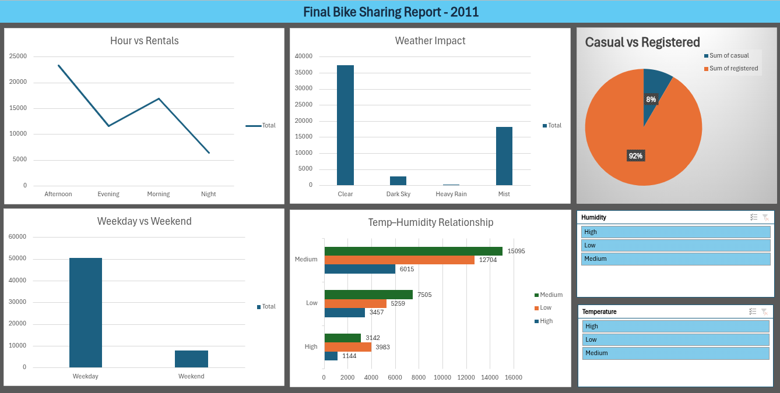
Interactive Dashboard — Final
Extended analysis using all three datasets
Provides deeper contextual insights
Enables comprehensive business intelligence

Slide 11
Key Business Insights
Bike rentals peak during weekday commute hours
Weather conditions strongly affect rental demand
Registered users are the primary contributors
Optimal demand occurs at favorable weather combinations
Interactive dashboards enable fast, data-driven decisions

Slide 12
Conclusion
Excel pivot tables and charts were used to analyze bike-sharing demand
Visual dashboards improved interpretability of data
The analysis supports informed operational and business planning
Project demonstrates effective use of Excel for business intelligence

