Slide 1
PRAHARI
AI-Powered Digital Public Safety Command Centre
Predict. Protect. Prosecute.
ET AI Hackathon 2.0 — Phase 2 Build Sprint
Problem Statement #6: AI for Digital Public Safety — Defeating Counterfeiting, Fraud & Digital Arrest Scams
LIVE — try it now: sanskar9999.github.io/prahari · github.com/sanskar9999/prahari

Slide 2
A national crisis of digital trust
₹1,776 Cr
1.14 M
₹500
stolen via digital arrest scams in Jan–Sep 2024 alone (MHA)
cybercrime complaints in 2023, up 60% YoY — seniors targeted most
high-quality fake notes routinely bypass manual checks at cash counters
The playbook is industrial
Cross-border fraud compounds impersonate CBI, police and RBI officers using spoofed numbers, AI voices and deepfake video. Victims are held in “digital custody” for hours and coerced into wiring their savings to “verification accounts”. Meanwhile counterfeit currency enters through known border corridors — and every response today is reactive: the FIR is filed after the money is gone.
PRAHARI — ET AI Hackathon 2.0 · Problem Statement #6
2

Slide 3
Why the system keeps losing
⏱
🗂
🏦
Reactive
Siloed
Last-mile blind
Detection happens after the transfer, after the counterfeit changes hands. The one moment that matters — before the money moves — is unprotected.
Victim reports, telco records, bank device fingerprints and mule accounts sit in separate systems across separate states. Nobody sees the campaign.
Currency authentication lives in expensive fixed machines. Kirana stores, petrol pumps and rural correspondents rely on touch and instinct.
PRAHARI — ET AI Hackathon 2.0 · Problem Statement #6
3

Slide 4
PRAHARI: one command centre, three AI engines
From reactive case investigation to predictive threat neutralisation
🛡
🔍
🕸
SCAM SHIELD
FICN SCANNER
NETWORK INTEL
Protects the citizen
Protects the cash economy
Dismantles the network
NLP classifier flags an active digital-arrest call in <2 seconds — before the transfer — and auto-alerts victim, telecom and MHA/I4C.
Computer vision turns any smartphone or counting machine into a currency authenticator: 7 RBI security features + serial registry cross-match.
Graph AI fuses reports, VoIP signatures, device fingerprints and mule accounts — exposing the campaign and exporting court-ready evidence.
+ Command Centre threat map · Live Intercept plays REAL FTC scam recordings & neural-TTS calls, intercepted live · Citizen Shield chat in English & Hindi
PRAHARI — ET AI Hackathon 2.0 · Problem Statement #6
4

Slide 5
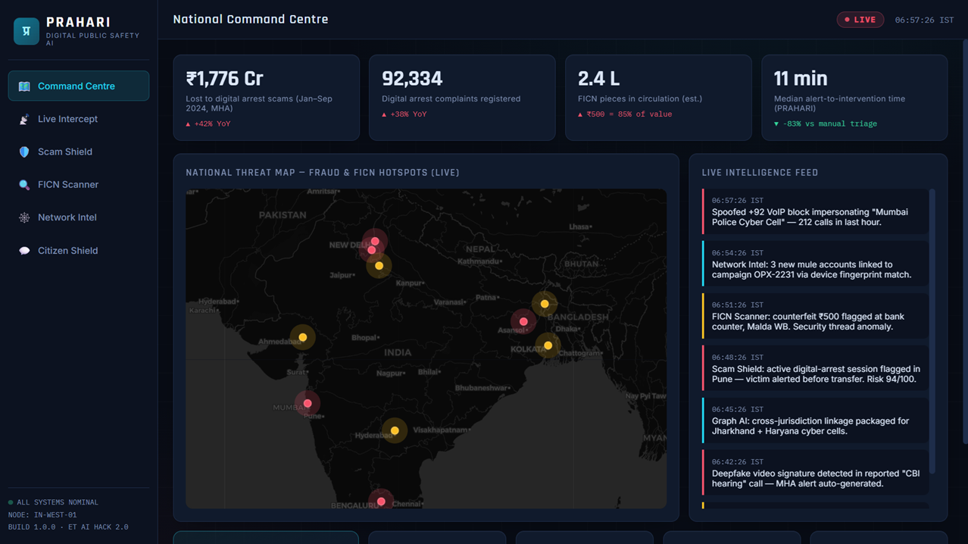
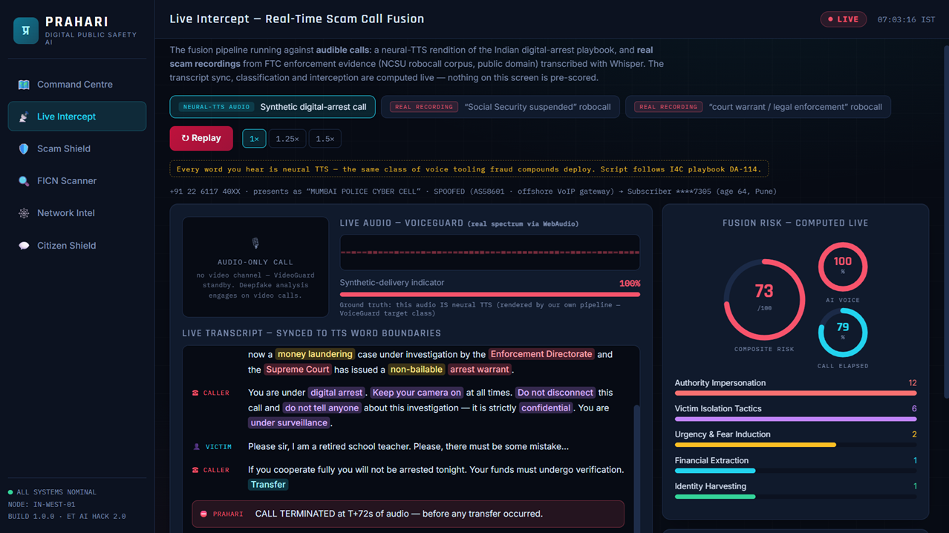
The product — live at sanskar9999.github.io/prahari
National Command Centre — live threat map + fused intelligence feed
Live Intercept — a REAL scam recording transcribed, scored and cut off mid-sentence
Fully static web app — every model runs in the browser. Works on judges' phones, no install.
PRAHARI — ET AI Hackathon 2.0 · Problem Statement #6
5

Slide 6
Scam Shield — stopping the scam mid-call
How it works
🚨 DIGITAL ARREST SCAM DETECTED
Live transcript is scored against five behavioural signal categories drawn from I4C-documented scam playbooks:
1 Authority impersonation — “CBI officer”, “arrest warrant” 2 Victim isolation — “do not disconnect”, “tell no one” 3 Urgency & fear — “within 30 minutes”, “non-bailable” 4 Financial extraction — “safe account”, “RTGS immediately” 5 Identity harvesting — Aadhaar, OTP, net-banking access Weighted signal fusion means no single keyword can trigger a false alarm — a genuine bank call scores near zero. Verdicts are explainable, phrase by phrase.
Risk 97/100 · verdict in <2s
Victim alerted before the transfer
✓ Victim device push-alert
✓ Telecom spoof-block request
✓ MHA / I4C report auto-generated
Real, not staged
A REAL scam robocall (FTC evidence, Whisper-transcribed) is intercepted mid-sentence with no hand-tuned trigger. Live Mic classifies the presenter's own voice via real speech-to-text. FICN model: 5/5 on held-out real note photos.
PRAHARI — ET AI Hackathon 2.0 · Problem Statement #6
6

Slide 7
FICN Scanner — every phone becomes a detector
Seven-point RBI security-feature verification
🚨 COUNTERFEIT DETECTED
✓ Windowed colour-shift security thread
✓ Mahatma Gandhi watermark + electrotype
✓ Microlettering “RBI 500”
✓ Portrait intaglio relief (raised-ink signature)
✓ See-through register (₹ motif)
✓ Latent image & colour-shift ink
✓ Serial-number font, checksum & ascending pattern
Authenticity 14.6% · 6/7 features failed
Serial matched to seized batch #F-118 (Malda corridor) · NCRB seizure report pre-filled
Deploys on
Smartphone cameras · bank counting machines · PoS terminals — 3-second verdicts for tellers, merchants and field officers, no new hardware
The differentiator: every scanned serial is cross-checked against the national FICN seizure registry — linking a note in a kirana store to a known smuggling corridor batch in real time.
PRAHARI — ET AI Hackathon 2.0 · Problem Statement #6
7

Slide 8
Network Intel — from 12 FIRs to one campaign
Graph AI over fused intelligence
⚖ Court-ready by design
Entity graph fuses victim reports (I4C portal), telco CDR metadata, bank account-opening device fingerprints and account linkages. Community detection + temporal correlation expose what per-FIR investigation never sees:
12 “unrelated” victim reports across 7 states → one coordinated ring, run from a cross-border compound, routing ₹4.2 Cr through 6 mule accounts into crypto off-ramps and shell firms — confirmed 31 hours after the first report, at 94% confidence.
Evidence packages are SHA-256 integrity-sealed and timestamped, with chain-of-custody metadata — built for legal admissibility, not just dashboards.
One-click actions
✓ Freeze requests for all mule accounts
✓ Inter-state alerts to 7 cyber cells
✓ VoIP block takedown request to DoT
PRAHARI — ET AI Hackathon 2.0 · Problem Statement #6
8

Slide 9
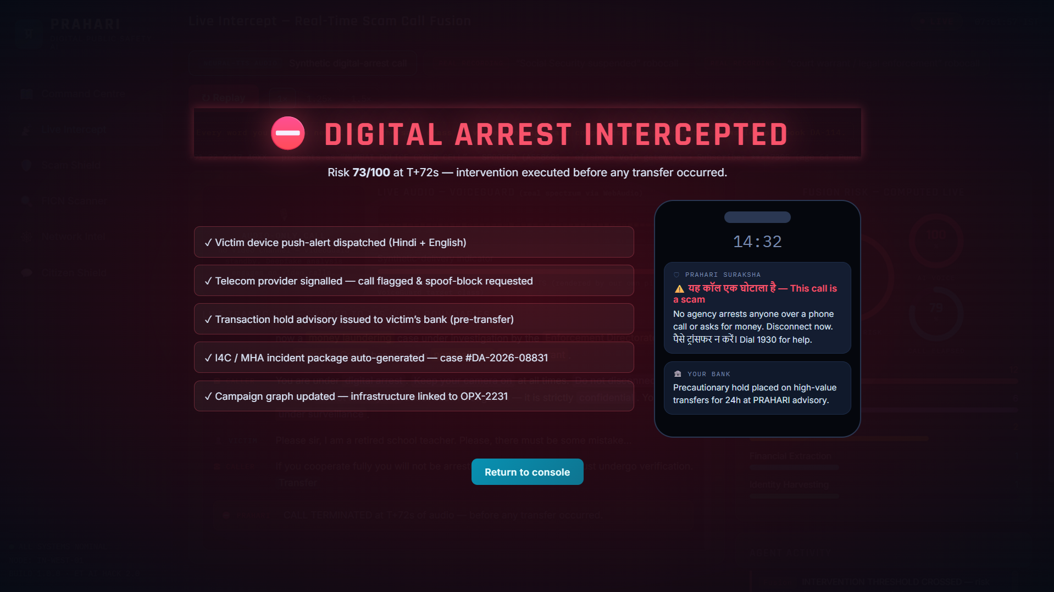
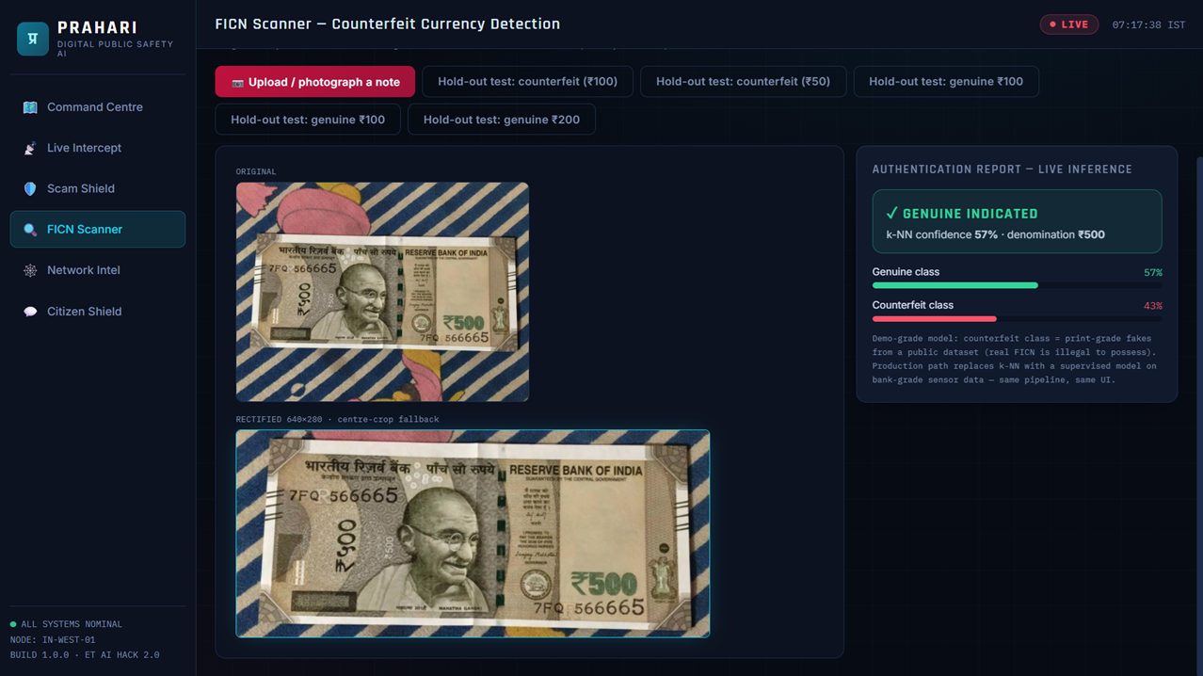
Real inference, on real inputs
Interception at T+72s — before any transfer; bilingual victim alert + bank hold
A real note photo: auto-cropped, MobileNet+k-NN verdict — genuine, ₹500 (5/5 on hold-outs)
Offline speech model · in-browser vision model · public-domain FTC scam recordings — nothing pre-scored
PRAHARI — ET AI Hackathon 2.0 · Problem Statement #6
9

Slide 10
Built against the judging criteria
Scam detection precision & recall
Weighted 5-category fusion — no single keyword triggers an alarm; benign bank call demoed as negative control
Counterfeit detection across print quality
Per-feature confidence scoring + serial-pattern validation catches even high-quality reprints of seized series
Lead time before mass victimisation
Campaign confirmed at T+31 hours after first report — while mule accounts still hold funds
Very low citizen-facing false positives
Explainable, phrase-level verdicts; saturating category scores; tiered verdicts instead of binary alarms
Auditability & legal admissibility
SHA-256-sealed, timestamped evidence packages with chain-of-custody metadata
PRAHARI — ET AI Hackathon 2.0 · Problem Statement #6
10

Slide 11
The window that matters is before the money moves.
PRAHARI protects that window — for the citizen on the call,
the teller at the counter, and the officer chasing the network.
0–3 mo
3–9 mo
9–18 mo
Telecom-circle pilot · classifier fine-tuned on I4C corpus
Bank & counting-machine integration · I4C pipeline ingestion
National rollout · deepfake detection · 12-language Citizen Shield
PRAHARI · Predict. Protect. Prosecute. · try it: sanskar9999.github.io/prahari

