Slide 1
Digital Logic and Design - CSE1003
Review 2
Topic : Flood Gate Control by Water Level Indication System

Slide 2
Project Abstract
AIM : To develop a sensor based control system to indicate a water levels using a seven-segment display and using this information to control flood gates for a calculated release of water from water containment utilities.
Project Targets
Build Motor Control using input from Arduino Uno.
Obtain Code for the control of stepper motor.
Circut to Deliver input of water level to accurately describe the position of the water level.
Targets Achieved
Simulation circuit of water level indicator is ready and implementable.
Code for the control circuit of Arduino and control of stepper motor.
Short list of materials to be aquired for the final working model is made.

Slide 3
Material Used
Arduino
Stepper Motor
Hydro – Sensors or Proximity Sensors
IC74148
IC7447
10KOhm Resistors X 7
Seven Segment Display
Connecting Wires
Power Source

Slide 4
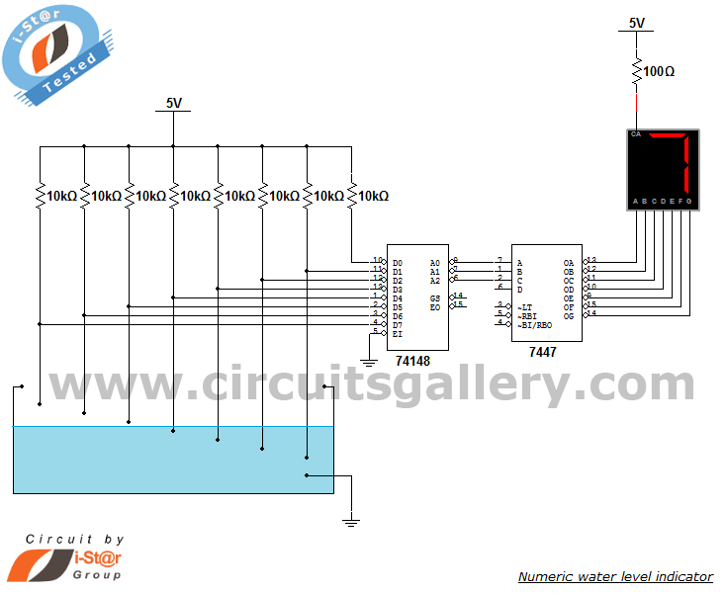
Circuit Diagrams
Common Circuit

Slide 5
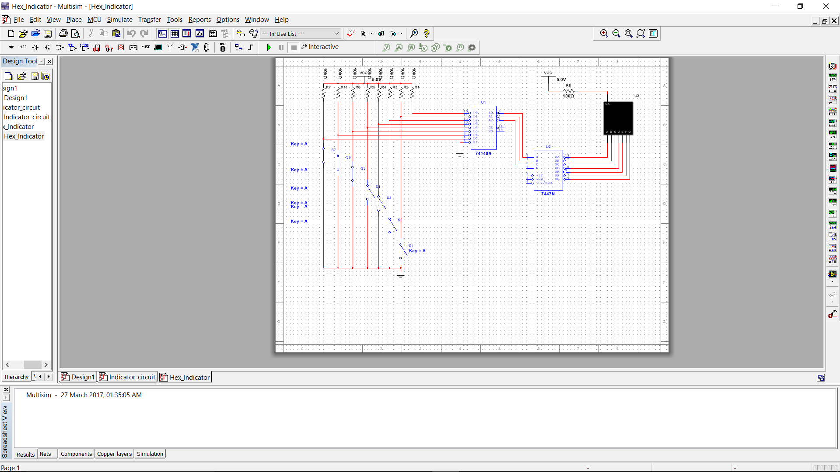
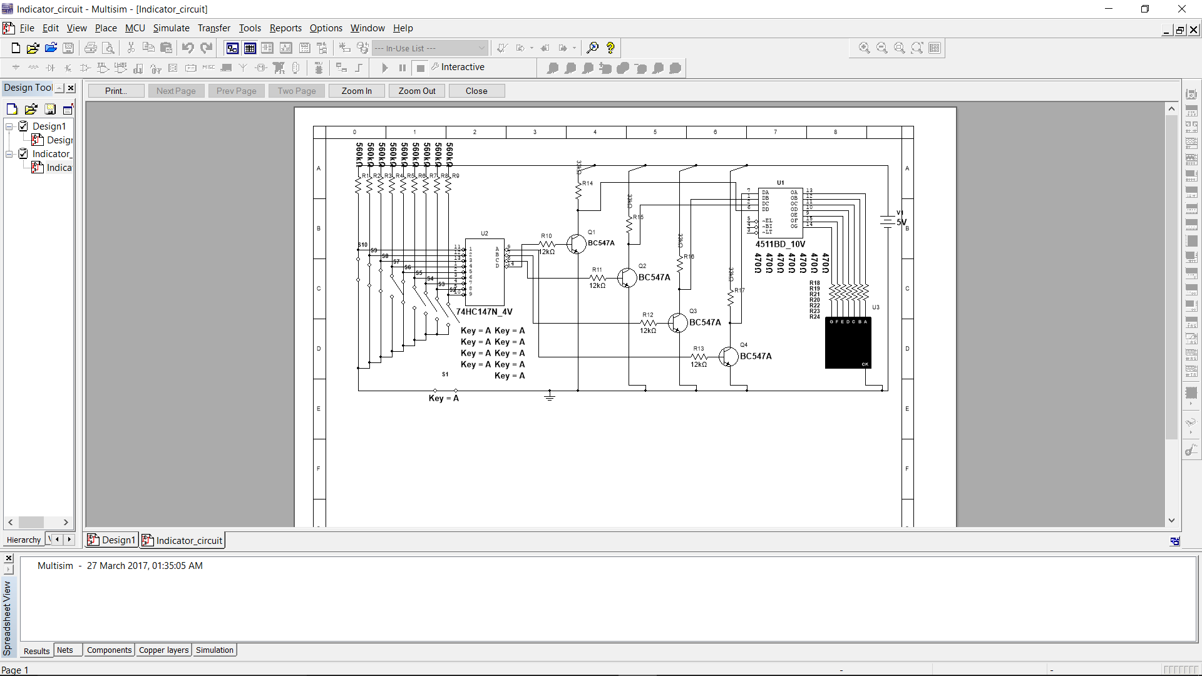
Simulation Circuit

Slide 6
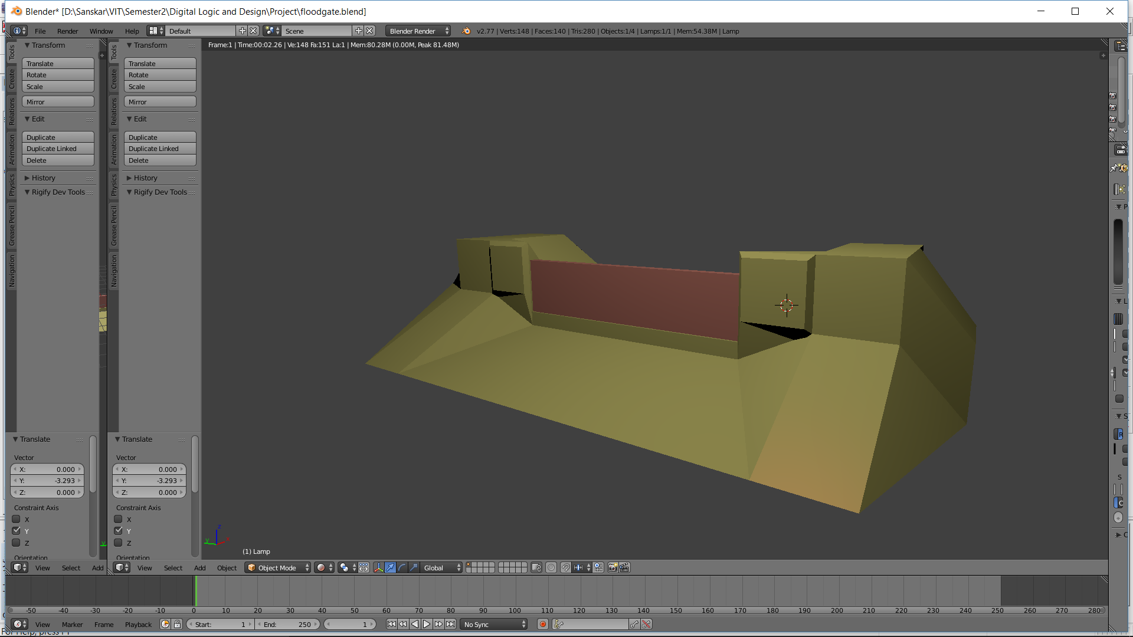
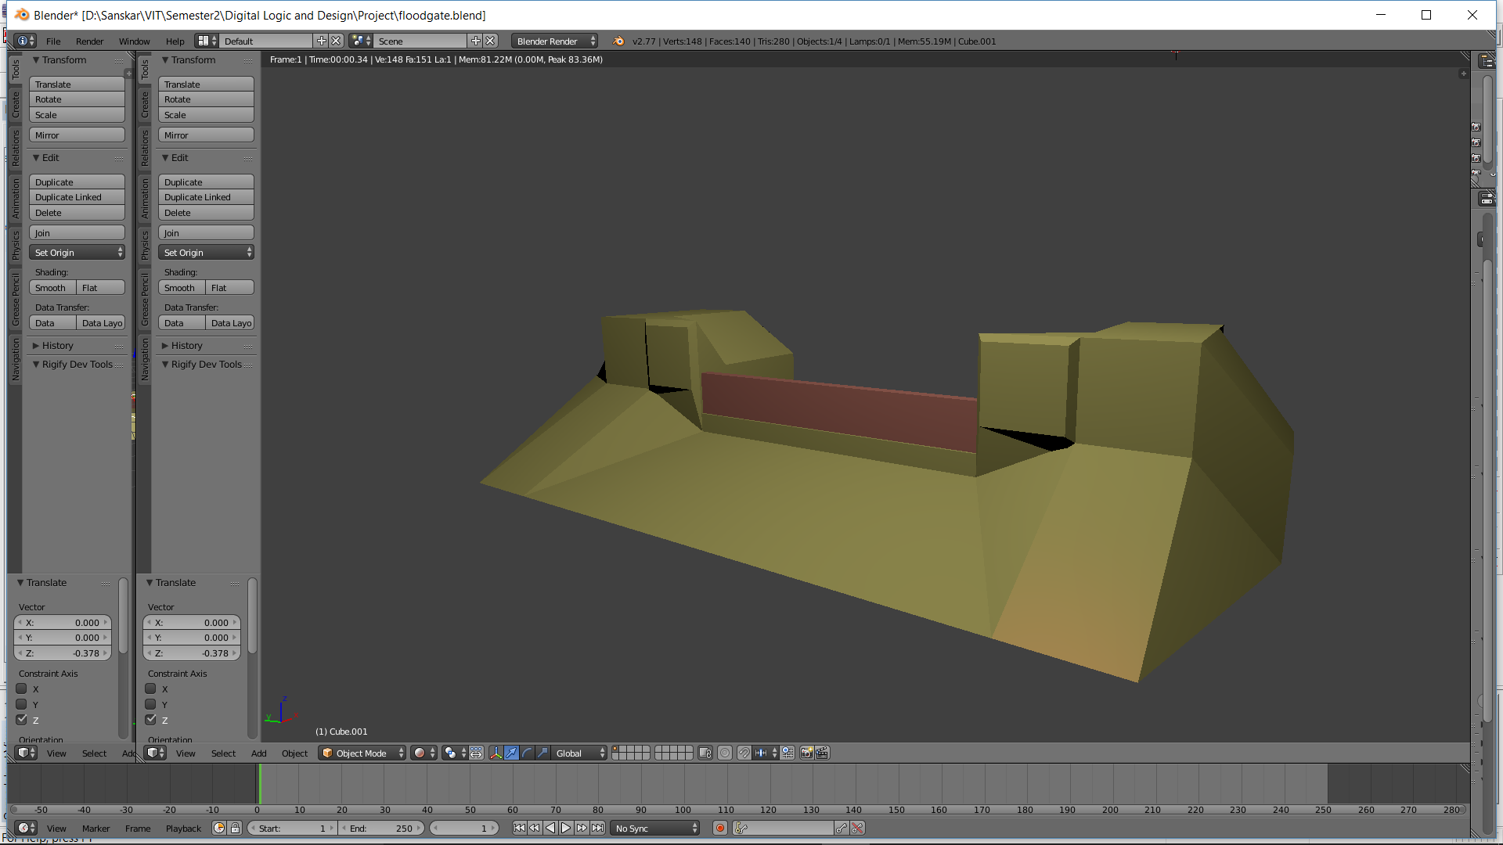
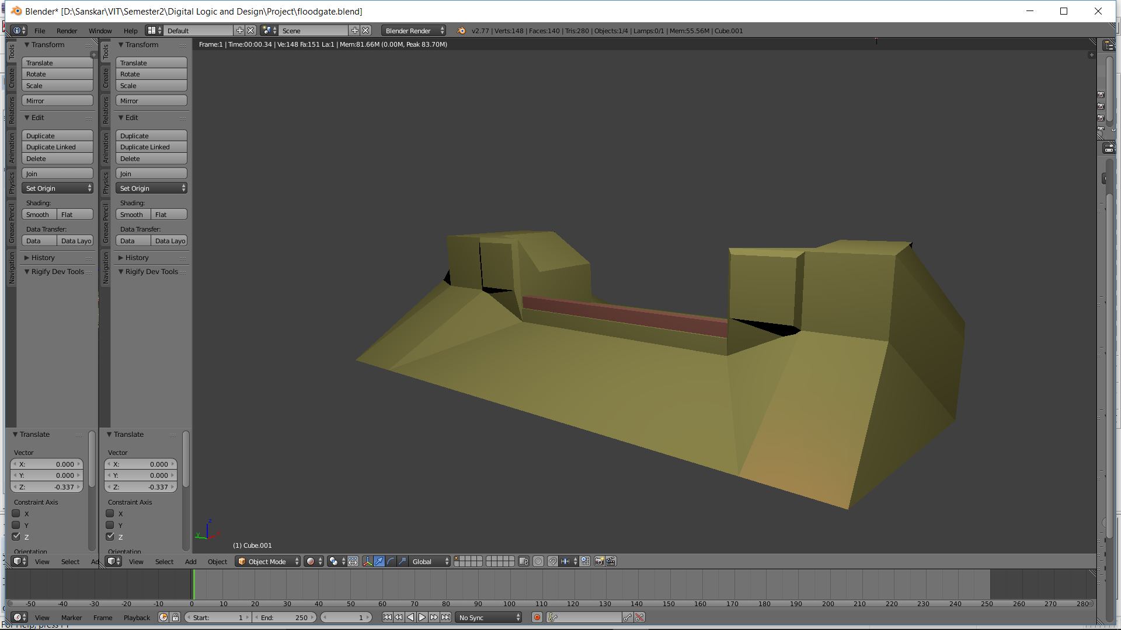
3D Model of Dam Mechanism

Slide 7
Block Model
Water Level Indicator
Arduino
Stepper Motor

Slide 8
Target of Final Review
Have a fully functional model of the proposed setup, detecting water level at 4 indicator points and accordingly releasing a controlled amount of water from the catchment zone.

