Slide 1
Sales Insights - Data Analysis Project using Tableau
BY - SANSKAR SHRIVASTAVA

Slide 2
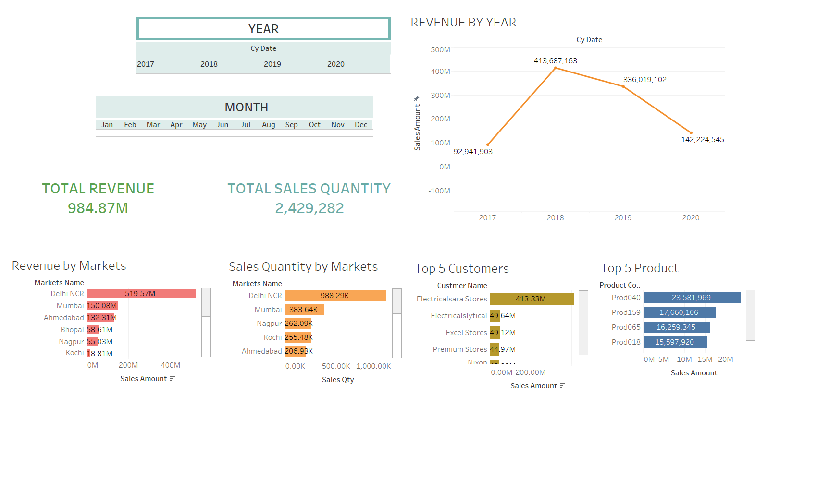

Slide 3
