Slide 1
INTERNSHIP
SUBMISSION
Data Science Master Virtual Internship
Sanskar Dubey
B.Tech CSE — Artificial Intelligence & Machine Learning
IILM University, Greater Noida
Enrollment No.: 25scs1003005208
June 2026 – August 2026 | Virtual | Individual

Slide 2
Internship Overview
A structured virtual internship focused on practical data science and AI/ML foundations.
Completed an 8-week Data Science Master Virtual Internship.
Internship period: June 2026 – August 2026.
Mode: Virtual; work completed individually.
Program: AICTE Virtual Internship Program, organized by EduSkills and supported by Siemens.
Academic context: B.Tech CSE with specialization/domain in Artificial Intelligence & Machine Learning.
IILM University, Greater Noida | B.Tech CSE (AI & ML)
2

Slide 3
Internship Objectives
The internship connected classroom concepts with practical data-science workflows.
Understand the end-to-end data science workflow.
Build a foundation in data preparation and data engineering.
Apply machine learning concepts to structured data.
Understand practical AI applications and use cases.
Develop familiarity with platform administration and project-oriented workflows.
Improve analytical thinking, problem-solving, and technical documentation skills.
IILM University, Greater Noida | B.Tech CSE (AI & ML)
3

Slide 4
Major Learning Modules
Core areas covered during the Data Science Master internship.
01
Data Engineering
Working with data workflows and structured data processes.
02
Data Preparation
Preparing, cleaning, organizing and transforming data for analysis.
03
Machine Learning
Understanding ML concepts and their practical application.
04
AI Applications & Use Cases
Connecting AI concepts with real-world applications.
05
Platform Administration
Understanding the supporting platform environment and workflows.
IILM University, Greater Noida | B.Tech CSE (AI & ML)
4

Slide 5
Data Science Workflow
A practical workflow used to understand how raw data becomes useful insight.
01 Collect
Identify and obtain relevant data.
02 Prepare
Clean, organize and transform data.
03 Explore
Inspect patterns, trends and relationships.
04 Model
Apply suitable machine-learning approaches.
05 Evaluate
Check results and interpret model performance.
06 Apply
Connect insights to a practical AI/ML use case.
IILM University, Greater Noida | B.Tech CSE (AI & ML)
5

Slide 6
Practical Work & Activities
Focus areas from the internship modules.
Worked through data-science concepts from data engineering to machine learning.
Practiced the importance of data quality, preparation and transformation before modelling.
Studied how machine-learning methods can be selected for different problem types.
Explored AI applications and real-world use cases.
Developed a better understanding of how data, models and platforms fit into an end-to-end workflow.
Documented learning and connected technical concepts with the requirements of an academic internship.
IILM University, Greater Noida | B.Tech CSE (AI & ML)
6

Slide 7
Skills & Knowledge Gained
Technical and professional outcomes of the internship.
Data Science: understanding of the complete data-to-insight lifecycle.
Data Engineering: foundational understanding of data workflows.
Data Preparation: cleaning, transformation and organization of datasets.
Machine Learning: improved understanding of modelling concepts and evaluation.
Artificial Intelligence: exposure to practical AI applications and use cases.
Professional Skills: independent work, structured learning, problem solving and technical reporting.
IILM University, Greater Noida | B.Tech CSE (AI & ML)
7

Slide 8
Key Learning Outcomes
What the internship added beyond classroom theory.
Understood why data preparation is critical before analysis and machine learning.
Learned to view AI/ML projects as end-to-end pipelines rather than isolated algorithms.
Improved ability to connect theoretical concepts with practical use cases.
Developed a more systematic approach to working with data.
Strengthened independent learning and technical communication.
IILM University, Greater Noida | B.Tech CSE (AI & ML)
8

Slide 9
Challenges & How I Addressed Them
Independent virtual learning required consistency and structured problem solving.
Challenge: Understanding multiple technical areas within a limited internship duration.
Approach: Broke the learning into modules and focused on one workflow at a time.
Challenge: Connecting theoretical ML concepts with practical data workflows.
Approach: Followed the complete data lifecycle from preparation through modelling and evaluation.
Challenge: Maintaining progress in a fully virtual, individual format.
Approach: Used structured self-learning, regular practice and documentation.
IILM University, Greater Noida | B.Tech CSE (AI & ML)
9

Slide 10
Conclusion
The internship strengthened my foundation for further work in AI, ML and data science.
Successfully completed the 8-week Data Science Master Virtual Internship.
Built foundational knowledge across data engineering, data preparation, machine learning and AI applications.
Improved independent working, analytical thinking and technical documentation.
The experience provides a stronger base for future academic projects and AI/ML development.
Overall internship performance: Outstanding (O) grade.
IILM University, Greater Noida | B.Tech CSE (AI & ML)
10

Slide 11
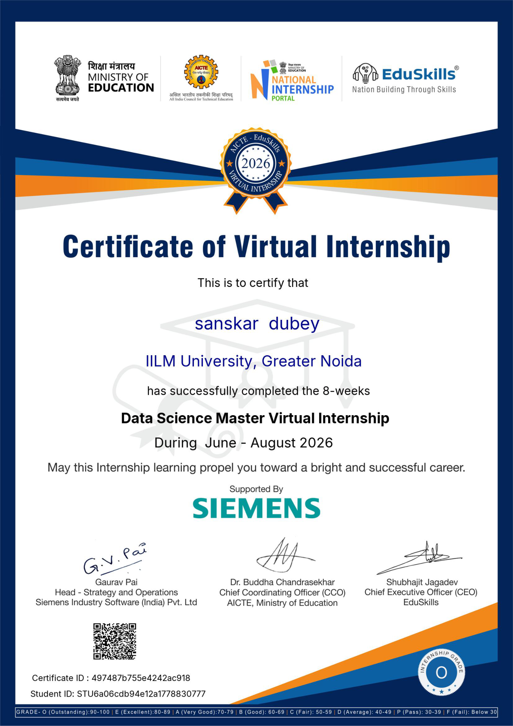
INTERNSHIP COMPLETION CERTIFICATE
Data Science Master Virtual Internship | June – August 2026
IILM University, Greater Noida | B.Tech CSE (AI & ML)

Slide 12
References
Primary program and learning references.
AICTE Virtual Internship Program — program framework and internship ecosystem.
EduSkills — Virtual Internship Program and learning resources.
Siemens — Data Science Master internship learning track and supporting material.
Course/module material covering Data Engineering, Data Preparation, Machine Learning, AI Applications and Platform Administration.
Note: References are listed by program/source name; use the official program pages and course portal for the exact materials accessed during the internship.
IILM University, Greater Noida | B.Tech CSE (AI & ML)
11

Slide 13
THANK YOU
Sanskar Dubey
B.Tech CSE — Artificial Intelligence & Machine Learning
IILM University, Greater Noida
Enrollment No.: 25scs1003005208

