Slide 1
Phishing URL Detection
22085609 |Sanskar Kafle

Slide 2
Table of contents
01
02
03
Introduction
Problem Domain
Project Scope
04
05
06
Dataset
Data Exploration
Model Selection

Slide 3
Table of contents
07
08
09
Hyperparameter Tuning
Training and Testing
Peformance Metrics
10
11
Results
Conclusion

Slide 4
Introduction
01

Slide 5
Brief Overview
Phishing threats have become ubiquitous in the digital landscape, posing significant challenges to cybersecurity. The sophistication of these threats, coupled with the ever-expanding internet ecosystem, underscores the need for advanced detection mechanisms. Cybercriminals employ deceptive tactics to create malicious URLs that mimic legitimate websites, making it imperative to address this pervasive issue. The prevalence of phishing attacks has escalated, leading to financial losses, data breaches, and compromised user privacy.

Slide 6
Project Objectives
DEVELOP MACHINE LEARNING MODELS
Create robust machine learning models capable of accurately detecting and categorizing phishing URLs.
USER SAFETY
Prioritize user safety by developing a system that safeguards against potential risks associated with phishing activities, ultimately creating a more secure online environment.
CONTRIBUTE TO CYBERSECURITY
Provide a meaningful contribution to the field of cybersecurity by implementing advanced algorithms that address the challenges posed by evolving phishing threats.

Slide 7
02
Problem Domain

Slide 8
In the current digital landscape, the proliferation of malicious URLs poses a significant challenge to cybersecurity. The rapid increase in the number of these URLs complicates the task of distinguishing secure websites from potentially dangerous ones. As internet platforms expand, the task of quickly identifying and categorizing malicious URLs becomes more difficult, allowing cyber threats to flourish. This growth is particularly concerning as it puts user data at risk, with new websites created daily, making it challenging to keep pace with potential threats.

Slide 9
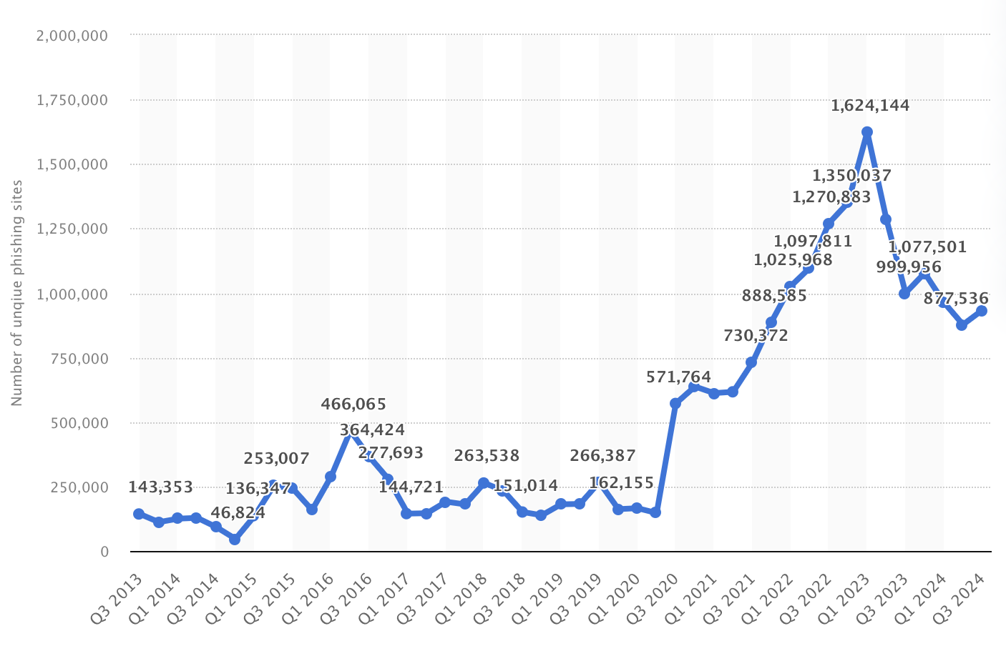
Awesome words

Slide 10
03
Project Scope

Slide 11
The project focuses on addressing the critical issue of URL phishing, aiming to enhance the detection mechanisms employed in cybersecurity. In an era marked by the expansive growth of internet platforms, the distinction between secure and malicious websites has become increasingly challenging. This project's scope encompasses the development of advanced systems dedicated to identifying and categorizing harmful URLs effectively. By leveraging machine learning algorithms, the project seeks to contribute to the improvement of defense mechanisms against evolving cyber threats, particularly those associated with phishing attacks.

Slide 12
04
Dataset

Slide 13
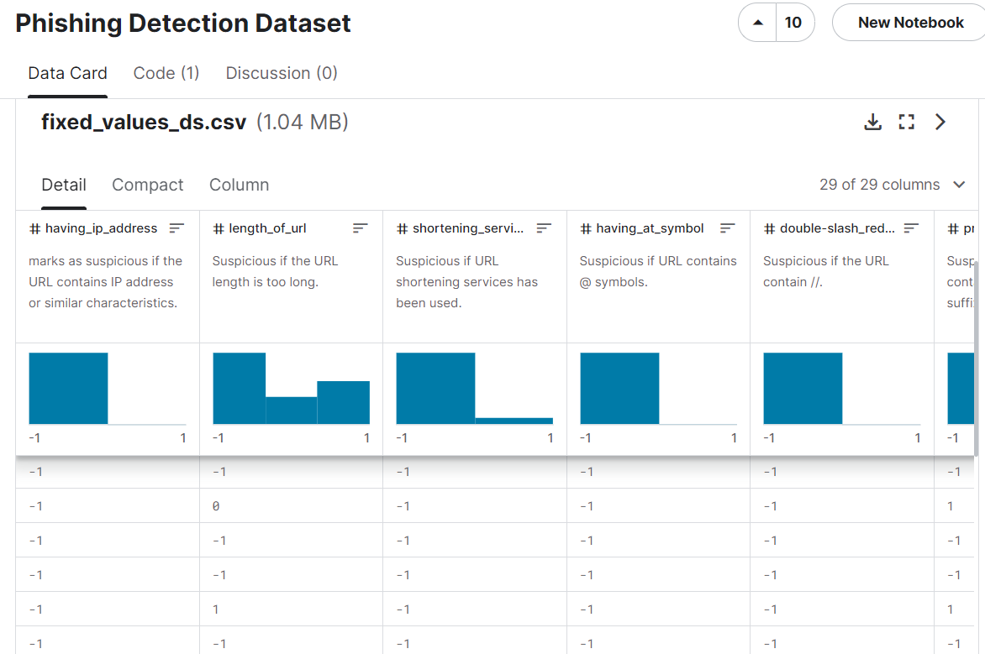

Slide 14
Reasons for choosing this dataset
Source and Authenticity
Size & Diversity
Reasons
Relevance to problem
Feature Richness

Slide 15
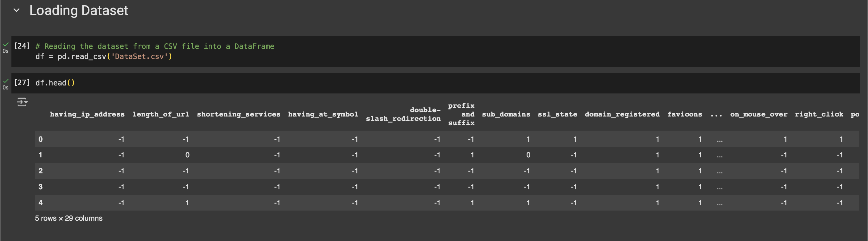
Loading Dataset

Slide 16
05
Data Exploration

Slide 17
Displaying dimensions of DataFrame

Slide 18
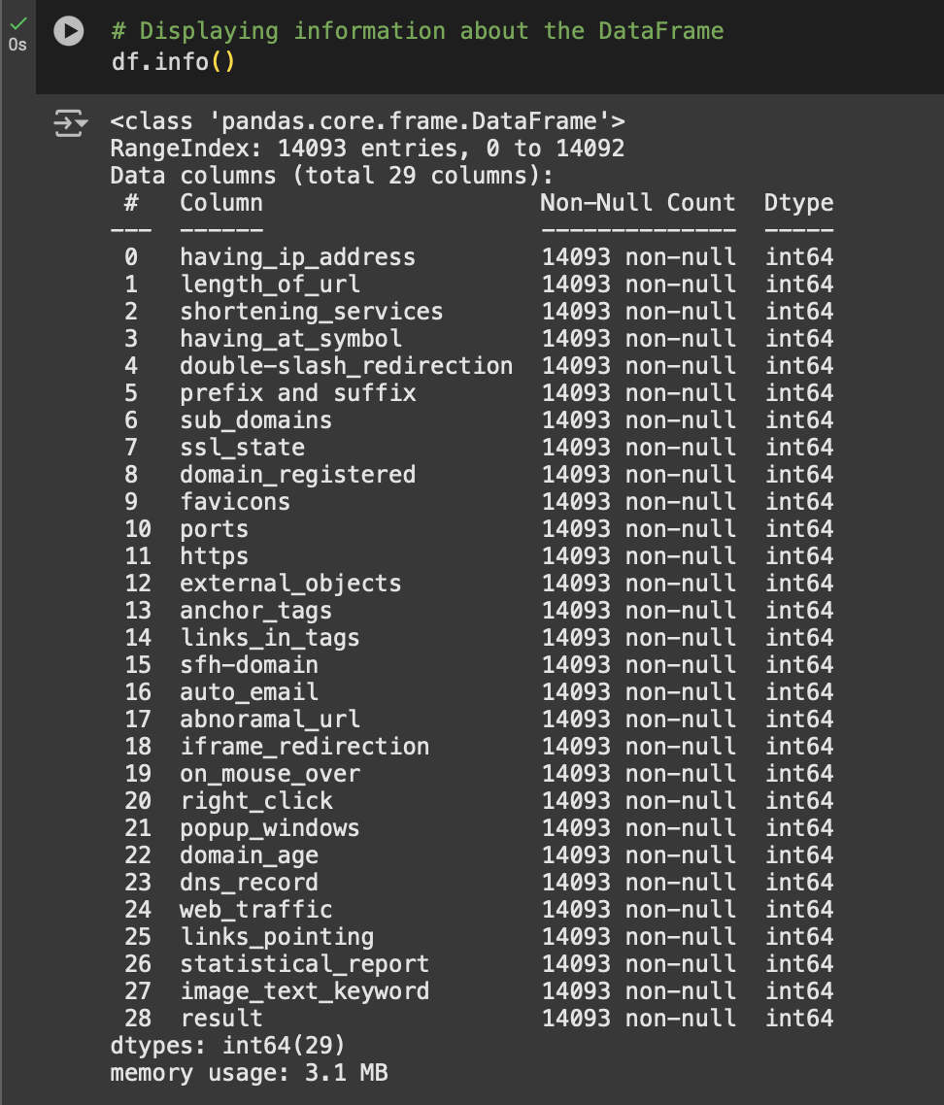
Displaying info about DataFrame

Slide 19
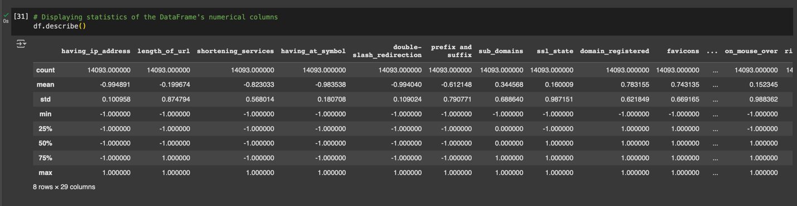
Displaying statistics of each column

Slide 20
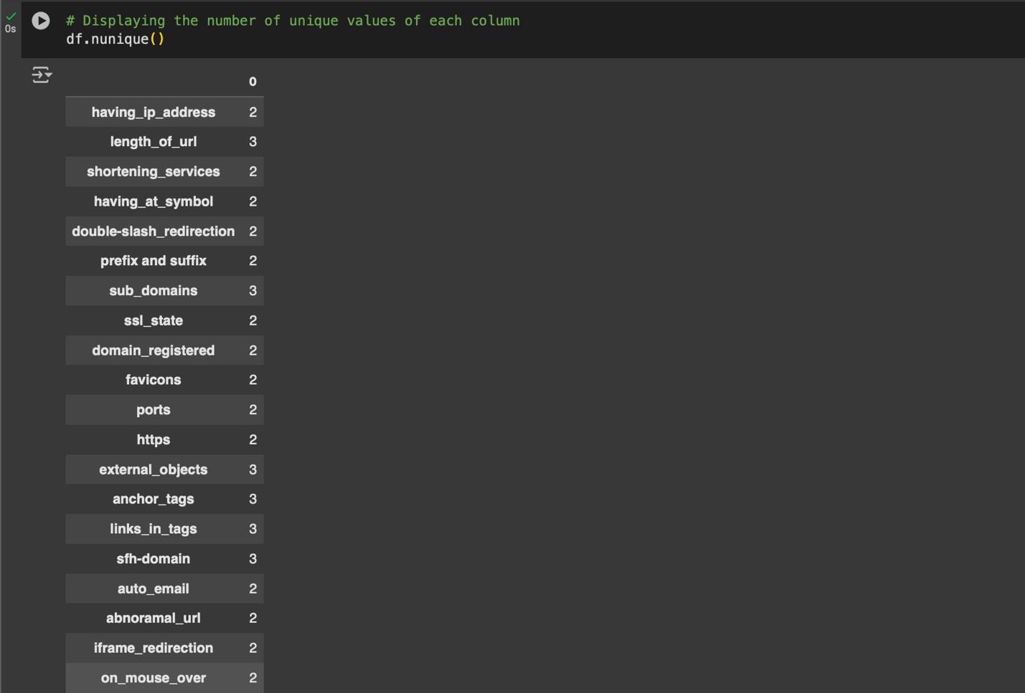

Displaying number of unique values in each column

Slide 21
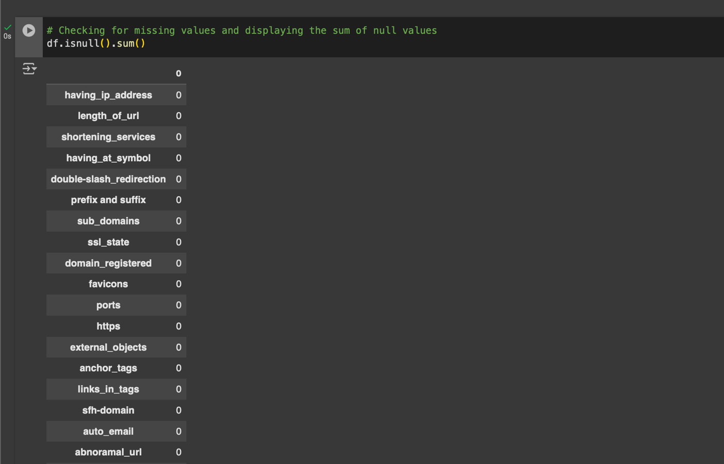

Checking for missing values and displaying the sum of null values

Slide 22
06
Model Selection

Slide 23
Selected Algorithms
Random Forest
K-Nearest Neighbors (KNN)
Leverages ensemble learning for improved accuracy
Due to pattern recognition
Support Vector Machines (SVM)
Handles complex data patterns

Slide 24
07
Performance Metrics

Slide 25
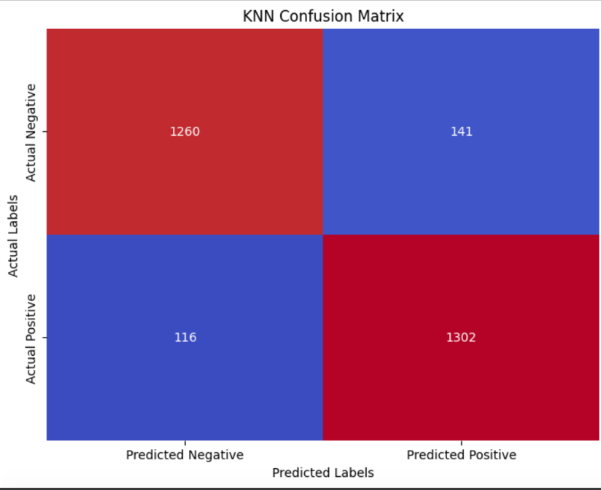
K-Nearest Neighbors (KNN)

Slide 26
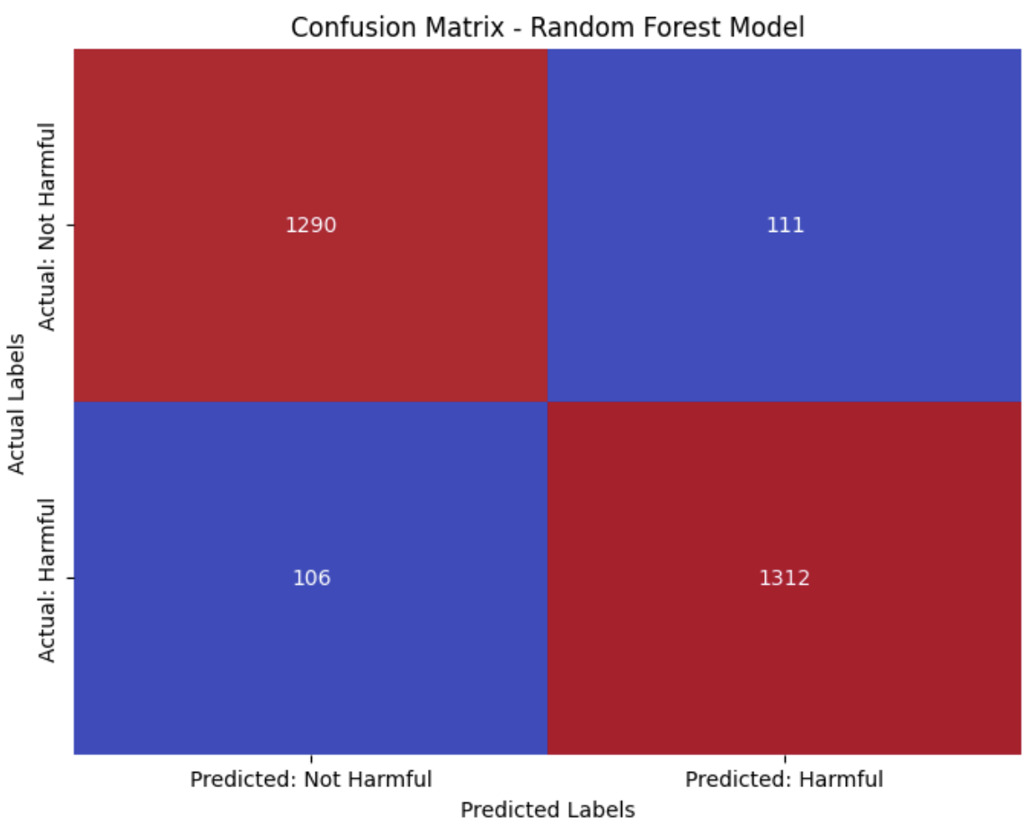
Random Forest

Slide 27
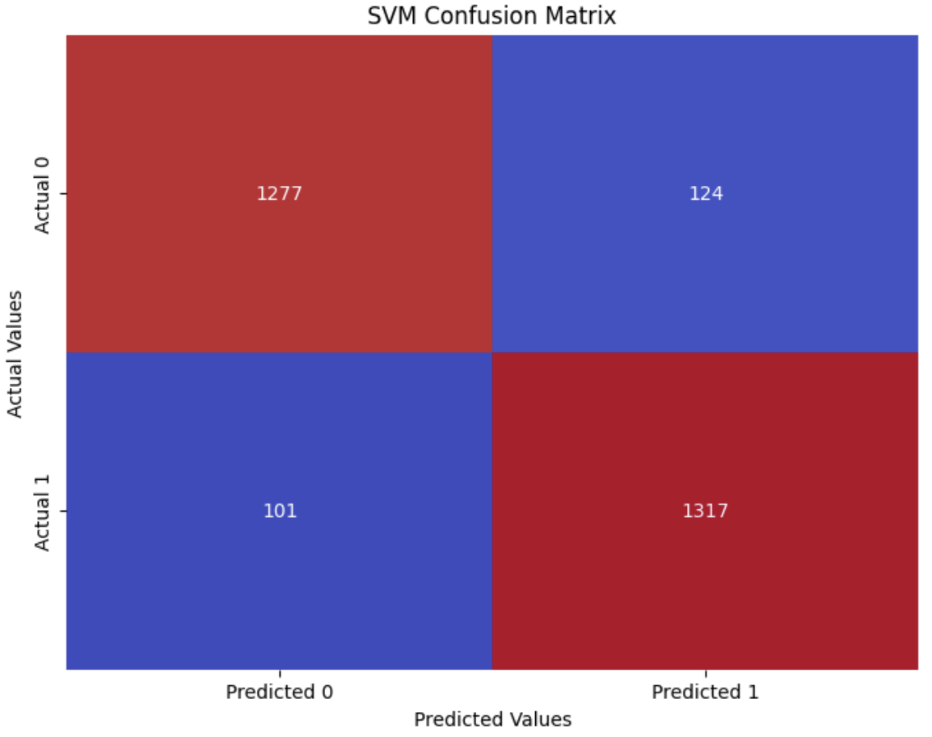
Support Vector Machines (SVM)

Slide 28
08
Results

Slide 29
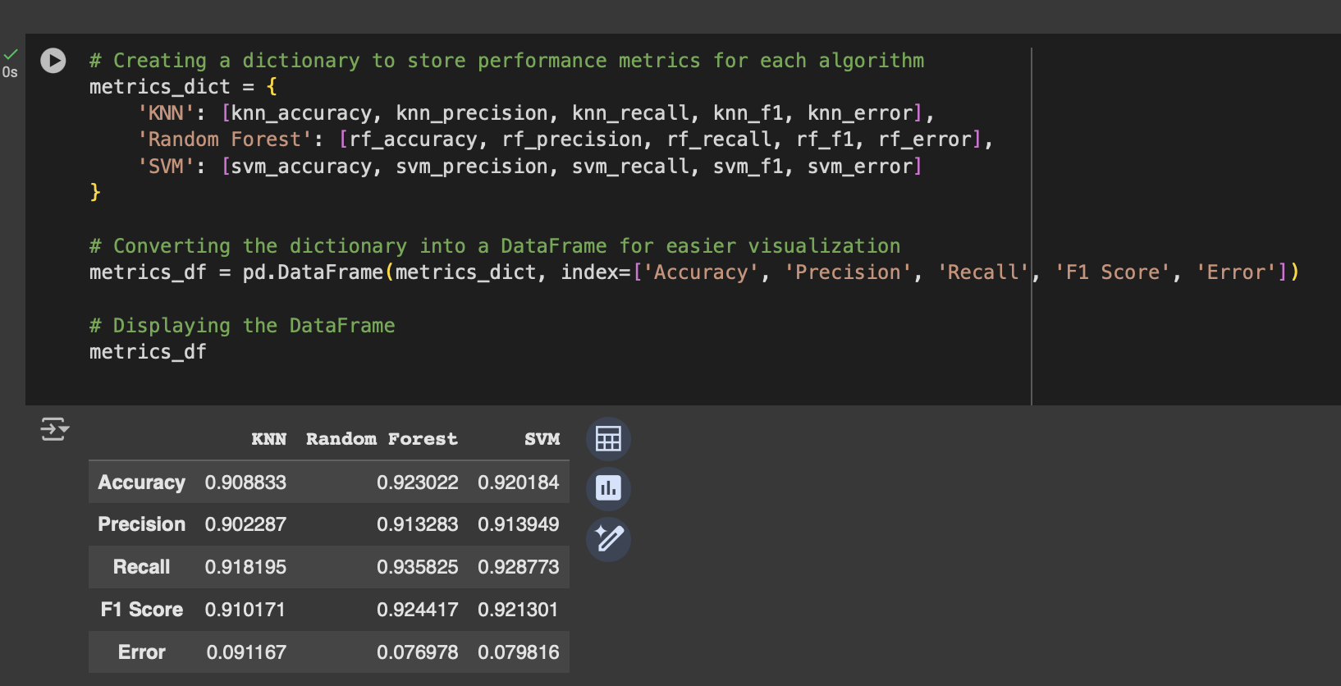
Performance Metrics

Slide 30
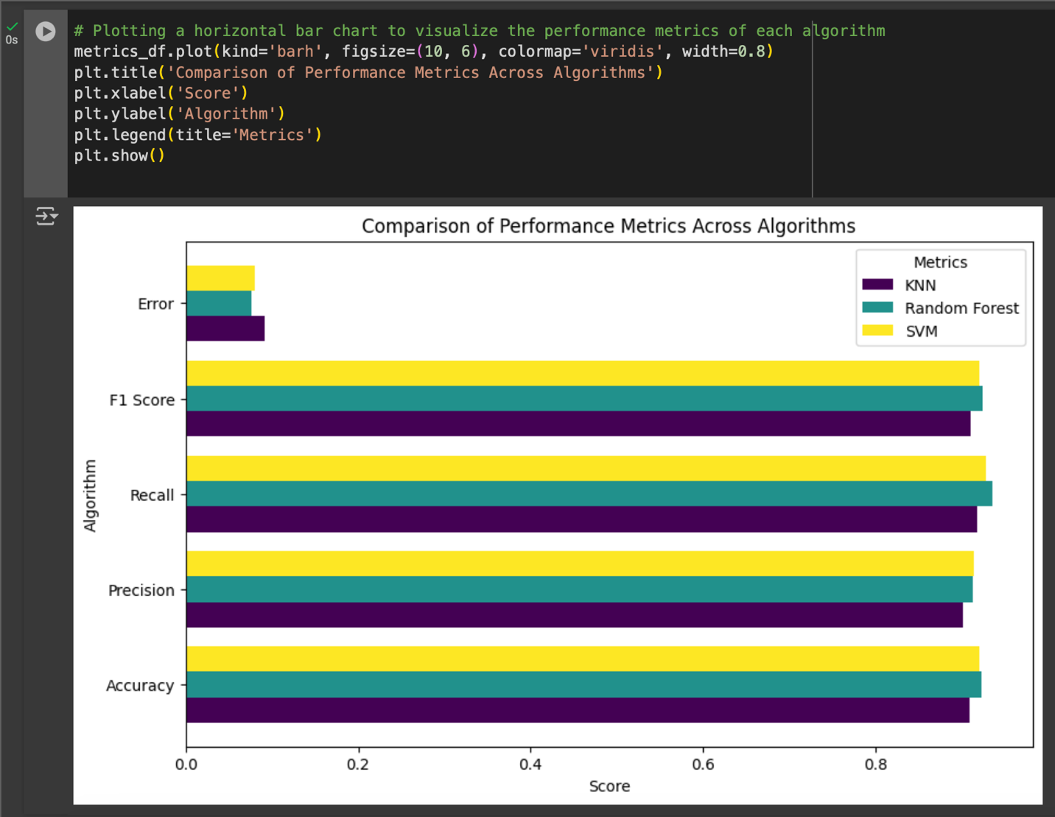
Performance Metrics

Slide 31
09
Conclusion

Slide 32
Among the models, the Random Forest model achieved the highest accuracy, demonstrating its strong performance in identifying URL phishing attacks. Both SVM and KNN performed well, striking a good balance between recall and precision. These results highlight the importance of selecting an algorithm for URL phishing detection that considers the specific requirements and trade-offs involved. The study provides valuable insights into the relative effectiveness of different machine learning models, aiding in the selection of suitable algorithms for real-world cybersecurity challenges.

