Slide 1
CROPxPert
A AI Powered Java Based Web Application that Will Predict The Plant Disease
Presented By : Sanskar Kumar 24MCA1066 Vishwas Kumar 24MCA1001 | To : Dr B Saleena (AI) Dr B Prakash (Ml) Dr M JayaSudha (Java)

Slide 2
Abstraction / Motivation
Early plant disease detection is crucial for crop health.
Manual diagnosis is slow and needs expertise.
Leaf images show clear disease patterns—ideal for AI.
Smartphones + deep learning = portable solutions.
AI bridges the knowledge gap for non-experts.
Scalable system with strong social and agricultural impact.

Slide 3
Introduction
This project focuses on identifying plant diseases from leaf images using a deep learning model.
MobileNet is used for image classification due to its lightweight architecture.
It aims to assist farmers and agriculturists with quick and accurate plant health diagnosis.
The Frontend part is based on Javafx
The Backend part is based on Python Flask
The Modle is trined using a CNN Technique called mobileNet
And last there are 2 AI agents That are helping to get the correct prediction and give some advice also

Slide 4
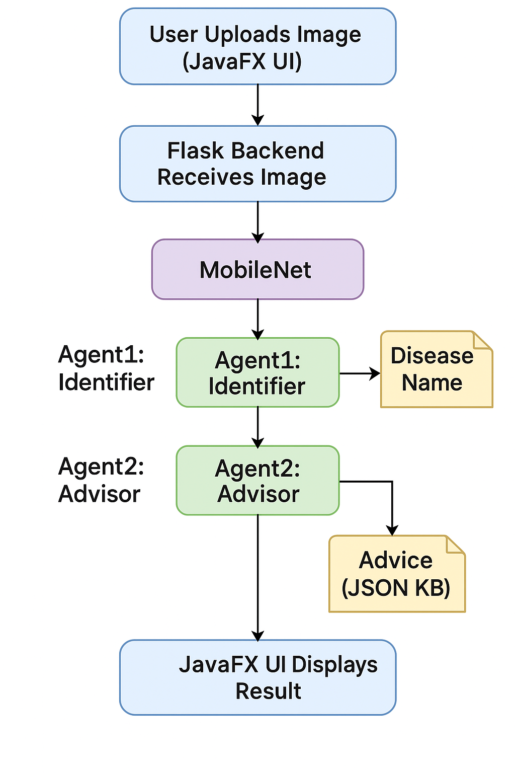
System Architecture

Slide 5
Model Prepration
Dataset used: PlantVillage Dataset
Contains over 50,000 images of plant leaves across various species and diseases.
Images are categorized into 11 sub classes
Resized all images to 224x224 pixels.
Normalized pixel values (scaled to [0, 1]).
Split the dataset: 80% training and 20% testing using stratified sampling per class.

Slide 6
Model Architecture and Training
Base Model: MobileNet (pre-trained on ImageNet).
Modified output layer to match 11 classes in our dataset.
Used transfer learning and fine-tuning techniques.
Used categorical cross-entropy loss function.
Optimizer: Adam.
Achieved high training and validation accuracy.
Early stopping and checkpointing were applied.

Slide 7
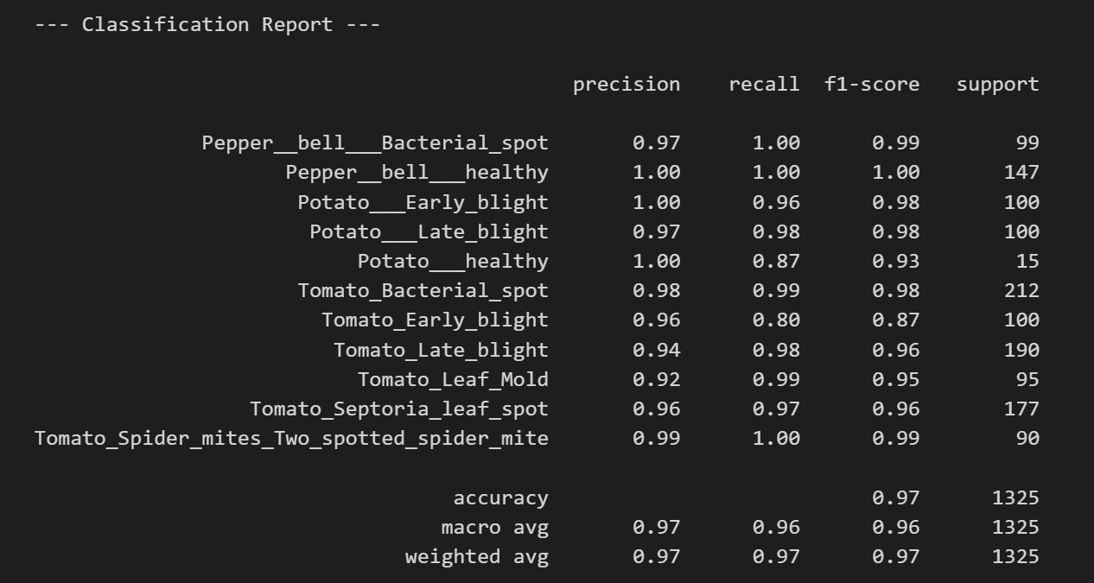
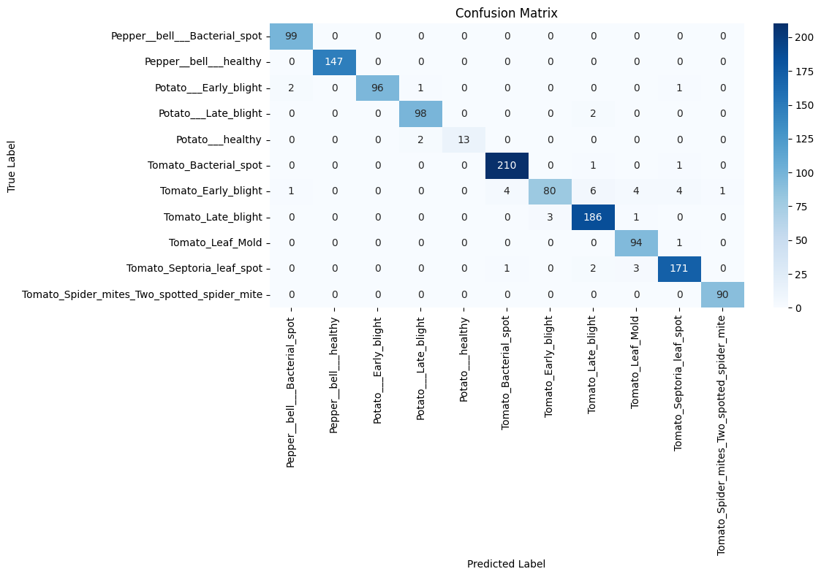
Model Evalution

Slide 8
Web Application
Frontend : Javafx
Backend: Flask API with image upload and prediction functionality.
CORS enabled for cross-origin communication with frontend.
AI Agents :
Separation of concerns: One agent identifies, another advises.
Easy to update independently (e.g., improve advice without touching model)
Mimics human expert consultation: diagnosis + prescription.
Scalable to more crops, diseases, or multilingual advice in the future.

Slide 9
Working Of Ai Agents in Our System
Agent 1: Identifier
Takes model prediction output (class index).
Maps it to the actual disease name.
Acts as the interface between the raw model output and human-readable result.
Ensures prediction consistency and clarity.
Agent 2: Advisor
Receives the identified disease name.
Refers to a pre-built knowledge base (JSON file).
Returns expert advice for treatment or prevention.
Makes the system actionable and useful for users.

Slide 10
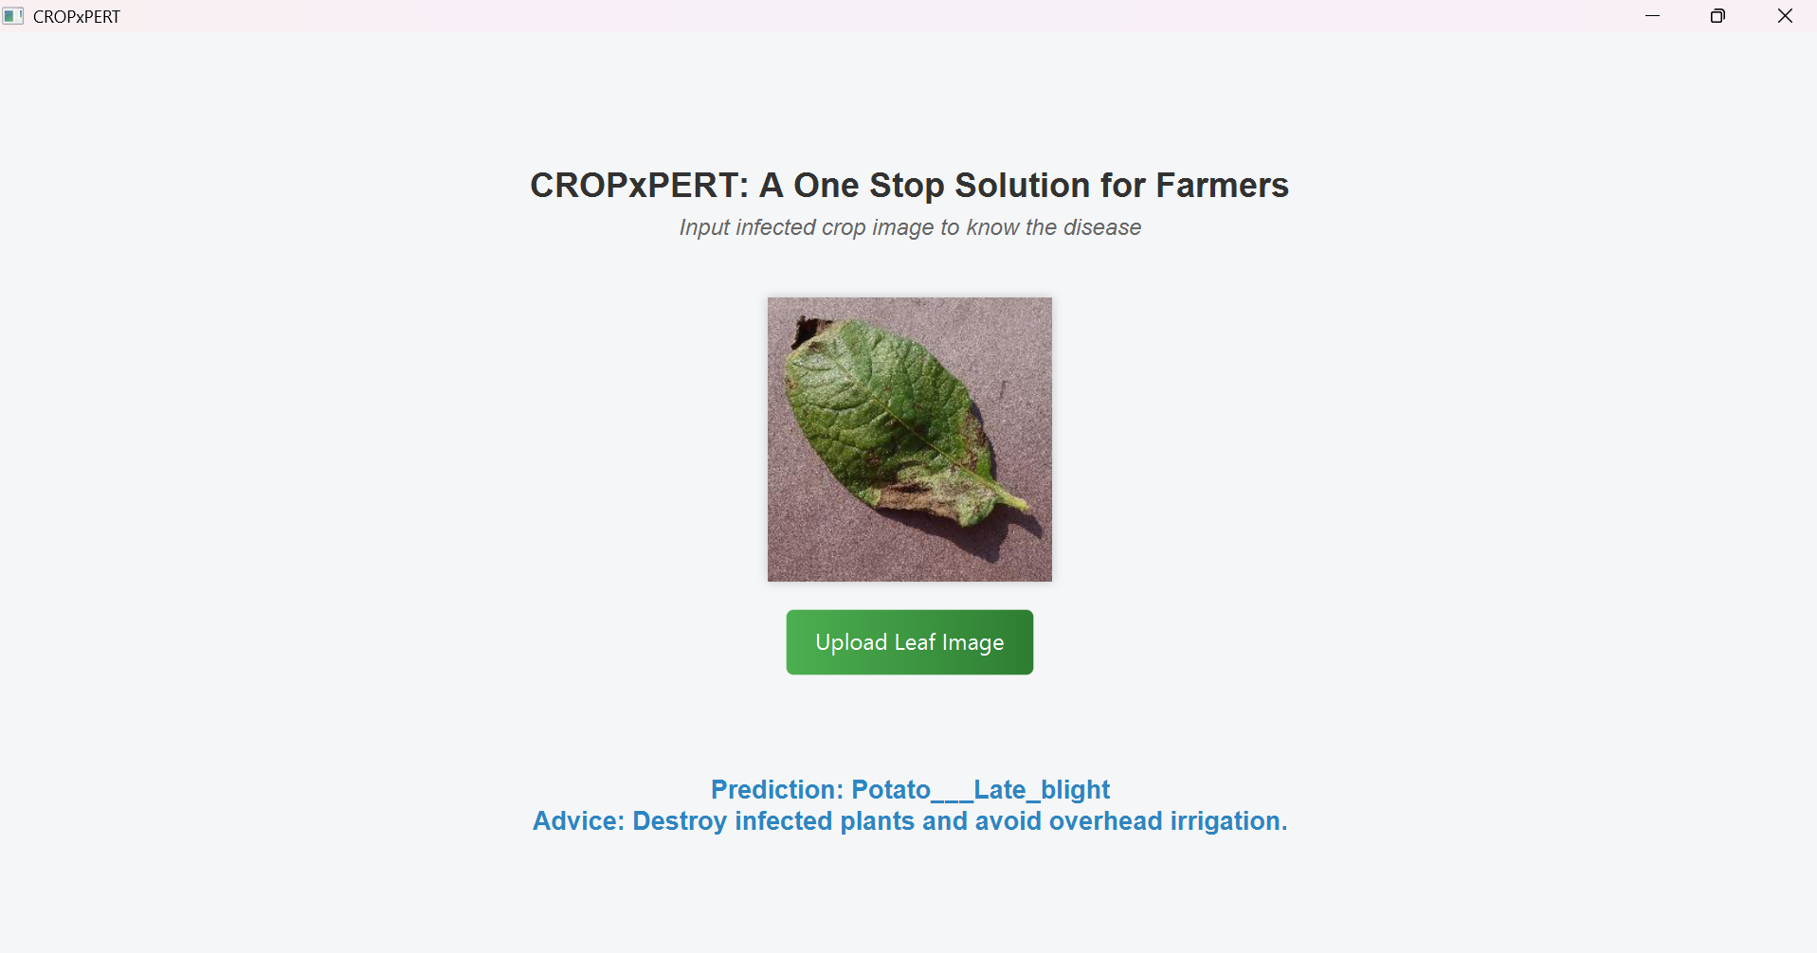
Executable Version

Slide 11
Results and Future Enhancement
The model accurately identifies plant diseases from images.
Gives actionable advice for each prediction using an AI advisor module.
Can generalize well across unseen leaf images.
The model accurately identifies plant diseases from images.
Gives actionable advice for each prediction using an AI advisor module.
Add More features like which is the nearest place where you can go and someone will come to look into your crops and do the treatment
Can generalize well across unseen leaf images.
Upgrade the frontend and make it more user friendly

Slide 12
Conclusion
This system automates plant disease identification using deep learning.
Provides instant and reliable advice to users.
Can be a valuable tool in precision agriculture and sustainable farming.

Slide 13
Thank You

