Slide 1
AIML Summer Internship 2026
Student Performance
Prediction System
Predicting Final Grades using Machine Learning
IIHMF, MNNIT Allahabad, Prayagraj | June 2026
Submitted by: Sanskar Kumar
Notes:
Introduce yourself. Tell the audience this is a machine learning project to predict student final grades.

Slide 2
Problem Statement
❓ The Problem
Teachers often cannot identify struggling students until it is too late.
No early warning system exists to predict which students are at risk.
Manual assessment is time-consuming and inconsistent.
💡 Our Solution
Build a Machine Learning model that predicts a student's Final Grade based on attendance, study habits, parental support and past performance.
Notes:
Explain why this problem matters. Teachers can intervene early if they know who is at risk.

Slide 3
Objectives
01
Collect & preprocess student performance data
04
Compare models using MAE, RMSE and R² Score
02
Perform Exploratory Data Analysis (EDA)
05
Deploy best model as a Streamlit web app
03
Build and train 3 ML models
Notes:
Walk through each objective one by one.

Slide 4
Dataset Description
1000
10
1
Students
Features Used
Target Variable
Feature | Type | Feature | Type
AttendanceRate | Numeric | ParentalSupport | Categorical
StudyHoursPerWeek | Numeric | Online Classes Taken | Boolean
PreviousGrade | Numeric | Gender | Categorical
ExtracurricularActivities | Numeric | FinalGrade (Target) | Numeric
Notes:
Source: Kaggle. 1000 rows, 12 columns originally. We dropped StudentID and Name as they are not useful.

Slide 5
Methodology — ML Lifecycle
1
2
3
4
Problem
Understanding
Data
Collection
Preprocessing
EDA
5
6
7
8
Feature
Engineering
Model
Building
Evaluation
Deployment
Notes:
Explain each phase briefly. We followed the complete ML lifecycle for this project.

Slide 6
Data Preprocessing
1
Dropped Columns
Removed StudentID, Name (irrelevant) and duplicate columns Study Hours and Attendance (%)
2
Missing Values
Filled numerical columns with Median and categorical columns with Mode
3
Fixed Invalid Data
StudyHoursPerWeek had value -5 and AttendanceRate had value 200 — both fixed using clip()
4
Label Encoding
Gender encoded as Male=1 Female=0. ParentalSupport mapped as Low=0 Medium=1 High=2
5
Boolean Encoding
Online Classes Taken converted from True/False to 1/0 using astype(int)
Notes:
Preprocessing is very important. Bad data gives bad results. Explain each step clearly.

Slide 7
Exploratory Data Analysis (EDA)
📊 Histogram
📊 Scatter Plot
Distribution of all
features including
FinalGrade
StudyHours vs Grade
Attendance vs Grade
(positive trend found)
📊 Boxplot
📊 Heatmap
Detected invalid values
-5 in StudyHours
200 in Attendance
PreviousGrade had
highest correlation
with FinalGrade
Notes:
Show actual plots from your notebook here. Replace the text cards with screenshots of your plots.

Slide 8
Machine Learning Models Used
Linear
Regression
Random
Forest
XGBoost
Simple model that finds a straight line relationship between features and target. Good baseline model.
Builds many decision trees and combines their results. Handles non-linear data and outliers well.
Gradient boosting that builds trees one by one. Each tree fixes errors of previous. Very powerful on tabular data.
All 3 models are Regression models since FinalGrade is a continuous number
Notes:
Explain why we chose regression and not classification. FinalGrade is a number not a category.

Slide 9
Results & Model Comparison
Model | MAE | RMSE | R² Score
Linear Regression | 8.06 | 9.57 | -0.02
Random Forest | 8.66 | 10.33 | -0.19
XGBoost | 9.71 | 11.87 | -0.57
Notes:
Fill in actual values from your notebook. Explain that higher R2 is better and lower RMSE is better.

Slide 10
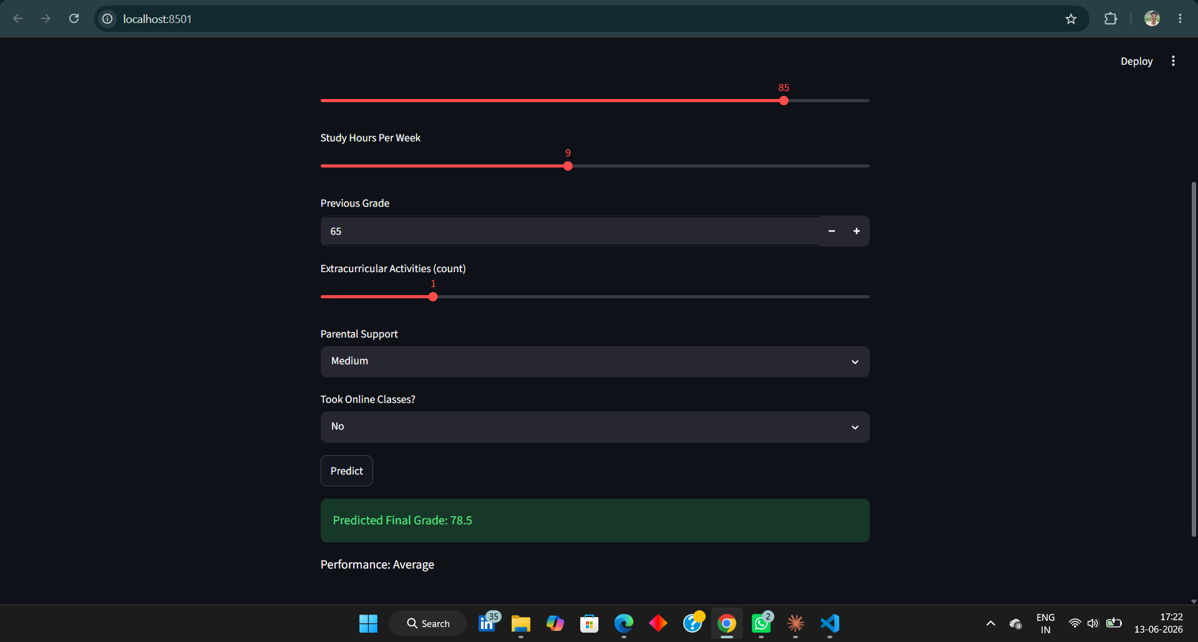
Streamlit Web Application
Live Demo
[ Paste your Streamlit app screenshot here ]
User enters student details → Model predicts Final Grade → Result shown with performance band
Notes:
Show a live demo here. Enter different values and show how the prediction changes.

Slide 11
Conclusion
✅
Successfully built a Student Performance Prediction System using ML
✅
Followed complete ML lifecycle from data collection to deployment
✅
Trained and compared 3 models — Linear Regression, Random Forest, XGBoost
✅
Random Forest gave the best R² Score and lowest RMSE
✅
Deployed as a live Streamlit web app — ready to use
Notes:
Summarize what was achieved. Keep it confident and clear.

Slide 12
Future Scope
📊
Collect more data from multiple schools and colleges for better accuracy
📋
Add a teacher dashboard to monitor student performance over time
🧠
Try deep learning models like Neural Networks
🏷️
Build a classification version to predict grade categories A B C D F
🌐
Host the app on Streamlit Cloud for free public access
Notes:
These are things you can improve in the future. Shows you understand the limitations.

Slide 13
Thank You!
Questions & Answers
AIML Summer Internship 2026 | IIHMF, MNNIT Allahabad
GitHub: https://github.com/sanskarkumar333222-dot
Notes:
End with confidence. Be ready to explain any part of your code or methodology.

