Slide 1
Python

Slide 2
What is python
Python is a high-level programming language that is designed to be easy to read and write.
Python offers a wide range of libraries and frameworks that make it versatile and powerful for various purposes, such as web development, data analysis, scientific computing, artificial intelligence, and automation.
Example :
Spotify: Python is used in Spotify's backend systems, data analytics, and machine learning projects.
Facebook: Python is used in various parts of Facebook's infrastructure, including their web applications, data analysis, and machine learning projects.

Slide 3
History
Python was created by Guido van Rossum and first released in 1991. Van Rossum wanted to develop a language that would be easy to learn and read, with a clean and readable syntax.
Python started gaining popularity in the early 2000s, as its simplicity and versatility made it attractive to developers. It was embraced by the open-source community, and a large number of libraries and frameworks were developed for various purposes .
Company :
Google: Python is one of the main programming languages used at Google. It is used for various purposes such as web development, system administration, and scientific computing.
Netflix: Python is used for building and maintaining their recommendation systems and content delivery infrastructure.
NASA: Python is widely used in scientific applications at NASA for tasks such as data analysis, simulations, and visualization.

Slide 4
Step to Download Python
Visit the official Python website at https://www.python.org/.
Go to the Downloads section and click on the "Python X.X.X" (replace X.X.X with the latest version number) button.
On the downloads page, you will see different installation packages available for different operating systems (Windows, macOS, Linux). Choose the appropriate package for your operating system.
Click on the installer to start the download. The file size will vary based on the package and version you chose.
Once the download is complete, run the installer to start the installation process.
Click the "Install Now" button to start the installation process. The installation may take a few minutes.

Slide 5
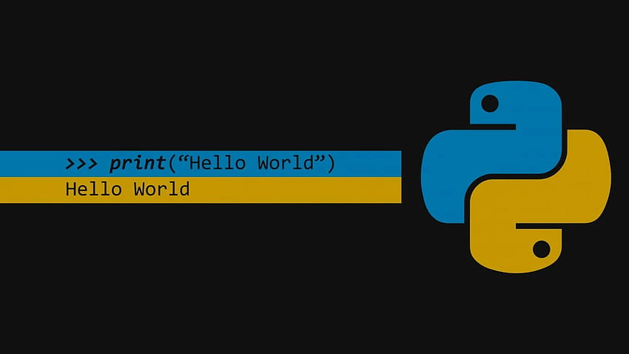
1ST program

Slide 6
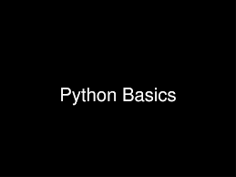

Slide 7
Data Types
In Python, data types are dynamically assigned to variables, meaning you don't need to explicitly specify the data type when declaring a variable. However, Python still has built-in data types that you can use.
1. Integer
- Syntax: `x = 10`
2. Float (Floating-point number)
- Syntax: `x = 3.14`

Slide 8
3. Complex (Complex number)
- Syntax: `x = 1 + 2j`
4. String
- Syntax: `x = "Hello, World!"`
5. Boolean
- Syntax: `x = True` or `x = False`
6. List (Ordered and changeable collection of elements)
- Syntax: `x = [1, 2, 3, 4]`

Slide 9
7. Tuple (Ordered and unchangeable collection of elements)
- Syntax: `x = (1, 2, 3, 4)`
8. Set (Unordered and unindexed collection of unique elements)
- Syntax: `x = {1, 2, 3, 4}`
9. Dictionary (Unordered and changeable collection of key-value pairs)
- Syntax: `x = {"name": "John", "age": 25}`
10. NoneType (Represents the absence of a value)
- Syntax: `x = None`

Slide 10
Variable
When you assign a value to a variable, Python creates an object in memory to store that value. The object contains both the value and the information about the type of the value.
This process of creating objects in memory and updating variable references is handled automatically by Python and you don't need to explicitly manage memory. Python's garbage collector takes care of freeing up memory for objects that are no longer in use.
+--------------------------+
| my_number = 42 |
| |
| +-------+ |
| | 42 | |
| +-------+ |
+--------------------------+

Slide 11
Comments
In Python, comments are used to add explanations or annotations to your code. They are ignored by the Python interpreter when running the program and are only meant for human readers.
# This is a comment
print("Hello, World!") # This is another com ment

Slide 12
Doc String
Python also supports multi-line comments called docstrings.
used to provide documentation for functions, classes, and modules.
To access the docstring of a function, you can use the `__doc__` attribute
def greet(name):
"""This function greets the person with the given name."""
print(f"Hello, {name}!")
print(greet.__doc__)

Slide 13
Operator
1. Arithmetic operators:
+ (addition), - (subtraction), * (multiplication), / (division), % (modulo), ** (exponentiation), // (floor division)
2. Assignment operators:
= (simple assignment), += (addition assignment), -= (subtraction assignment), *= (multiplication assignment), /= (division assignment)
3. Comparison operators:
== (equal to), != (not equal to), < (less than), > (greater than), <= (less than or equal to), >= (greater than or equal to)
4. Logical operators:
and (logical AND), or (logical OR), not (logical NOT)
5. Bitwise operators:
& (AND), | (OR), ^ (XOR), ~ (NOT), << (left shift), >> (right shift)
6. Membership operators:
in (checks if a value is present in a sequence), not in (checks if a value is not present in a sequence)
7. Identity operators
: is (checks if two variables refer to the same object), is not (checks if two variables do not refer to the same object)

Slide 14
conditional statements
the if-else statement is used when you want to execute one block of code if a condition is True and another block of code if the condition is False.
if condition:
// code block to be executed if condition is True
if condition:
// code block to be executed if condition is True
elif condition2:
// code block to be executed if condition2 is True
else:
// code block to be executed if all conditions are False

Slide 15
loops
loops are used to repeatedly execute a block of code until a certain condition is met. There are two types of loops in Python: the for loop and the while loop.
for variable in sequence:
// code block to be executed for each iteration
while condition:
// code block to be executed as long as the condition is True

Slide 16
Functions
a function is a block of code that performs a specific task and can be reused multiple times. Functions help in organizing code, making it more readable and modular. They also help in reducing code duplication.
def function_name(parameter1, parameter2, ...):
// code to be executed
return result
To call a function, you simply write the function name followed by parentheses, passing the required arguments (if any).
n addition to defining your own functions, Python also provides many built-in functions that you can use. These functions perform common tasks and are available without needing to define them yourself. Examples include `print()`, `len()`, `max()`, `min()`, `sum()`, etc.
V N

Slide 17
Introducing Lists.
A list is a collection of items in a particular order. You can make a list that includes the letters of the alphabet, the digits from 0–9, or the names of all the people in your family.
bicycles = ['trek', 'cannondale', 'redline', 'specialized']
print(bicycles)

Slide 18
List function
1. `len()` function: Returns the number of elements in a list.
fruits = ["apple", "banana", "orange"]
print(len(fruits)) # Output: 3
2. `append()` method: Adds an element to the end of a list.
fruits = ["apple", "banana", "orange"]
fruits.append("grape")
print(fruits) # Output: ["apple", "banana", "orange", "grape"]
3. `insert()` method: Inserts an element at a specified position in a list.
fruits = ["apple", "banana", "orange"]
fruits.insert(1, "grape")
print(fruits) # Output: ["apple", "grape", "banana", "orange"]

Slide 19
4. `remove()` method: Removes the first occurrence of a specified element from a list.
fruits = ["apple", "banana", "orange"]
fruits.remove("banana")
print(fruits) # Output: ["apple", "orange"]
5. `pop()` method: Removes and returns the last element of a list, or an element at a specified index.
fruits = ["apple", "banana", "orange"]
popped_fruit = fruits.pop()
print(popped_fruit) # Output: "orange"
print(fruits) # Output: ["apple", "banana"]

Slide 20
6. `extend()` method: Extends a list by adding elements from another iterable (e.g., another list).
fruits = ["apple", "banana"]
more_fruits = ["orange", "grape"]
fruits.extend(more_fruits)
print(fruits) # Output: ["apple", "banana", "orange", "grape"]
7. `sort()` method: Sorts the elements of a list in ascending order.
numbers = [3, 1, 4, 2, 5]
numbers.sort()
print(numbers) # Output: [1, 2, 3, 4, 5]
8. `reverse()` method: Reverses the order of elements in a list.
numbers = [1, 2, 3, 4, 5]
numbers.reverse()
print(numbers) # Output: [5, 4, 3, 2, 1]

Slide 21
Tuples
A tuple is a collection of ordered elements, enclosed in parentheses. Tuples are similar to lists, but they are immutable, meaning their elements cannot be changed after creation. The elements can be of any data type and can be accessed using indexing.
my_tuple = (1, "hello", 3.14)
Since tuples are immutable, you cannot modify their elements directly. However, you can create a new tuple by concatenating existing tuples or by creating a tuple from other data structures.

Slide 22
Dictionary
you can create a dictionary using curly braces `{}` or the `dict()` function. A dictionary consists of key-value pairs where each key is unique within the dictionary.
Creating a dictionary
my_dict = {'apple': 5, 'banana': 3, 'orange': 8}
# Accessing values using keys
print(my_dict['apple']) # Output: 5
# Modifying values
my_dict['banana'] = 10
print(my_dict['banana']) # Output: 10

Slide 23
# Adding new key-value pairs
my_dict['grape'] = 4
print(my_dict['grape']) # Output: 4
# Removing key-value pairs
del my_dict['orange']
print(my_dict.get('orange')) # Output: None

Slide 24
Sets
A set is another built-in data structure in Python that represents a collection of unique elements. Unlike lists and tuples, sets do not have an order and do not allow duplicate values. Sets are commonly used for mathematical operations such as union, intersection, and difference.
my_set = {1, 2, 3}
Sets support various operations, such as adding elements, removing elements, checking membership, and performing set operations like union, intersection, and difference.

