Slide 1
Impact of DRS on Fan Engagement in Cricket
Research Synopsis Presentation
M.Tech Computer Science
Your Name | Roll No. | NIT Srinagar

Slide 2
Introduction
• What is DRS?
• Why it matters
• Impact on fairness
• Fan interest

Slide 3
Problem Statement
• Umpiring errors affect fairness
• Fans lose trust
• DRS improves accuracy but sparks debates

Slide 4
Objectives
• Analyze DRS impact
• Collect data
• Use NLP & Visualization
• Predict future opportunities

Slide 5
Evolution of Umpiring
• Pre-2008: Manual only
• 2008: DRS introduced
• 2015+: ICC adoption
• Current: Tech-driven

Slide 6
Working of DRS
• Hawk-Eye
• UltraEdge
• HotSpot
• 3rd Umpire

Slide 7
Fan Engagement Before vs After
Before: Accepted decisions
After: Social media, memes, debates

Slide 8
Literature Review
• Studies on DRS
• Fan engagement papers
• Research gap: Fan analytics

Slide 9
Proposed Framework
• Input: Match + Social media data
• Processing: NLP + Sentiment
• Output: Trends & Visuals

Slide 10
Data Collection Sources
• Match footage
• Twitter, YouTube, Instagram
• Cricinfo / Cricbuzz APIs

Slide 11
Methodology
• Data Cleaning
• Sentiment Analysis
• Visualization
• Comparison with/without DRS

Slide 12
Weekly Research Plan
W1: Review
W2: Collection
W3: Cleaning
W4: Sentiment
W5: Visualization
W6: Results

Slide 13
Timeline / Gantt Chart
Phase 1: W1–W2
Phase 2: W3–W4
Phase 3: W5–W6

Slide 14
Data Preprocessing & Tools
• Python, Pandas, SQL
• NLP: NLTK, SpaCy
• Viz: Matplotlib, Plotly

Slide 15
Sample Results
• Sentiment graph
• Word cloud
• Before vs After DRS comparison

Slide 16
Fan Engagement Trends
• Social spikes during DRS
• Trending hashtags
• Emotional fan reactions

Slide 17
Impact of DRS
• Improved fairness
• Higher fan involvement
• Excitement during reviews

Slide 18
Future Opportunities
• AI umpiring
• VR replays
• AR overlays
• Predictive analytics

Slide 19
Challenges
• Tech costs
• Biased fan reactions
• Limited data access

Slide 20
Conclusion
• DRS transformed cricket
• Fans now part of decisions
• Future: AI, VR, AR in sports

Slide 21
References
• ICC, ESPN Cricinfo
• IEEE/ACM papers
• NLP & Sentiment analysis

Slide 22
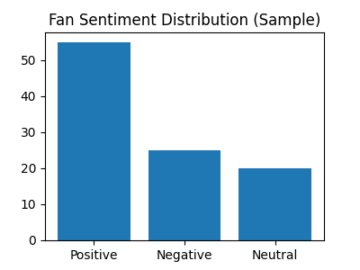
Sample Sentiment Analysis

Slide 23
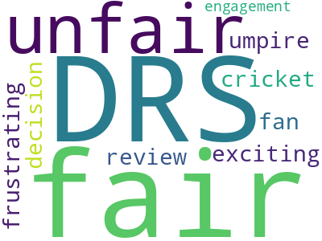
Fan Reactions Word Cloud

