Slide 1
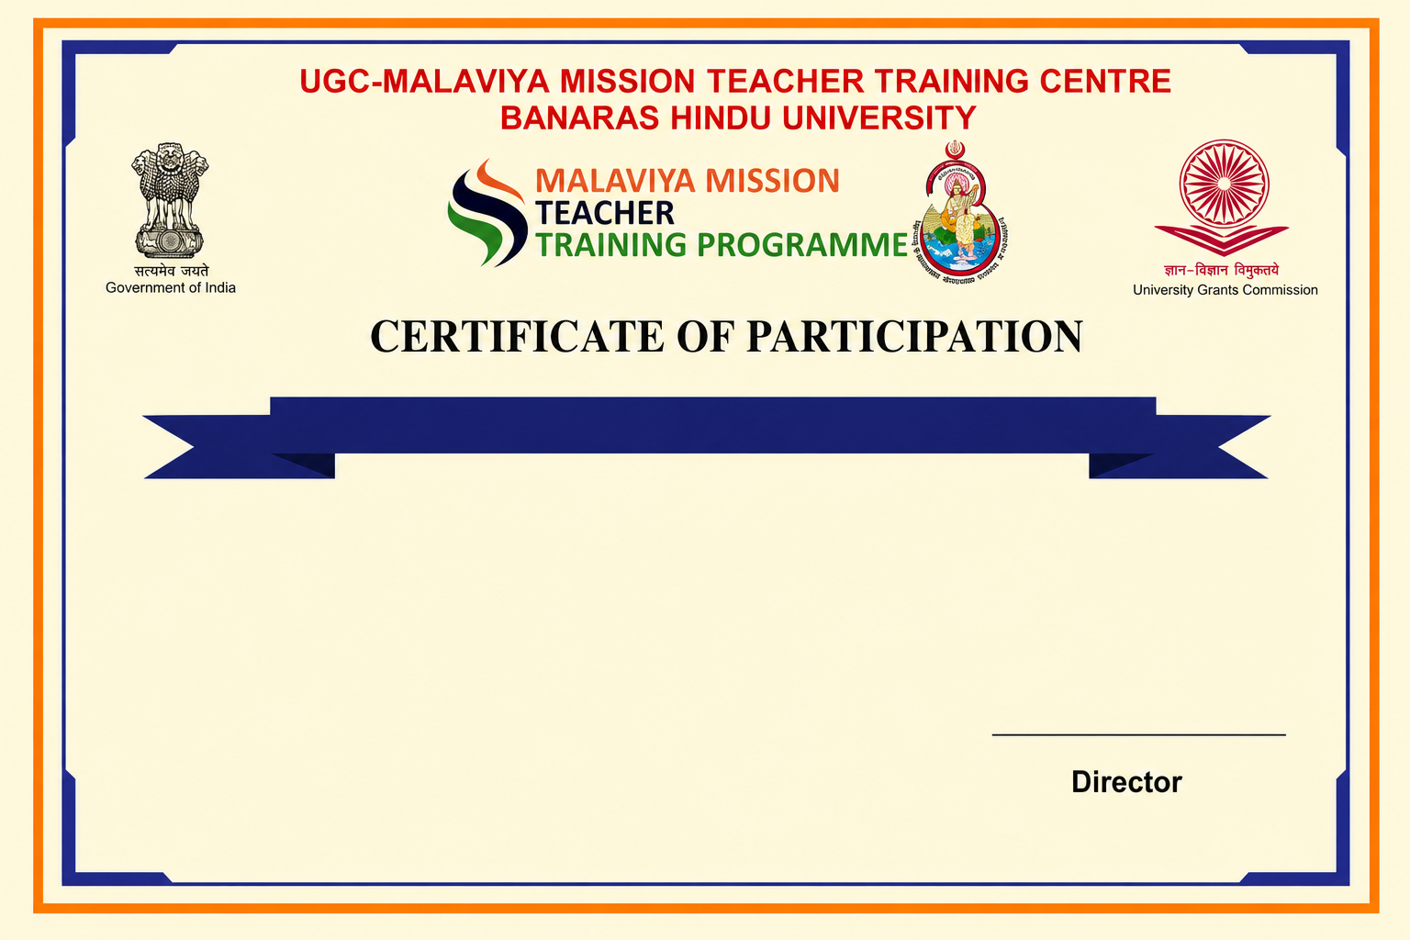
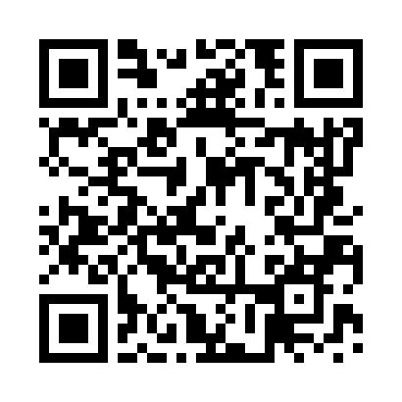
19th Faculty Induction Programme
This is to certify that Test 4, has completed the 19th Faculty Induction Programme under Malaviya Mission Teacher Training Programme (MM-TTP) of University Grants Commission (UGC) organized by UGC – Malaviya Mission Teacher Training Centre, Banaras Hindu University, Varanasi – 221005 (U.P.) from 14-07-2026 to 10-08-2026.

