Slide 1
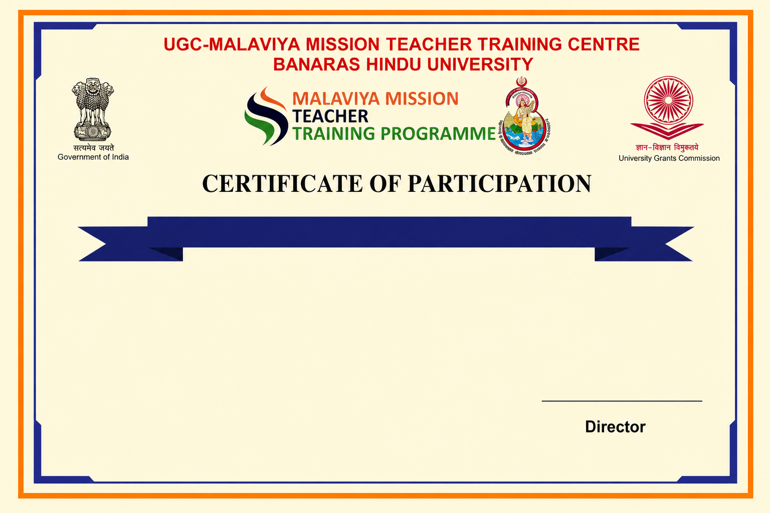
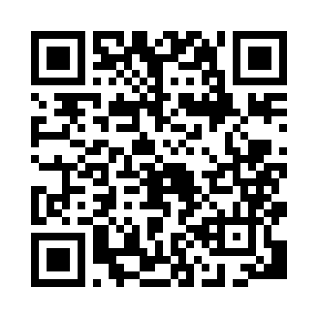
Refresher Course in Education
This is to certify that Mr. Test 4, from Lucknow University, has completed the Refresher Course in Education under Malaviya Mission Teacher Training Programme (MM-TTP) of University Grants Commission (UGC) organized by UGC – Malaviya Mission Teacher Training Centre, Banaras Hindu University, Varanasi – 221005 (U.P.) from 03-07-2026 to 16-07-2026.

