Slide 1
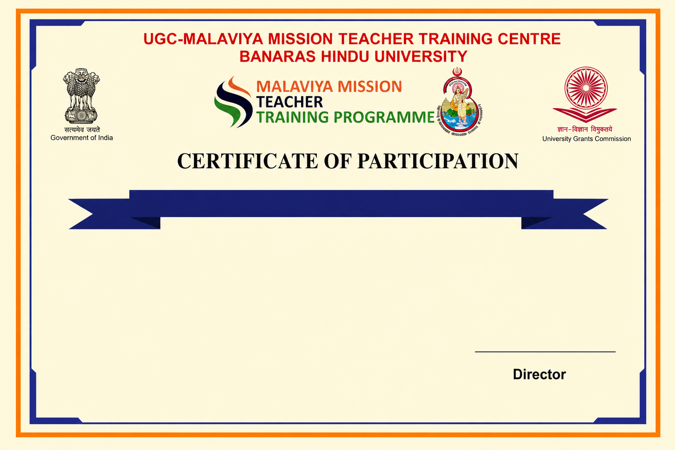
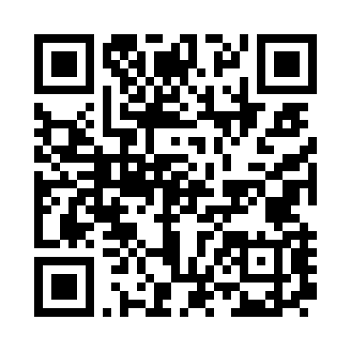
Refresher Courses in Botany/ Life Science
This is to certify that Mr. Test 4, from Lucknow University, has completed the Refresher Courses in Botany/ Life Science under Malaviya Mission Teacher Training Programme (MM-TTP) of University Grants Commission (UGC) organized by UGC – Malaviya Mission Teacher Training Centre, Banaras Hindu University, Varanasi – 221005 (U.P.) from 04-08-2026 to 17-08-2026.

