Slide 1
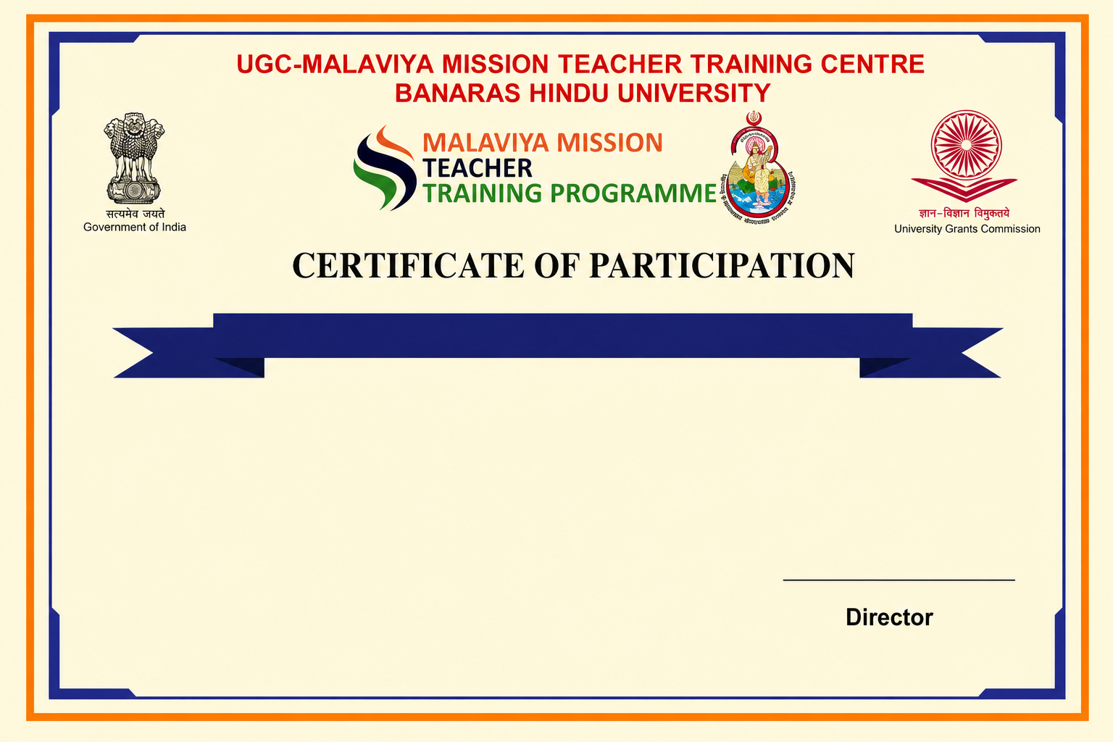
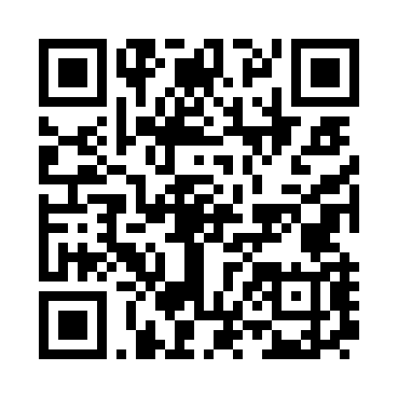
Refresher Course in Geography
This is to certify that Test 4, has completed the Refresher Course in Geography under Malaviya Mission Teacher Training Programme (MM-TTP) of University Grants Commission (UGC) organized by UGC – Malaviya Mission Teacher Training Centre, Banaras Hindu University, Varanasi – 221005 (U.P.) from 18-08-2026 to 02-09-2026.

