Slide 1
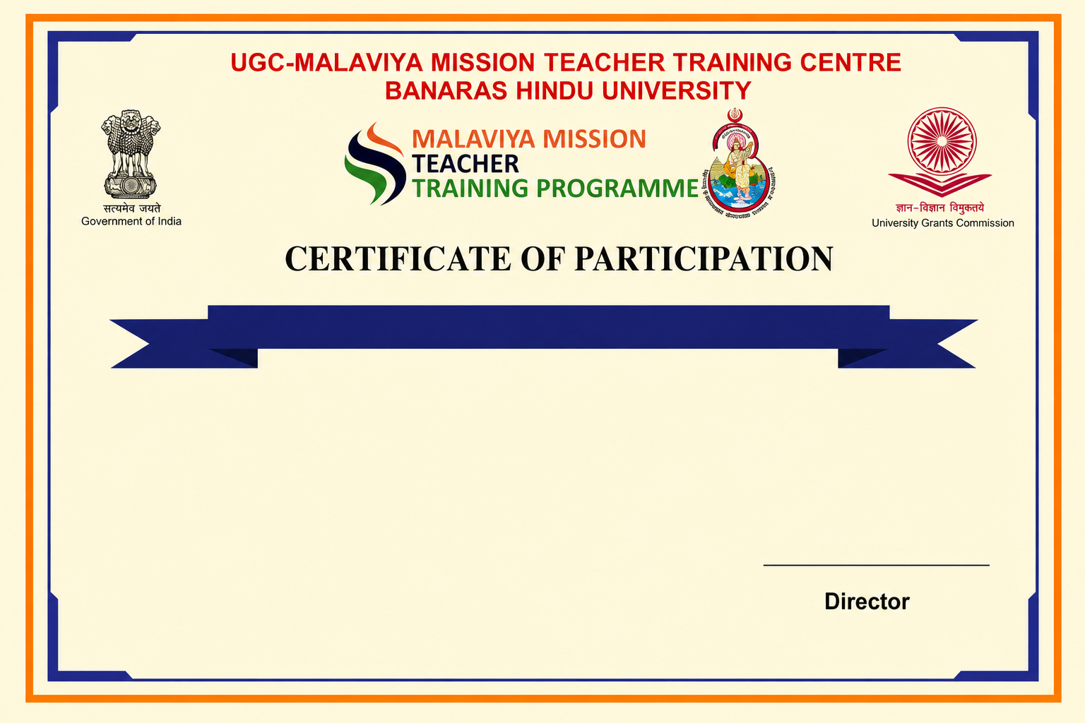
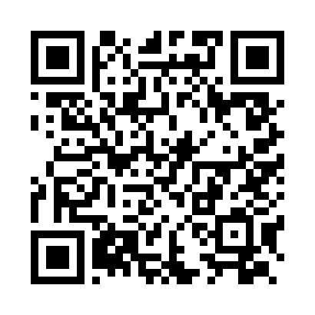
Refresher Course in Innovation in Research Methodology
This is to certify that Test 4, has completed the Refresher Course in Innovation in Research Methodology under Malaviya Mission Teacher Training Programme (MM-TTP) of University Grants Commission (UGC) organized by UGC – Malaviya Mission Teacher Training Centre, Banaras Hindu University, Varanasi – 221005 (U.P.) from 08-09-2026 to 20-09-2026.

