Slide 1
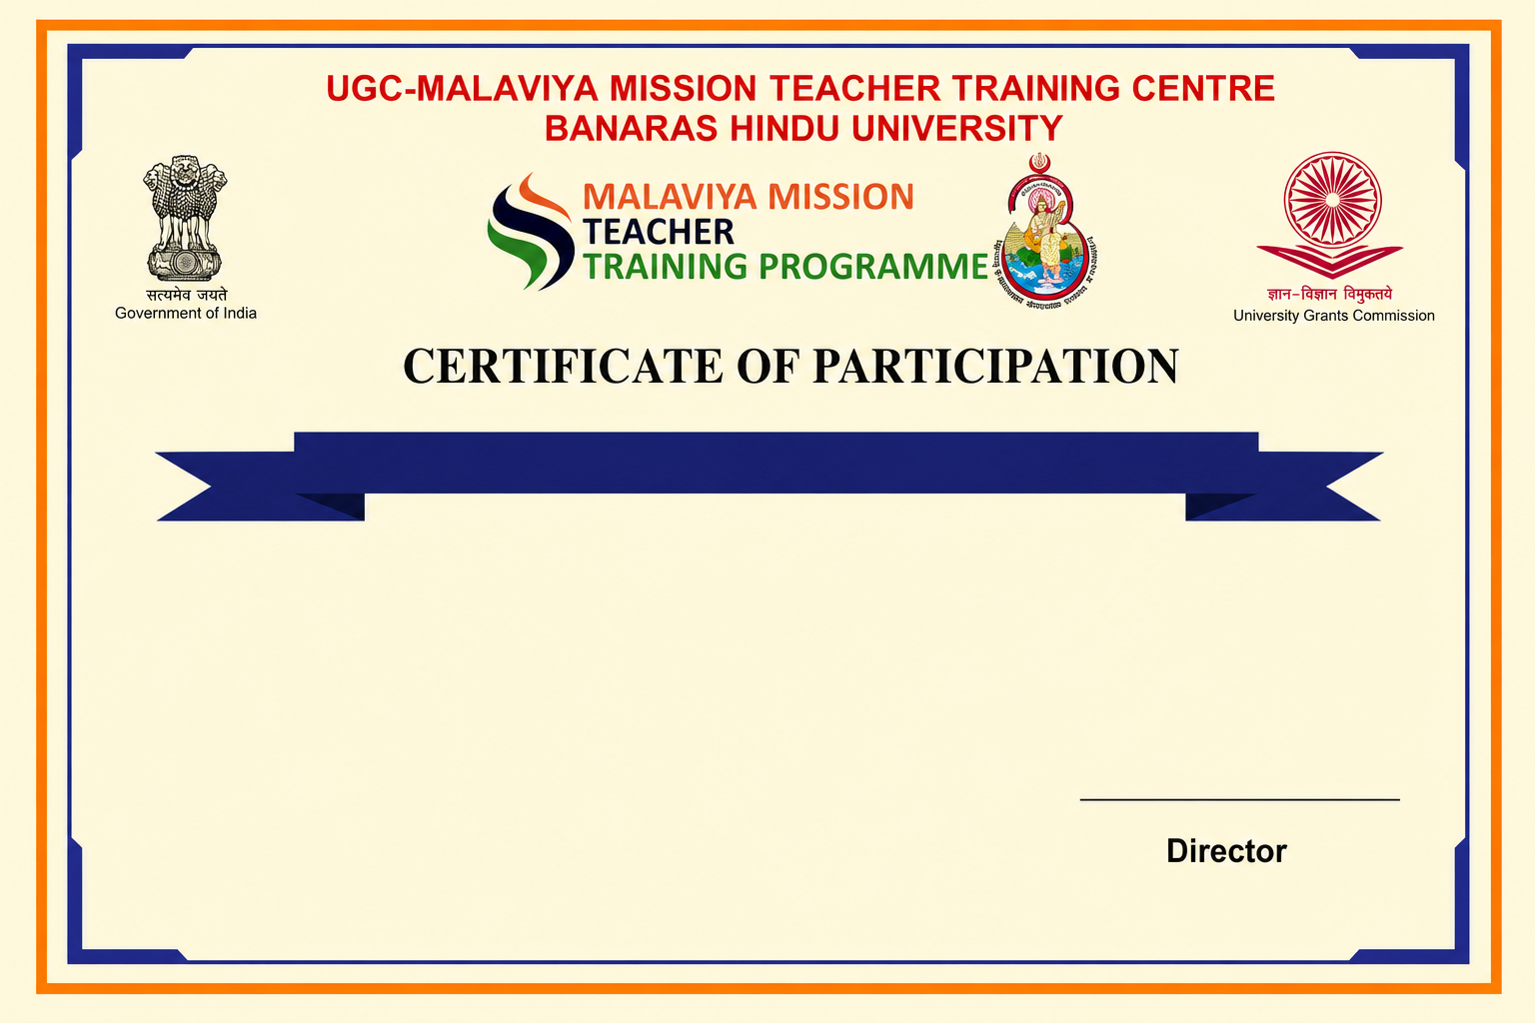
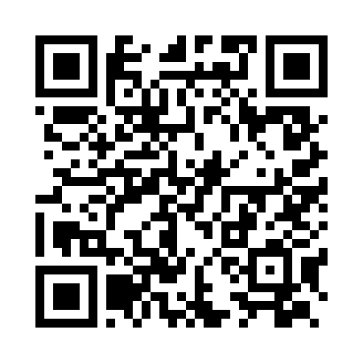
Refresher Course in Comparative Literature
This is to certify that Test 4, has completed the Refresher Course in Comparative Literature under Malaviya Mission Teacher Training Programme (MM-TTP) of University Grants Commission (UGC) organized by UGC – Malaviya Mission Teacher Training Centre, Banaras Hindu University, Varanasi – 221005 (U.P.) from 03-10-2026 to 17-10-2026.

