Slide 1
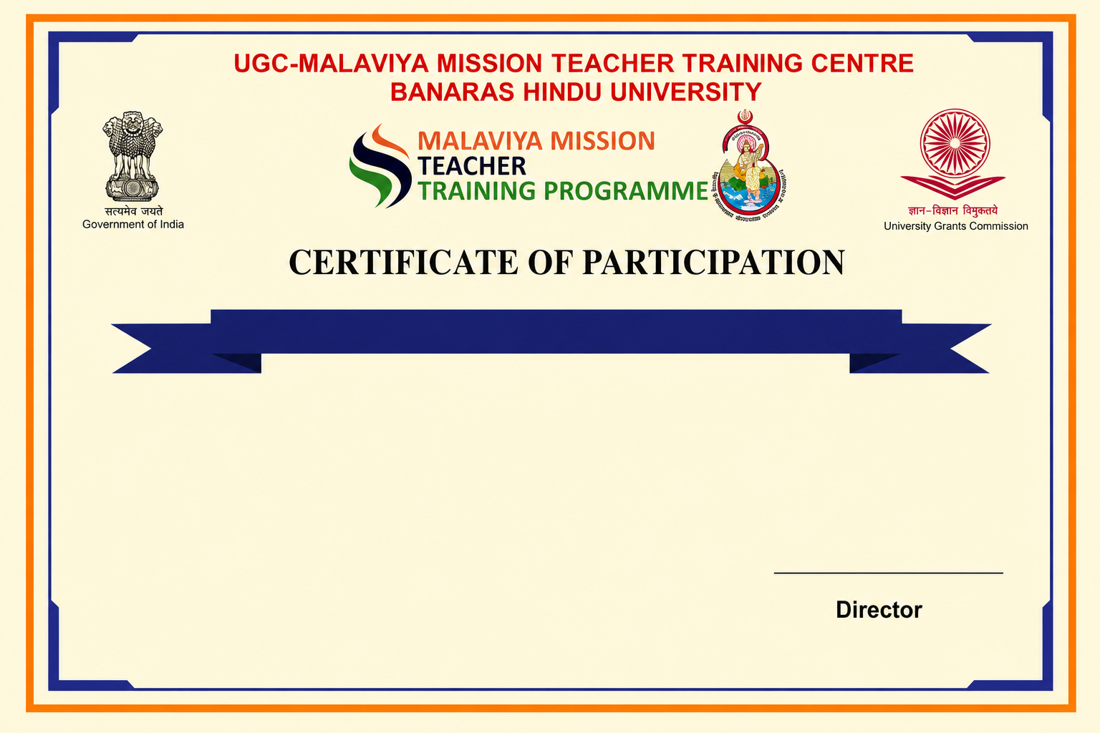
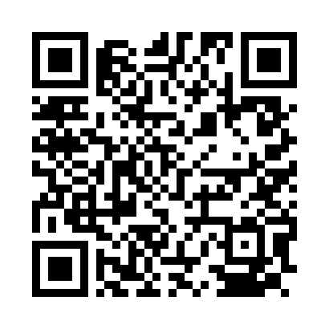
October A
This is to certify that Prof. Sanskar Shukla, Professor from Banaras Hindu University, has completed the October A under Malaviya Mission Teacher Training Programme (MM-TTP) of University Grants Commission (UGC) organized by UGC – Malaviya Mission Teacher Training Centre, Banaras Hindu University, Varanasi – 221005 (U.P.) from 05-10-2026 to 14-10-2026.

