Slide 1
Microsoft Financial Insights & Analytics Dashboa
Complete Hinglish Presentation with Detailed Graph Explanations

Slide 2
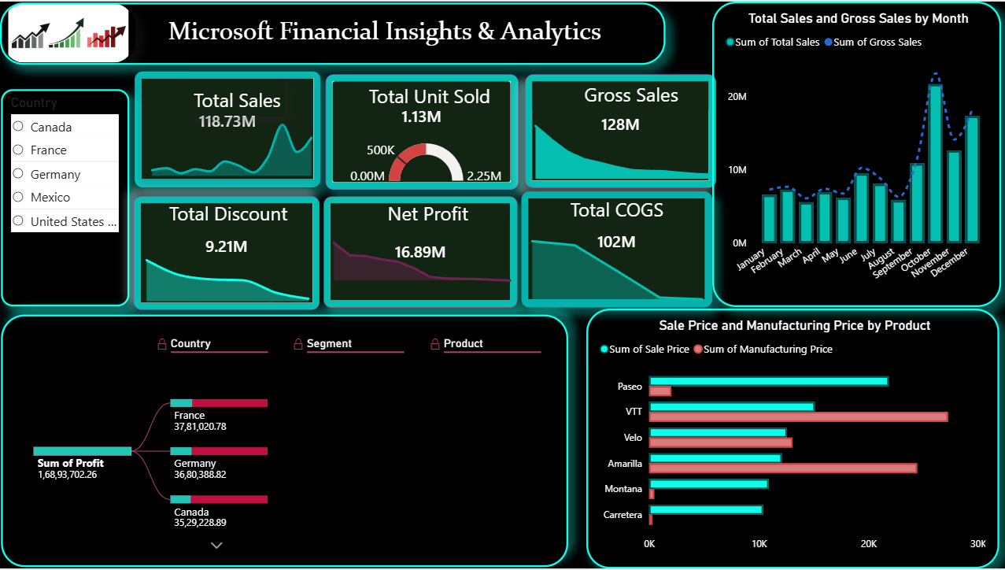
Introduction
Ye dashboard sales, profit aur business performance analyze karta hai.
Power BI me build kiya gaya hai.
Raw data ko business insights me convert karta hai.

Slide 3
Dashboard Overview
Dashboard multiple KPI aur graphs use karta hai.
Country-wise aur product-wise analysis available hai.
Monthly trends aur profit insights diye gaye hain.

Slide 4
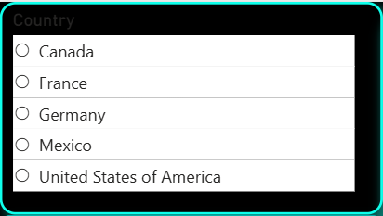
Country Filter
Country-wise performance analysis ke liye use hota hai.
Canada, France, Germany, Mexico aur USA included hain.
Regional business comparison me help karta hai.

Slide 5
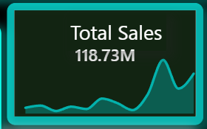
KPI - Total Sales
Total Sales = 118.73M
Final sales revenue show karta hai.
Strong customer demand ko indicate karta hai.

Slide 6
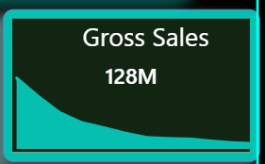
KPI - Gross Sales
Gross Sales = 128M
Discounts se pehle ka revenue hai.
Original sales capability ko show karta hai.

Slide 7
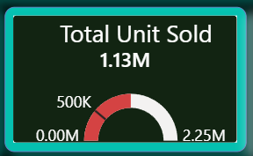
KPI - Total Units Sold
1.13M units sell hue.
High customer engagement show karta hai.
Product demand strong hai.

Slide 8
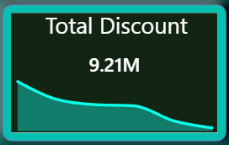
KPI - Total Discount
Total Discount = 9.21M
Discounts sales increase karte hain.
Lekin profit margins reduce kar sakte hain.

Slide 9
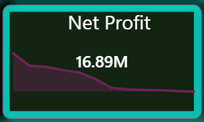
KPI - Net Profit
Net Profit = 16.89M
Final earnings after expenses.
Company profitable hai.

Slide 10
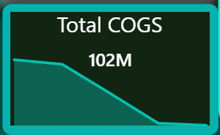
KPI - Total COGS
COGS = Cost Of Goods Sold
Total production aur operational cost.
Value = 102M

Slide 11
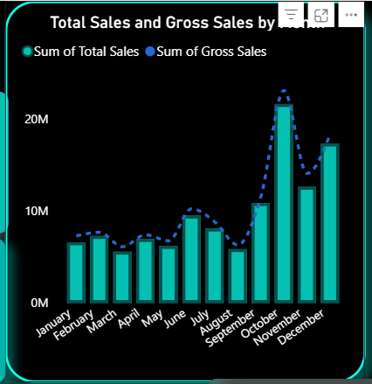
Monthly Sales Trend
October aur December peak months hain.
January aur March low sales months hain.
Seasonal trend clearly visible hai.

Slide 12
Monthly Trend Insights
Peak season festive demand ko indicate karta hai.
Inventory planning improve ki ja sakti hai.
Marketing campaigns optimize karne me help milti hai.

Slide 13
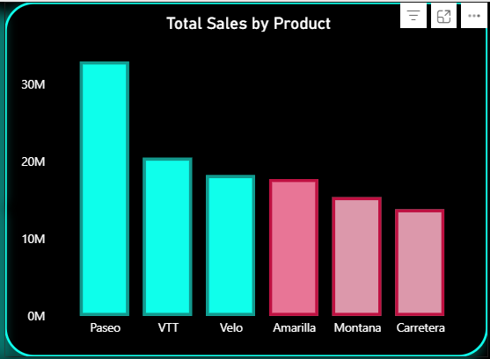
Sales by Product
Paseo highest-performing product hai.
Carretera lowest sales generate karta hai.
Product-wise contribution visible hai.

Slide 14
Product Performance Insight
Paseo strongest revenue contributor hai.
Weak products ko improvement ki zarurat hai.
Investment planning me help milti hai.

Slide 15
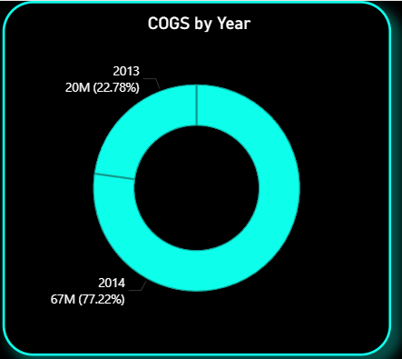
COGS by Year
2013 = 20M
2014 = 67M
Operational expenses increase hue hain.

Slide 16
COGS Insight
Higher production ya expansion reason ho sakta hai.
Supply chain optimization important hai.
Cost reduction profit improve karega.

Slide 17
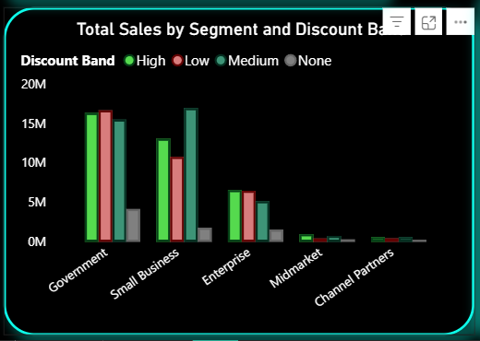
Sales by Segment & Discount
Government segment highest revenue deta hai.
Discount bands customer behavior affect karte hain.
High discounts sales increase karte hain.

Slide 18
Discount Band Analysis
High, Medium, Low aur None categories hain.
Discount strategy sales ko impact karti hai.
Balanced discounting important hai.

Slide 19
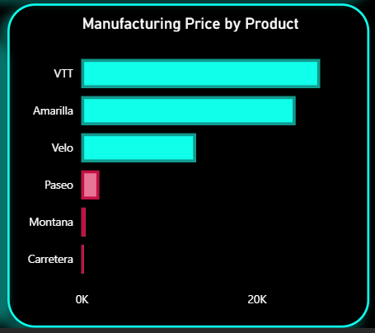
Manufacturing Price by Product
VTT aur Amarilla high manufacturing cost show karte hain.
Montana aur Carretera comparatively low hain.
Operational efficiency improve karni chahiye.

Slide 20
Manufacturing Cost Insight
High manufacturing cost profit reduce karta hai.
Supplier negotiation improve karni chahiye.
Cost optimization long-term growth me help karega.

Slide 21
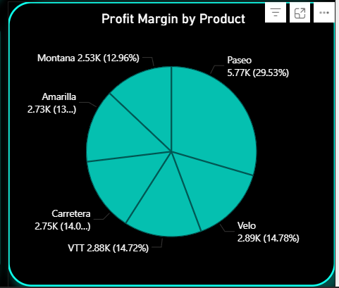
Profit Margin by Product
Paseo highest profit margin generate karta hai.
High-selling aur high-profit product hai.
Profitable products par focus zaruri hai.

Slide 22
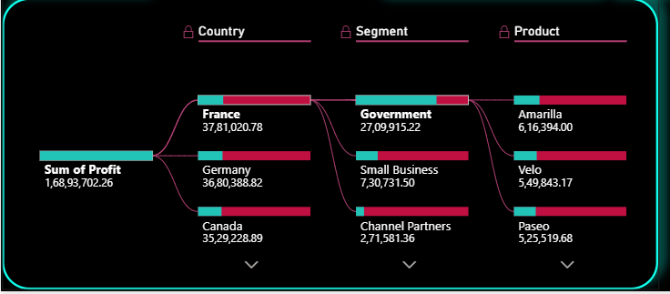
Profit Decomposition Tree
Country se product level tak profit breakdown karta hai.
France aur Germany top contributors hain.
Government strongest segment hai.

Slide 23
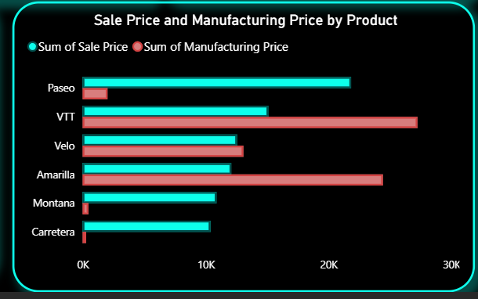
Sales Price vs Manufacturing Price
Selling aur manufacturing cost compare hoti hai.
Bigger gap means higher profitability.
Pricing strategy improve karne me help karta hai.

Slide 24
Major Business Insights
Paseo best-performing product hai.
Government segment strongest hai.
October aur December peak months hain.
Discounts sales increase karte hain.

Slide 25
Business Recommendations
High-performing products me investment badhao.
Manufacturing cost optimize karo.
Marketing campaigns improve karo.
Discount strategy balanced rakho.

Slide 26
Tools & Technologies
Power BI
DAX
Data Visualization
Business Intelligence
Financial Analytics

Slide 27
Conclusion
Dashboard raw data ko meaningful insights me convert karta hai.
Management better decisions le sakta hai.
Power BI strong business analytics tool hai.

