Slide 1
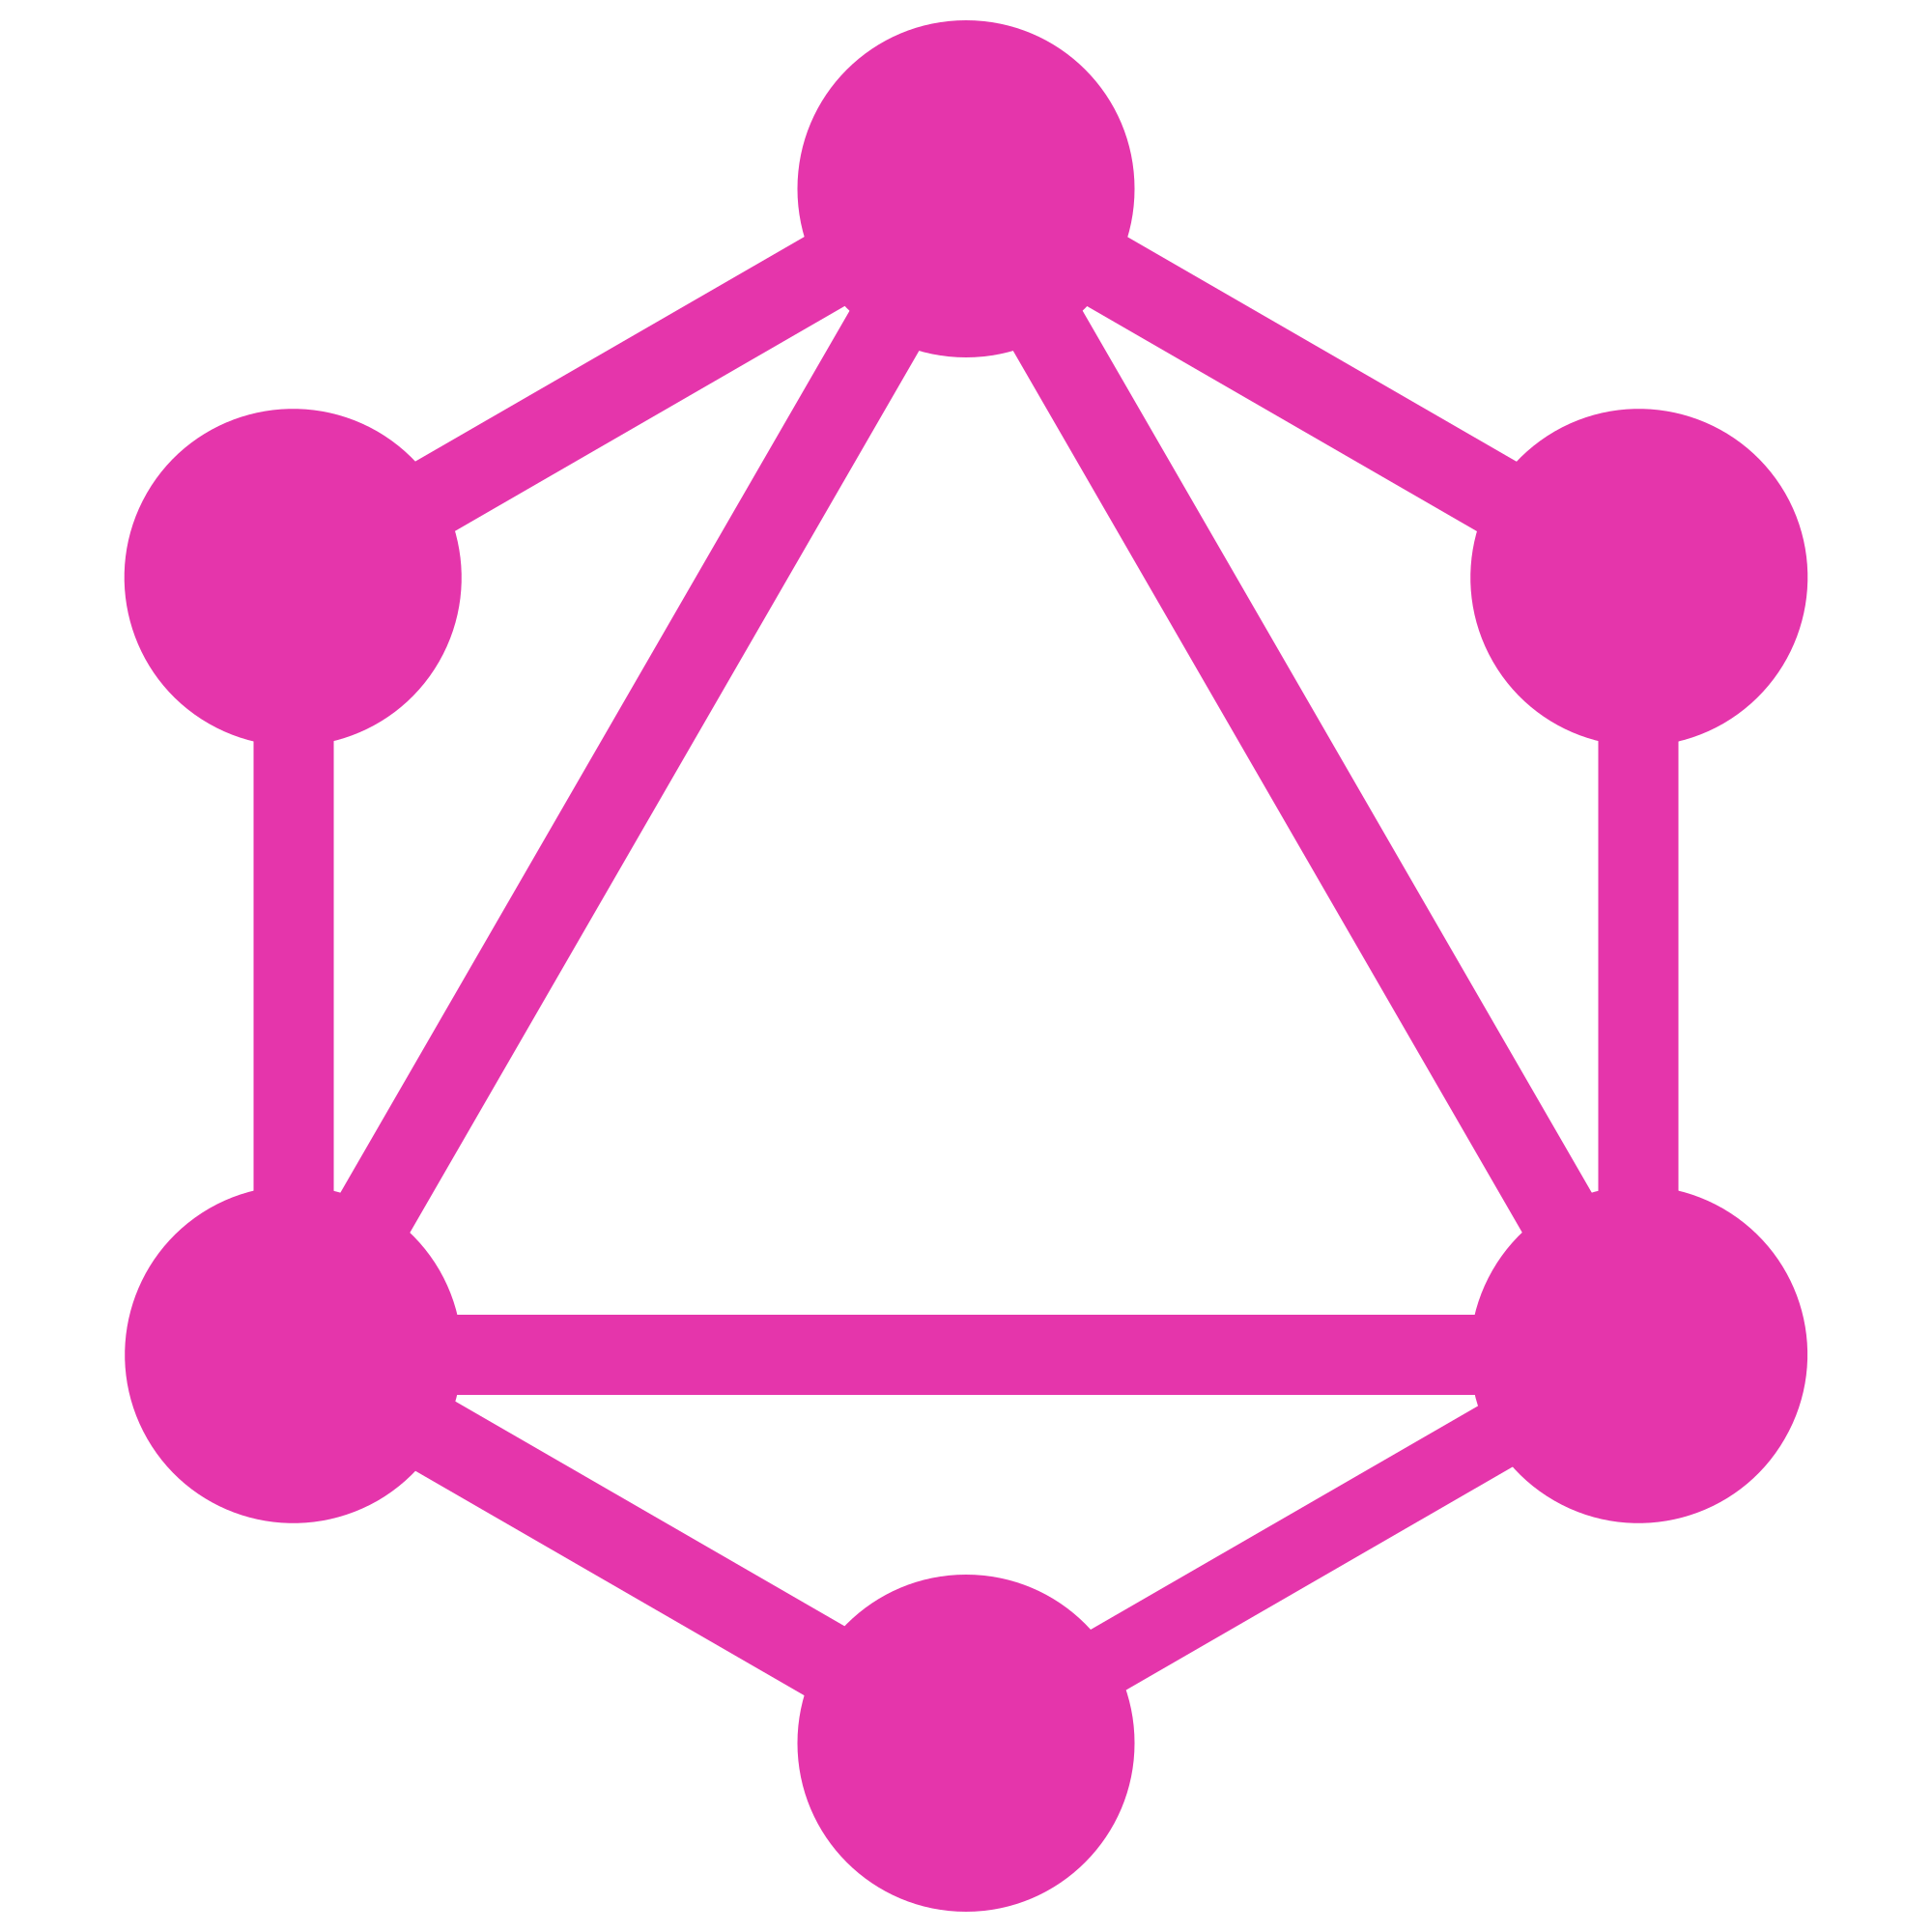
Graphql
By: Sandeep Kumar
SSE

Slide 2
What Is GraphQL?
GraphQL (Graph Query Language) is an open source data Query and Manipulation Language built on using the Graph Data Structure. GraphQL can be used to Query from an API and/or Database.

Slide 3
Graphql Operations
Query: Read data (Retrieve Data from resource).
Mutation: Write data(Create ,Update, Delete data in resource).
Subscription: Observe Event and automatically send data(pub-sub).

Slide 4
How Do We Use GraphQL?/ GraphQL ecosystem
It is based on web application. In typical way ,it is two-tier architecture.
GraphQL Client and/or GraphQL Server,
Or it can be single--tier architecture. Where only GraphQL Server will exist. And the graphql endpoint can be consumed by client.

Slide 5
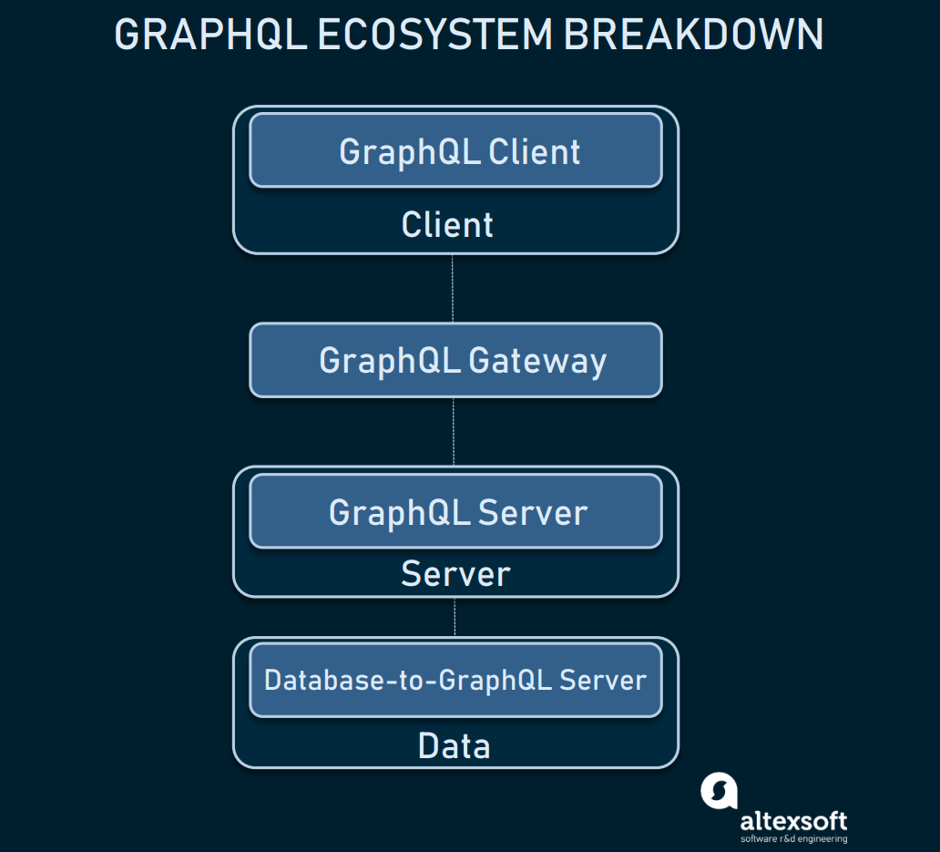

Slide 6
GraphQL Clients
Apollo-Client
Apollo-Boost
React-Apollo
Graphql-Relay
React-Relay

Slide 7
GraphQL Gateways
Placed on top of the server or as a standalone proxy to route to the server, GraphQL gateway offers additional features to find issues with your API much faster, and improve performance.
Apollo Engine is the most popular GraphQL-specific gateway. Its features are:
query execution tracing: provides the entire route of the query
query caching
error tracking
trend analysis: tracks the performance of the API over time.

Slide 8
GraphQL Servers
Apollo-Server
Apollo-Server Express
GraphQL-Yoga
Prisma
Graphcool
Note:- It can be used standalone or with node/express.

Slide 9
Database-to-GraphQL Servers
Connecting the database and the GraphQL server, these tools provide powerful features that save time writing SQL queries in your resolvers and simplify complex database operations. Popular options are:
Prisma
PostGraphile
Neo4j-GraphQL: specific for the Neo4j database.

Slide 10
GraphQL Requirements
GraphQL requires a Schema, which is comprised of following two items:
Types/TypeDefs: User defined Queries, Mutations, and Types.
Resolvers: Interacts with the Database ,Legacy system,Third-Party.
Resolver
Query
Result

Slide 11
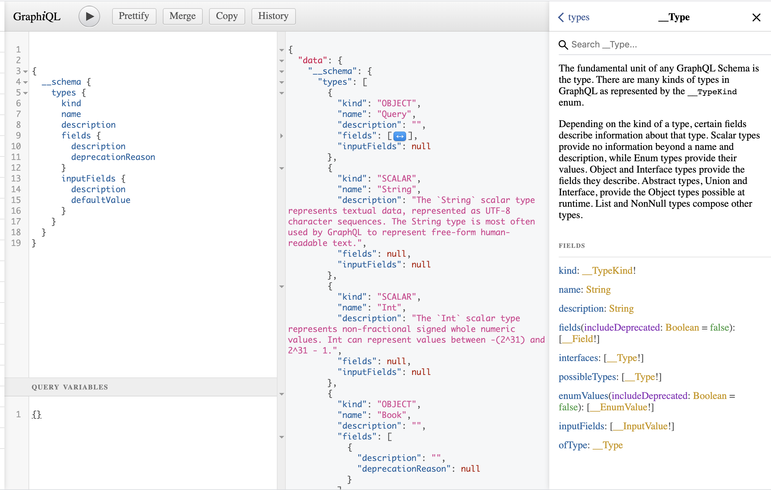
Introspection
It helps developer to view the available data before the request has been made.Introspection is an optional feature, enabled by default, which allows clients (Usually developers) to navigate into the Types (TypeDefs) and discover the schema.

Slide 12
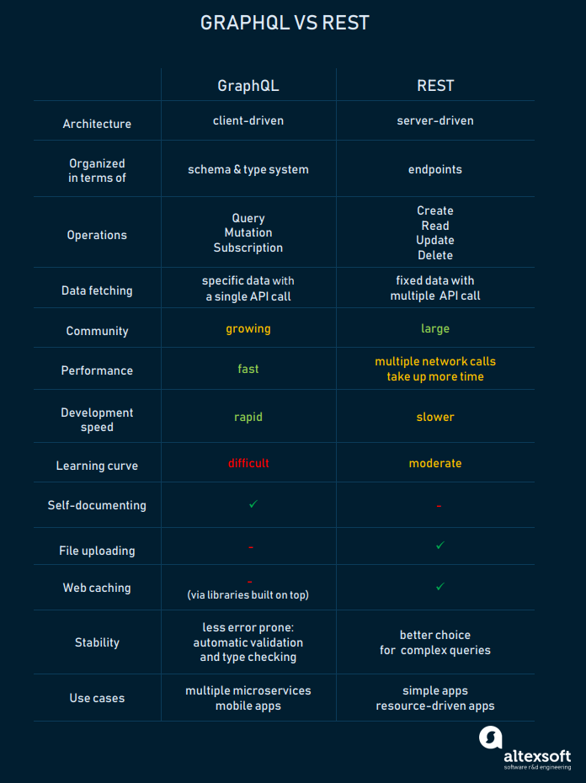
GraphQL VS REST

Slide 13
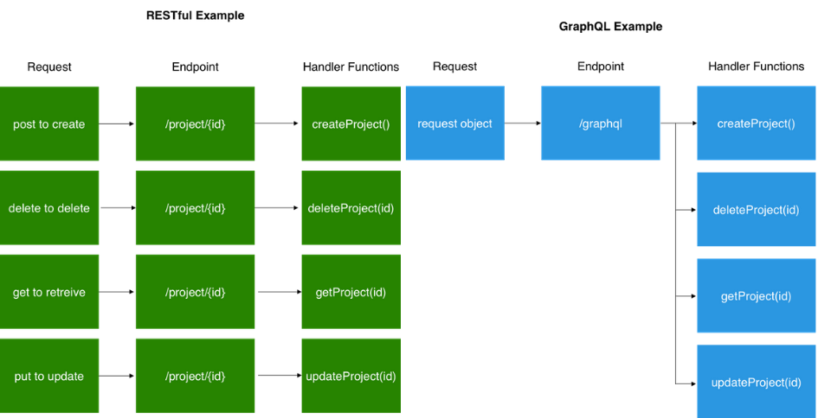

Slide 14
GraphQL IDEs
GraphQL Playground
GraphiQL
GraphQL IDE

Slide 15
GraphQL Tooling
GraphCMS
GraphQL Docs
GraphQL Network
GraphQL Bindings
GraphQL CLI
GraphQL Boilerplates
GraphQL Config
GraphQL Voyager

Slide 16
Architecture
There are 3 different kinds of architectures that include a GraphQL server:-
Usecase:-
GraphQL server with a connected database
GraphQL server that is a thin layer in front of a number of third party or legacy systems and integrates them through a single GraphQL API
A hybrid approach of a connected database and third party or legacy systems that can all be accessed through the same GraphQL API

Slide 17
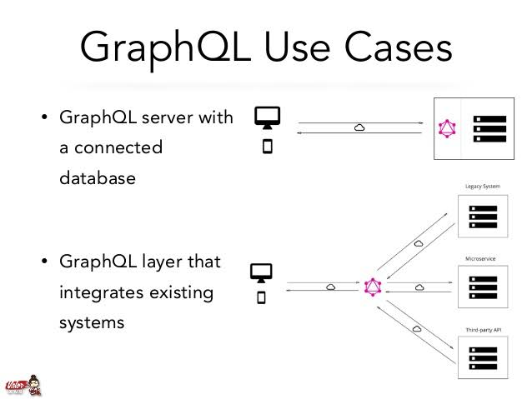

Slide 18
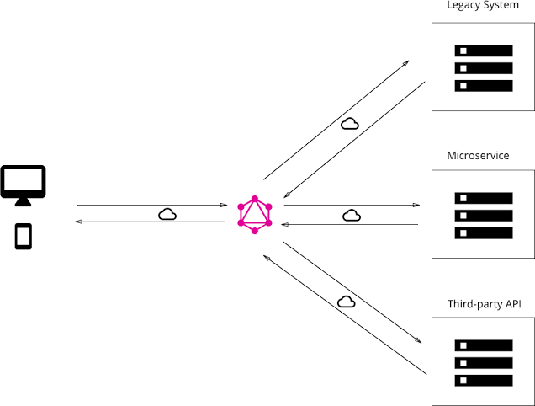
it’s possible to combine the two approaches and build a GraphQL server that has a connected database but still talks to legacy or third—party systems.
When a query is received by the server, it will resolve it either retrieve the required data from the connected database or some of the integrated APIs.
Database

Slide 19
DEMO !!!
Setup code with Node js/express.
Server setup.
Extend Query ,resolver merge & Query bundling with graphql-tools.
Key points of graphql.
Execution of Operations.

Slide 20
THANKS

