Slide 1
History of Cologne Digital Lexicons
Mārcis Gasūns,
October 2019
@gasyoun

Slide 2
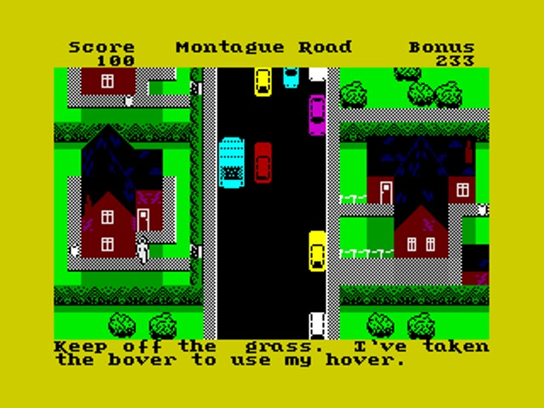

Slide 3
Digital Lexicons
Digital Lexicons
1988-1994
1994-2005
pre-2014
2014-2019

Slide 4
Austin 1988
“Many Sanskritists are highly computer literate”
“Bright hopes” by D. Wujastyk
Undoing sandhi, conjunct characters
Sanskrit text archive, a remake of Thesaurus Linguae Graecae, est. 1972
Full textual reference (Panini)

Slide 5
Post-Austin 1988 (Kharagpur 2019)
Undoing sandhi solved, opensource
1992-2000, Peter Scharf (Pascal)
2009 Jim Funderburk (Perl, Java)
2015 Jim Funderburk (Python 2.7)
Conjunct characters are not an issue in Unicode. Not widely used in India and that does become an issue (ex., Pune intranet). It’s solved in 2016 for OCR.

Slide 6
Post-Austin 1988 (Kharagpur 2019)
Sanskrit text archive (GRETIL), 2001
"simply rapid access library“
no “grammatical and lexical systems”
Digital Corpus of Sanskrit (DCS), 2010
560 000 lemmatized sentences (linguistic database, Sanskrit expert system)
Parallel Sanskrit-Russian Corpora, 2013
Rigveda, Atharvaveda, Mahabharata, Ramayana

Slide 7
Post-Austin 1988 (Kharagpur 2019)
Full contextual reference (Panini)
GRA links to RV, not yet Panini 2018 Jim Funderburk

Slide 8
Cologne 1997 Edition
Coding yet to be done
supplement
transliteration of Greek
botanical terms
verbal forms
literary sources

Slide 9
MW 2019: Supplement
MW supplement (additions and corrections)
fully integrated AFAIK 2018? Jim Funderburk

Slide 10
MW 2019: Translitate Greek
transliteration of Greek (16 out of 34 dictionaries)
2007, 2010 Beta Code to Unicode Jim Funderburk, Peter Scharf
2010? Interlinking with Perseus Jim Funderburk
2015-2019 Proofreading Old Greek Jim Funderburk, Jonathan Migliori

Slide 11
MW 2017: Botanical Terms
to recognise and to renew plant names, Linnaean taxonomy changed over time (15826 cases in 8408 entries in MW)
<bot>Hedysarum_Gangeticum</bot>
<c><bot>sesamum</bot>_grain</c>
<c>the_flower_of_<abE>Hib</abE><bot>Hibiscus</bot>_<abE>Mut</abE><bot>Mutabilis</bot></c>

Slide 12
MW 2017: Botanical Terms
Mis-markup (surnames coded as plants)
Roxb., Hex., Gaertn., Nees., Schott., Bl., Wall., Benth., Spreng., Willd., Schott.
<bot>Erycibe_Paniculata_Roxb.</bot> ---> <bot>Erycibe_Paniculata</bot><ls>Roxb.</ls>
<ls>L.</ls> after botanical nomenclature is not L[exicographer], but Carl Linnaeus.
corrections can generate false positives, work with allbot1a.txt has just begun, but stopped rapidly

Slide 13
MW 2017: Verbal Forms
Compare verbal forms databases
Gérard Huet (gitlab INRIA)
Amba Kulkarni (Uni of Hyderabad)
Dhaval Pathel (SanskritVerb)
Jim Funderburk
? Oliver Hellwig

Slide 14
MW 2019: Literary Sources
Interlinking with Pāṇini was meant initially
Cologne interlinking only for GRA to RV
Turned out we still do not know how to resolve all abbreviations of literary sources
Punctuation between references: unsolved
Review of abbreviations (mwabbreviations)

Slide 15
Cologne 2019: Useful Byproducts
List of all Sanskrit headwords from dictionaries sanhw1.txt & sanhw2.txt
dīpita:dīpita:AP,AP90,MW,MW72,SHS,STC,WIL,YAT
dīpitar:dīpitar:PW,PWG
dīpitā:dīpitā:SKD
dīpitṛ:dīpitṛ:AP,BUR,MW,MW72,SHS,WIL,YAT
dīptaka:dīptaka:MW,MW72,PW,PWG,SHS,WIL,YAT;dīptakaṃ:SKD;dīptakaḥ:AP,AP90
MW normalized grammatical information
Spellchecking & hyphenation (possible patterns)

Slide 16
MW 2017: Misc User Interface
Replica of Printed Fonts for Web Display

Slide 17
PW 2017: Code Reorganization Sample
meta-line format;
addition of div markup (breaking huge blobs of text into much more manageable pieces);
addition of abbreviation markup;
conversion to modern IAST;
improvements to spelling of the list of works and authors;
xml markup in place of most esoteric markup using special symbols.

Slide 18
Simple Search

Slide 19
Cologne 2020: Simple Search
How `simple` at Cologne works (#3)
Searching for khan: kāma kaṇa khan kam kāṇa khāna kan khana kaṇ khaṇa kām kham kāna kana (14 results).
„Sanskrit made easy“ in Prof. Huet wording (#2)
Implemented at SpokenSanskrit.org (#1)
To do in 2020
Cut off verbal endings (enter an inflected form and get underlying MW dictionary words)

Slide 20
Sanskrit Dataset Crowdsourcing
Carthago delenda est
When we say DCS is the source, we are not actually giving a real source. It itself bases on GRETIL (108 Mb of HTML files, 1600 texts), which is nothing but an aggregator.
https://github.com/sanskrit-lexicon/

Slide 21
Sanskrit Dataset Crowdsourcing
Carthago delenda est
At the level of Cologne I’ve seen what 2.5 people can do in 5 years. What if we can unite 25 Sanskrit enthusiasts, manually checking the suspicious words found marked via Fuzzy (Levenshtein) algorithm
https://github.com/sanskrit-lexicon/

Slide 22
I give you my thanks! gasyoun@gmail.com
PhD Mārcis Gasūns
github.com/gasyoun
October 2019
Krasnodar, Russia

