Slide 1
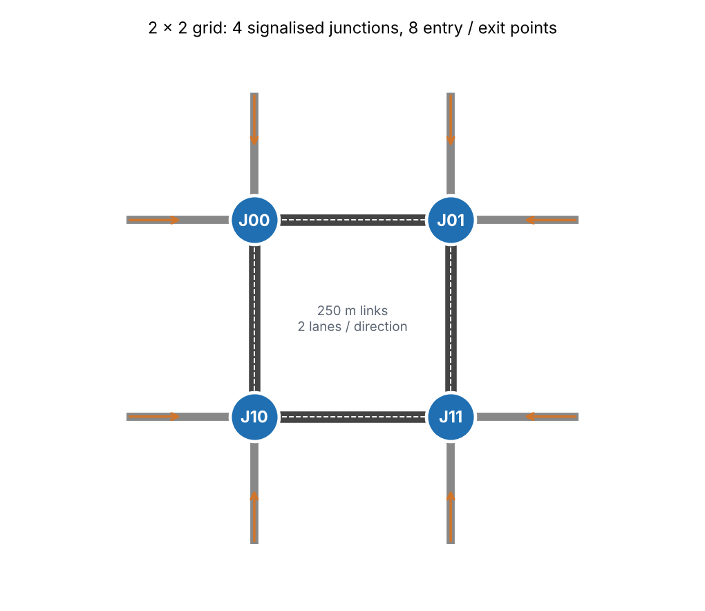
Slide 1 | Motivation & introduction
Multi-Agent RL for Traffic-Signal Coordination
Urban congestion wastes travel time, fuel and air quality; much of it is queueing at signals.
Fixed-time plans repeat the same cycle all day and cannot react to fluctuating demand.
Neighbouring intersections influence each other: a long queue released upstream arrives downstream seconds later.
Project 10: one DQN agent per intersection learns to adapt its signal; goal = shorter waits and queues.
Testbed: 2 x 2 signalised grid, one simulated hour with an off-peak / peak / off-peak demand profile (built-in simulator (SUMO-free fallback)).
Traffic-signal coordination | Project 10 | results backend: built-in Python mesoscopic simulator (NOT SUMO) | slide 1 of 5

Slide 2
Slide 2 | Environment, states, actions, rewards
Problem Formulation
Environment: 4 junctions, 250 m links, 2 lanes per direction, Poisson demand on 8 entries.
State (per agent): density, queue and waiting time of each incoming lane + one-hot current phase + time since switch + neighbours' mean queue / wait.
Action: choose the next green phase (10 s decision step): same phase = extend, different = 3 s yellow then switch.
Reward: r = -(0.1 x halting vehicles + sum of waiting seconds / 300), clipped at -10.
Training reward is shared: (1 - a) r_i + a mean(r_neighbours), a = 0.3.
Metrics: avg waiting time, avg queue, throughput, cumulative reward.
Component | Design
Agents | 4 (one per junction)
Actions / agent | 10 s step, 4 green phases
State dim / agent | 31
Episode | 3600 s = 360 decisions
Traffic-signal coordination | Project 10 | results backend: built-in Python mesoscopic simulator (NOT SUMO) | slide 2 of 5

Slide 3
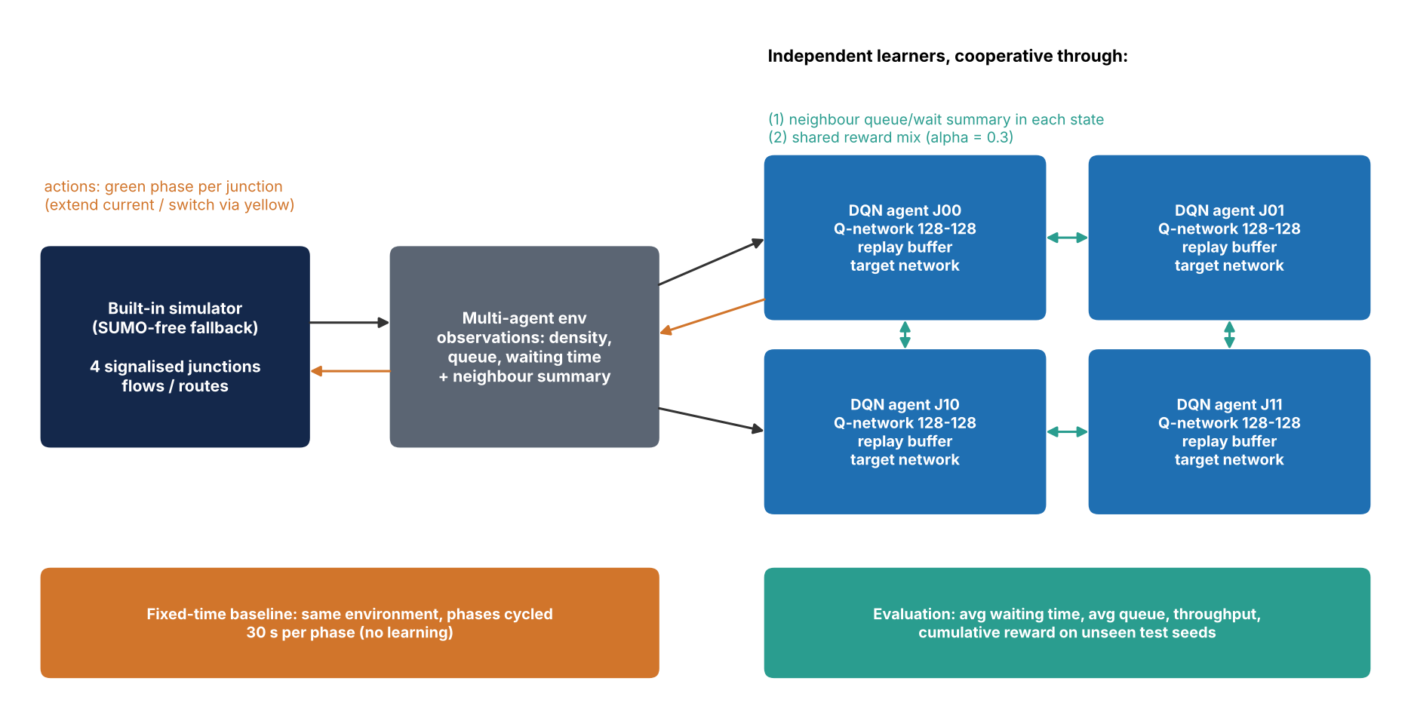
Slide 3 | Architecture & training
Methodology: Multi-Agent Double DQN
Independent learners: each junction has its own Q-network (MLP 128-128), replay buffer and target network.
Double-DQN target, Huber loss, Adam (lr 0.0005), gamma 0.9, batch 64.
Epsilon-greedy 1.0 -> 0.05; 150 training episodes with random demand jitter.
Coordination = neighbour summary in the state + cooperative reward mix.
Model selection on separate validation seeds; final test on unseen seeds against fixed-time control.
Traffic-signal coordination | Project 10 | results backend: built-in Python mesoscopic simulator (NOT SUMO) | slide 3 of 5

Slide 4
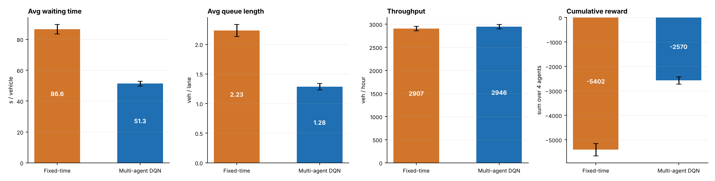
Slide 4 | Experimental results (built-in simulator (SUMO-free fallback))
Results: Fixed-Time vs Multi-Agent DQN
Avg waiting time: 86.6 s -> 51.3 s (40.7% lower with DQN).
Avg queue: 2.23 -> 1.28 veh/lane (42.5% lower).
Throughput: 2907 -> 2946 veh/h (1.3% higher).
Cumulative reward: -5402 -> -2570.
Mean over 10 unseen test seeds; DQN better on waiting time in 10 of 10 seeds.
Traffic-signal coordination | Project 10 | results backend: built-in Python mesoscopic simulator (NOT SUMO) | slide 4 of 5

Slide 5
Slide 5
Limitations, Ethics, Future Scope & Conclusion
Limitations: one small grid, synthetic demand, one random-seed family, no pedestrians / buses / sensor noise; independent learners are non-stationary.
Ethics: safety (min-yellow, human fallback to fixed-time), fairness to minor roads and pedestrians, and equity of who benefits must be audited before deployment.
Future scope: larger / real networks, graph-based communication (CoLight, MA-PPO), pressure-based rewards, pedestrians, emergency-vehicle priority.
Conclusion: on this benchmark the multi-agent DQN changed average waiting time by -40.7% and throughput by +1.3% relative to fixed-time control (built-in simulator (SUMO-free fallback)).
Traffic-signal coordination | Project 10 | results backend: built-in Python mesoscopic simulator (NOT SUMO) | slide 5 of 5

