Slide 1


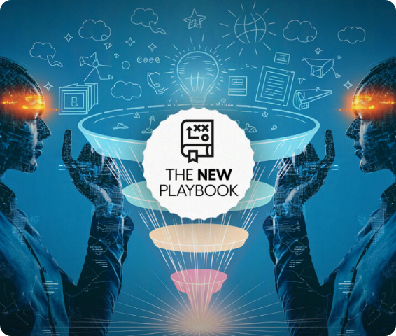

EXL INTERNSHIP WEEK 1 DELIVERABLE
Insurance Conversational Voice Agent
Foundation & Happy Path Implementation
Presented By Your Name
Program EXL Internship

Slide 2



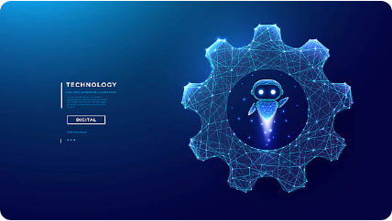




Project Overview
The Project Objective
Build an AI-powered conversational insurance voice agent that securely automates customer interactions, authenticates users, detects intents, and retrieves critical information seamlessly through backend APIs.
High Call Volume
Long Customer Wait Times
Manual Claim & Policy Processing
Suboptimal Customer Experience
EXL Insurance Voice Agent Project
Slide 2

Slide 3





Week 1 Scope
Understand Business Use Case
Identify core metrics, insurance pain points, and target voice processes.
Completion Checklist
Business Use Case Understood
Define Core Intents
Map queries to policy inquiries, claims tracking, and common journeys.
Intents Defined & Mapped
Authentication Mechanism Designed
Design Happy Path Conversation
Construct clear, frictionless logic mapping optimal interactions.
Mock APIs Created & Integrated
Happy Path Flow Functional
Implement Authentication
Enforce robust validation logic covering customer authentication flows.
Progress Tracking • Happy Path Phase
Slide 3

Slide 4








High-Level Architecture
👤 Customer
🤖 CX Agent Studio
🛡 Auth Layer
🔀 Intent Routing
⚙ Backend APIs
💬 Response
High Space Modern Interface Architecture
Slide 4

Slide 5













Core Customer Intents
🛡 Policy Inquiry
📄 Claim Status
💰 Benefits Info
View coverage lists & limits.
Instant real-time progress.
Co-pays & deductible status.
🔄 Policy Renewal
📞 Escalation
🔐 Authentication
Payment processing triggers.
Transfer cleanly to live experts.
Automated user validation.
These intents represent the primary customer journeys implemented during Week 1.
Slide 5

Slide 6





Happy Path Conversation
Start Call
Authenticate User
Detect Intent
Route Service
Query API
Return Info
Completed
End-to-End Optimal Conversation Workflow Flowchart
Slide 6

Slide 7








Secure User Verification
Security Features
Phone Number Verification
Date of Birth Check
Verification Question 1 (Dynamic)
Multi-step Customer Identity Verification
Backend Service Level Validation
Secure End-to-End Customer Access
Protect & Prevent Unauthorized Requests
Multi-tier Verification Gateway Protocol
Slide 7

Slide 8







Mock API Integration
validateUser()
getPolicyDetails()
getClaimsStatus()
Validates inbound user identity against secure customer records.
Retrieves coverage statements, premium metrics and limits.
Tracks processing milestones for customer claims.
getBenefitsInfo()
renewPolicy()
createCase()
Checks standard plan deductibles and out-of-pocket rules.
Processes recurring terms and accepts approval mandates.
Saves transcript and assigns urgent tasks for human agents.
Mock APIs simulate backend services enabling complete flow testing prior to production.
Slide 8

Slide 9








End-to-End Customer Journey
Customer Call
Authentication
Intent Detect
API Execution
Voice Response
Satisfied User
Green status indicators represent completed and validated capabilities for Happy Path.
Slide 9

Slide 10







Week 1 Key Achievements
Happy Path Implemented
Secure Auth Completed
Backend APIs Integrated
Intent Routing Functional
WEEK 1 (ACTIVE)
WEEK 2 (NEXT)
WEEK 3 (UPCOMING)
Foundation & Happy Path
Edge Cases & Fallbacks
Voice Integration & Eval
Weekly Deliverable Progress & Trajectory
Slide 10

Slide 11












Skills & Knowledge Gained
Conversation Design
Secure Authentication
API Integration
Translating traditional call flows into dynamic, human-like voice response interactions.
Structuring multi-parameter validations safely without risking backend query performance.
Formulating mock microservices that faithfully mirror production databases and core states.
CX Agent Studio
Intent Mapping
Process Architecture
Mastering workflow builders, managing agent logic, and controlling dynamic route nodes.
Training natural language nodes with robust utterances to maximize identification accuracy.
Understanding critical operational KPIs governing professional insurance service workflows.
EXL Core Competencies Developed
Slide 11

Slide 12




Project Roadmap & Next Steps
Week 1: Foundation
Week 1 successfully established the core architecture of the Insurance Conversational Voice Agent by implementing authentication, defining customer intents, integrating mock APIs, and delivering functional happy-path conversational workflows.
Happy Path Implementation
Week 2: Edge Cases & Exceptions
Failed Authentication Flows
Invalid Policy/Claim Exceptions
Strong Foundation for Advanced Features & Production Readiness
System API Fallbacks & Human Transfers
Week 3: Quality & Evaluation
Voice Processing Integrations
Robust End-to-End Stress Verification
Accuracy Optimization Metrics
Roadmap Delivery Status • Week 1 Completed
Slide 12

Slide 13


Image Sources
https://insurancenewsnet.com/wp-content/uploads/2025/11/The-New-Playbook-AI-powered-prospecting-for-insurance-agents-1150x610.jpg
Source: insurancenewsnet.com
https://media.istockphoto.com/id/2227324698/vector/robot_gear-low-poly-wireframe.jpg?s=612x612&w=0&k=20&c=8tEG9xTrh0Iuefof5_YPuEONZ55FUT0Kt9ZeUIx3LdQ=
Source: www.istockphoto.com

