Slide 1
EMGT-308
END to END Web Application

Slide 2







A list of all the services used in the application
AWS IAM
AWS CodeCommit
AWS Amplify
AWS Cognito
AWS DynamoDB
AWS Lambda
AWS API Gateway

Slide 3
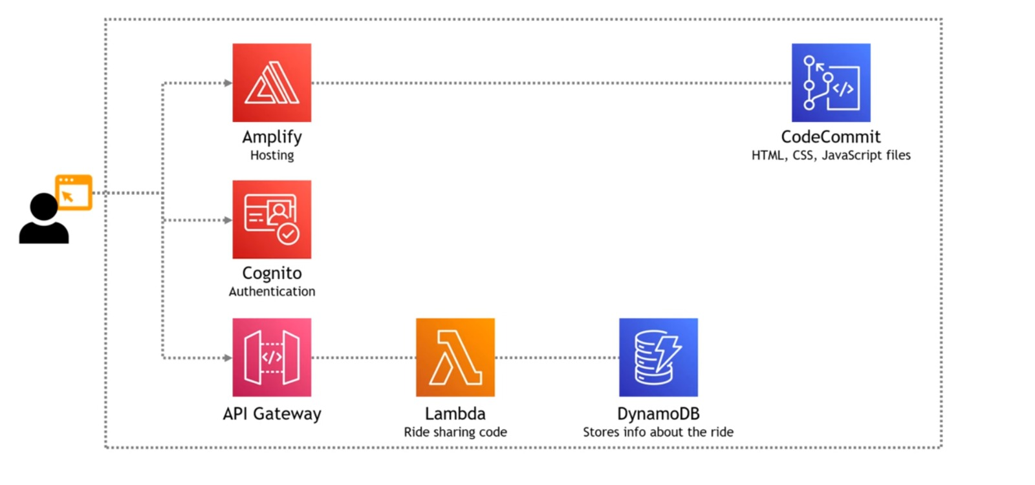
System Architecture

Slide 4
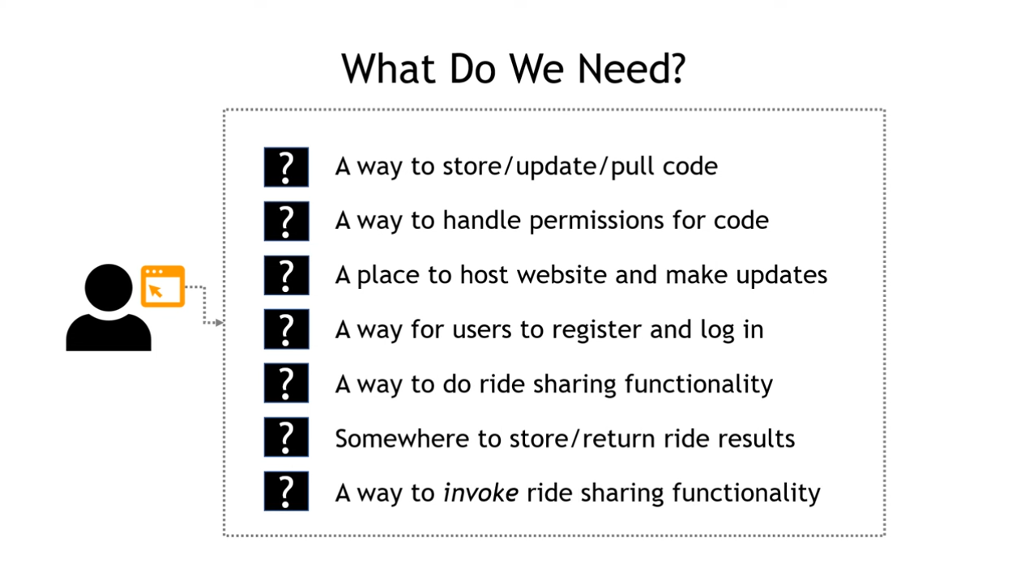
Things we need to do

Slide 5
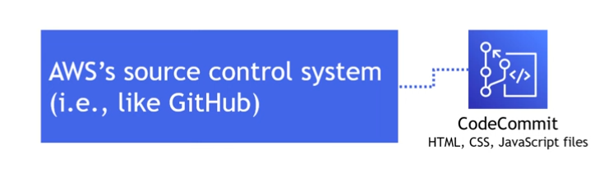
A way to Store, Update and Pull the Code
A way to handle permissions for the code
Accounts/Users Specific permissions
Identity and Access Management

Slide 6
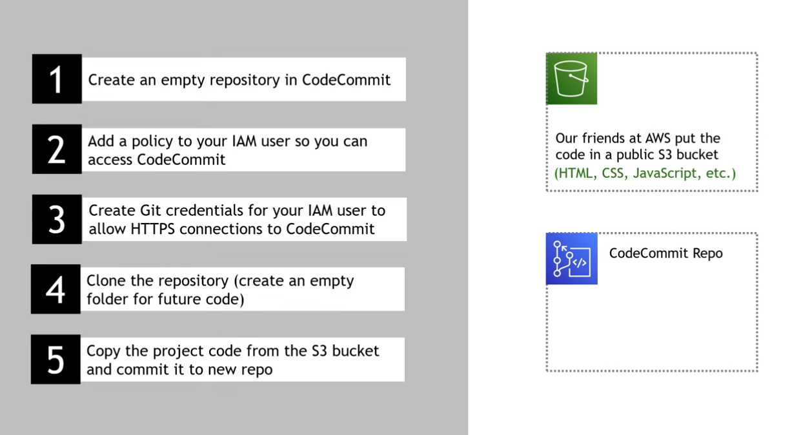

Slide 7
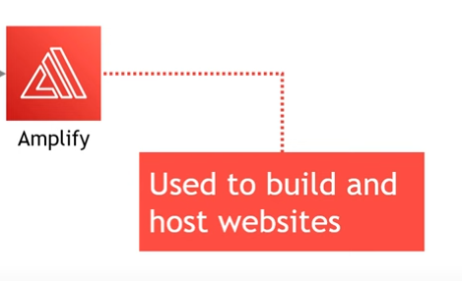
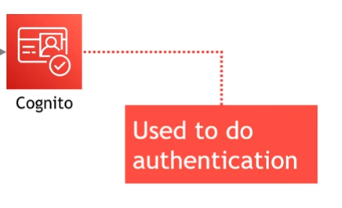
A place to Host website and make Update
A way for users to Register and Login

Slide 8
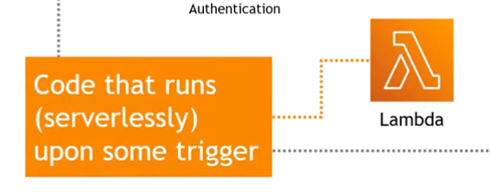
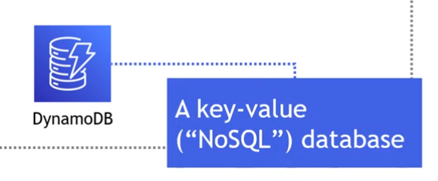
A way to do ride sharing functionality
A way to store and return ride results

Slide 9
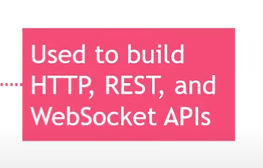
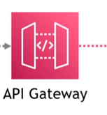
A way to invoke ride sharing functionality

