Slide 1

RAT IN A MAZE

Slide 2
TABLE OF CONTENTS
01
03
02
04
Problem Definition
Design Technique Used
Algorithm
Problem Explanation

Slide 3
TABLE OF CONTENTS
05
07
06
08
Dry Run
Time Complexity
Conclusion
Code Implementation
& output

Slide 4
PROBLEM DEFINITION
A Maze is given as N*N binary matrix of blocks where source block is the upper left most block i.e. maze[0][0] and destination block is lower rightmost block i.e. maze[N-1][N-1]. A rat starts from a source where its stuck and has to reach the destination. So, we need to find all paths or directions from where a rat can move.
In the maze matrix, 0 denotes that the road or path which is blocked or dead and 1 means that the block can be used to go from source to destination.

Slide 5
PROBLEM EXPLANATION
So, basically we are given a maze(2D matrix) with obstacles, starting from (0,0) you have to reach (n-1, n-1). If you are currently on (x, y), you can move to (x+1,y) or (x,y+1) only two directions are possible. You can not move towards block.
Idea: Try all the possible paths to see if you can reach (n-1,n-1).
GIVEN INPUT:
0 denotes path is blocked, 1 denotes free path. Next n lines contain m numbers (0 or 1).
REQUIRED OUTPUT:
Print 1 if rat can reach (n-1,m-1) Print 0 if it can not reach (n-1,m-1).

Slide 6
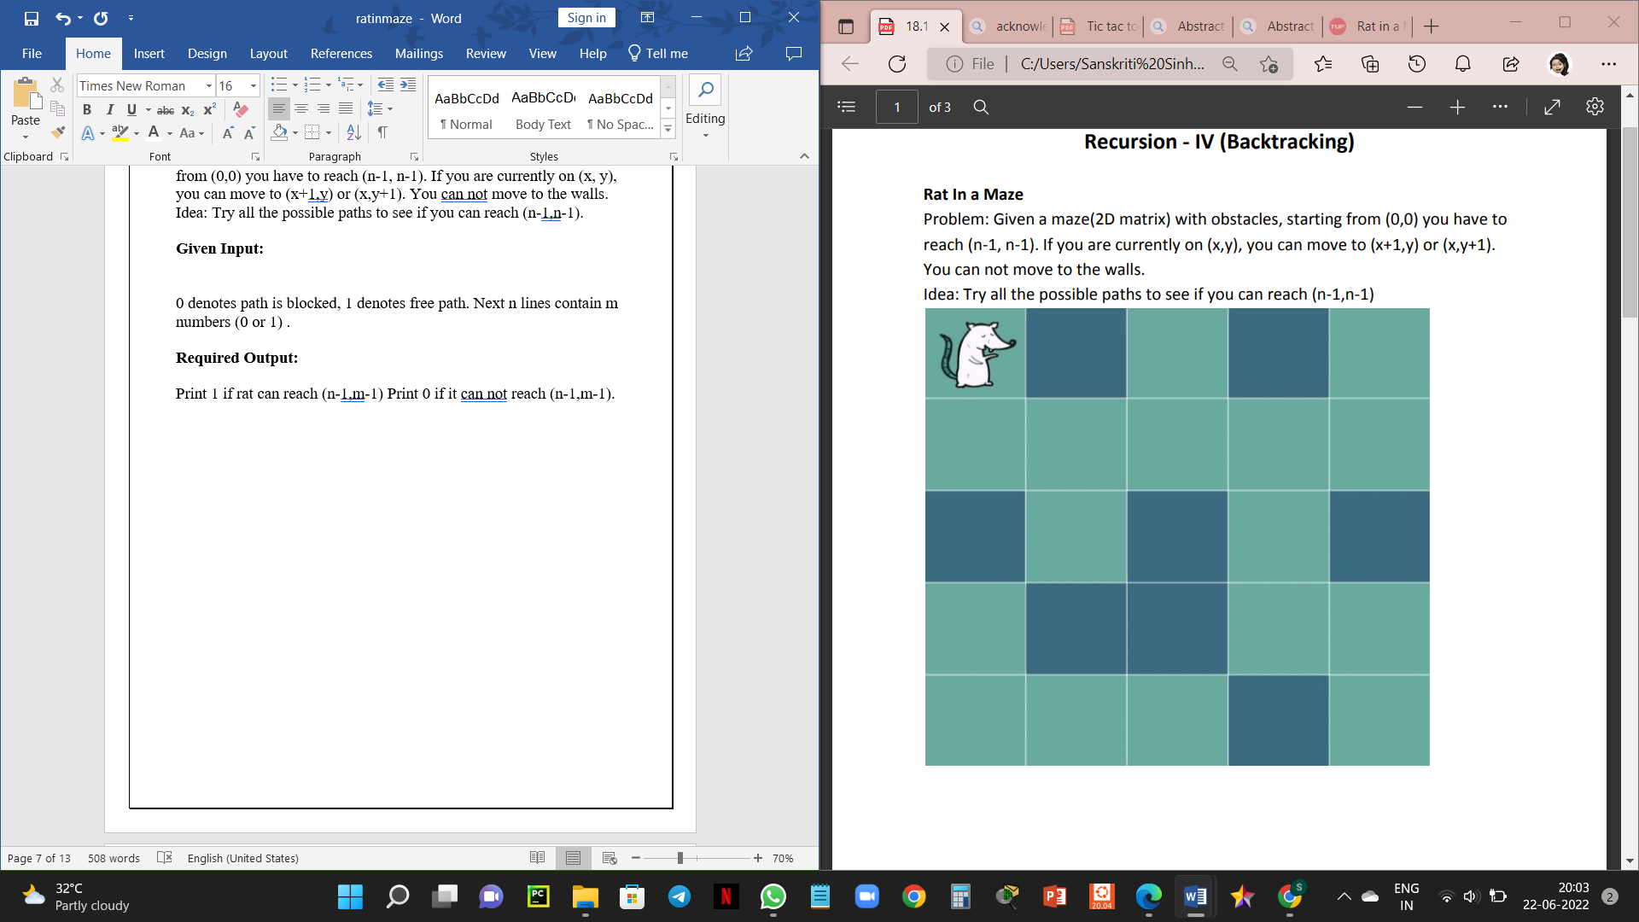

Slide 7
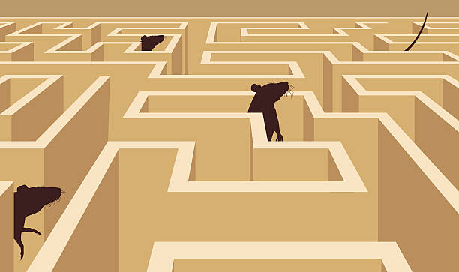
DESIGN TECHNIQUE USED?

Slide 8
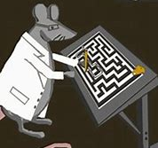
BACKTRACKING
The rat in a maze problem is solved using BACKTRACKING design technique.

Slide 9
ABOUT BACKTRACKING?
Backtracking is a design technique or algorithm technique for solving recursive problems or finding a solution by trying to build every possible solution incrementally and removing those solutions or steps that fail to satisfy the condition or constraints of the problem at any point of time.
So, it tries to find a bunch of solution which has some small checkpoints from where the problem can backtrack if no feasible solution is found for the problem.
In backtracking, we use recursion to explore all the possibilities until we get the best result for the problem

Slide 10
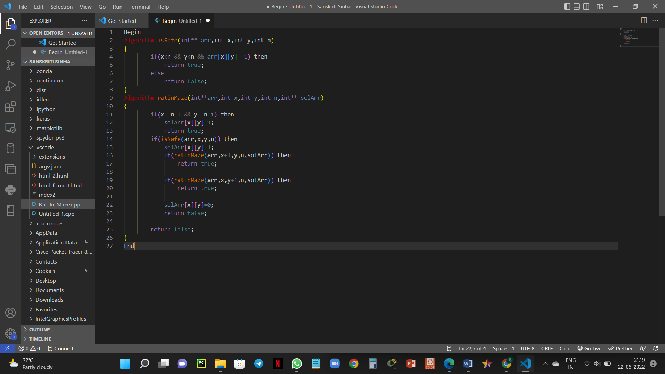
ALGORITHM

Slide 11
DRY RUN

Slide 13
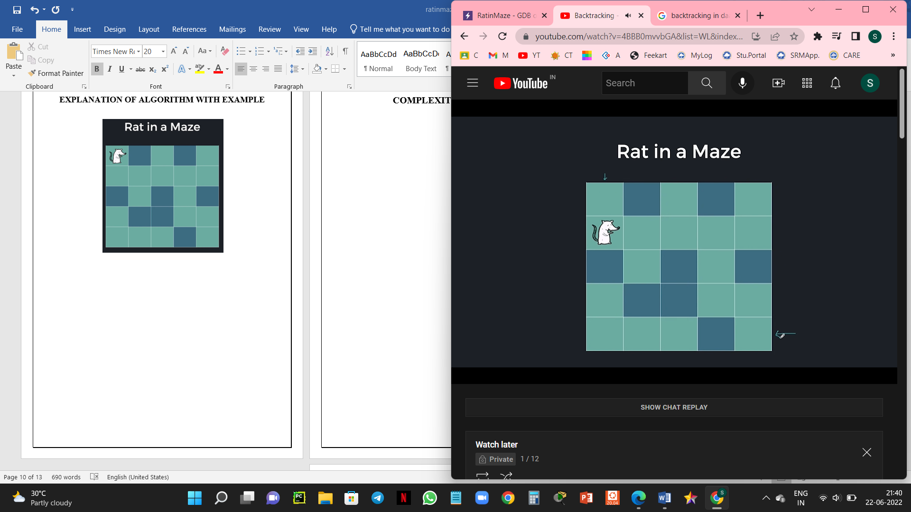

Slide 14
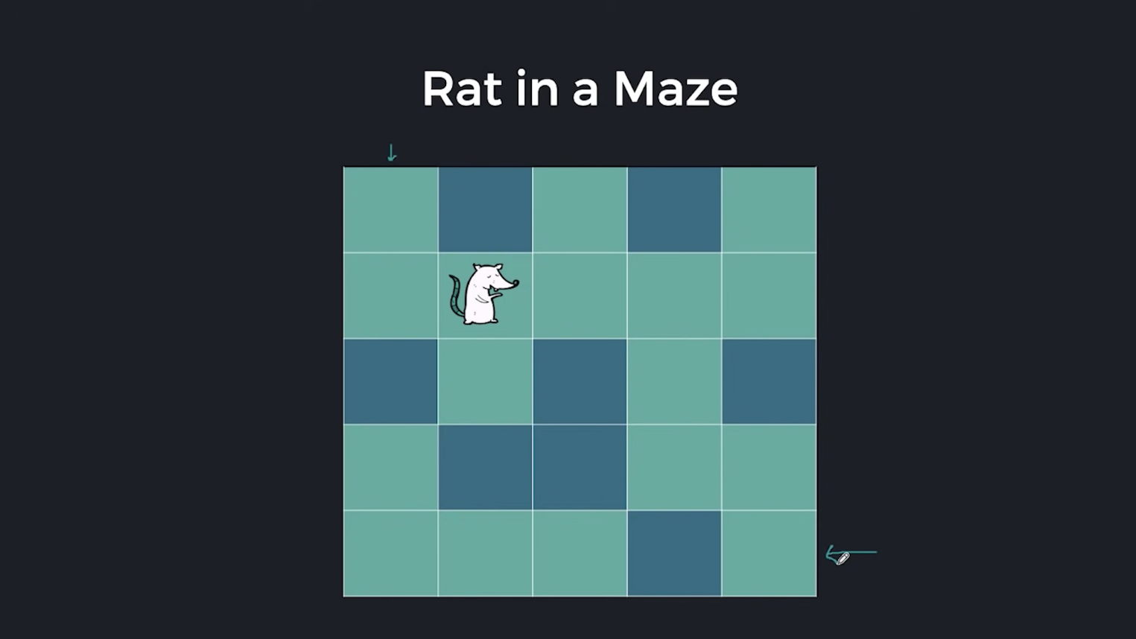

Slide 15


Slide 17


Slide 18


Slide 19


Slide 20


Slide 21


Slide 22


Slide 23
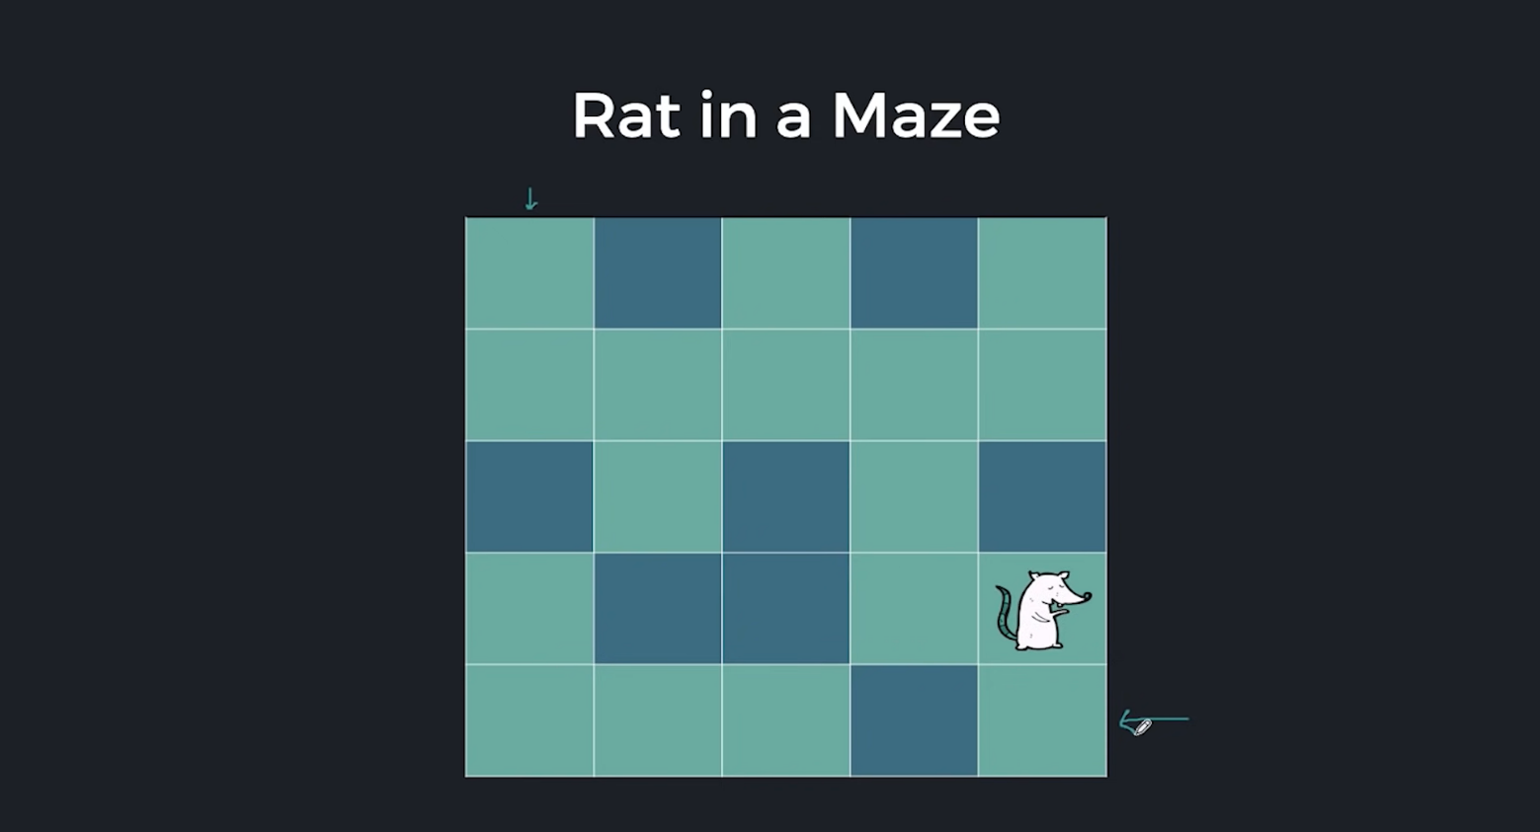

Slide 24
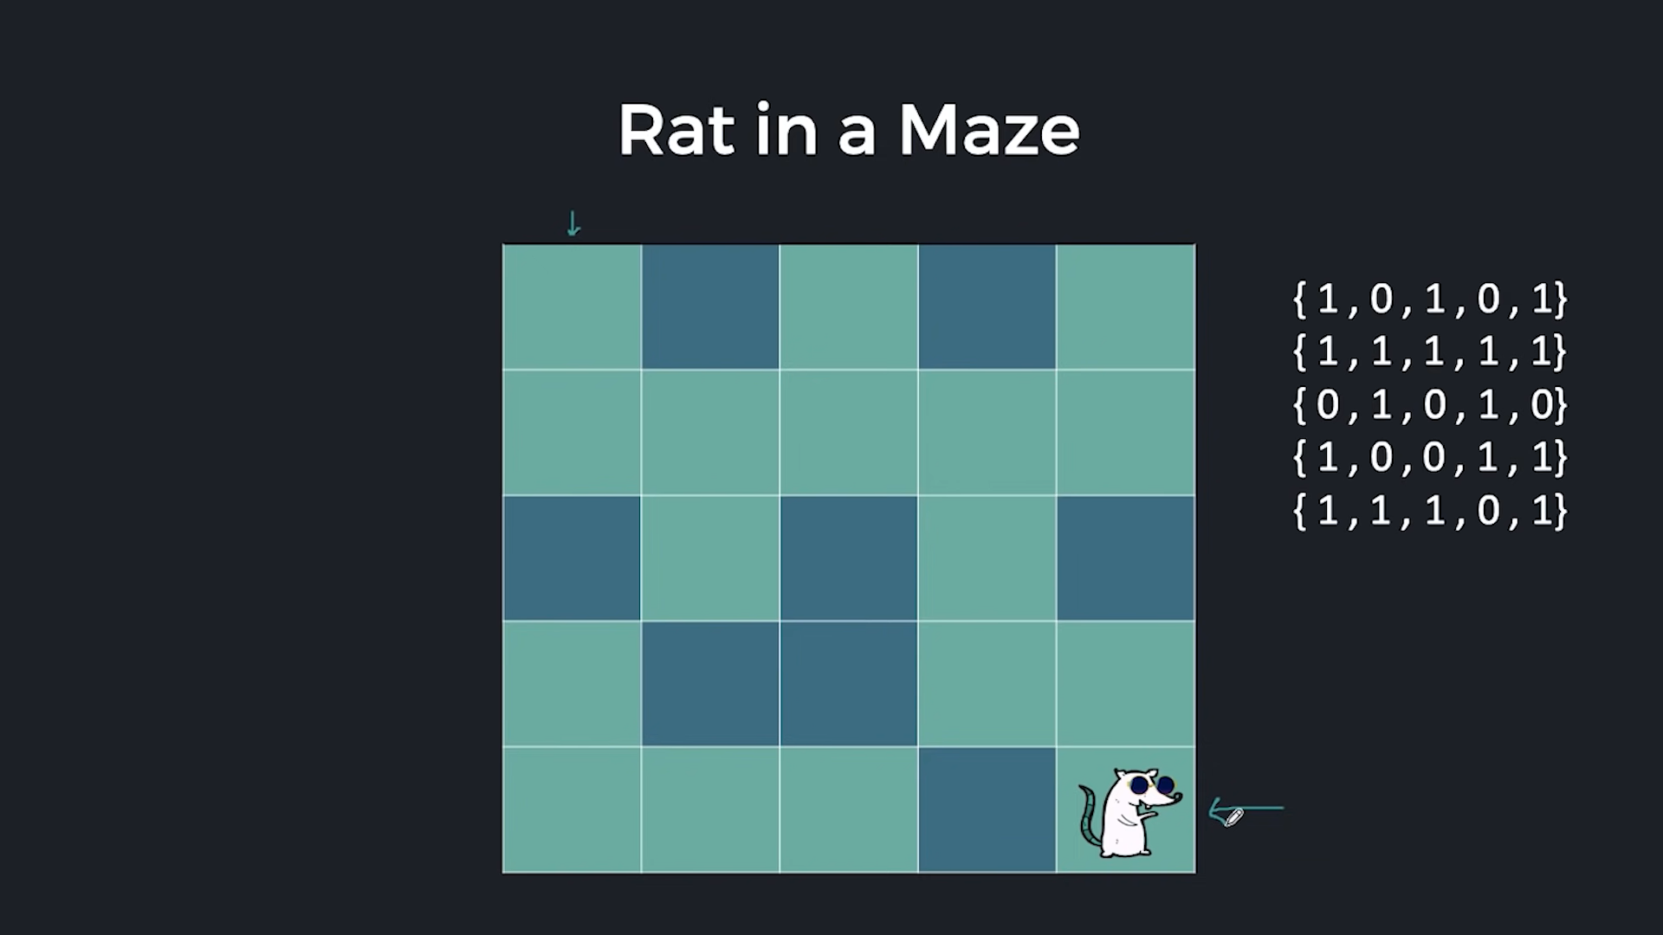
WHOAAA! I REACHED

Slide 25
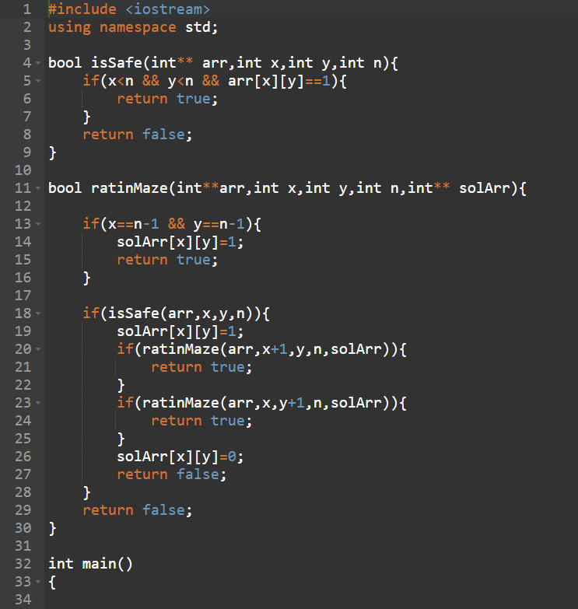
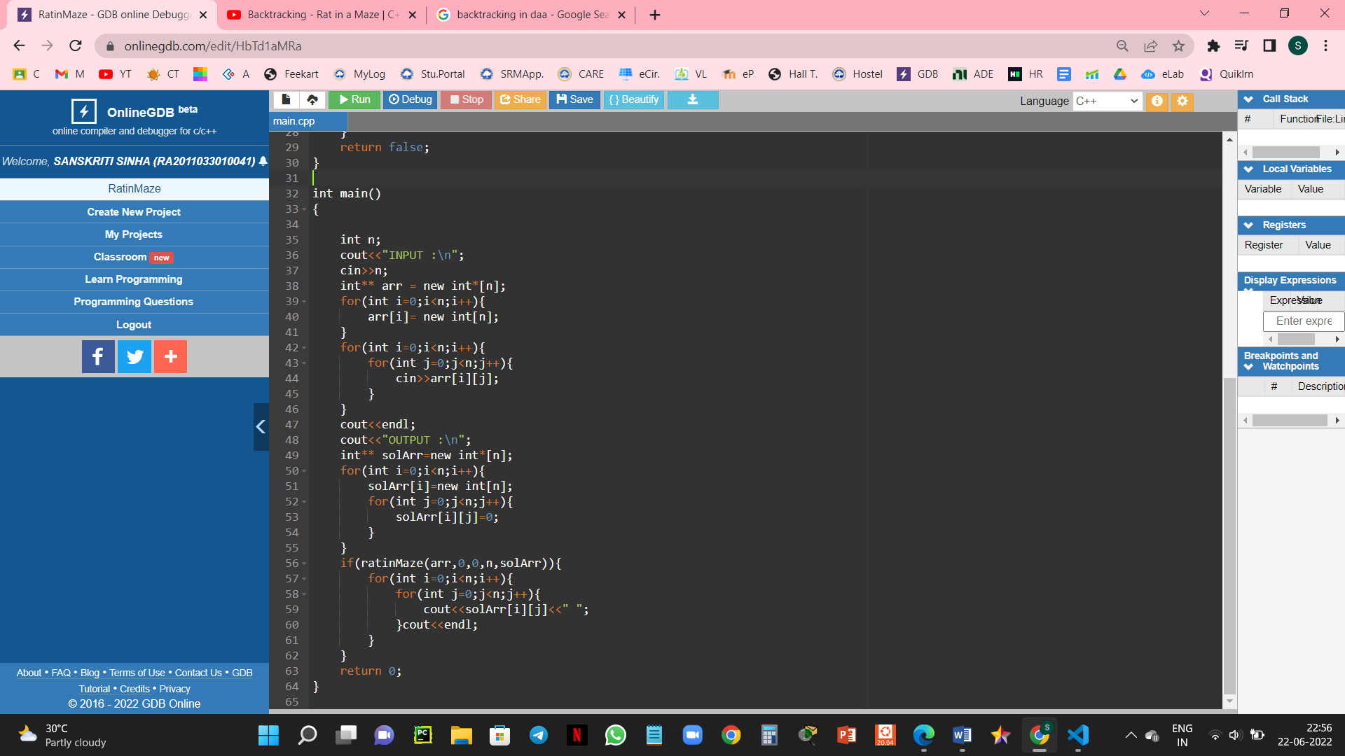
CODE AND IMPLEMENTATION

Slide 26
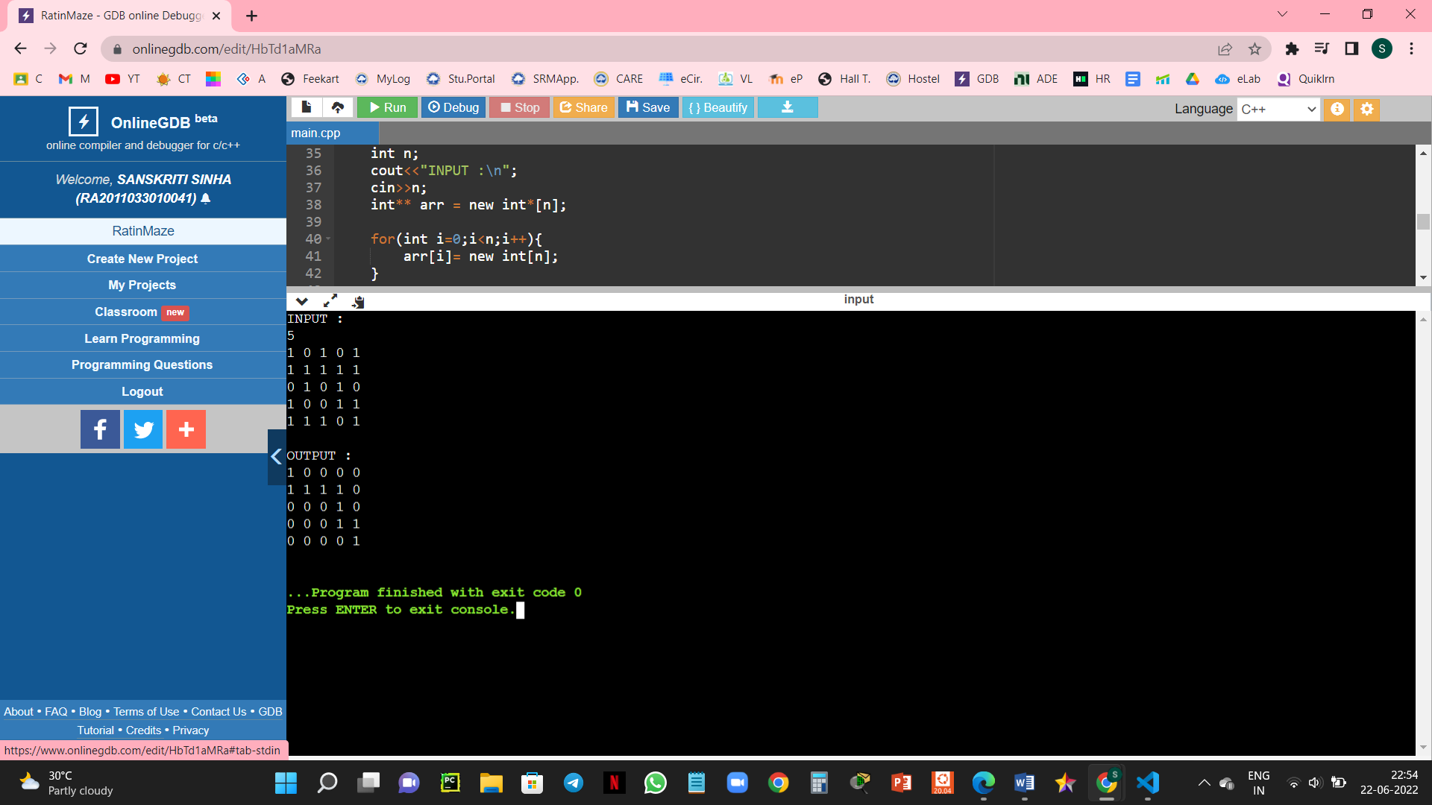
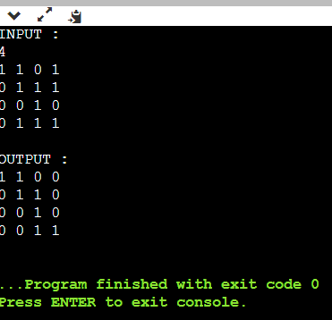
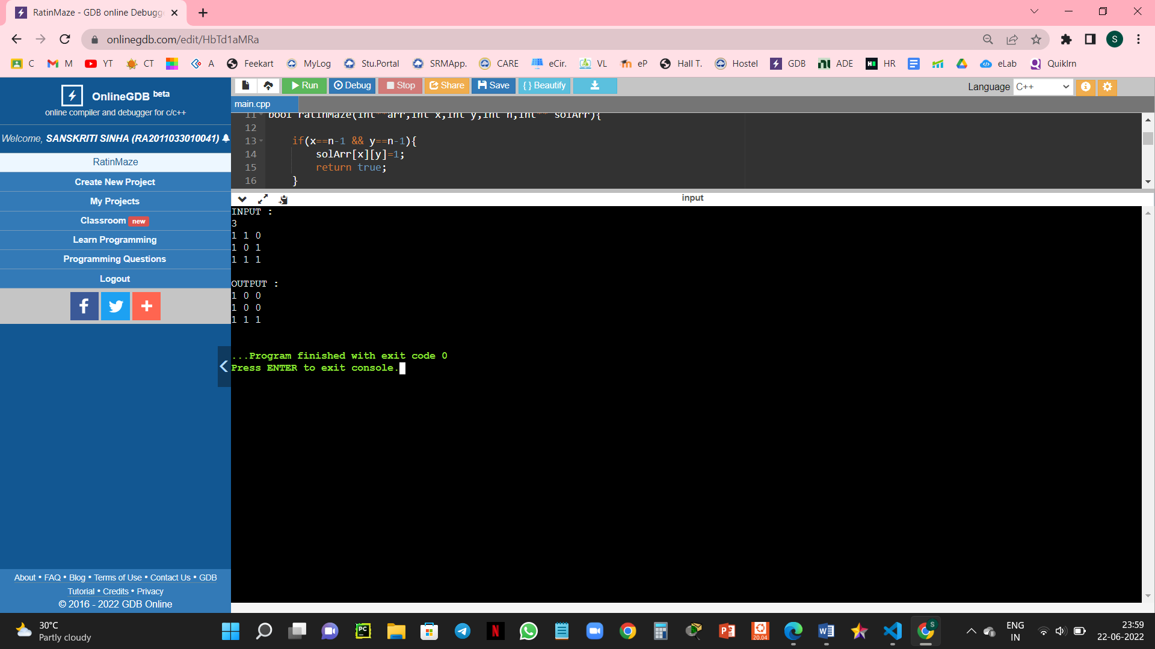
OUTPUT
5X5
4X4
3X3

Slide 27
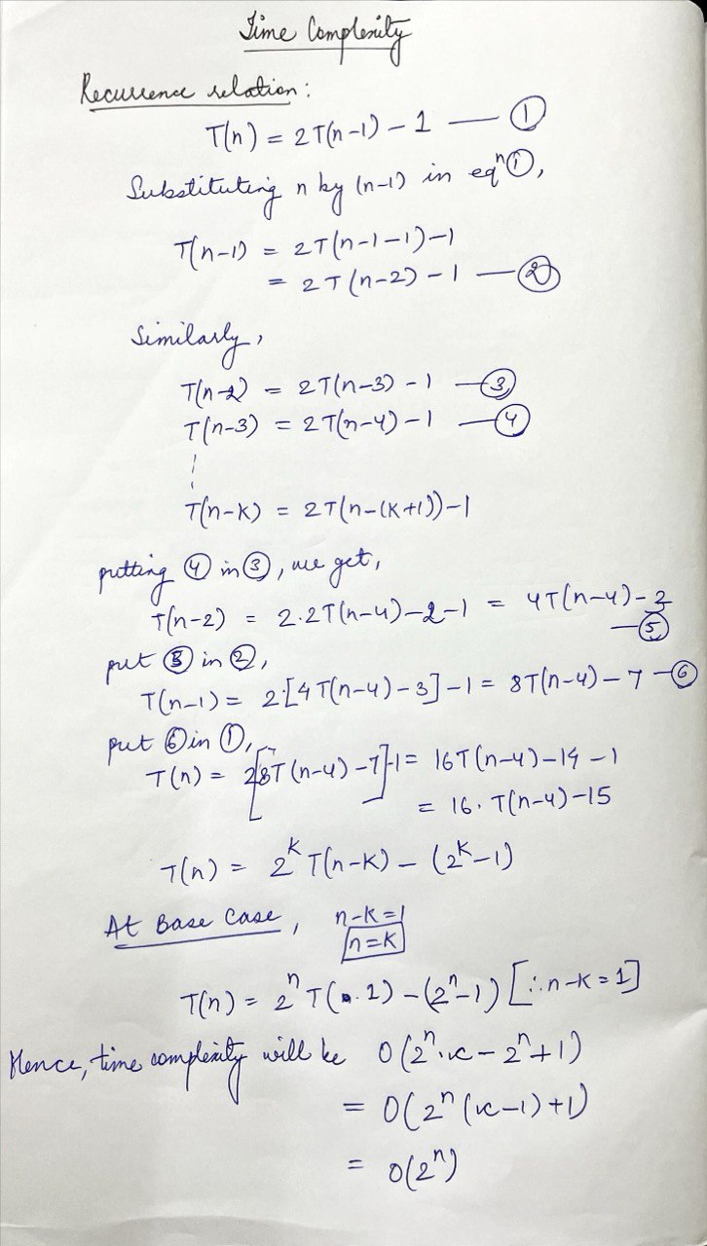
TIME COMPLEXITY AND CONCLUSION
Space Complexity : O(2^n)
Time Complexity : O(2^n)

Slide 28
CONCLUSION
The Rat in a maze problem is implemented using Backtracking design technique in C++. The outcome is evaluated, algorithm and code is implemented, output is obtained. The discussion is on how or what are the paths or options a rat is having to come out of a maze, to reach from source to destination. Also, space complexity and time complexity is obtained.

Slide 29
THANKYOUU!

