Slide 1
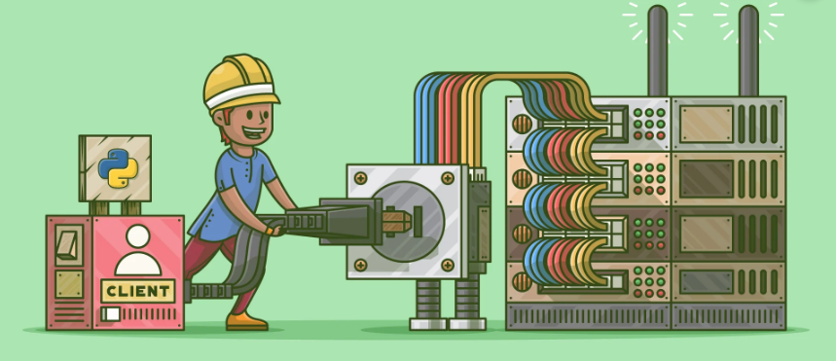
TCP QUIZ

Slide 2
TABLE OF CONTENTS
01
04
02
03
Abstract
Network Architecture
What is TCP?
05
Output
06
Conclusion
What is Socket Programming?

Slide 3
ABSTRACT
A network has been designed for conducting quiz competitions which can have multiple users
The organization hosts a quiz competition on a server which is accessible to internet users
using the public IP address. A network was designed using the Python programming
language. The basic requirements were tested. A server was set up, which can have
connections with multiple users. Clients or users can play a quiz online and each client can
view the score of the other participants. Also, a buzzer is provided there whoever will press it
first will answer first. If the user guesses the correct answer he gets +1 score and if we guess
wrong one then he gets -1 score. In the end, the winner is broadcast with the score.

Slide 4
WHAT IS TRANSMISSION CONTROL PROTOCOL?
The protocols at the transport layer of the OSI reference model provide an end-to-end data delivery service for application processes to exchange messages over the Internet. Protocols operating in the Transport layer use the services of the Internet Protocol (IP) to deliver messages. Many protocols exist at this layer and one of the most important protocols at this layer is Transmission Control Protocol (TCP) for the delivery of data between the Application Layer and the Internet Layer. The shortcoming of IP to guarantee the delivery of datagrams is overcome by TCP by setting up a virtual circuit between the communicating parties. The design of TCP was specifically to provide reliable end-to-end delivery of data over an unreliable medium. The unreliable medium of transport is the Internet Protocol (IP). TCP is a connection-oriented protocol with guaranteed delivery of transport layer segments and error detection mechanism.

Slide 5
WHAT IS SOCKET PROGRAMMING?
Socket programming is a way of connecting two nodes on a network to communicate with each other. One socket(node) listens on a particular port at an IP, while the other socket reaches out to the other to form a connection. The server forms the listener socket while the client reaches out to the server. They are the real backbones behind web browsing. In simpler terms, there is a server and a client.
CLIENT:
A client application is a process or program that sends a job request to a server via the communication network. Those jobs request the server to perform a particular task, such as looking up a record in a database or returning a portion or customized report. Examples of clients are a web browser, thin client, remote desktop, emulator, front-end application, mobile app, etc.
SERVER:
The server is a collection of the programme, listens for client requests that are transmitted via the communication network. Servers perform actions such as database queries or reading files. Server processes typically run on dominant PCs, workstations or mainframe computers.

Slide 6
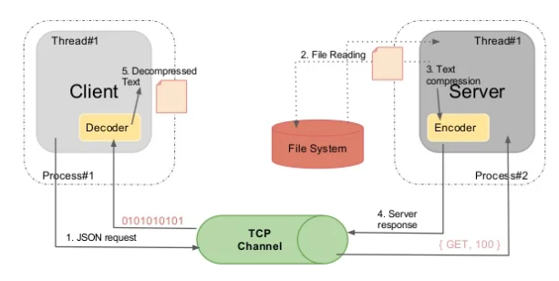
NETWORK ARCHITECTURE

Slide 7
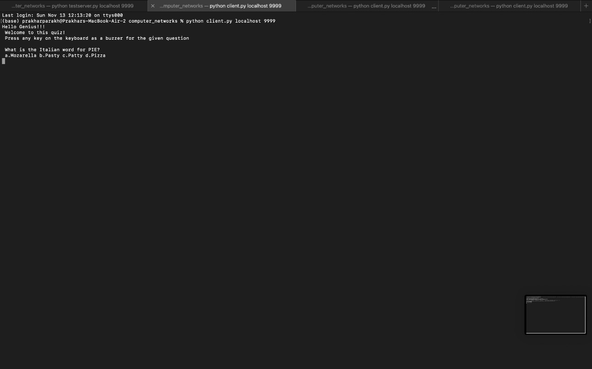
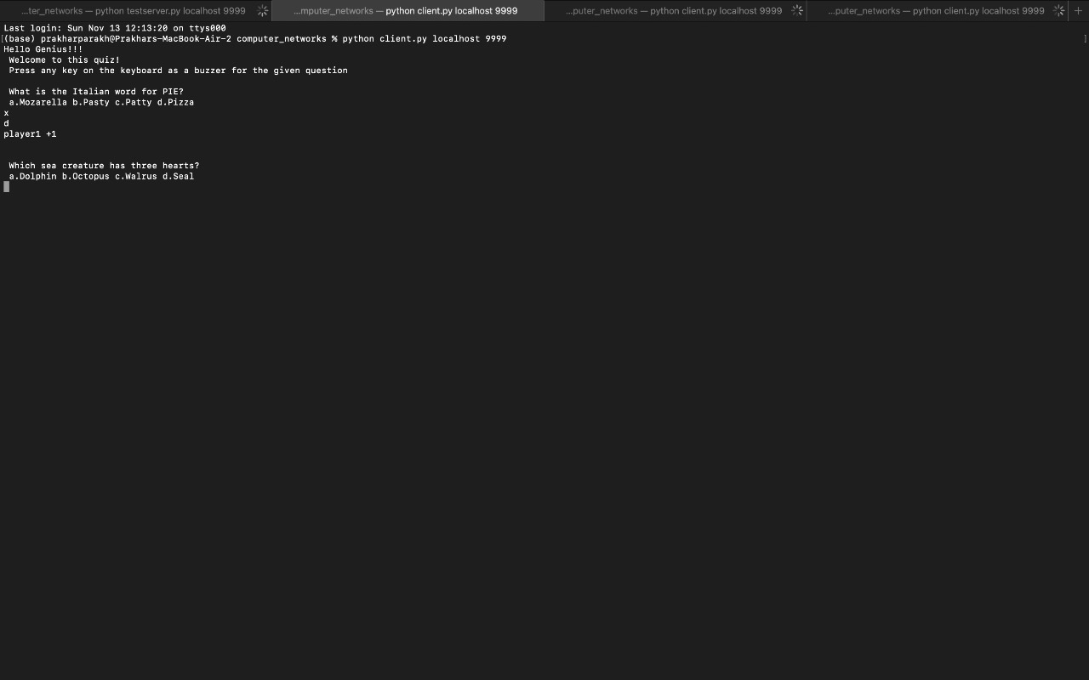
OUTPUT
SERVER
CLIENT 1

Slide 8
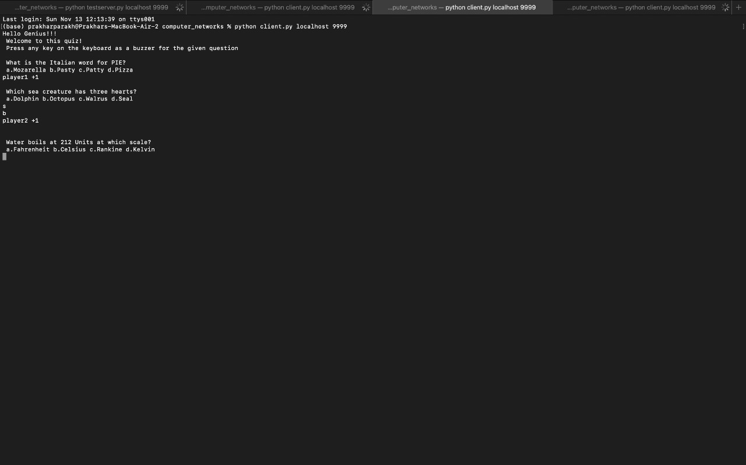
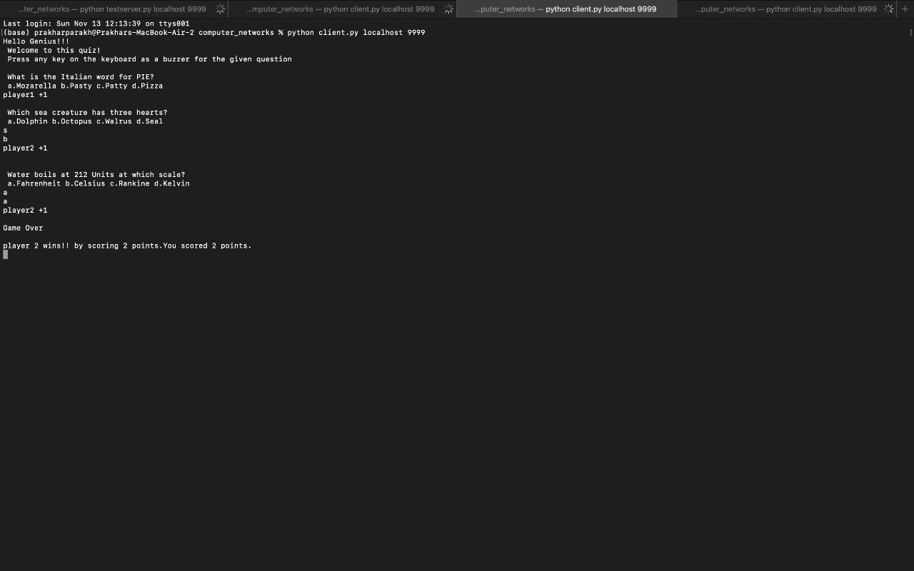
OUTPUT
CLIENT 2
CLIENT 3

Slide 9
CONCLUSION
In conclusion, we created a game quiz between the server and multiple clients. The server is hosted by an
organization. Clients have respected IP addresses and multiple clients can play at one time. If client 1 presses
the buzzer first, he gets a chance to answer first and if client answers correctly they get +1 or else -1 is
deducted from the result. Same procedure followed for Client 2 and 3. At the end of the quiz session,
whichever client will win, it will be displayed on each client’s interface. For future enhancement, we can
display result graph in the end. Also, we can store the data i.e. the questions of the user in MySQL, moreover
we can fetch the data from MySQL to the client's interface.

Slide 10
THANKYOU!

