Slide 1

FSDL Jury Examination
Student Name: Sanskrti Singh
Enrollment No.: ADT23SOCB1557
Course: Full Stack Front-End Development (23IT3001)
Semester: V
Class: TY IT SMAD
Project Title: Muzz : A Real-Time Collaborative Music Listening App
Department of Information Technology
MIT School of Computing, Pune
AY: 2025-26

Slide 2
Project Overview and Introduction
Introduction: Muzz is a full-stack social music application. It's designed as a platform for users to stream their favorite artists, discover new tracks, and interact with friends in real-time.
Problem Statement: Listening to music is often a solitary experience. It can be difficult for users to discover new music with friends and share their listening activity seamlessly in one place.
Motivation: The project was inspired by being "tired of jamming alone." The goal was to create a platform where music is a shared experience, allowing users to "listen together, chat together, and vibe together" in real-time.
Proposed Solution: A full-stack web application that integrates music discovery with social features. The app provides user authentication, personalized user profiles, and a "Rooms" feature where users can create listening parties, invite friends, and manage a shared music queue.

Slide 3
Scope and Objectives
Project Scope: The project includes a public-facing website (Landing Page, About, Contact, Events), a complete user authentication flow (Signup, Login), and a protected main application. Core features include user profile creation and editing, a music discovery dashboard, and a social "Rooms" feature. All data persistence (e.g., user info, profiles, rooms) is managed via localStorage
Key Objectives:
Implementing a functional user authentication system (Signup, Login, Logout) and using localStorage to manage sessions.
Developing a responsive user interface using React and Tailwind CSS, including a dashboard for music discovery.
Protecting application routes, allowing access only to logged-in users, and redirecting new users to a "Set Profile" page if their profile is incomplete.
Building a "Rooms" feature allowing users to create listening rooms, invite friends, and approve join requests.

Slide 4
Technology Stack
Frontend
Core: React 19, TypeScript, Vite
UI & Styling: Tailwind CSS, Lucide React (icons)
Routing: React Router
Whiteboard: tldraw
Database
Persistence is currently managed on the client-side via localStorage for saving login information and user profile details as well as rooms created

Slide 5
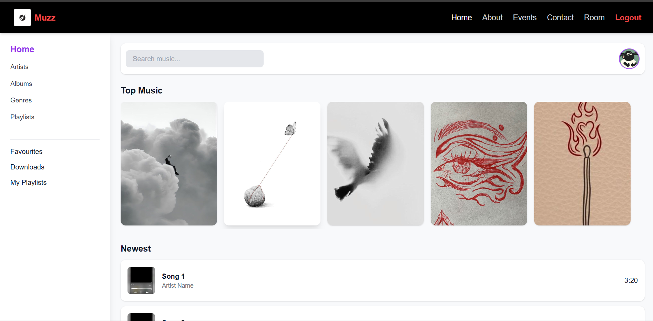
Implementation
Frontend
Homepage

Slide 6
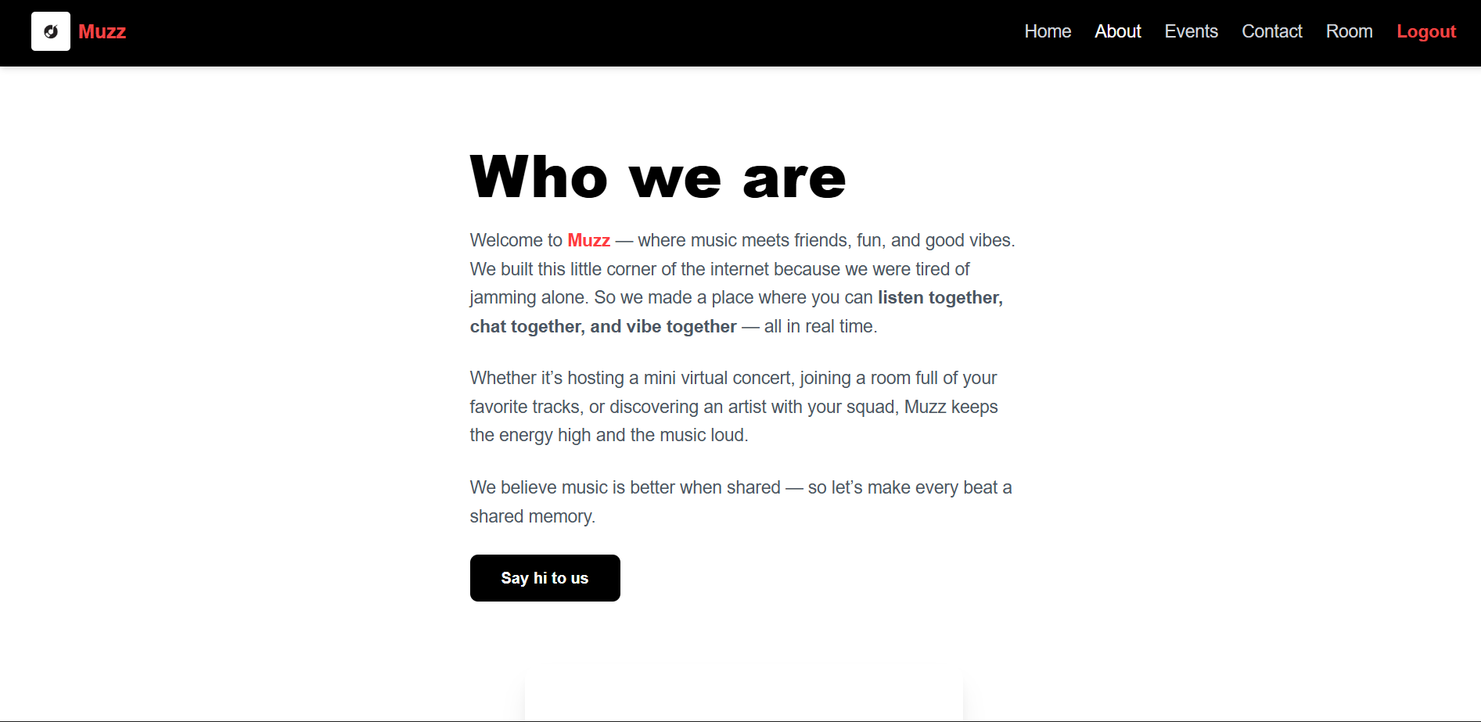
Implementation
Frontend
About page

Slide 7
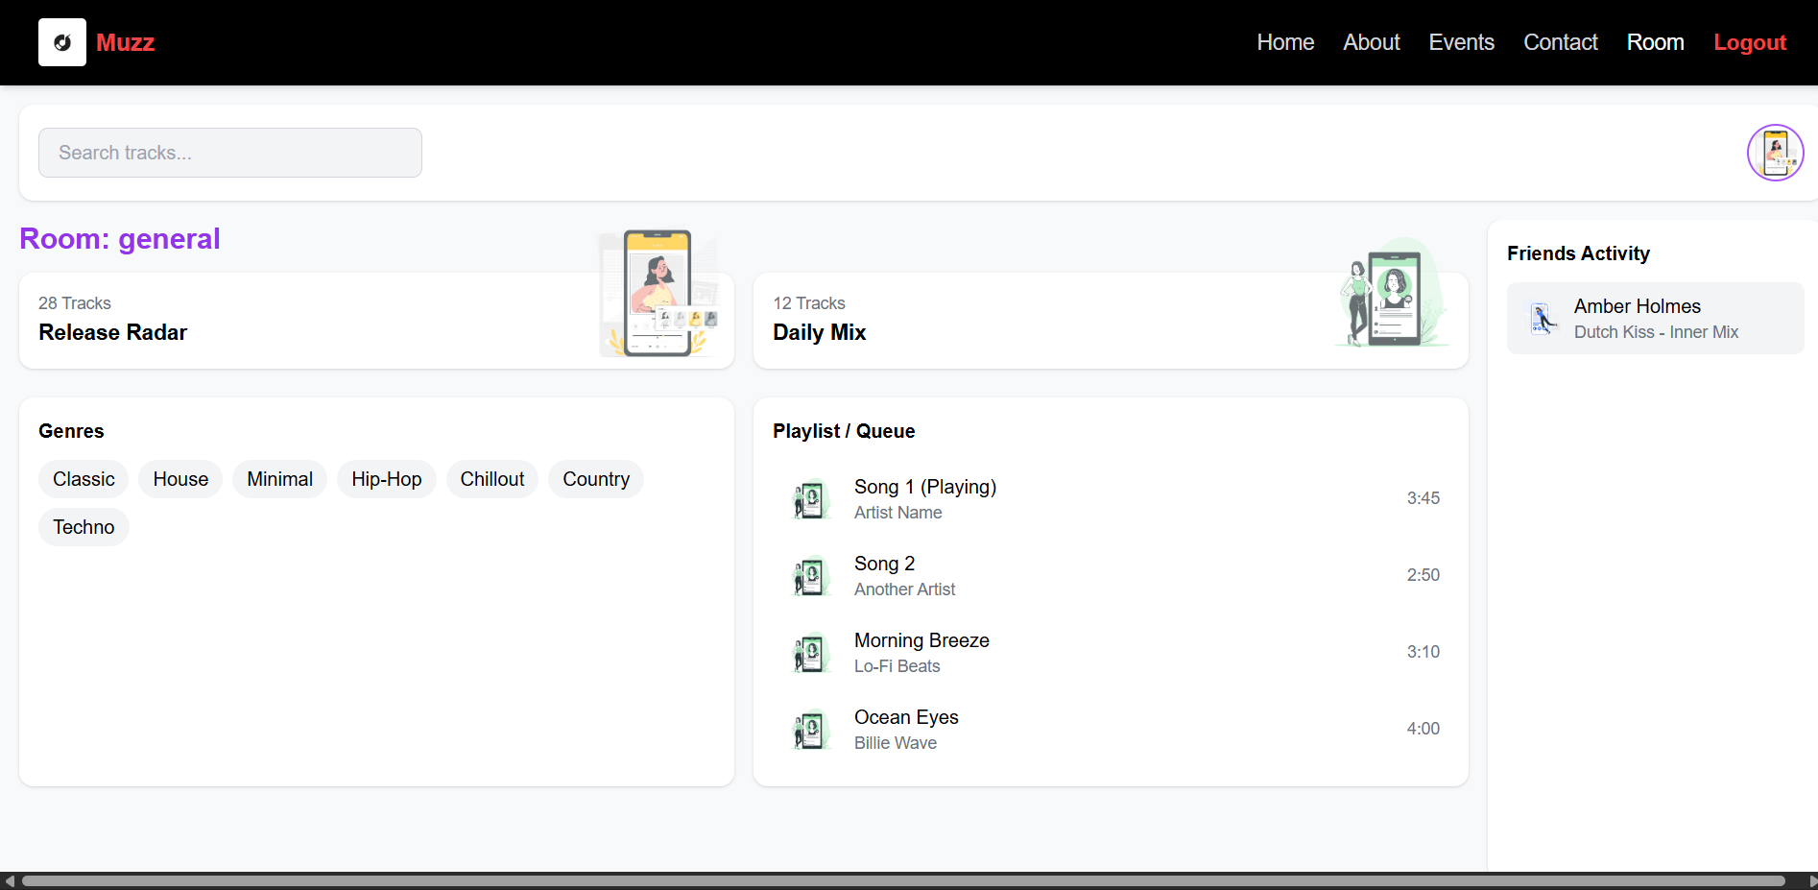
Implementation
Frontend
Room

Slide 8
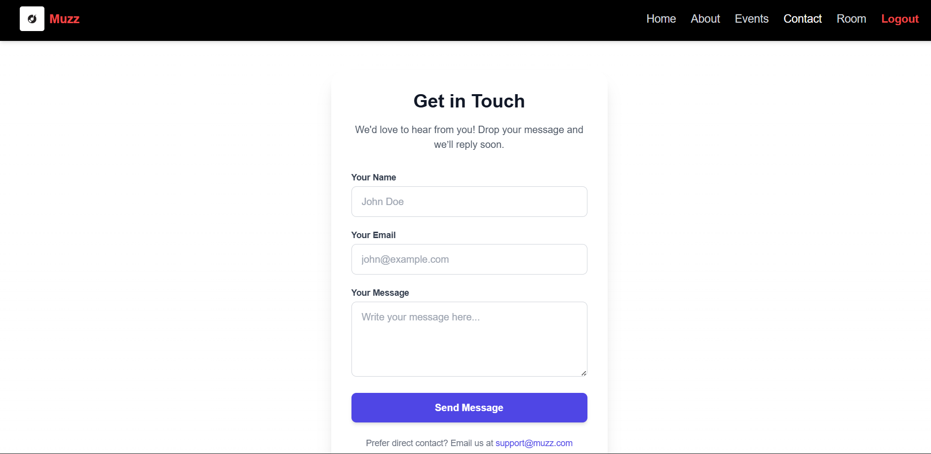
Implementation
Frontend
Contact page

Slide 9
THANK YOU

