Slide 1

FSDL Jury Examination
Student Name: Shrinivas Sherikar
Enrollment No.: ADT23SOCB1610
Course: Full Stack Front-End Development (23IT3001)
Semester: V
Class: TY IT SMAD
Project Title: DrawKit: A Real-Time Collaborative Whiteboard
Department of Information Technology
MIT School of Computing, Pune
AY: 2025-26

Slide 2
Project Overview and Introduction
Introduction: DrawKit is a full-stack, real-time collaborative whiteboard application designed for teams. It provides an infinite canvas for brainstorming, wireframing, and system design, allowing teams to bring their ideas to life from anywhere.
Problem Statement: Teams often struggle with digital brainstorming tools that are clunky, restrictive, and fail to capture the fluid, fast-paced nature of an in-person whiteboard session.
Motivation: The inspiration for this project was to build a platform that feels intuitive, fast, and is collaborative at its core, enabling teams to brainstorm as freely online as they do on a physical whiteboard.
Proposed Solution: A full-stack web application using a modern frontend (React, Vite) and a scalable backend (Node.js, Express). It integrates the powerful tldraw library to provide a feature-rich, real-time whiteboard experience with data persistence.

Slide 3
Scope and Objectives
Project Scope: The project includes a public-facing website (Home, About, Contact, and Pricing pages), a user-facing dashboard, and the core collaborative whiteboard. The current implementation uses local storage for persistence and mock authentication.
Key Objectives:
To implement a functional, real-time collaborative whiteboard using the tldraw library.
To develop a fully responsive, modern user interface using React, TypeScript, and Tailwind CSS.
To build a secure and functional user authentication system with protected routes (currently mocked using local storage for demo purposes).
To build a robust backend API structure using Node.js and Express to handle future logic.
To create a pricing page UI, which is not connected to a payment gateway in this phase.

Slide 4
Technology Stack
Frontend
Backend
Core: React 19, TypeScript, Vite
UI & Styling: Tailwind CSS, Lucide React (icons)
Routing: React Router
Whiteboard: tldraw
Framework: Node.js with Express
Language: TypeScript
Database
Other Tools
Persistence is currently managed on the client-side via localStorage for both session/auth tokens and whiteboard data.
Package Manager: npm
Linting: ESLint

Slide 5
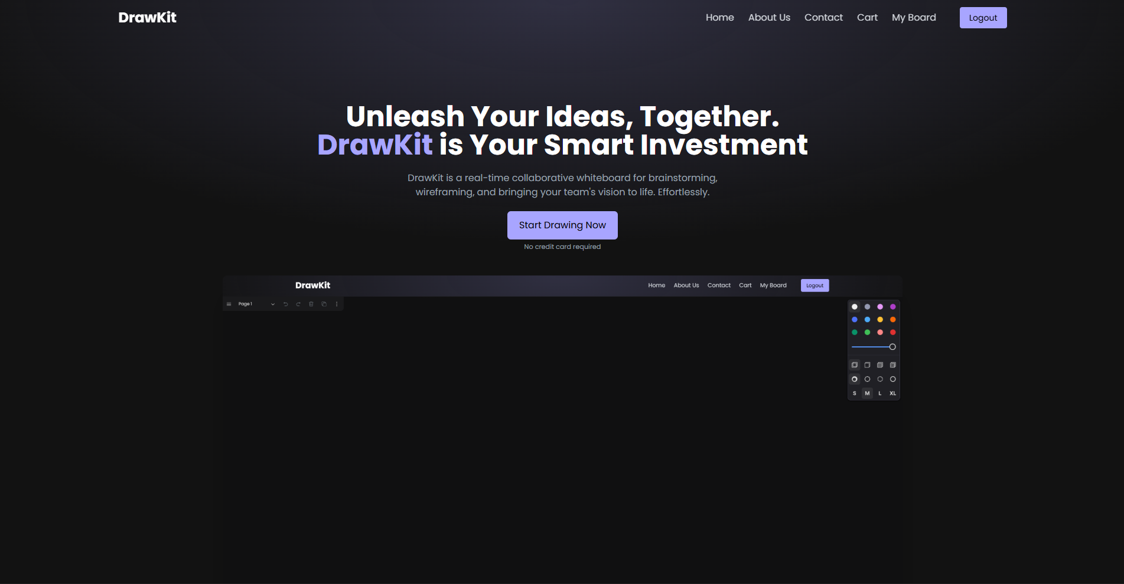
Implementation
Frontend
Homepage

Slide 6
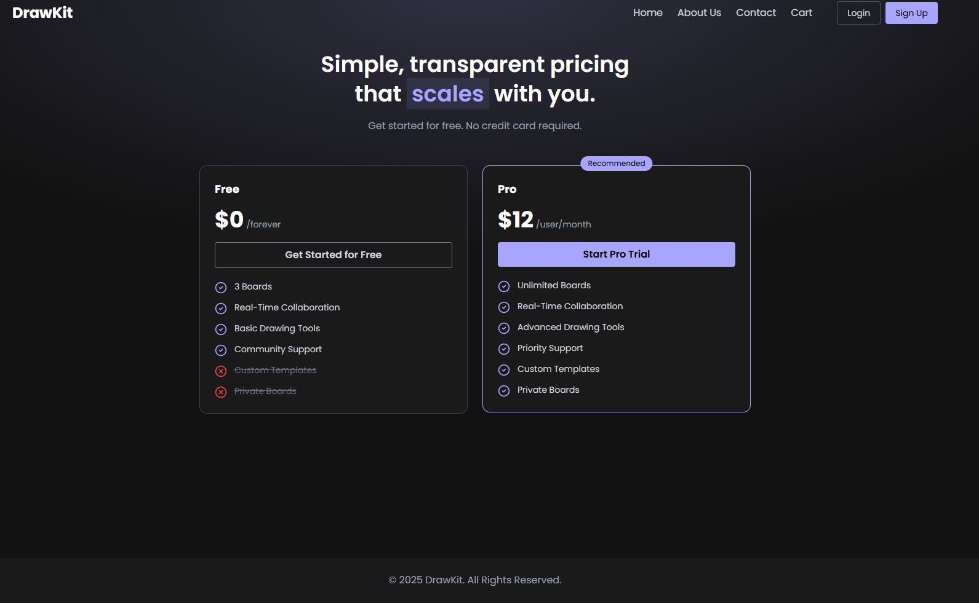
Implementation
Frontend
Cart page

Slide 7
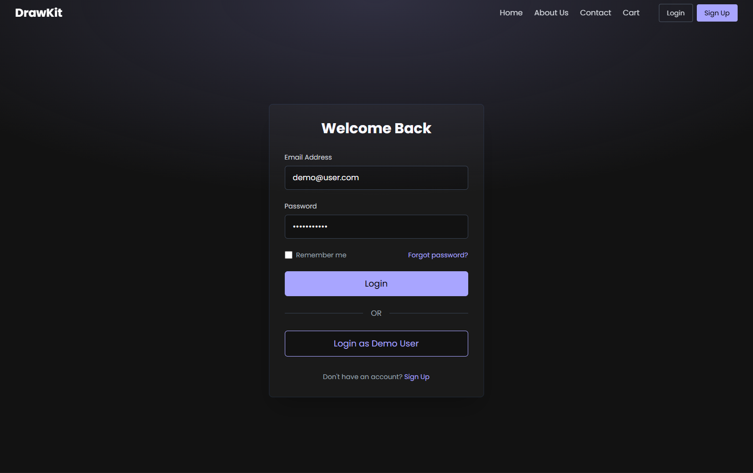
Implementation
Frontend
Login

Slide 8
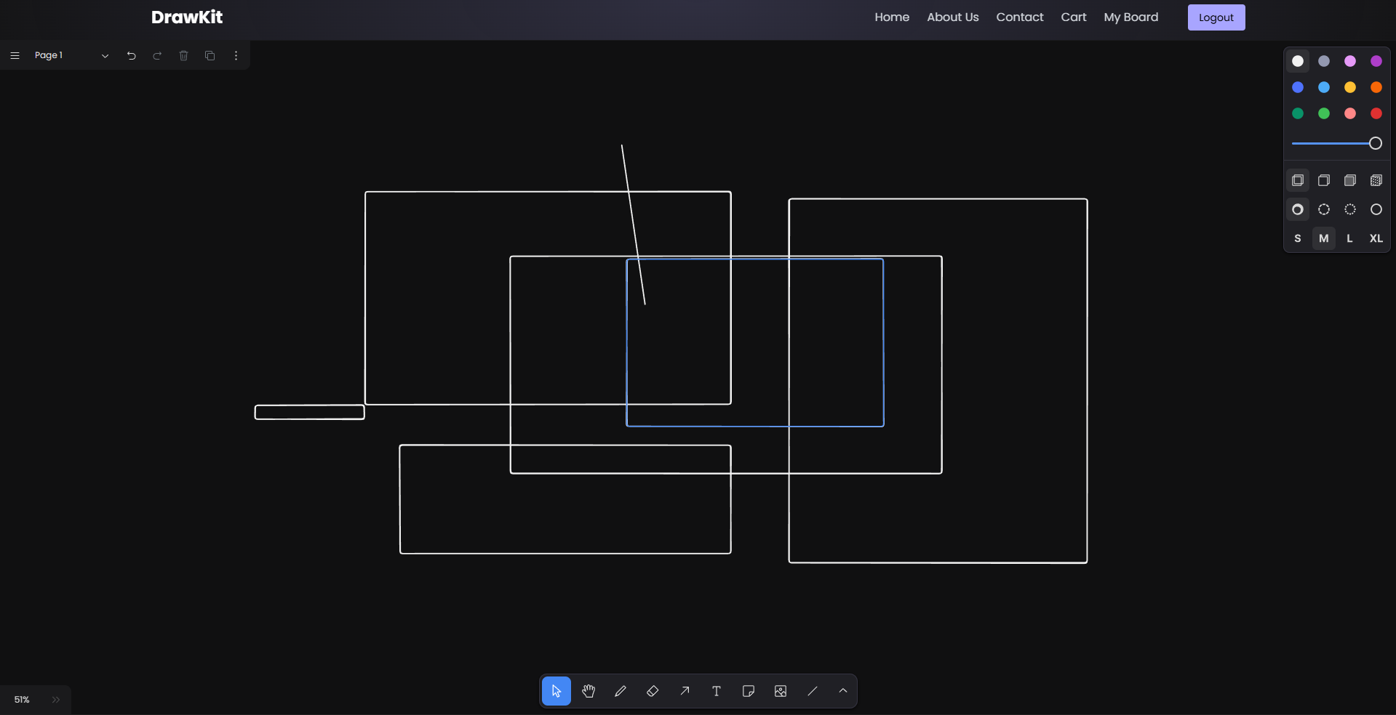
Implementation
Frontend
Drawing page

Slide 9
Implementation
Frontend
Code Snippet (Core Whiteboard Implementation)
import { Tldraw } from 'tldraw'
export default function Board() {
return (<div className="fixed inset-0 pt-16">
<Tldraw inferDarkMode
persistenceKey='data'
/>
</div>
)
}

Slide 10
THANK YOU

